Slide 1
Classification Project
Gemma Draper

Slide 2


Slide 3
Problem statement
Given the conditions in a particular community
what technologies would be most beneficial to
pursue?

Slide 4
Stakeholders
Energy suppliers
Charities
Government

Slide 6
Solution
The UN collects data on 244 SDG indicators each year.
In a given area, we can identify new energy sources which are likely to succeed.

Slide 7
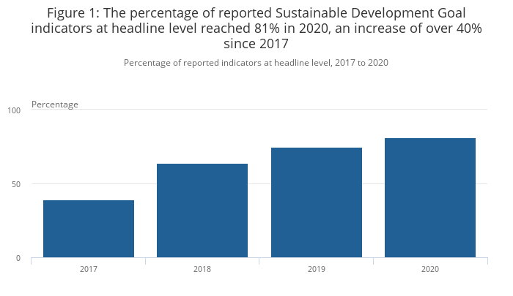
Src:
ONS

Slide 8
Technical

