Slide 1

Makefile

Slide 2
Build Process
.i
Extended files
.s
Assembly files
Source files
.c .cpp .h
preprocessor
parser
Code generator
.o
Processor architecture specific machine codes with no absolute address (relocatable file)
Assembler
Object files

Slide 3
Build Process
Re-locatable object files
Executable & debug file
.o
Linker
Locator
.elf
Objcopy tool
.a
.ld
.ihex
.bin
Static Libraries
Linker script
Intel hex format
Bin format

Slide 4
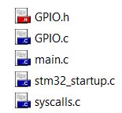
Why you need makefile?
Your project have many source files and you build it by an IDE (Keil C)
At a time, you want to edit or add a file
Add this file to the project & Rebuild all file
Makefile???
You just need to build edited/added files: led .c
Build only
It spend many time to rebuild with a big project

Slide 5
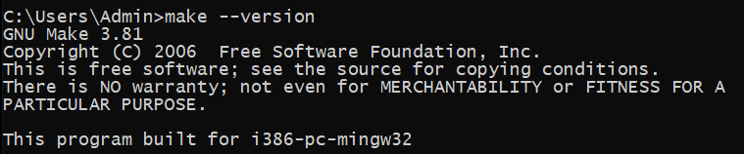
What is Makefile?
Makefile is a script file format that contains some information:
Project structure (file, dependencies)
Commands to create files (object file, elf/bin/hex files, …)
The make command will read makefile content, understand project’s structure and execute the commands
Tools for Makefile:
Cygwin/Mingw/GNU Make

Slide 6
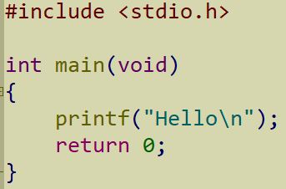
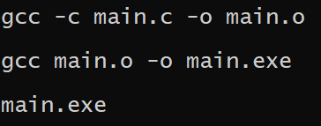
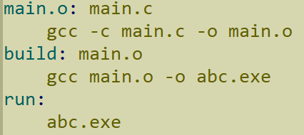
From GCC commands to Makefile
main.c
My project:
main.c → main.o → main.exe
With GCC:
With Makefile:
Generate object file
Generate .exe file
Run .exe file
Results
Combine GCC commands into one script file

Slide 7
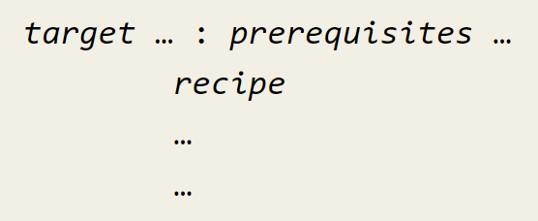
Rules Makefile
Basic form of a basic simple makefile
Input files to make target
Action / File target
Tab space
Action that make carry out

Slide 8
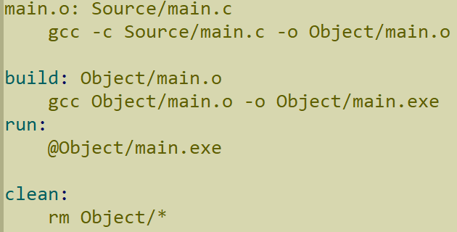
For examples
Input files to make target file
Target file
Actions
Input files to make actions
Action that make carry out

Slide 9
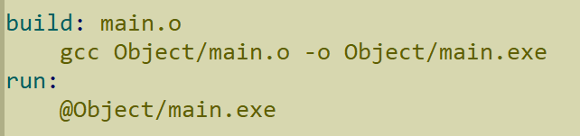

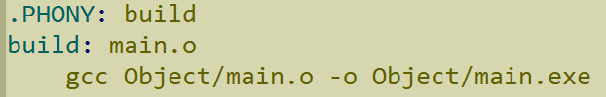
PHONY keyword
I have a file has the same name with an action
Action ‘build’ is not running with make command
Add PHONY keyword to signal ‘build’ is a action

Slide 10


Variables in Makefile
Use to generalize makefile, avoid using specific names of files
Assign symbols
Variable names
Values
Symbol to access the value of a variable: $(variable_name)

Slide 11


Print value of variables
Printing value of variables to check, debugger when working with makefile ➔ Use ‘echo’ command & string substitution
Results

Slide 12


Automatic Variables
Symbols | Meaning
$@ | File name of the target of the rule
$^ | Name of all the prerequisite
$< | Name of the first prerequisite
Some symbols used to generalize the rules

Slide 13
Variables & Functions?
We use Variables & Functions as a wildcard, avoid using specific names → Reusable Makefile → When I have some edit (add/del/edit source files), I don’t need rewrite the makefile
Some Functions to use: wildcard, foreach, notdir, …

Slide 14

‘wildcard’ Characters
The wildcard characters in make are ‘*’, ‘?’, ‘[…]’
For examples, *.c specifies a list of all the files whose names end in ‘.c’
Clear all files in ‘output’ folder
Get all files in the PATH C:\Users\Admin\...

Slide 15
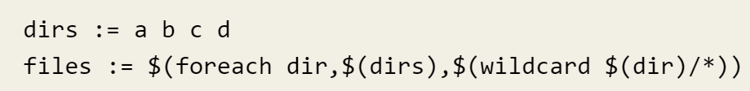
‘foreach’ function
This function causes one piece of text to be used repeatedly, each time with a different substitution performed on it.
Get all files in the all folder of dirs.

Slide 16

‘notdir’ – not direct
Use to get file or folder without the direct/path

Slide 17
Pattern Rules
%.o : %.c
recipes….
→ Tell how to make a .o file from a respectively .c file

Slide 18
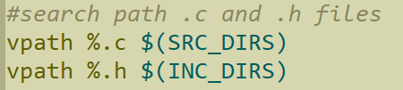
VPATH
Your project has many files in the different folders
VPATH variable specifies the list of directories that make should search for prerequisites and targets of rules
VPATH directive allows us to specify search path more selectively:
vpath pattern directories
vpath pattern
vpath

Slide 19

Create hex, bin, elf for Microcontrollers
With microcontroller, I will GNU Toolchain instead of GCC
I will create hex/bin/elf files by following syntax:
Then, I can download them to the flash by Utility app or GDB Debugger

Slide 20
Examples
Check Endianness of your Microcontrollers

