Slide 1

Makefile

Slide 2
Introduce to Building Process

Slide 3
Build Process
.i
Extended files
.s
Assembly files
Source files
.c .cpp .h
preprocessor
parser
Code generator
.o
Processor architecture specific machine codes with no absolute address (relocatable file)
Assembler
Object files

Slide 4
Build Process
Re-locatable object files
Executable & debug file
.o
Linker
Locator
.elf
Objcopy tool
.a
.ld
.ihex
.bin
Static Libraries
Linker script
Intel hex format
Bin format

Slide 5
GCC

Slide 6
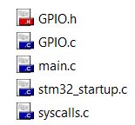
Why you need makefile?
Your project have many source files and you build it by an IDE (Keil C)
At a time, you want to edit or add a file
Add this file to the project & Rebuild all file
Makefile???
You just need to build edited/added files: led .c
Build only
It spend many time to rebuild with a big project

Slide 7
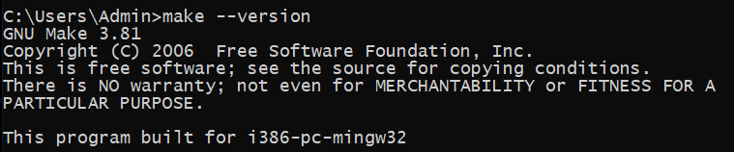
What is Makefile?
Makefile is a script file format that contains some information:
Project structure (file, dependencies)
Commands to create files (object file, elf/bin/hex files, …)
The make command will read makefile content, understand project’s structure and execute the commands
Tools for Makefile:
Cygwin/Mingw/GNU Make

Slide 8
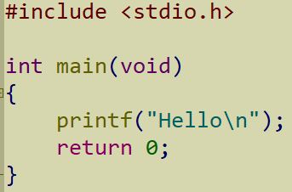
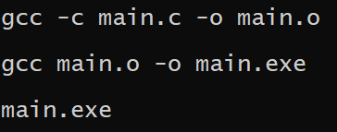
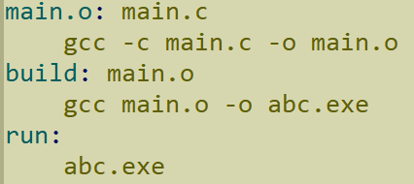
From GCC commands to Makefile
main.c
My project:
main.c → main.o → main.exe
With GCC:
With Makefile:
Generate object file
Generate .exe file
Run .exe file
Results
Combine GCC commands into one script file

Slide 9
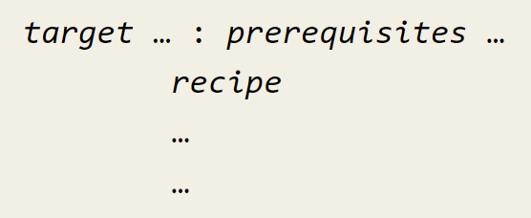
Rules Makefile
Basic form of a basic simple makefile
Input files to make target
Action / File target
Tab space
Action that make carry out

Slide 10
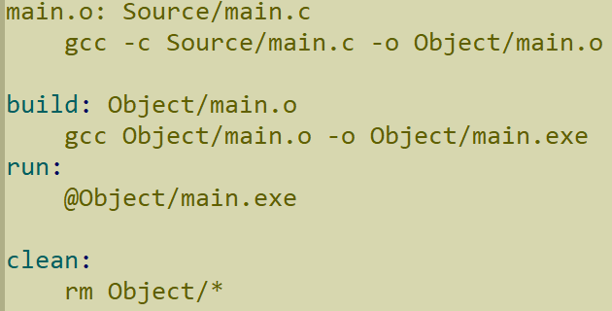
For examples
Input files to make target file
Target file
Actions
Input files to make actions
Action that make carry out

Slide 11
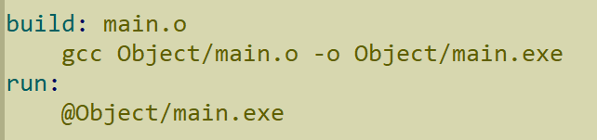

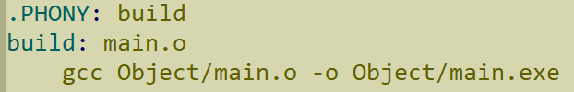
PHONY keyword
I have a file has the same name with an action
Action ‘build’ is not running with make command
Add PHONY keyword to signal ‘build’ is a action

Slide 12


Variables in Makefile
Use to generalize makefile, avoid using specific names of files
Assign symbols
Variable names
Values
Symbol to access the value of a variable: $(variable_name)

Slide 13


Print value of variables
Printing value of variables to check, debugger when working with makefile ➔ Use ‘echo’ command & string substitution
Results

Slide 14


Automatic Variables
Symbols | Meaning
$@ | File name of the target of the rule
$^ | Name of all the prerequisite
$< | Name of the first prerequisite
Some symbols used to generalize the rules

Slide 15

‘wildcard’ Characters
The wildcard characters in make are ‘*’, ‘?’, ‘[…]’
For examples, *.c specifies a list of all the files whose names end in ‘.c’
Clear all files in ‘output’ folder
Get all files in the PATH C:\Users\Admin\...

Slide 16
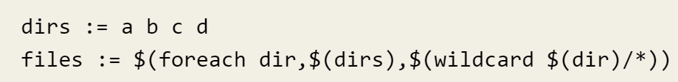
‘foreach’ function
This function causes one piece of text to be used repeatedly, each time with a different substitution performed on it.
Get all files in the all folder of dirs.

Slide 17

‘notdir’ – not direct
Use to get file or folder without the direct/path

Slide 18
Pattern Rules
%.o : %.c
recipes….
→ Tell how to make a .o file from a respectively .c file

Slide 19
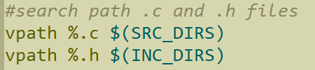
VPATH
Your project has many files in the different folders
VPATH variable specifies the list of directories that make should search for prerequisites and targets of rules
VPATH directive allows us to specify search path more selectively:
vpath pattern directories
vpath pattern
vpath

Slide 20
Create hex, bin, elf for Microcontrollers

Slide 21
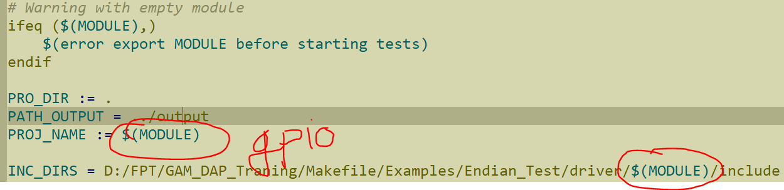
Ifeq & export
Use many module in a test program → Modify Makefile with each module??? → NO
We can use export

