Slide 1
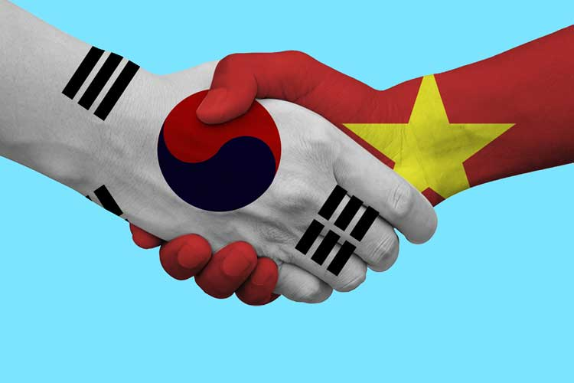
대한민국 vs. 베트남 의 명절 Differences and Similarities
Some facts of Vietnam
Lunar new year holidays
What Vietnam can learn from Korea?
What Korea can learn from Vietnam?

Slide 2
People and history
 | 대한민국 | 베트남
People | ~50mil (대한민국) ~25mil (북한) one ethnic | ~100mil 54 ethnic groups (China - 56 ethnic) main ( Kinh people)
Folk costume | 한복 | 베트남복: Ao dai Ao tu than

Slide 3
New year activity
설날음식
설빔 (Quan ao ngay tet)
Notes:
Visiting relatives, friends, colleagues, neighbors

Slide 4
New year activity
성묘 ( tao mo)
친척 (ho hang)
Visiting relatives, friends, colleagues, neighbors
The first day is father’s Tet
The second day is mother’s Tet
The third day is teacher’s Tet
Notes:
Visiting relatives, friends, colleagues, neighbors

Slide 5
New year activity
Greetings
Notes:
Visiting relatives, friends, colleagues, neighbors

Slide 6
New year activity
Go to pagodas to pray
Fortune teller
Notes:
Visiting relatives, friends, colleagues, neighbors

Slide 7
New year activity
세뱃돈
Notes:
Visiting relatives, friends, colleagues, neighbors

Slide 8
New year activity
전통놀이 (tro choi truyen thong)
차례
덕담

Slide 9
What Vietnam can learn from Korea?
베트남 축구 국가대표팀: 박항서

Slide 10
What Vietnam can learn from Korea?
 | 대한민국 | 베트남
Great leader | 박정희 Trained in Japan | Ho Chi Minh Trained in France, England, America, China, Soviet Union
박정희 대통령
광주 민주화 항쟁

Slide 11
What Korea can learn from Vietnam?
 | 대한민국 | 베트남
2 parts | 1950-now: 대한민국 vs 북한 | 2 times 1954 - 1975: 북베트win 16xx - 18xx: 남베트win
Balance between China and America
Relationship with N. Korea

