Slide 1
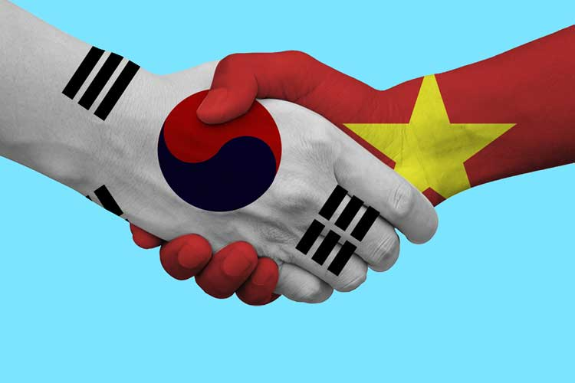
대한민국 vs. 베트남 의 명절 Differences and Similarities
Some fact of Vietnam
Lunar new year holidays
What Vietnam can learn from Korea?
What Korea can learn from Vietnam?

Slide 2
People and history
 | 대한민국 | 베트남
People | ~50mil (대한민국) ~25mil (북한) one ethnic | ~100mil 54 ethnic groups (China - 56 ethnic) main ( Kinh people)
2 parts | 1950-now: 대한민국 vs 북한 | 2 times 1954 - 1975: 북베트win 16xx - 18xx: 남베트win
Folk costume | 한복 | 베트남복: Ao dai Ao tu than

Slide 3
New year activity
설날음식
전통놀이 (tro choi truyen thong)
차례
덕담
세뱃돈
설빔 (Quan ao ngay tet)
성묘 ( tao mo)
친척 (ho hang)

