Slide 1
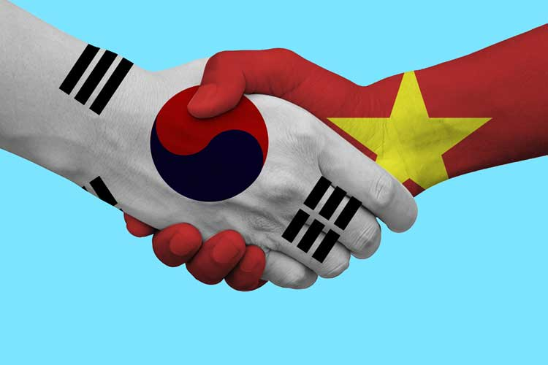
LUNAR NEW YEAR HOLIDAY:
What do Vietnamese do during “TET’ holiday?
Some facts of Vietnam
Lunar new year holidays
What Vietnam can learn from Korea?
What Korea can learn from Vietnam?

Slide 2
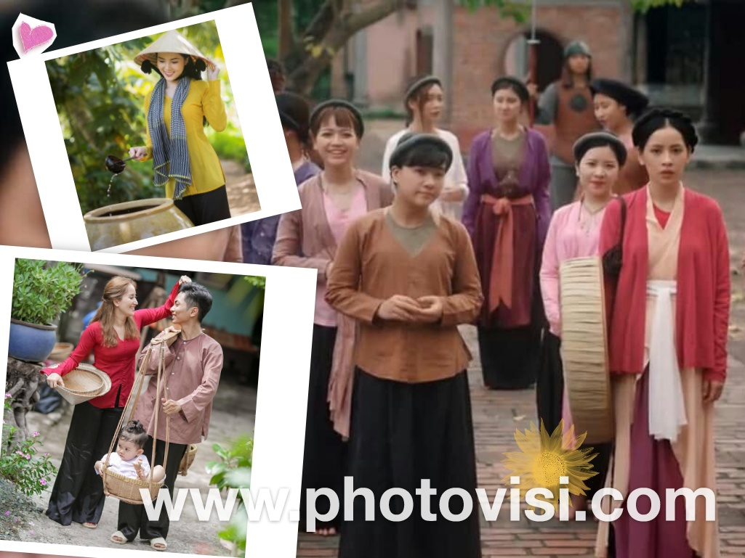
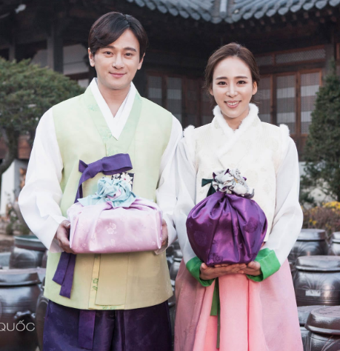
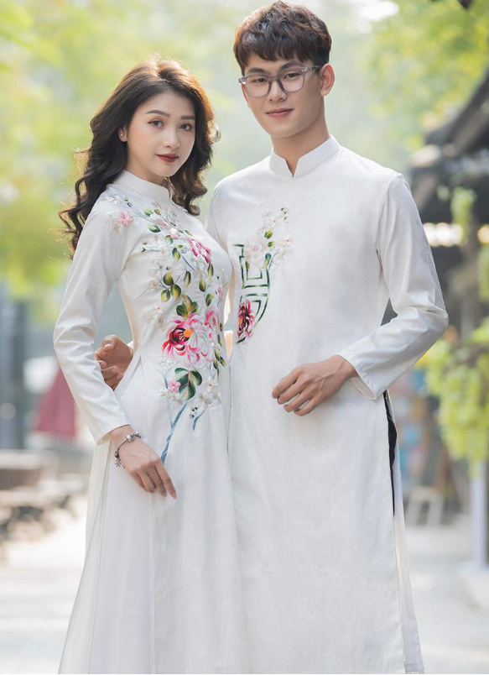
베트남민족
 | 대한민국 | 베트남
사람 | ~50mil (대한민국) ~25mil (북한) one ethnic | ~100mil 54 ethnic groups (China - 56 ethnic) main ( Kinh people)
전통의상 | 한복 | 베트남복: Áo tứ thân (four-part dress) Áo dài (long dress) Áo bà ba (the shirt of Mrs)
Notes:
https://www.vietvisiontravel.com/post/tet-holiday-vietnamese-new-year-festival/
https://www.photovisi.com/vi/photovisi/angled-side-by-side

Slide 3
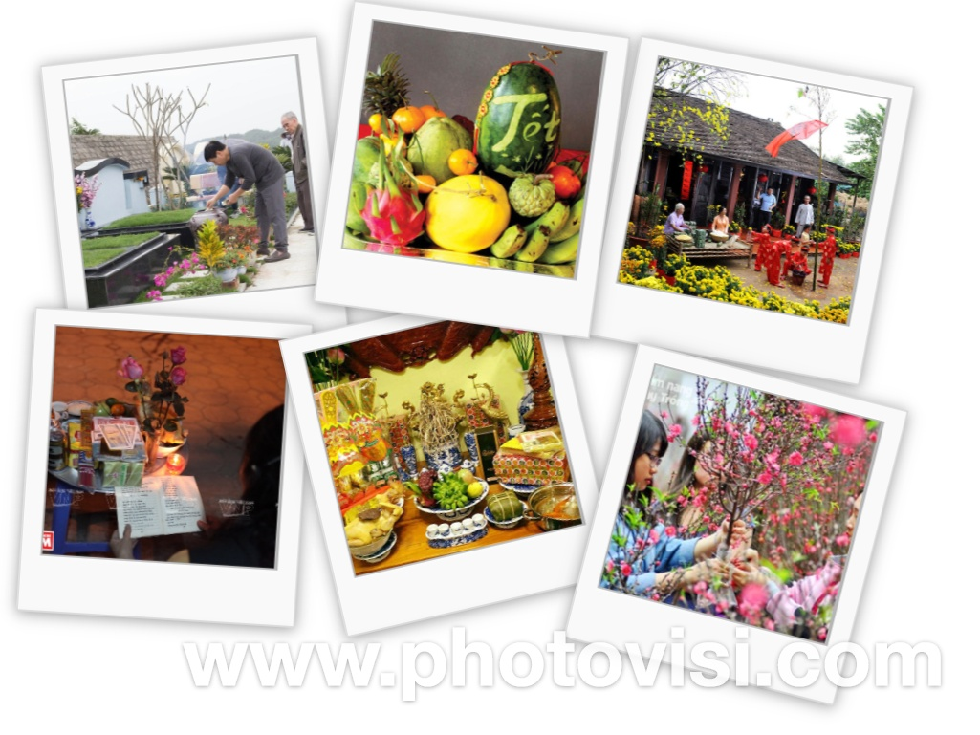
설날 이벤트
성묘 ( tao mo)
Tray of Five Fruits
Neu Tree
Flowers: Dao, Mai
Notes:
Visiting relatives, friends, colleagues, neighbors

Slide 4
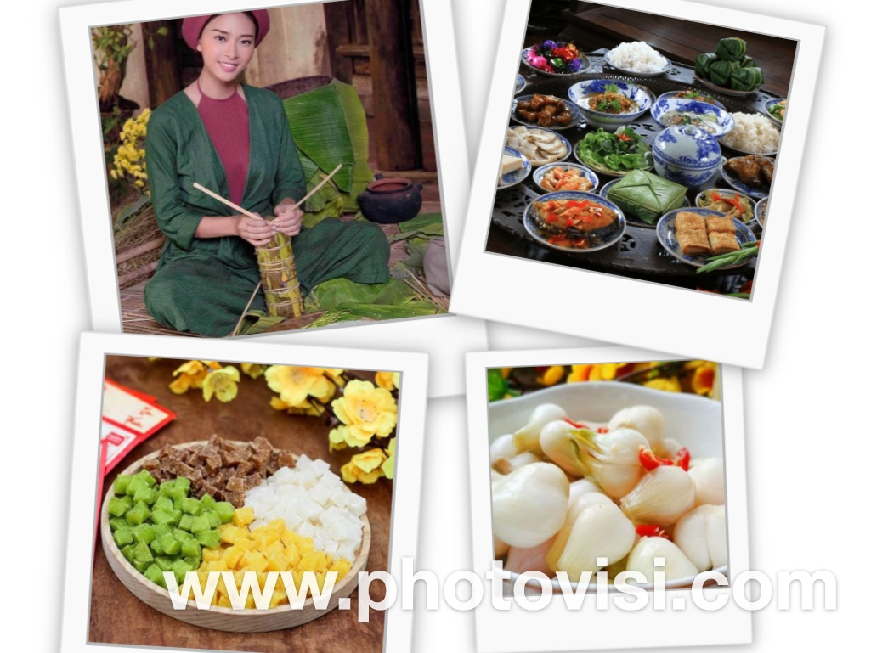
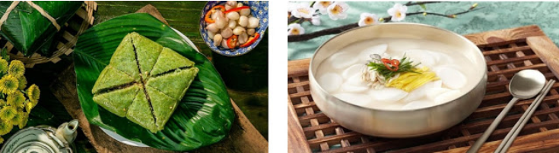
설날 이벤트
설날음식
Chung cake
Pickled onions: 베트남 김지
Jam
Notes:
Visiting relatives, friends, colleagues, neighbors

Slide 5
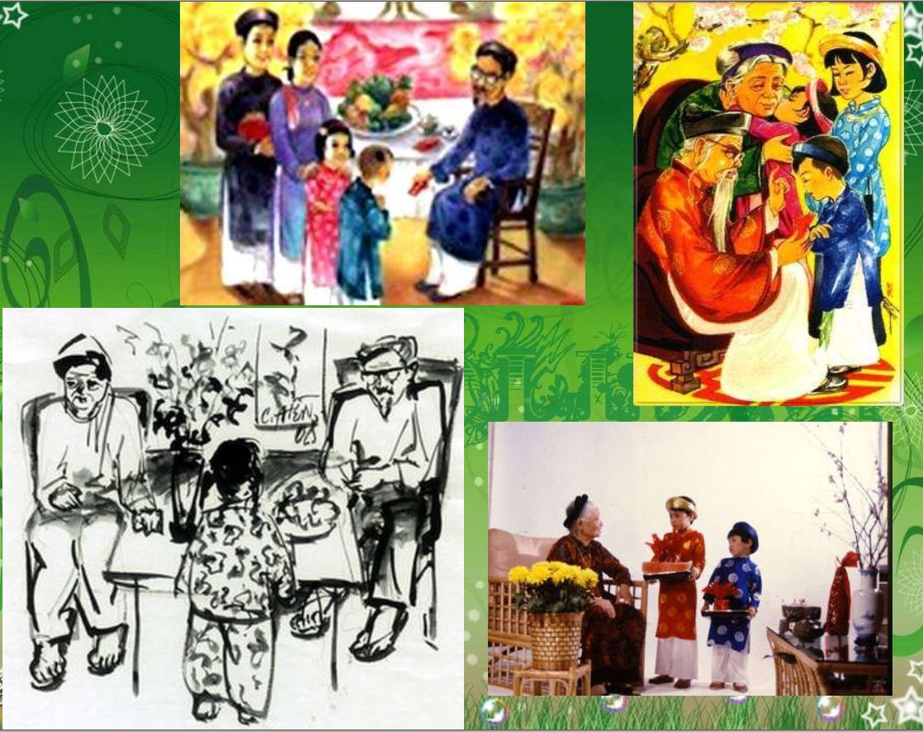
설날 이벤트
친척 (ho hang)
세뱃돈
Visiting relatives, friends, colleagues, neighbors
The first day is father’s Tet
The second day is mother’s Tet
The third day is teacher’s Tet
Notes:
Visiting relatives, friends, colleagues, neighbors

Slide 6
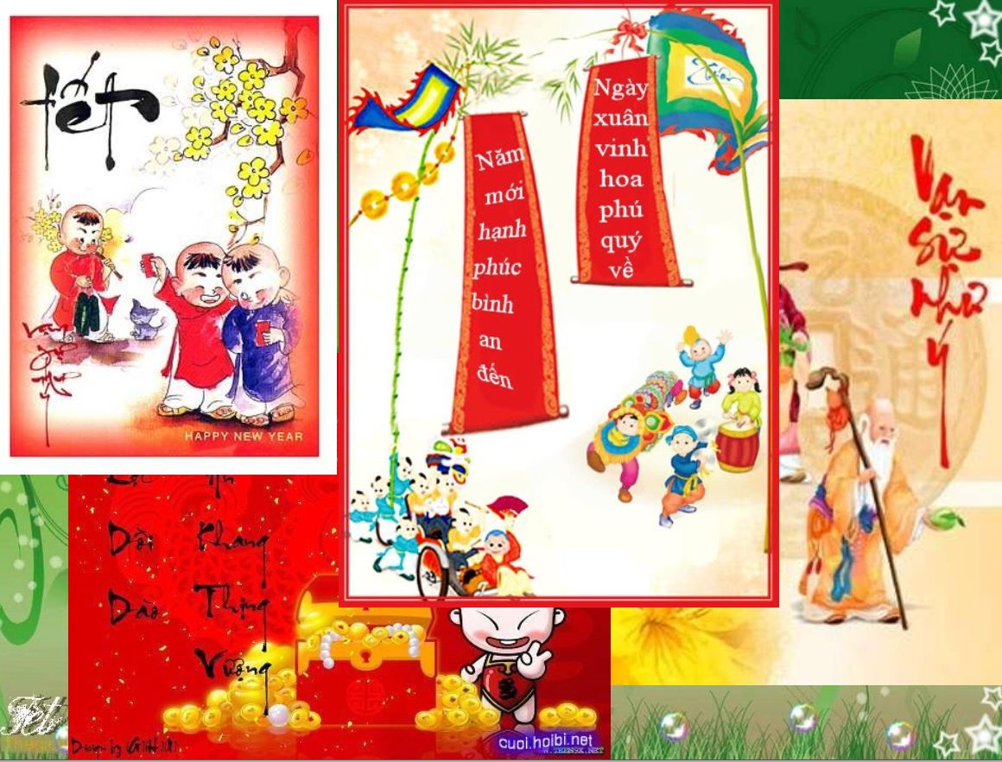
설날 이벤트
Greeting(새해 복 많이 받으세요):
Live up to 100 years
Security, good health, and prosperity
萬事如意 (Van su nhu y)
Plenty of health
恭喜发财 , 恭喜發財 (Cung hy phat tai)
Notes:
Visiting relatives, friends, colleagues, neighbors

Slide 7
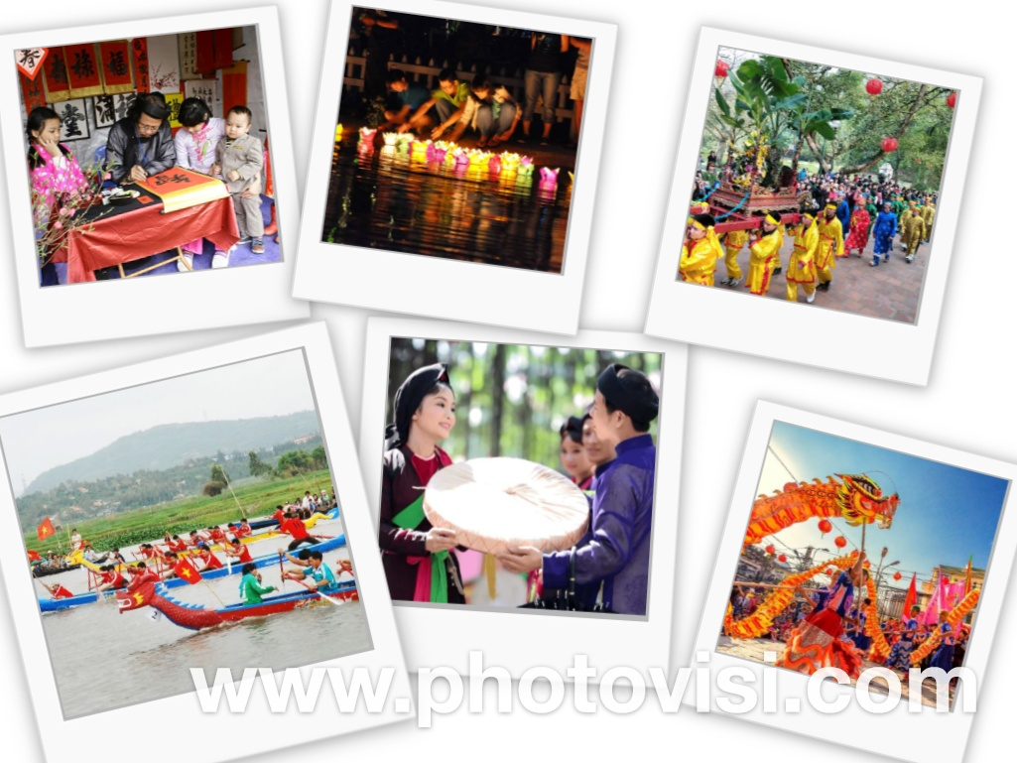
설날 이벤트
Go to pagodas to pray
Traditional festivals in Pagoda
Notes:
Visiting relatives, friends, colleagues, neighbors

Slide 8
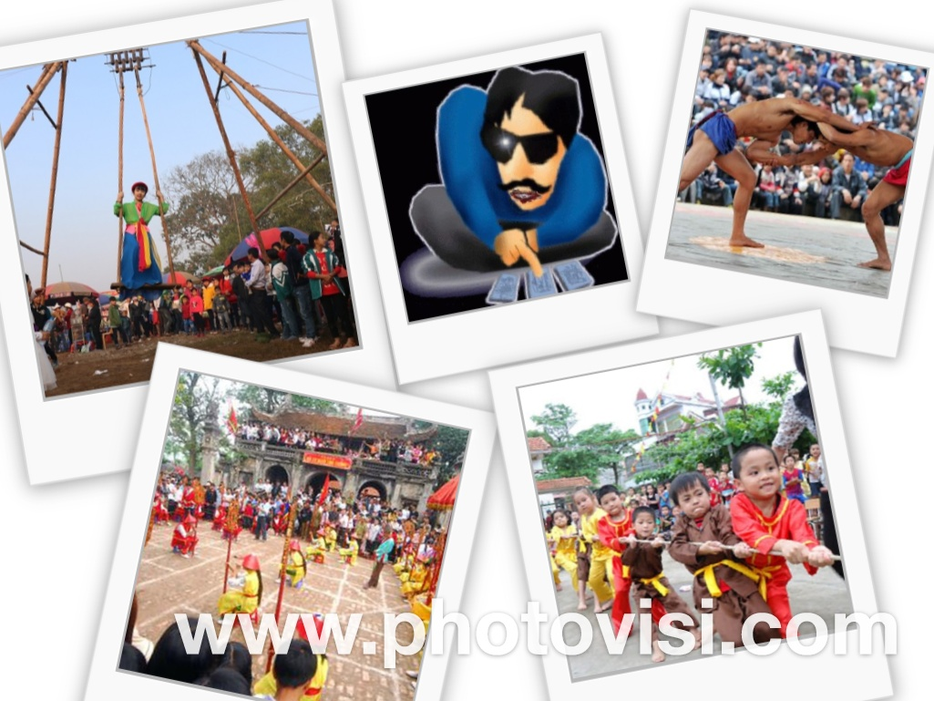
설날 이벤트
전통놀이 (tro choi truyen thong)

