Slide 1
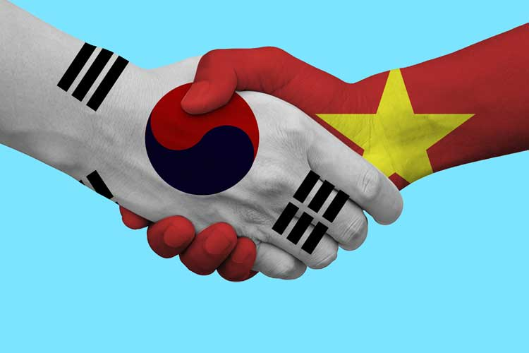
대한민국 vs. 베트남 의 설날 차이점 및 유사점
Some facts of Vietnam
Lunar new year holidays
What Vietnam can learn from Korea?
What Korea can learn from Vietnam?

Slide 2
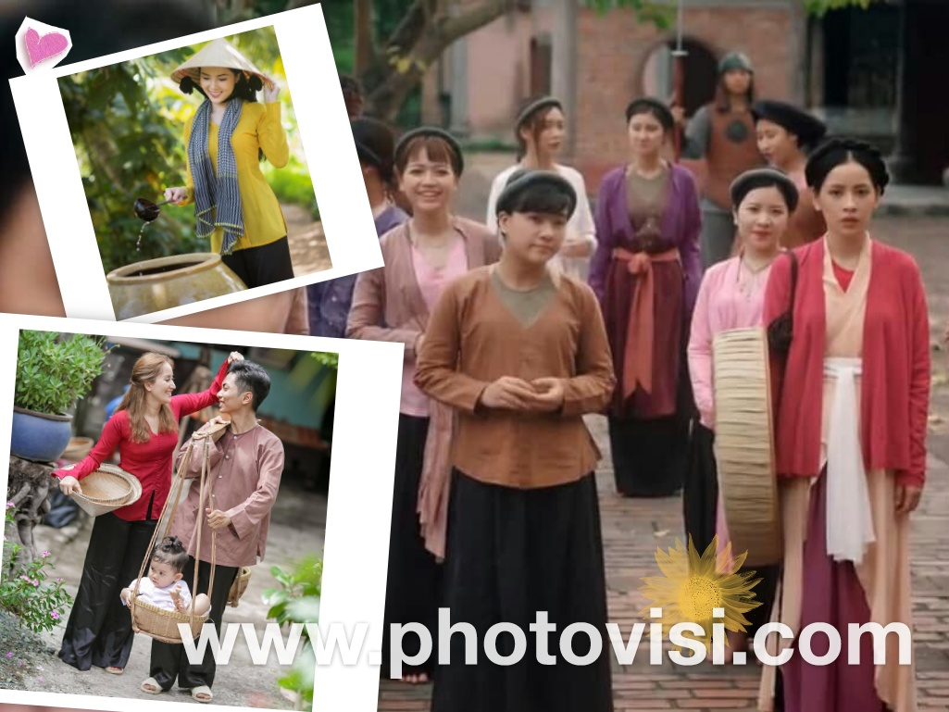
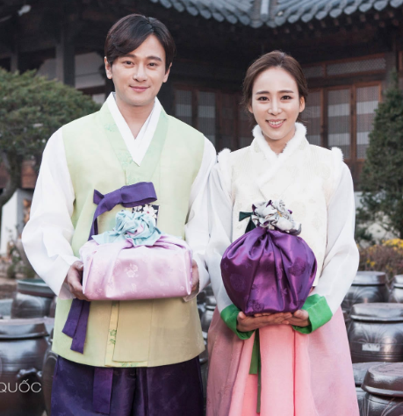
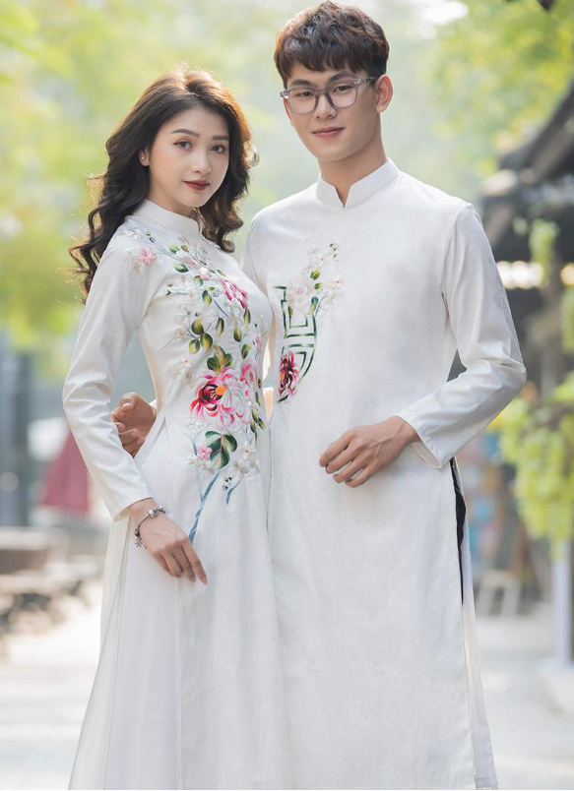
베트남민족
 | 대한민국 | 베트남
사람 | ~50mil (대한민국) ~25mil (북한) one ethnic | ~100mil 54 ethnic groups (China - 56 ethnic) main ( Kinh people)
전통의상 | 한복 | 베트남복: Áo tứ thân (four-part dress) Áo dài (long dress) Áo bà ba (the shirt of Mrs)
Notes:
https://www.vietvisiontravel.com/post/tet-holiday-vietnamese-new-year-festival/
https://www.photovisi.com/vi/photovisi/angled-side-by-side

Slide 3
설날 이벤트
설날음식
성묘 ( tao mo)
Notes:
Visiting relatives, friends, colleagues, neighbors

Slide 4
설날 이벤트
설빔 (Quan ao ngay tet)
친척 (ho hang)
Visiting relatives, friends, colleagues, neighbors
The first day is father’s Tet
The second day is mother’s Tet
The third day is teacher’s Tet
Notes:
Visiting relatives, friends, colleagues, neighbors

Slide 5
설날 이벤트
Greeting
세뱃돈
Notes:
Visiting relatives, friends, colleagues, neighbors

Slide 6
설날 이벤트
Go to pagodas to pray
Festivals in Pagoda
Notes:
Visiting relatives, friends, colleagues, neighbors

Slide 7
설날 이벤트
전통놀이 (tro choi truyen thong)
차례
덕담

Slide 8
What Vietnam can learn from Korea?
베트남 축구 국가대표팀: 박항서

Slide 9
What Vietnam can learn from Korea?
 | 대한민국 | 베트남
Great leader | 박정희 Trained in Japan | Ho Chi Minh Trained in France, England, America, China, Soviet Union
박정희 대통령
광주 민주화 항쟁

Slide 10
What Vietnam can learn from Korea?
화산 이씨, 花山李氏, Hoa Sơn Lý thị
이용상, 李龍祥, Lý Long Tường

Slide 11
What Korea can learn from Vietnam?
 | 대한민국 | 베트남
2 parts | 1950-now: 대한민국 vs 북한 | 2 times 1954 - 1975: 북베트win 16xx - 18xx: 남베트win
Balance between China and America
Relationship with N. Korea

