Slide 1

ADDIS ABABA INSTITUTE OF TECHNOLOGY
Center of Information Technology and Scientific Computing
Department of Software Engineering
Ethiopian Music and Movies Copyrighter Group Members:-
Eyosias Samson
Gemechu
Henok
Immanuel
Kaleab Belete
Kalid Sultan
07/03/2018

Slide 2
Outline
Overview
Problem Statement
Scope of the Project.
Methodology.

Slide 3
Overview
According to a recent study, more than 95% of music and 98% of locally made movies on the market are illegal copies. Due to the rampant copyright infringement, publishers are paying less money for movies.
A study conducted by EIPO on the level of copyright infringement at a national level indicates that the infringement rate was 58.6% for the year 2014. Out of this, the infringement rate on musical works was 80.33% - far higher than that of films, which was at 49.05%. This affirms that Ethiopia's music sector is particularly susceptible to piracy.

Slide 4
Problem Statement
What motivates you to do this project?
The constant infringement of intellectual property rights in the music industry
The absence of applications like iTunes that can be used to allow legal digital purchases of Ethiopian music with Ethiopian currency.
The desire to build a safer environment for both the users and developers.
What gaps have initiated you?
The only existing application in the Google Play Store that allows for purchases of Ethiopian music with Ethiopian Birr (called ArifZefen) has been highly criticized by users for its inconvenience and incompetence.

Slide 5
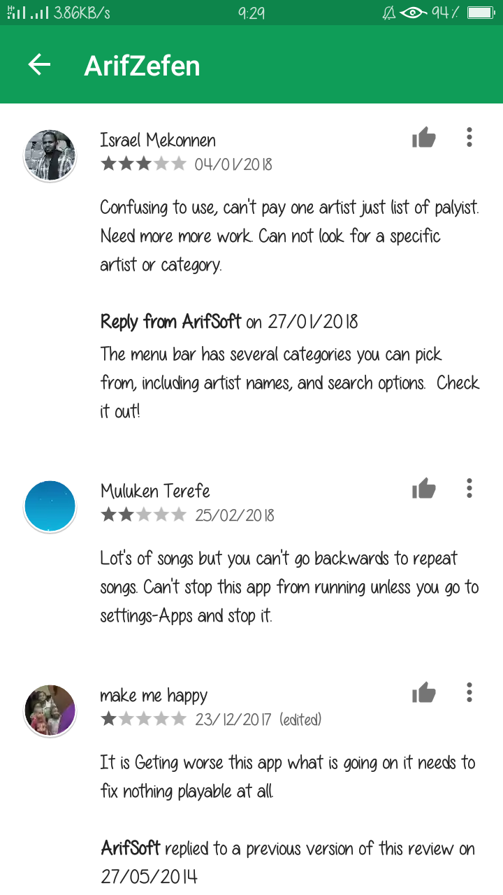
Some user comments

Slide 6
Scope of the Project
What is the main solution?
Create a system that allows users to purchase their products without infringing on the copyrights of the products.
What is this project intended to do?
Allow users to purchase music
Allow artists to receive payment for their works.
Create an ecosystem where both users and artists are both happy
Develop a system where the products in the system cannot infringe on the copyright to be copied elsewhere.
What are the limitation of the project?
Our application is restricted to those with access to mobile phones and desktop computers. People that don’t have access to these will likely continue to infringe on Artists' intellectual property rights .
Users and Artists should have a bank account to transfer the money to.

Slide 7
Methodology
What methods do you use to collect data?
By reviewing the successes of contemporary applications like iTunes and Spotify, we intend to capitalize on the experiences acquired by pre-existing platforms.
Development methods you are going to use?
Spiral Software development model makes more sense to use because our application has enormous risk associated with it. Since it involves two industries (Financial and Music), it is best to assess risk intensively and at the beginning of each step.

