Slide 1
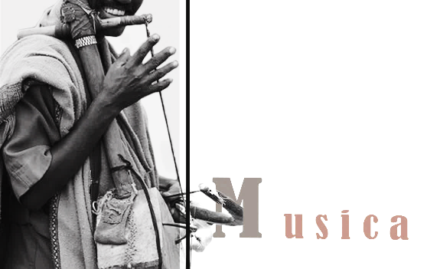
Musika
Q U A L I T Y I S W H A T M A T T E R S !!

Slide 2
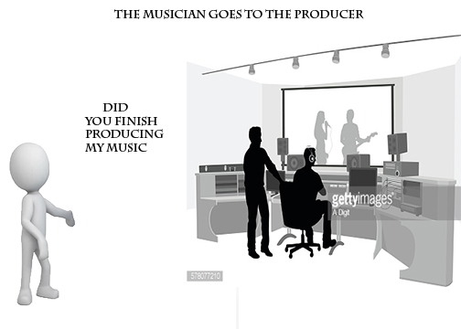
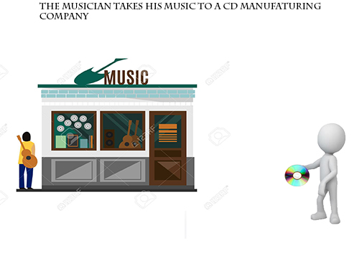
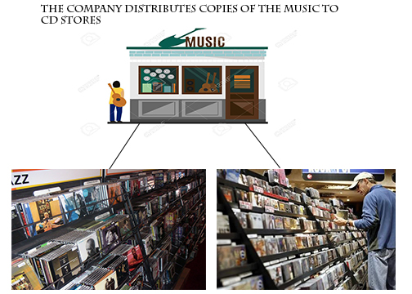
The Existing System

Slide 3
Statement of the Problem
The existing system uses CDs
Enable sharing of music
Result the artist to loose a lot of money
CDs currently in service are getting outdated
Vulnerable to be damaged and scotched

Slide 4
Objective of the Project
General Objective
Develop a system that allows clients to purchase music products and to protect the copyright of the music
Specific Objective
Provide a safe environment where copyright laws are protected.
Establish a transaction space based on the geographical area.
.

Slide 5
Proposed System
user downloads and install the application on the mobile phone
setup his account by filling the requirements
He will be given variety of music currently available in the system To download a music
the user is asked to give password for the bank account in his account

Slide 6
Feasibility Study
Economic Feasibility
developmental cost
Operational Cost
Operation | Cost
Employees | 0 br
Interviews | 200 br
Internet Research | 300 br
Food | 400 br
Transportation | 800 br
Other | 300 br
Total | 2000 br
Operation | Cost
Deployment | 0 br
Bug fixes (App maintenance) | 677br
Web hosting | 1,400 br
Total | 1500 br

Slide 7
Feasibility Study cont’d
2. Technical Feasibility
This system requires a Mobile device running an Android Operating system
This is currently widely available and can even be obtained with ease.
system requires a bank account to purchase the music products
Users are familiar with banking system

Slide 8
Feasibility Study cont’d
3. Schedule Feasibility
The system is destined to get delivered at the end of the semester

Slide 9
Scope
Geographically
This platform is aimed solely at providing a legal digital music marketplace for the Ethiopian people.
Functionally
Allow users to purchase music with Ethiopian currency.
Allow artists to receive payment for their works.
By utilizing the new online payment systems developed by the Commercial Bank of Ethiopia, it will create a mobile application that allows for digital music purchases.

