Slide 1










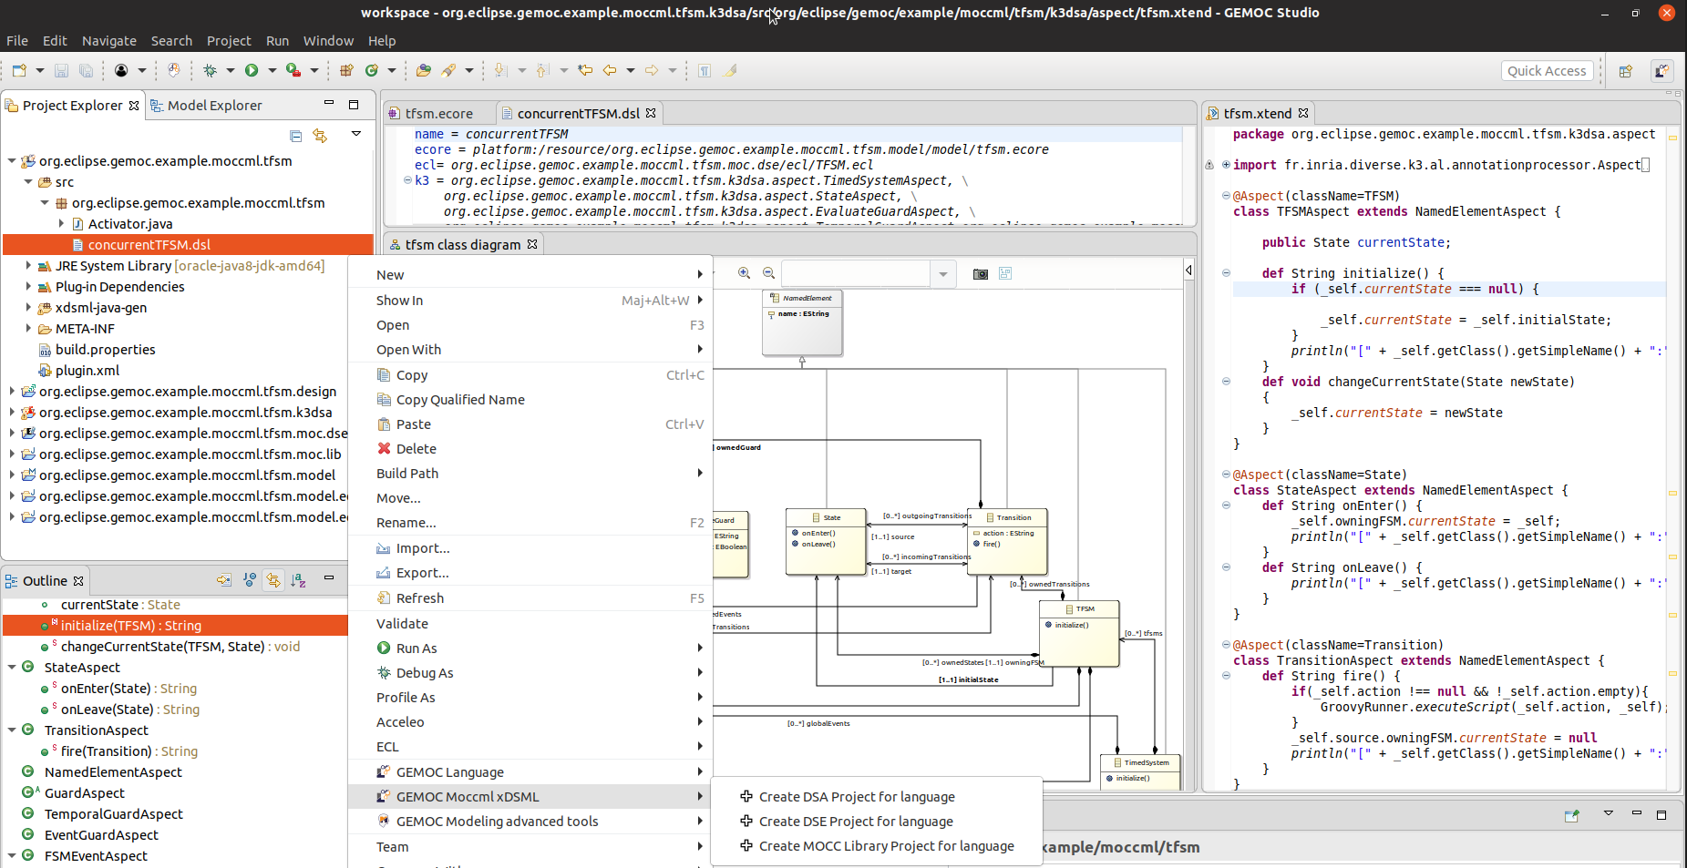
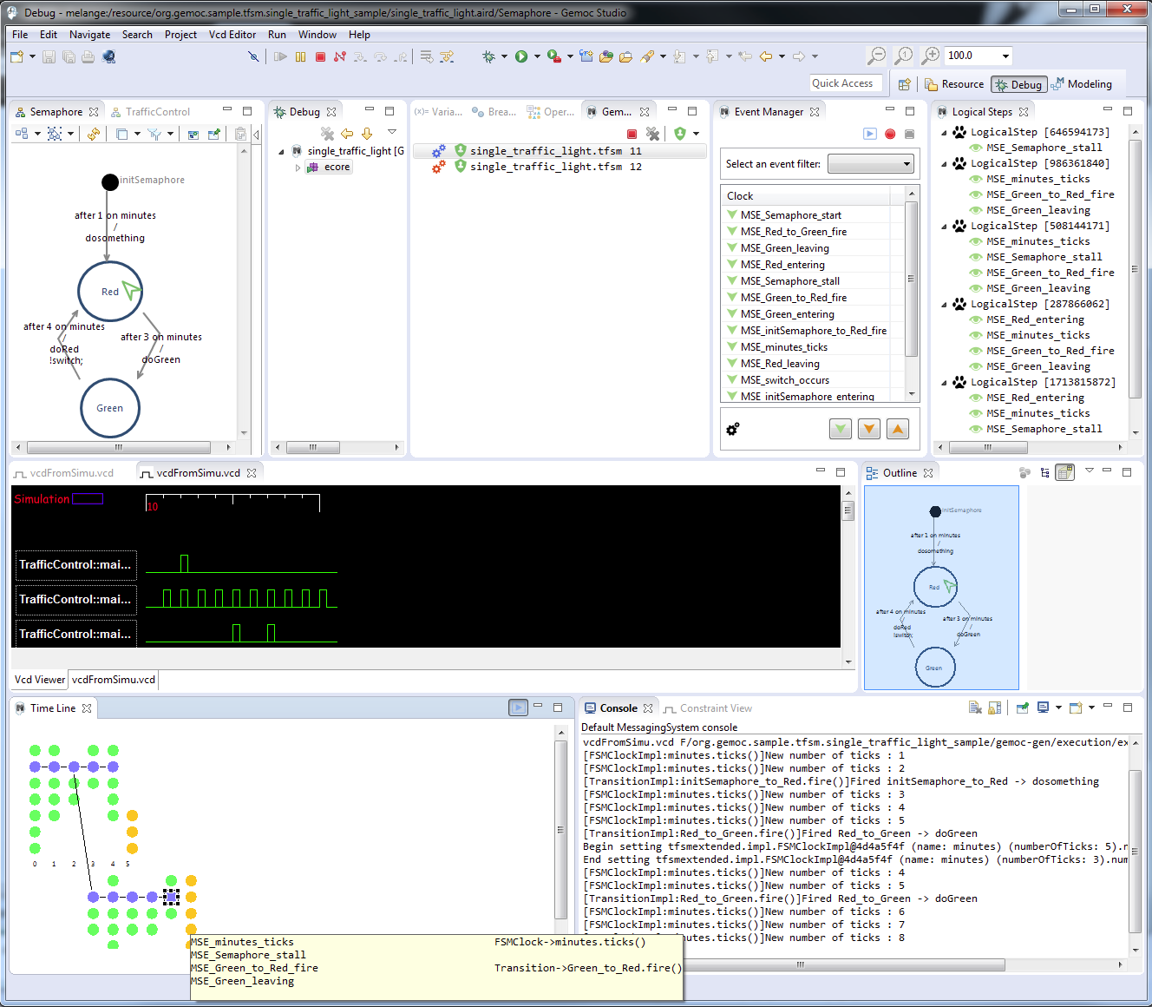
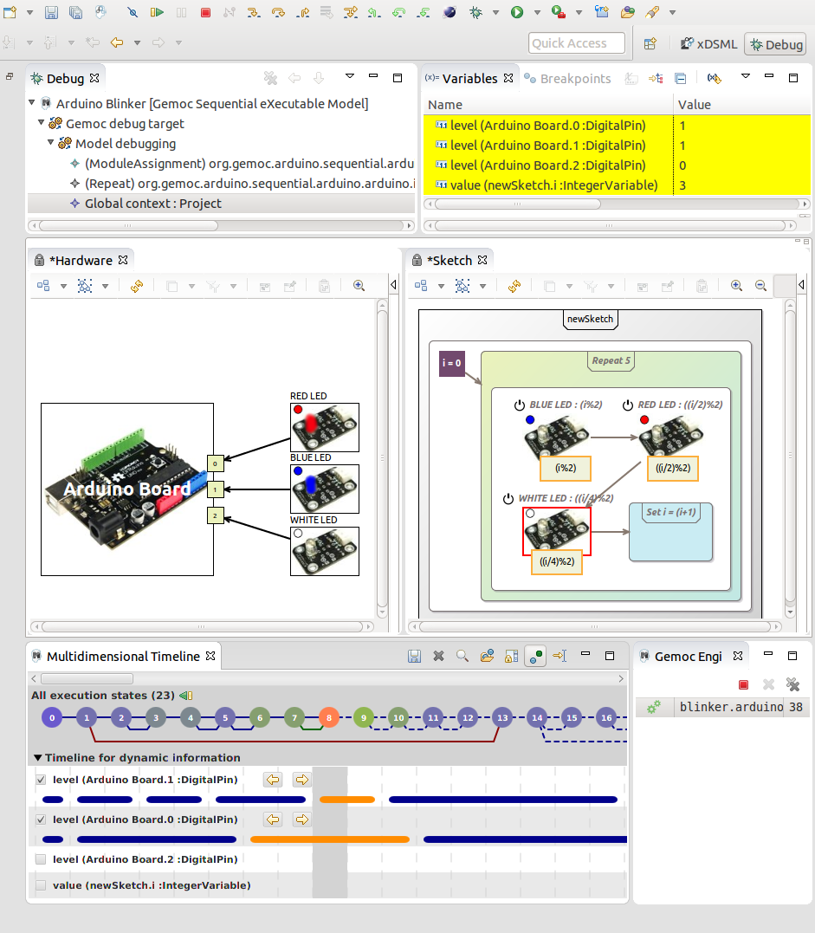
The GEMOC Studio
Breathing Life into your Modeling Languages
contact@gemoc.org
@gemocinitiative
http://gemoc.org/studio
Studio for Language Engineer Experts
Research questions:
Modular language design and implementation
Language interfaces (structural and behavioral)
Integration of dedicated meta-languages for specific language concerns (e.g., concurrency)
Protocols for executable modeling (e.g., debugging, animation, run-time monitoring)
Language composition operators (e.g., reuse/variability mana-gement, behavioral coordination)
"Integrated frameworks and protocols providing innovative Software Language Engineering tools and methods"
Context:
Heterogeneous modeling of complex software intensive systems
Why the GEMOC Studio:
Extensible framework to support new approaches through well defined interfaces and protocols: Execution engines, editors, tools (execution space exploration, model testing, runtime monitoring…), frontends and backends
Community with active members from academia and industry
Expected outcome:
Scientific and technological foundations on modeling language design, implementation and coordination
Innovative frameworks and protocols for Software Language Engineering
A cutting edge language workbench
Studio for Language Engineers
"A Language Workbench for configuring and building the tooling of Domain Specific Languages with a strong focus on their behavior and correctness."
Why the GEMOC Studio:
Open source EMF-based technologies
Supports several approaches for the concrete syntax of languages (Xtext, Sirius)
Supports several approaches for the behavioral semantics of languages (ALE, Java, MOCCML, Henshin, xMOF)
Assistance for language definition and building (wizards, checkers)
Assistance to define the languages behavior (Runtime Data , observable steps, Behavioral interface)
Syntactic and semantic language reuse (modeltype, Melange, revisitor)
Language coordination patterns
Interaction and
Coordination
Approach
(BCOoL, Behavioral Interface)
Metaprogramming
Approach
(ALE, Kermeta/Xtend/Java,
MoCCML, xMOF, Henshin)
Metamodeling
Approach
Concrete Syntax
Approach
(Sirius, Xtext)
Ecore
Ease tooling development
Coordination
Rules
Operational Semantics
Abstract Syntax
Concrete Syntaxes
Execution
Rules
Domain Model
(Metamodel)
Static
Representations
Execution
State
Dynamic
Representations
Leverage on know how and fuel research challenges
Coordination
Model
Event
manager
Execution
Engine
Model Editor
Trace
metamodel
Interpreter
a Running
Model
diagram
text
Model Animator
code generation /
interpretation
Timeline, control
panel, omniscient
debugger, VCD
Diagram
Legend
<<dependsOn>>
Execution Framework and Protocols
<<conformsTo>>
Debug Adapter
Protocol
Language Server
Protocol
Expected outcome: implementation of a large ecosystem of collaborative, interoperable and composable modeling languages from GEMOC partners and its community
Studio for Software and System Engineers
"A Modeling Workbench for Heterogeneous Modeling and Simulation of Complex Software-Intensive Systems"
Why the GEMOC Studio:
Homogeneous user interface and tooling across all DSLs
State-of-the-practice model editing support (incl. Textual and graphical model edition)
Cutting edge model execution with animation and advanced debugging features
  Interactive execution with forward and backward stepping
  Runtime data analysis and visualization (Multidimensional Data timeline, Variable view, Trace comprehension operators)
  Event management and concurrency analysis (Event timeline, Call stack view)
Execution coordination of multiple models (incl. heterogeneous behavioral models expressed in different languages) and cosimulation
Expected outcome: Prototypes, demonstrators, and pilot projects
Dec. 2019

