Slide 1

UNIVERSITY OF THESSALY
SCHOOL OF ENGINEERING
DEPARTMENT OF ELECTRICAL AND COMPUTER ENGINEERING
Separation, Classification, and Localization of Acoustic Events from
Multi-channel Audio Signals
Diploma Thesis
Moirotsos Georgios
Supervisor: Potamianos Gerasimos

Slide 2
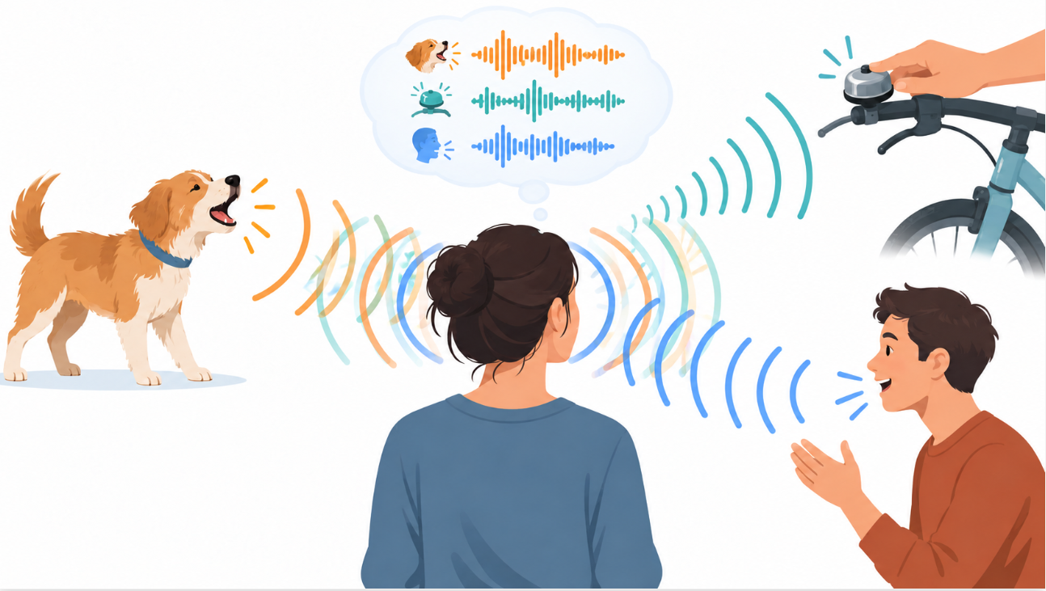
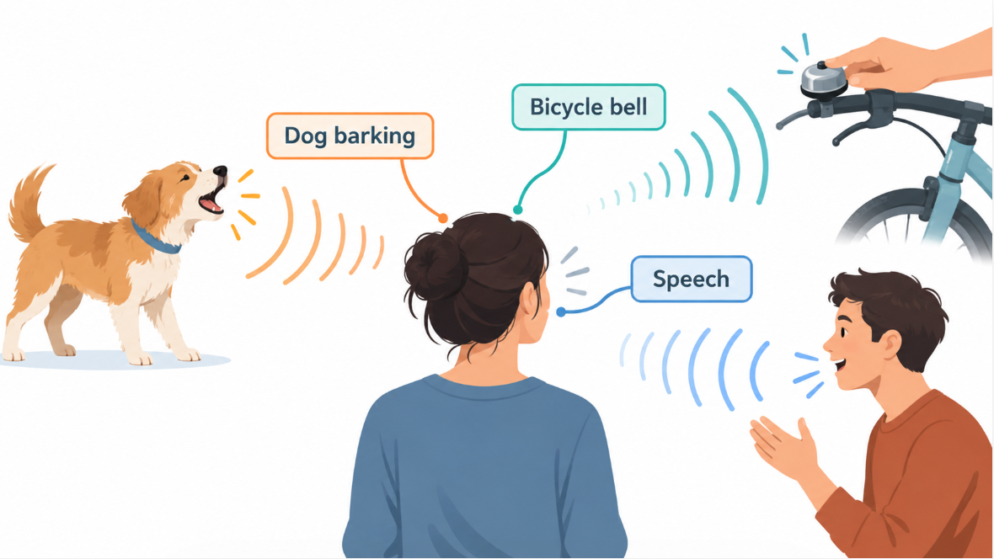
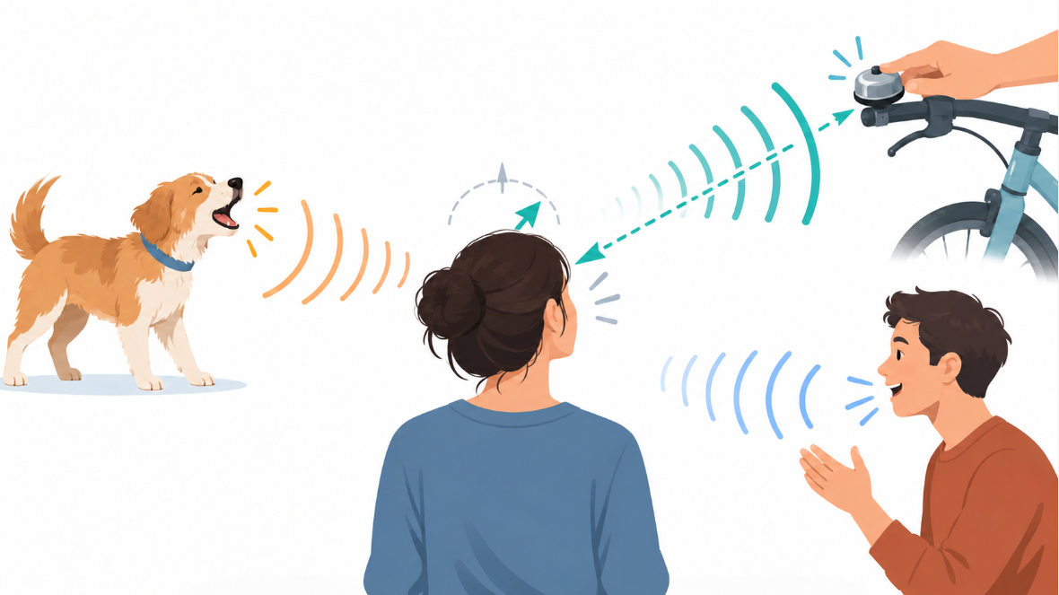
Thesis Research Fields and Inspiration
Related Work
This Thesis lies at the intersection of artificial intelligence and audio and signal processing. Its three main tasks – separation, classification, and localization – are inspired by capabilities of the human auditory system: decomposing a mixture into its individual source signals, recognizing what they are, and identifying where they are coming from.
Our Inspiration
Can I hear each sound separately?
What am I hearing?
Where is the sound coming from?

Slide 3
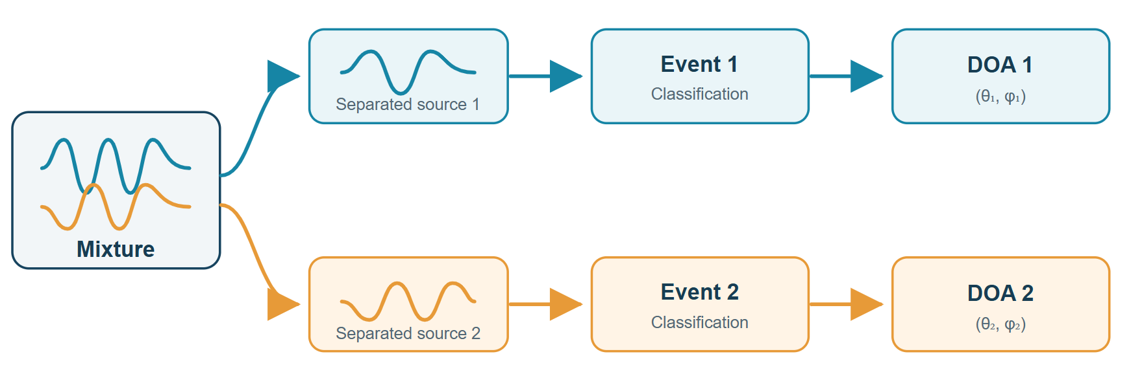
Thesis Problem and Objective
Related Work
Problem: The analysis and understanding of complex acoustic scenes containing multiple simultaneously active sound sources captured by multiple microphones.
Objective: Develop and evaluate a pipeline that:
  Separates the underlying sources without prior knowledge about the mixing process. This is called blind source separation (BSS).
  Classifies the acoustic event in each separated signal.
  Estimates the direction of arrival (DOA) of each estimated separated signal.

Slide 4
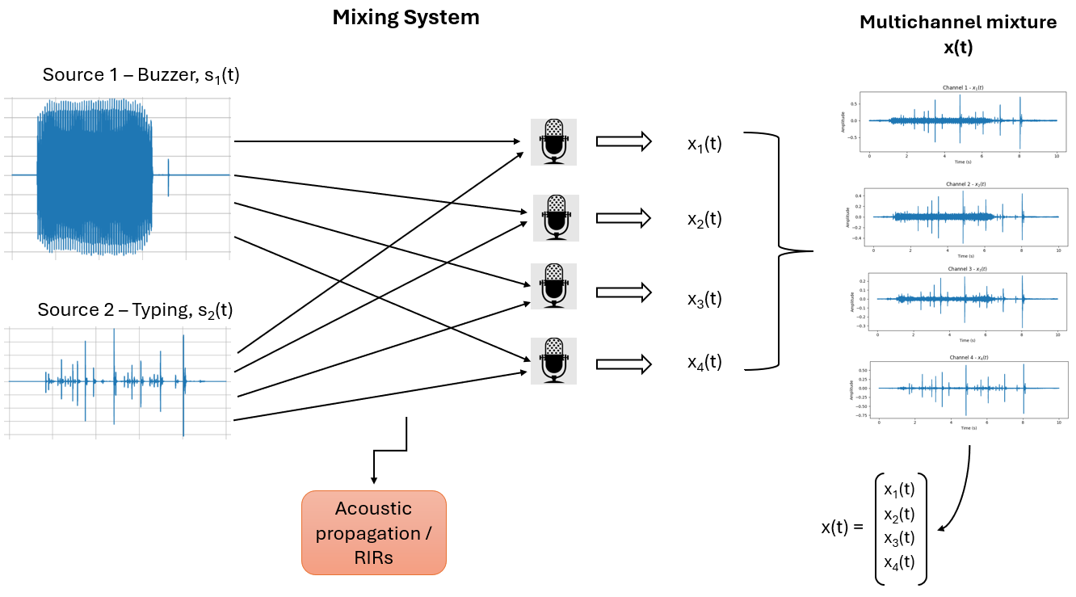
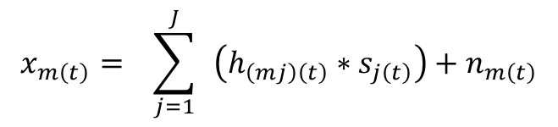
Acoustic Scenario
Related Work
The acoustic scenario considered in this Thesis consists of a multichannel audio mixture signal of:
1–3 simultaneous target acoustic events.
4 microphone channels.
The duration of all mixture clips is fixed at 10 seconds.
All files are available in 16-bit wav format at 32 kHz.
Each microphone captures a different channel-specific mixture of the same acoustic scene. The four channels jointly form one multichannel mixture signal.
Additional acoustic conditions:
1-2 optional non-target acoustic events.
Non-directional background noise.
Room Impulse Responses (RIRs) model sound propagation and reverberation.
Mathematical Formulation
$$x_{m\left(t\right)}= \sum_{j=1}^{J}{ }\left(h_{\left(mj\right)\left(t\right)}∗s_{j\left(t\right)}\right)+n_{m\left(t\right)}$$

Slide 5
Thesis Contribution on Each Stage
Thesis Focus
1.Audio Source Separation
2. Acoustic Event Classification
3. Acoustic Source Localization
Formulation of the source separation task as BSS, without prior knowledge of the source signals or the acoustic mixing process.
Implementation of Independent Vector Analysis (IVA) for the separation of complex multichannel mixture signals.
Extraction of the estimated separated sources. BSS will be used as a preprocessing step for classification and localization.
Evaluation of the IVA separation performance, investigating the conditions affecting source separation.
Development and Training of a Convolutional Neural Network (CNN) classifier for the 18 acoustic-event classes using clean target sources.
Integration of the classifier with the BSS stage, enabling classification directly on the estimated separated sources.
Evaluation of the effect of source separation on classification performance, through comparison between clean target sources and BSS-estimated signals.
Exploitation of the spatial information recovered during the IVA separation stage for each separated acoustic source.
Spatial analysis of the separated sources, examining how each separated source is represented across the Ambisonics spatial channels.
DOA estimation of each separated source, providing azimuth and elevation estimates from the source-specific spatial information.

Slide 6
DCASE2025 Task4 Dataset
Dataset details:
15.1 Gigabytes.
It is divided into a development set, an evaluation set, and a ground truth set.
Available at Zenodo.
Contains 2290 mixture files.
Contains the isolated target sound events of each class, in a total of 18 classes.
The list of target acoustic event classes (18) is:
  “AlarmClock”,
  “BicycleBell”,
  “Blender”,
  “Buzzer”,
  “Clapping”,
  “Cough”,
  “CupboardOpenClose”,
  “Dishes”,
  “Doorbell”,
“FootSteps”,
“HairDryer”,
“MechanicalFans”,
“MusicalKeyboard”,
“Percussion”,
“Pour”,
“Speech”,
“Typing”, and
“VacuumCleaner”.

Slide 7
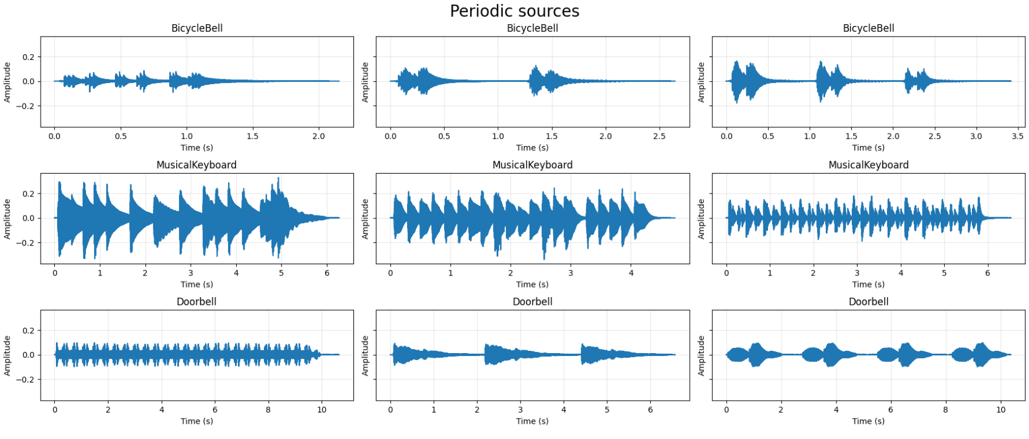
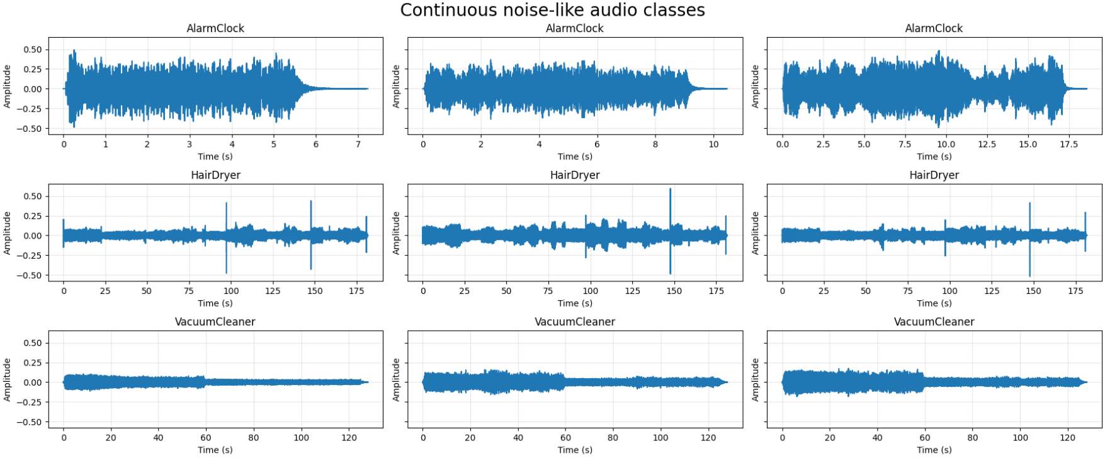
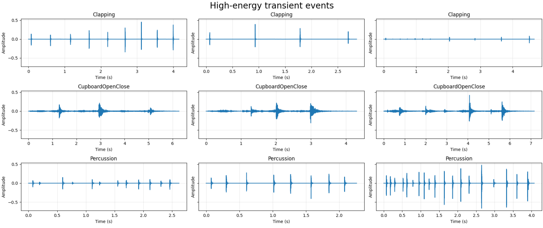
DCASE2025 Task4 Dataset
Development Dataset
The variability of the acoustic event classes in terms of temporal and spectral characteristics constitutes a more realistic and challenging benchmark for source separation and acoustic event analysis.

Slide 8
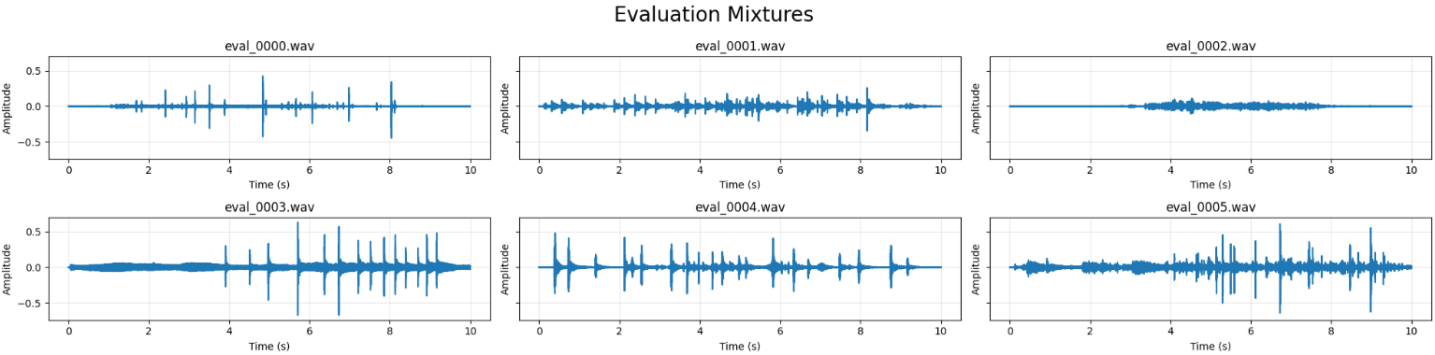
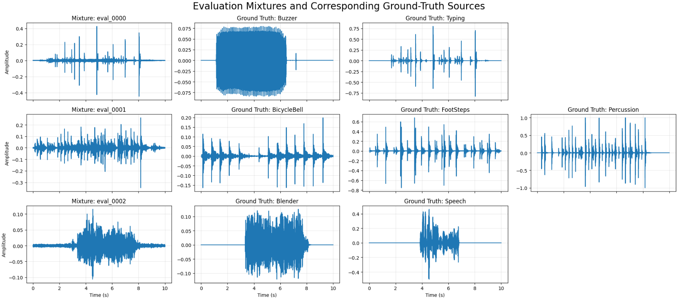
DCASE2025 Task4 Dataset
Evaluation Dataset
Includes all the multichannel spatial mixture signals.
Evaluation Ground Truth Dataset
Contains the isolated ground truth signals of the evaluation multichannel mixture signals.

Slide 9
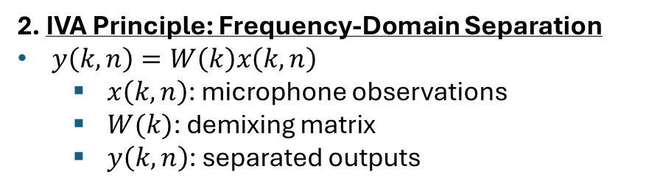
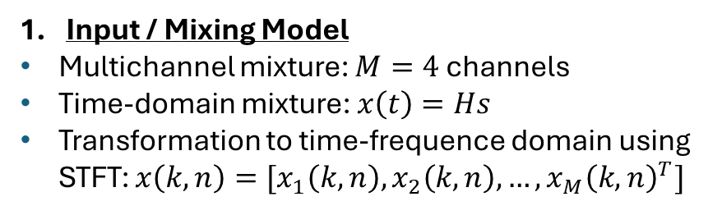
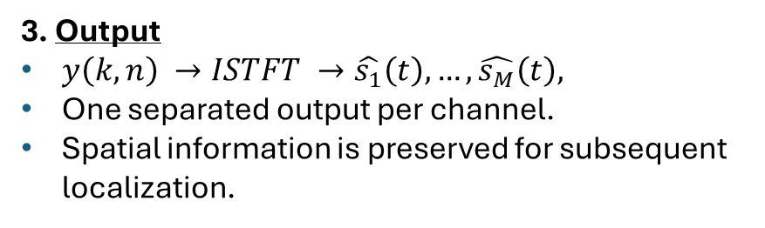
Independent Vector Analysis (IVA)
IVA is a statistical independence separation algorithm. It uses the statistical properties of the source signals bases on their spectral characteristics and their spatial relationships. It is applied to the frequency domain for multichannel mixture signals.
Input / Mixing Model
Multichannel mixture: $M=4$ channels
Time-domain mixture: $x\left(t\right)=Hs$
Transformation to time-frequence domain using STFT: $x\left(k,n\right)=[x_{1}\left(k,n\right), x_{2}\left(k,n\right), …, x_{M}{\left(k,n\right)}^{T}]$
2. IVA Principle: Frequency-Domain Separation
$y\left(k,n\right)=W\left(k\right)x\left(k,n\right)$
  $x\left(k,n\right)$: microphone observations
  $W(k)$: demixing matrix
  $y\left(k,n\right)$: separated outputs
3. Output
$y\left(k,n\right) →ISTFT →\hat{s_{1}}\left(t\right), …,\hat{s_{M}}\left(t\right),$
One separated output per channel.
Spatial information is preserved for subsequent localization.

Slide 10
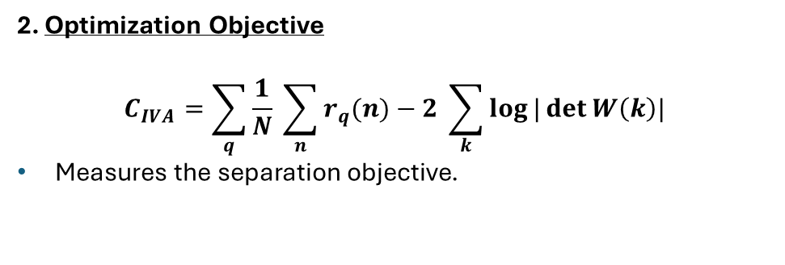
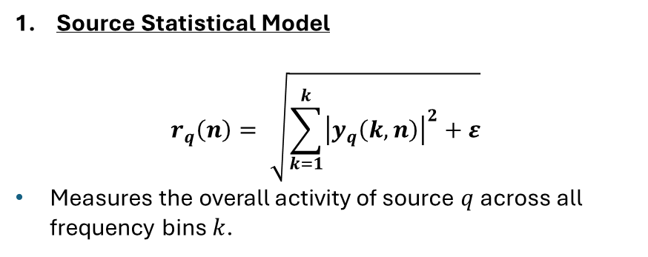
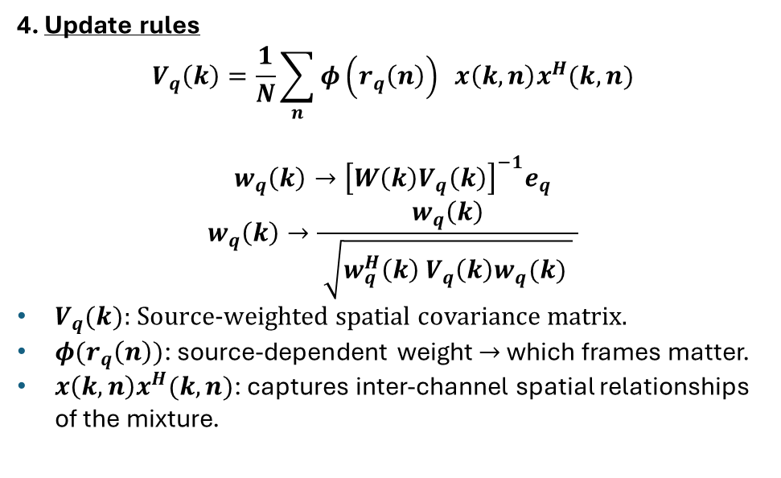
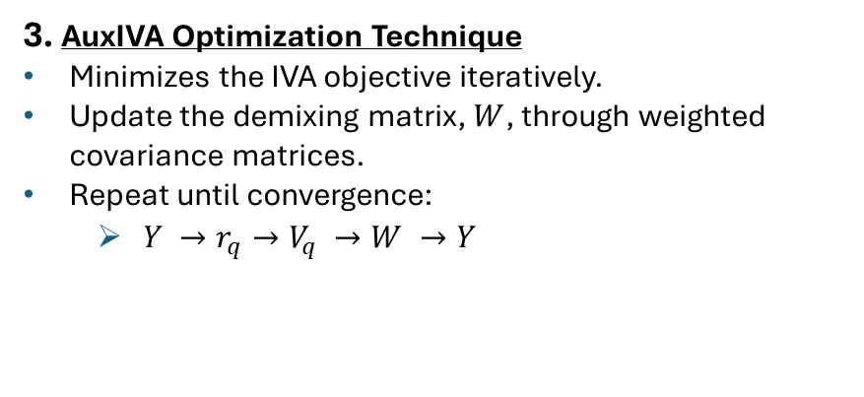
How does IVA perform the separation? – AuxIVA Optimization
Source Statistical Model
$$r_{q}\left(n\right)= \sqrt{\sum_{k=1}^{k}{{\left|y_{q}\left(k,n\right)\right|}^{2}+ε}}$$
Measures the overall activity of source $q$ across all frequency bins $k$.
2. Optimization Objective
$$C_{IVA}=\sum_{q}{\frac{1}{N} \sum_{n}{r_{q}(n)−2 \sum_{k}{\log{|\det{W\left(k\right)|}}}}}$$
Measures the separation objective.
3. AuxIVA Optimization Technique
Minimizes the IVA objective iteratively.
Update the demixing matrix, $W$, through weighted covariance matrices.
Repeat until convergence:
  $Y →r_{q}→V_{q} →W →Y$
4. Update rules
$$V_{q}\left(k\right)=\frac{1}{N}\sum_{n}{φ\left(r_{q}\left(n\right)\right) x\left(k,n\right)x^{H}(k,n)}$$
$$w_{q}\left(k\right)→{\left[W\left(k\right)V_{q}\left(k\right)\right]}^{−1}e_{q}$$
$$w_{q}\left(k\right)→\frac{w_{q}\left(k\right)}{ \sqrt{w_{q}^{H}\left(k\right) V_{q}\left(k\right)w_{q}(k) } }$$
$V_{q}(k)$: Source-weighted spatial covariance matrix.
$φ(r_{q}\left(n\right))$: source-dependent weight $→$which frames matter.
$x\left(k,n\right)x^{H}(k,n)$: captures inter-channel spatial relationships of the mixture.

Slide 11
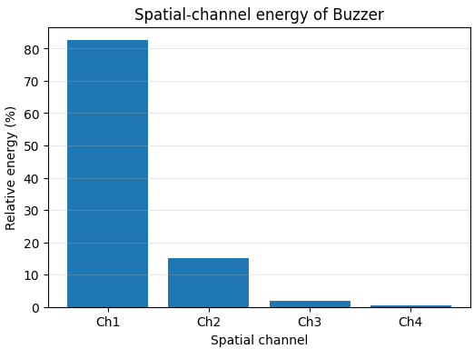
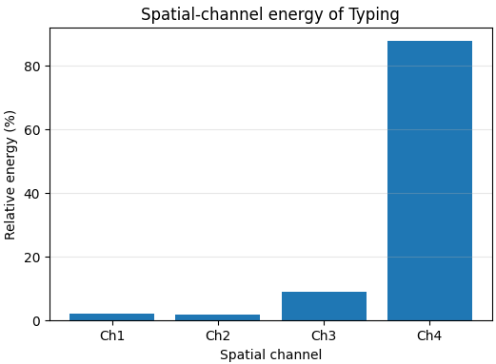
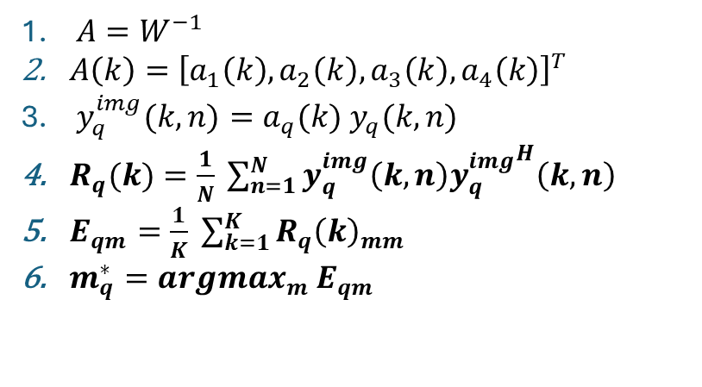


Acoustic Source Localization
Source-Specific Spatial Analysis
Reconstruction of each separated source in the spatial domain and analyze its source-specific covariance to determine how its energy is distributed across the spatial channels.
$A=W^{−1}$
$A\left(k\right)={\left[a_{1}\left(k\right), a_{2}\left(k\right), a_{3}\left(k\right), a_{4}\left(k\right)\right]}^{T}$
$y_{q}^{img}(k,n)=a_{q}(k) y_{q}(k,n)$
$R_{q}(k)=\frac{1}{N} \sum_{n=1}^{N}{y_{q}^{img}\left(k,n\right){y_{q}^{img}}^{H}\left(k,n\right)}$
$E_{qm}=\frac{1}{K} \sum_{k=1}^{K}{R_{q}{\left(k\right)}_{mm}}$
$m_{q}^{∗}=argmax_{m} E_{qm}$
$$y_{1}→Buzzer$$
$$y_{4}→Typing$$

Slide 12
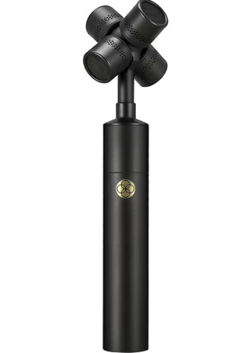
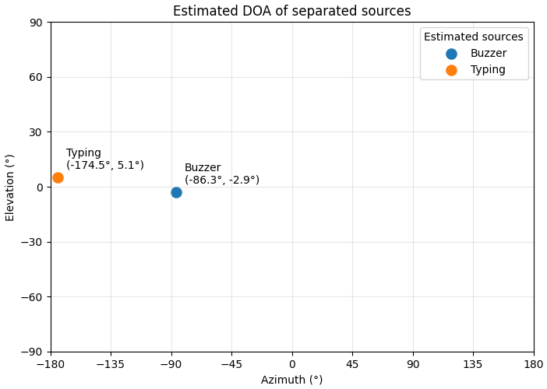
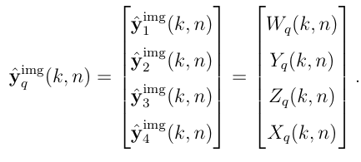
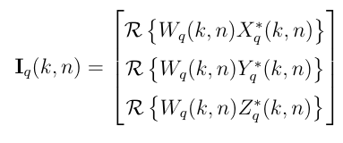


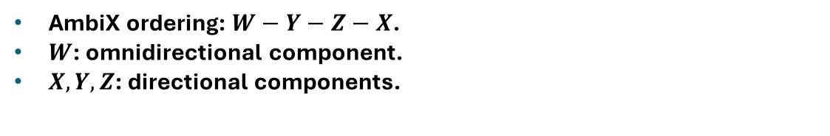
Acoustic Source Localization
Direction-of-Arrival (DOA) Estimation
Estimate the DOA for each separated acoustic event in terms of azimuth and elevation.
First-order Ambisonics (FOA) representation. Works as a spherical array.
AmbiX ordering: $W−Y−Z−X$.
$W$: omnidirectional component.
$X,Y,Z$: directional components.
and
$$DOA=azimuth θ+elevation φ=(θ_{q}, φ_{q})$$
Azimuth: horizontal direction around the array (left or right)
Elevation: vertical direction above or below the horizontal plane.

Slide 13
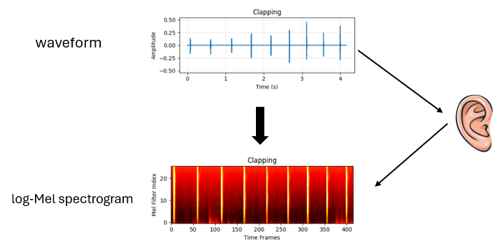
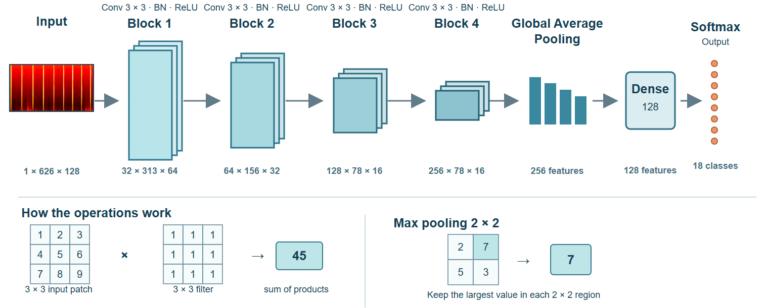
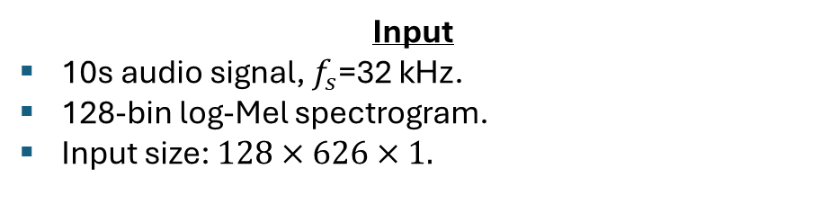

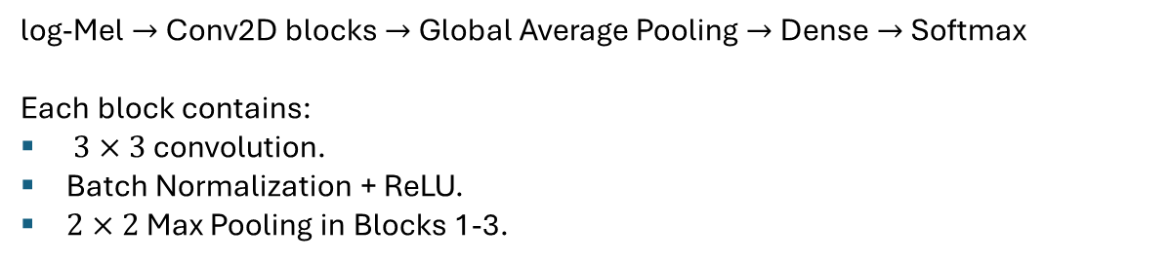
Acoustic Event Classification - CΝΝ Architecture
Input
10s audio signal, $f_{s}$=32 kHz.
128-bin log-Mel spectrogram.
Input size: $128×626×1.$
Architecture
log-Mel $→$Conv2D blocks $→$ Global Average Pooling $→$ Dense $→$ Softmax
Each block contains:
$3×3$ convolution.
Batch Normalization + ReLU.
$2×2$ Max Pooling in Blocks 1-3.
Feature maps: $32→64→128→256$
Training
Adam optimizer.
Sparse categorical cross-entropy.
Class weighting duo to the imbalance of the classes.
A maximum of 50 epochs.
Learning rate at 0.001.
Learning rate reduction: factor 0.5 after 3 epochs without validation loss improvement.
Early stopping: based on validation loss.
Output
Probability distribution over 18 acoustic-event classes.
Predicted class = highest-probability class

Slide 14
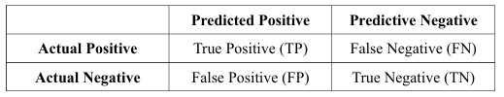
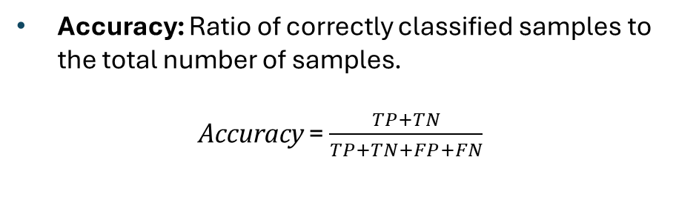
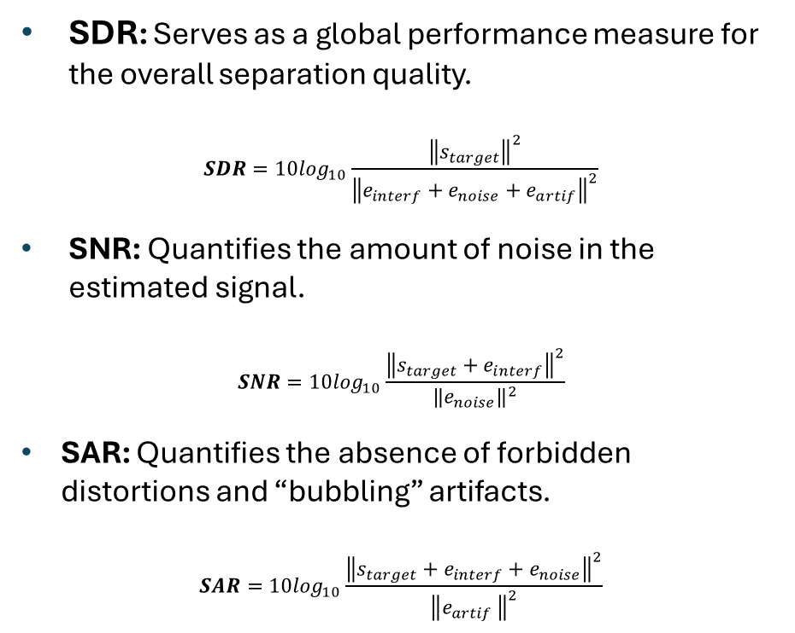
Evaluation Metrics
Separation Performance Metrics
Classification Metrics
Metrics used to evaluate the quality of separated signals with respect to the true source signals.
Metrics used to evaluate how well a classification model assigns data points to correct categories or classes.
SDR: Serves as a global performance measure for the overall separation quality.
$$SDR=10log_{10}\frac{{\left\|s_{target}\right\|}^{2}}{{\left\|e_{interf}+e_{noise}+e_{artif}\right\|}^{2}}$$
SΝR: Quantifies the amount of noise in the estimated signal.
$$SNR=10log_{10}\frac{{\left\|s_{target}+e_{interf}\right\|}^{2}}{{\left\|e_{noise}\right\|}^{2}}$$
SAR: Quantifies the absence of forbidden distortions and “bubbling” artifacts.
$$SAR=10log_{10}\frac{{\left\|s_{target}+e_{interf}+e_{noise}\right\|}^{2}}{{\left\|e_{artif }\right\|}^{2}}$$
Confusion Matrix
Accuracy: Ratio of correctly classified samples to the total number of samples.
Accuracy = $\frac{TP+TN}{TP+TN+FP+FN}$

Slide 15
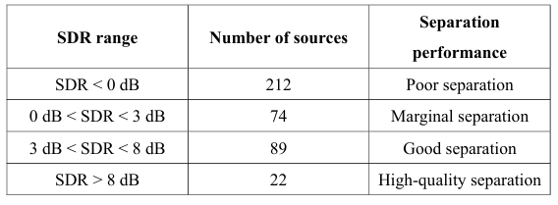
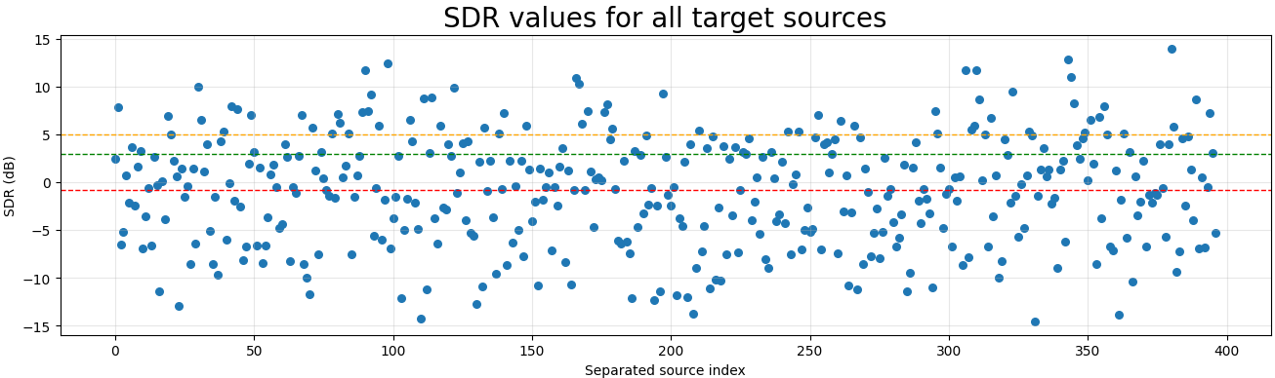
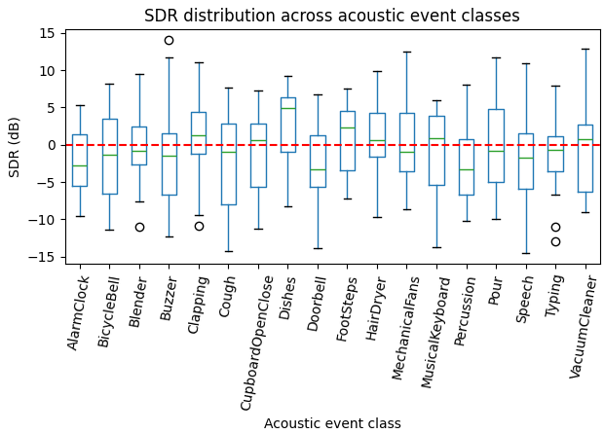
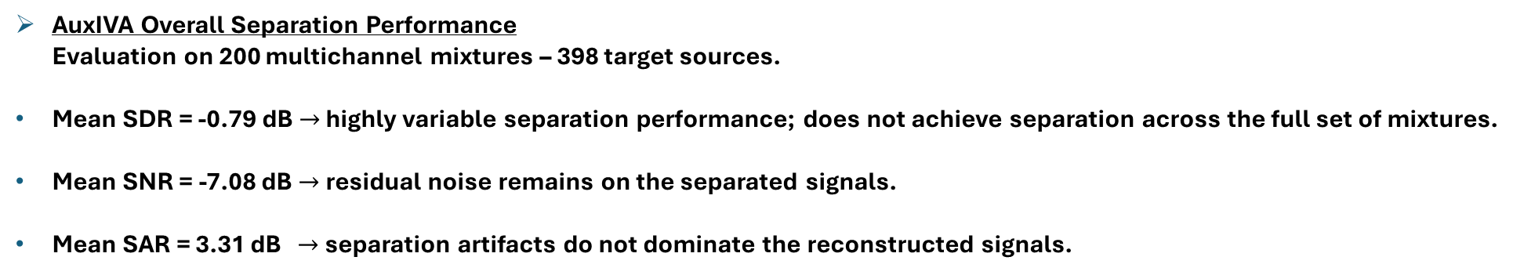
AuxIVA Separation Performance
AuxIVA Overall Separation Performance
Evaluation on 200 multichannel mixtures – 398 target sources.
Mean SDR = -0.79 dB $→$ highly variable separation performance; does not achieve separation across the full set of mixtures.
Mean SNR = -7.08 dB $→$residual noise remains on the separated signals.
Mean SAR = 3.31 dB $→$ separation artifacts do not dominate the reconstructed signals.
SDR Distribution
Large variability in SDR across individual sources.
Both highly successful and unsuccessful separations are observed.
No consistent dependence on the acoustic event class was identified.

Slide 16
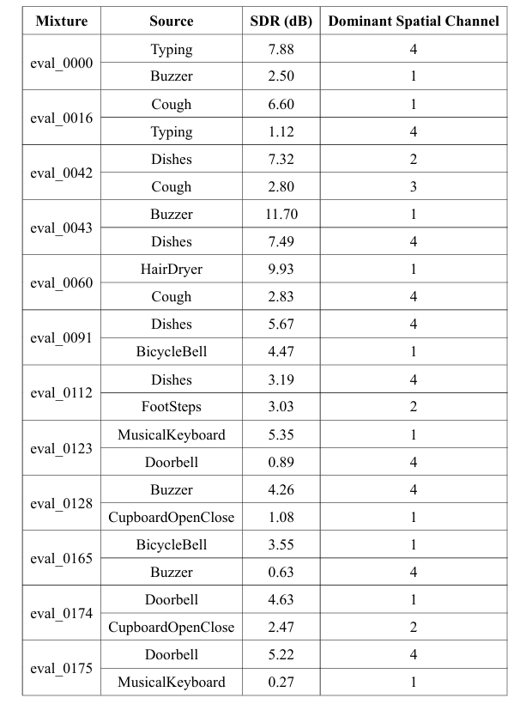
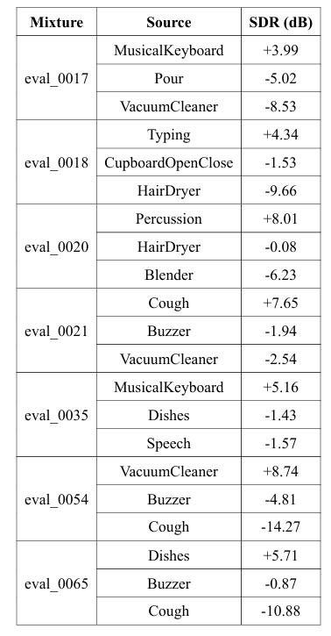
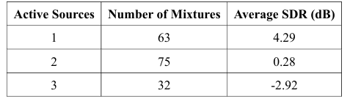
AuxIVA Separation Performance
AuxIVA Best vs. Worst Cases
Best Cases
Worst Cases
Best-performing mixtures mostly contain fewer active sources, while three-source mixtures are significantly more challenging.
Average SDR decreases as the number of active sources increases.
Spatial diversity appears beneficial, as best-performing mixtures often show different dominant microphone channels for the separated sources.
No clear dependence on acoustic event class was observed, suggesting that IVA is influenced by the mixture composition and spatial configuration.

Slide 17
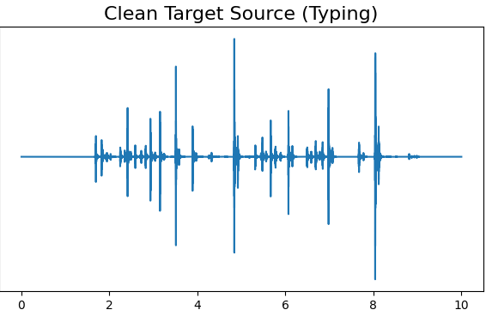
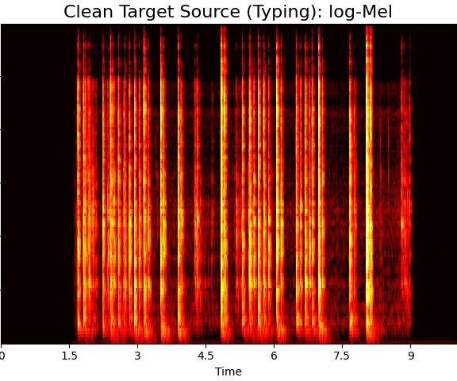
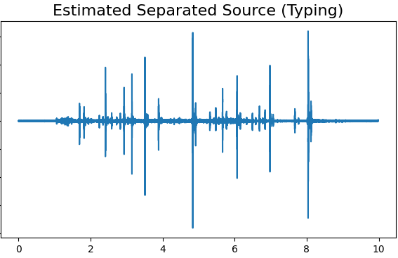
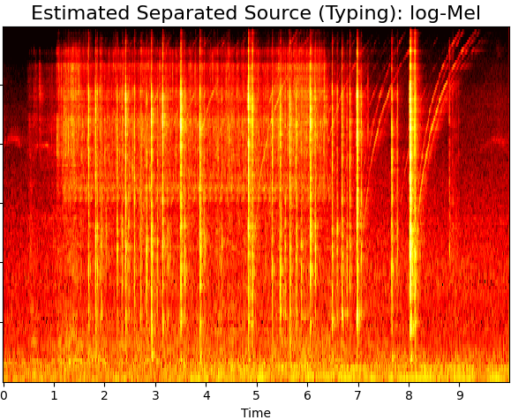
Classification Performance
Clean target sources
2136 / 3000 correctly classified
Accuracy: 71.2%
Estimated separated sources (AuxIVA)
135 / 397 correctly classified
Accuracy: 34.0%
Conclusion: Classification performance strongly depends on the quality of the BSS stage. Although the model learns how to classify clean target sources, the CNN model is strongly affected by residual interference and separation artifacts indicating a huge degradation on the classification performance of the estimated separated signals.
Clean Target Source
AuxIVA Estimated Source
Separation artifacts and residual interference substantially modify the log-Mel representation of the separated signal provided to the CNN.

Slide 18
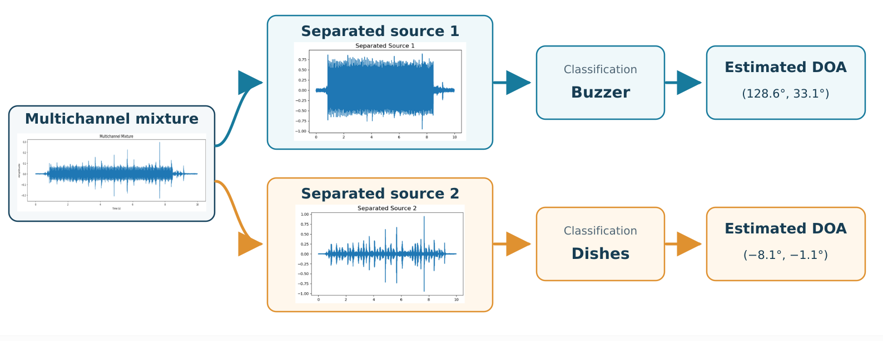
Complete Processing Pipeline in Practice

Slide 19
Conclusions
An integrated framework was developed for multichannel acoustic scene analysis, combining source separation, acoustic event classification, and source localization.
AuxIVA achieved a mean SDR of -0.79 dB across the evaluated sources, while exhibiting substantial variability in separation performance, with both highly successful and unsuccessful cases observed.
Better separation was associated with fewer simultaneously active sources and stronger spatial differentiation between them.
Separation quality strongly affected the classification performance, with the CNN achieving 71.2% accuracy on clean sources but only 34.0% accuracy on estimated separated sources.
The overall results highlight the strong interdependence of the three stages, since BSS constitutes a critical preprocessing step for classification and localization.

Slide 20
Future Work
Validation of AuxIVA on additional benchmark datasets, to assess how strongly the complexity of the acoustic scene affects separation performance.
Integration of IVA with deep-learning approaches.
Source localization evaluation using datasets with known ground truth DOAs.
Improvement of the AEC stage by training the classifier with separated/noisy signals that better match the actual test conditions.

