Slide 1
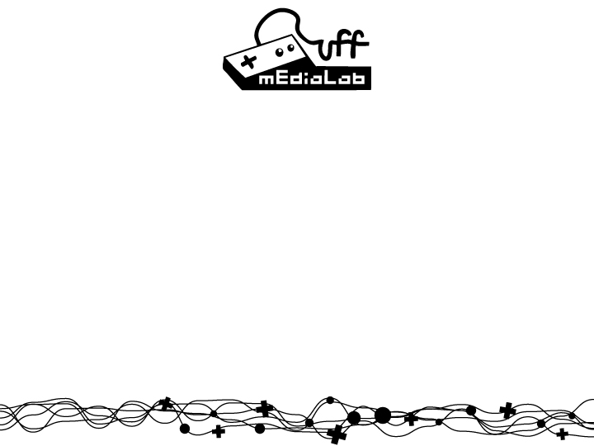


Specular Fading over Distance on Wrinkled Surfaces
Troy C Kohwalter

Slide 2
Summary
Introduction
Related Work
Bump Mapping
Normal Mapping
LEAN Mapping
Distance Fog
Specular Fading
Comparison
Conclusion

Slide 3
Introduction
Bump mapping
Blurring
Lean Mapping
Fix blurring
Shiny surface
Fog
Distance fading
Changing Alpha

Slide 4
Related Work

Slide 5
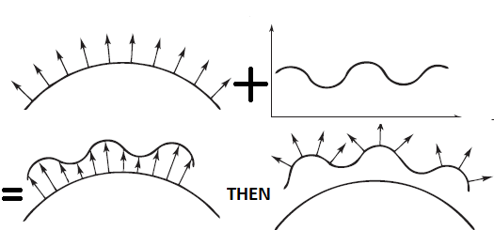
Bump Mapping
Add details on object’s surface
Use a texture to define changes in underlying surface
Simulate Wrinkled Surfaces
Smooth Surface + Wrinkle Function = Wrinkled Surface
Then change the surface normals

Slide 6
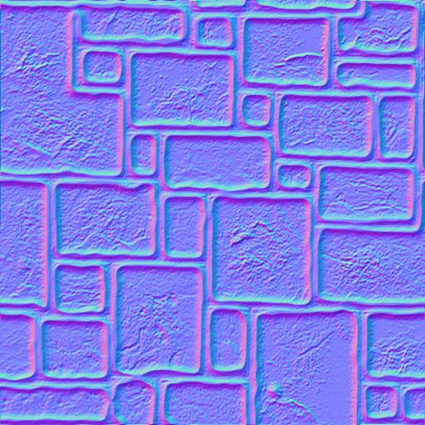
Normal Mapping
Store in a texture the new surface normals
Replace the original normal to the texture
Textured normals are on tangent space
Not limited to object space, unlike Bump Mapping
Can use a high definition model
generate normal map
use it in a lower definition model.
Each vertex normal is mapped to
a texel

Slide 7
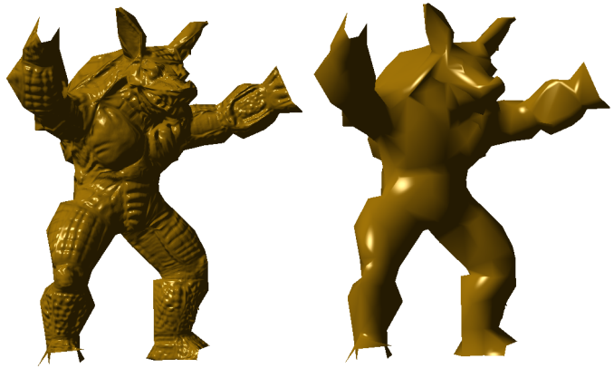
Normal Mapping
Example of normal Mapping
Used high definition mesh to generate normals
Applied the normal texture on a 975 triangles mesh
Left figure
vertex normals

Slide 8
LEAN Mapping
Used to improve Bump Mapping
Correct antialising and blurring problems
Based on Ward model
Compatible with Blinn-Phong
Real time
Requires one additional MIP texture lookup
Uses a height or normal texture

Slide 9
LEAN Mapping
Low computation overhead
Can be used for game arts
Save N, B, M in textures
Use 2 textures, since need to save 8 values

Slide 10


LEAN Mapping
Covariance
Add 1/s to M.x and M.y to make Blinn-Phong compatible
Specular Term

Slide 11
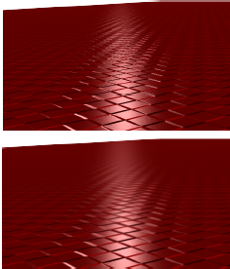
LEAN Mapping
Bump Mapping
Ordinary bump map
LEAN Mapping
Trilinear MIP filtering

Slide 12
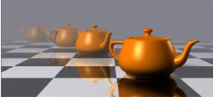
Distance Fog
Also known as Range-Based Fog
Tints screen according to pixel distance
Objects furthur away appears to fade
Simulates Light Scattering
Change alpha

Slide 13



Distance Fog
Linear fog equation:
Exponential fog equations:
start is the distance at which fog effects begin.
end is the distance at which fog effects no longer increase.
e is the base of natural logarithms (approximately 2.71828).
density is an arbitrary fog density that can range from 0.0 to 1.0.
d represents depth, or the distance from the viewpoint. For range based fog, the value for d is the distance between the camera position and a vertex. For non-range based fog, the value for d is the absolute value of the Z-coordinate in camera space.

Slide 14
Specular Fading

Slide 15
Specular Fading
Try to correct the specular highlight over distances
Bump surface
Uses LEAN mapping to avoid blurring
Changes one term in the specular computation

Slide 16
Specular Fading
Fading equation:
Similar to fog
V: View vector
Fade and maxP: Configurable parameters
Applied as below:
Ks: Material specular component
N: Normal Vector
L: Light vector
Spec: LEAN specular term
Alef: Fading term
Notes:
Alef

Slide 17
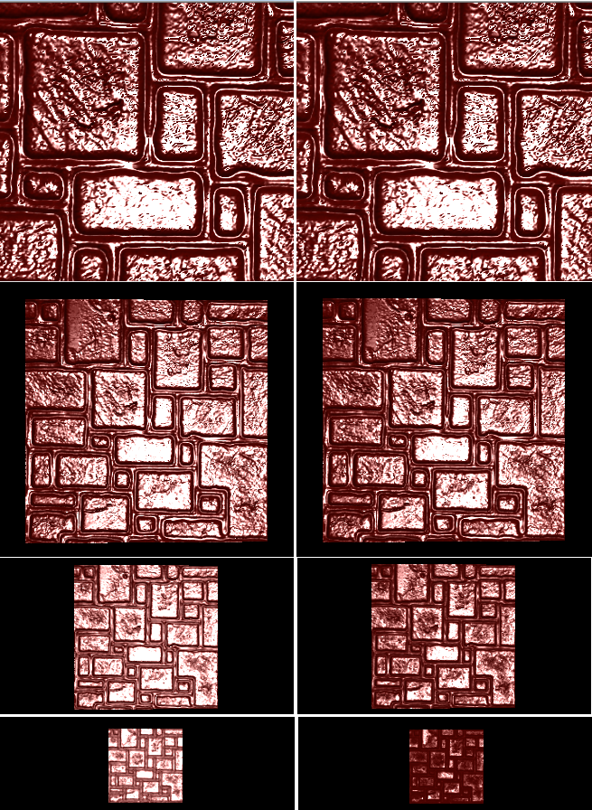
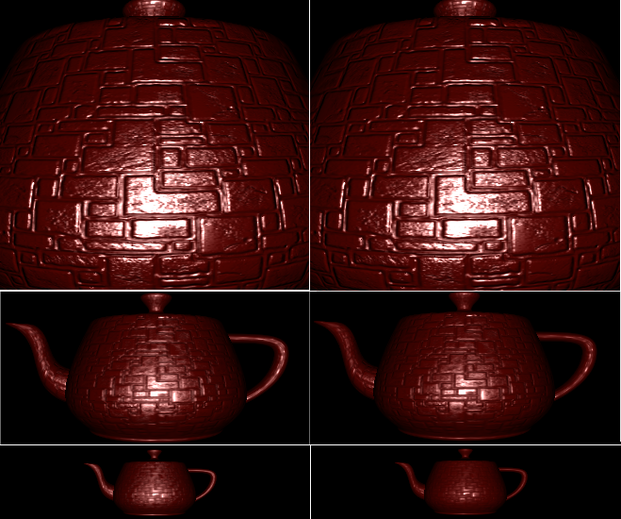
Comparison

Slide 18
Conclusion
Specular Fading
Similar to distance fog
Changes specular highlight
Don't affect alpha
Varies accordingly to distance
Uses LEAN mapping
Antialiasing
Blurring
Real time

Slide 19
Specular Fading over Distance on Wrinkled Surfaces
Troy C Kohwalter

