Slide 1
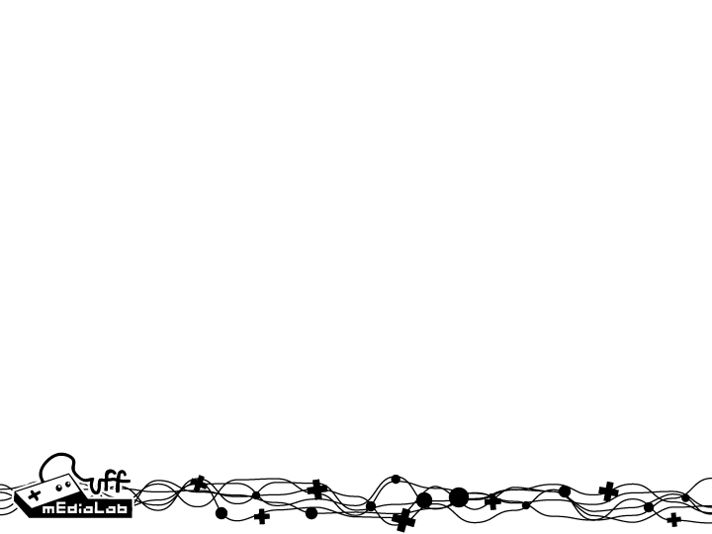
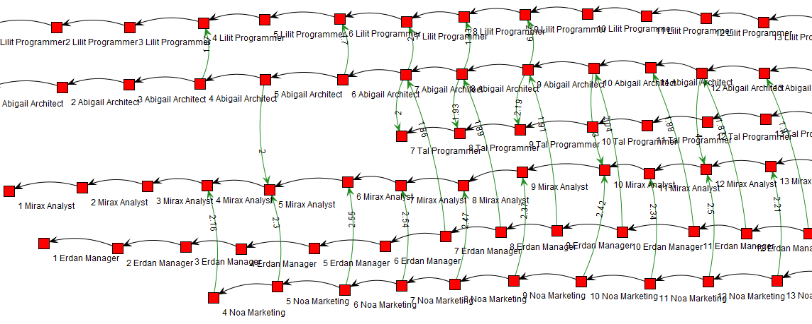
Provenance in Games
Provenance Model
Bring Provenance to Games
Analysis using Provenance techniques
Provenance Graph
Action-flow
Analyze game-flow
Identify divergence points
Influences
Understand cause-effect relations
Events, actions, decisions, outcome
Game-Provenance Model

