Slide 2
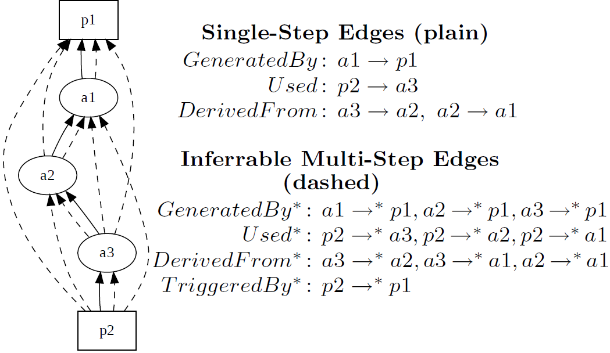
used*
wasGeneratedBy*
P₁
wasGeneratedBy
a₁
wasDerivedFrom
a₂
wasDerivedFrom
a₃
used
P₃
wasDerivedFrom*
wasTriggeredBy*
Ag
used
P₂
wasTriggeredBy
wasControlledBy

Slide 3
Milk
wasDerivedFrom
Cook
Icing
wasDerivedFrom
Butter
Flour
Used(ingredient)
wasControlledBy
Used
wasControlledBy
(mixer)
Used(ingredient)
wasGeneratedBy
(dessert)
Sugar
Used(ingredient)
Mix
wasTriggeredBy
Bake
wasTriggeredBy
Decorate
Cake
Eggs
Used(ingredient)
Used(baking)
Used
(tool)
Oven
Hand Mixer

Slide 4
wasDerivedFrom*
Milk
wasDerivedFrom
Cook
Icing
wasDerivedFrom
Butter
wasControlledBy
Flour
Used(Ingredient)
Used
wasControlledBy
(Mixer)
wasGeneratedBy*
Used(Ingredient)
wasGeneratedBy
(dessert)
Sugar
Used(Ingredient)
Mix
wasTriggeredBy
Bake
wasTriggeredBy
Decorate
Cake
Eggs
Used(Ingredient)
Oven
Used
(Baking)
Used
(tool)
Hand Mixer
wasTriggeredBy*
Used*

Slide 5
Mix
wasTriggeredBy
Bake
Mix
wasGeneratedBy
Cake batter
Used
Bake

Slide 6
Milk
wasDerivedFrom
Butter
Milk
Used
Churning
wasGeneratedBy
Butter

Slide 7
wasDerivedFrom
wasRevisionOf
Entity
wasStartedBy
wasEndedBy
Used
wasAttributedTo
wasQuotedFrom
wasGeneratedBy
wasInvalidatedBy
Agent
Activity
wasAssociatedWith
wasInformedBy
wasInfluencedBy
actedOnBehalfOf

