Slide 1
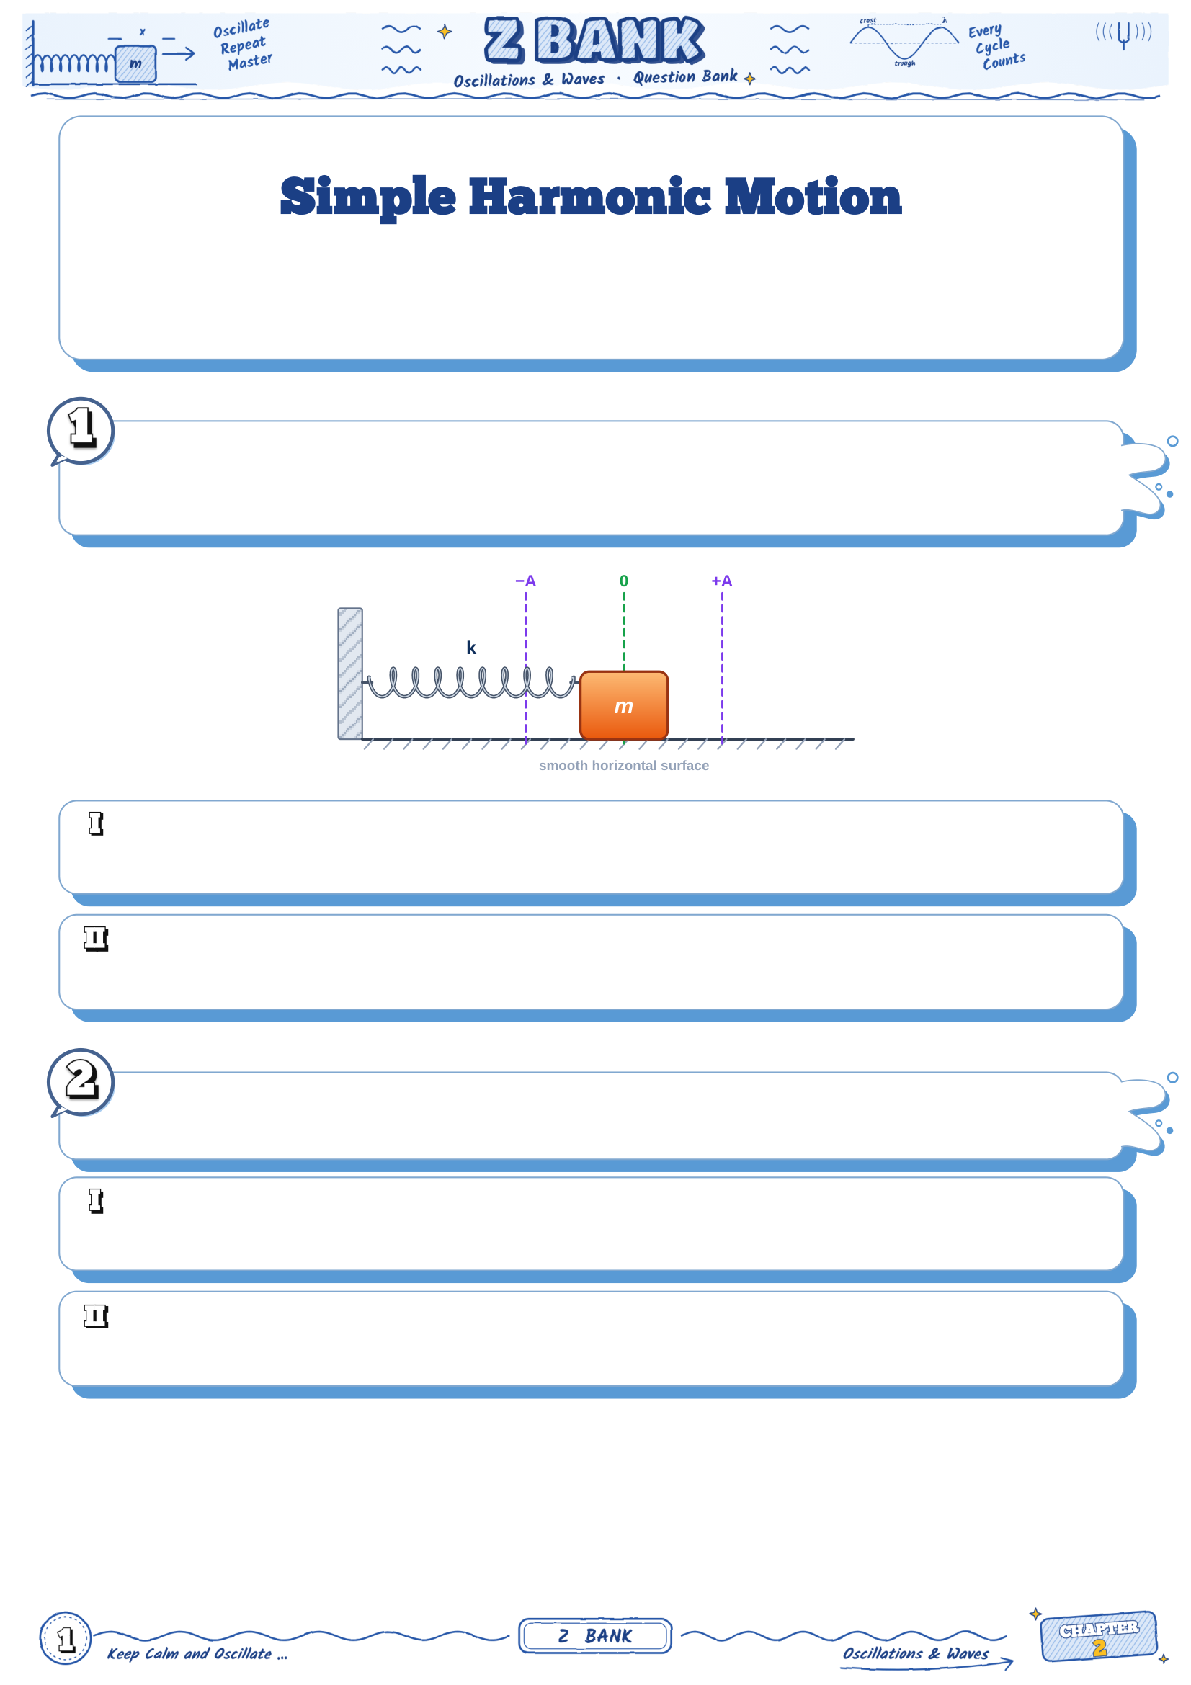
Chapter 2 · Lesson 1
The restoring force · the periodic time and the frequency · the mass–spring oscillator · x = A
sin ωt · energy in SHM
Take π = 3.14
A block of mass 0.5 kg is attached to a horizontal spring of spring constant 50 N/m on a
smooth horizontal surface. The block is pulled aside and released, so it oscillates in simple
harmonic motion:
The angular frequency of the oscillation equals ............
a) 5 rad/s
b) 100 rad/s
c) 25 rad/s
d) 10 rad/s
The periodic time of the oscillation equals ............
a) 0.628 s
b) 0.314 s
c) 1.59 s
d) 6.28 s
The displacement of a body moving in simple harmonic motion is given by the equation x =
0.05 sin (20 t), where x is in metres and t in seconds:
The amplitude of the motion equals ............
a) 20 m
b) 0.05 m
c) 0.1 m
d) 1 m
The frequency of the motion equals ............
a) 20 Hz
b) 0.314 Hz
c) 3.18 Hz
d) 126 Hz

Slide 2
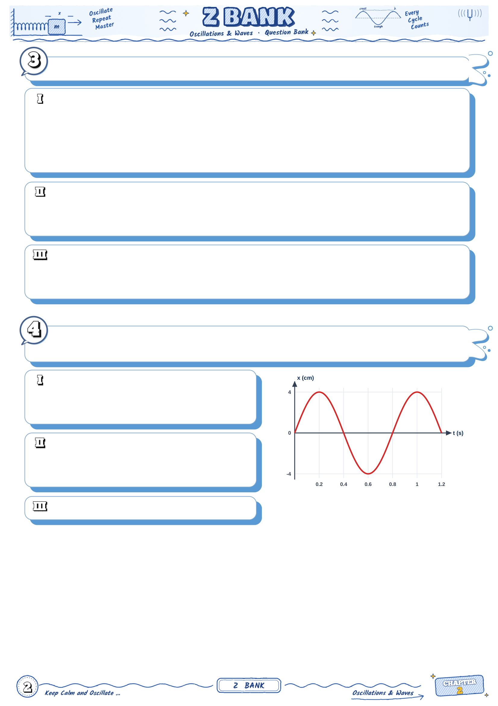
Choose the correct answer:
In simple harmonic motion, the restoring force is always ............
a) in the direction of motion
b) directed towards the equilibrium position and proportional to the displacement
c) constant in magnitude
d) proportional to the velocity
The speed of the body is maximum at ............
a) the equilibrium position
b) the two extreme positions
c) halfway between them
d) every point equally
The acceleration of the body is maximum at ............
a) the equilibrium position
b) halfway to the extremes
c) the two extreme positions
d) no point
The graph shows how the displacement of a body in simple harmonic motion changes with
time:
The amplitude of the motion is ............
a) 8 cm
b) 4 cm
c) 2 cm
d) 0.8 cm
The frequency of the motion is ............
a) 0.8 Hz
b) 2.5 Hz
c) 1.25 Hz
d) 7.85 Hz
Calculate the angular frequency.

Slide 3
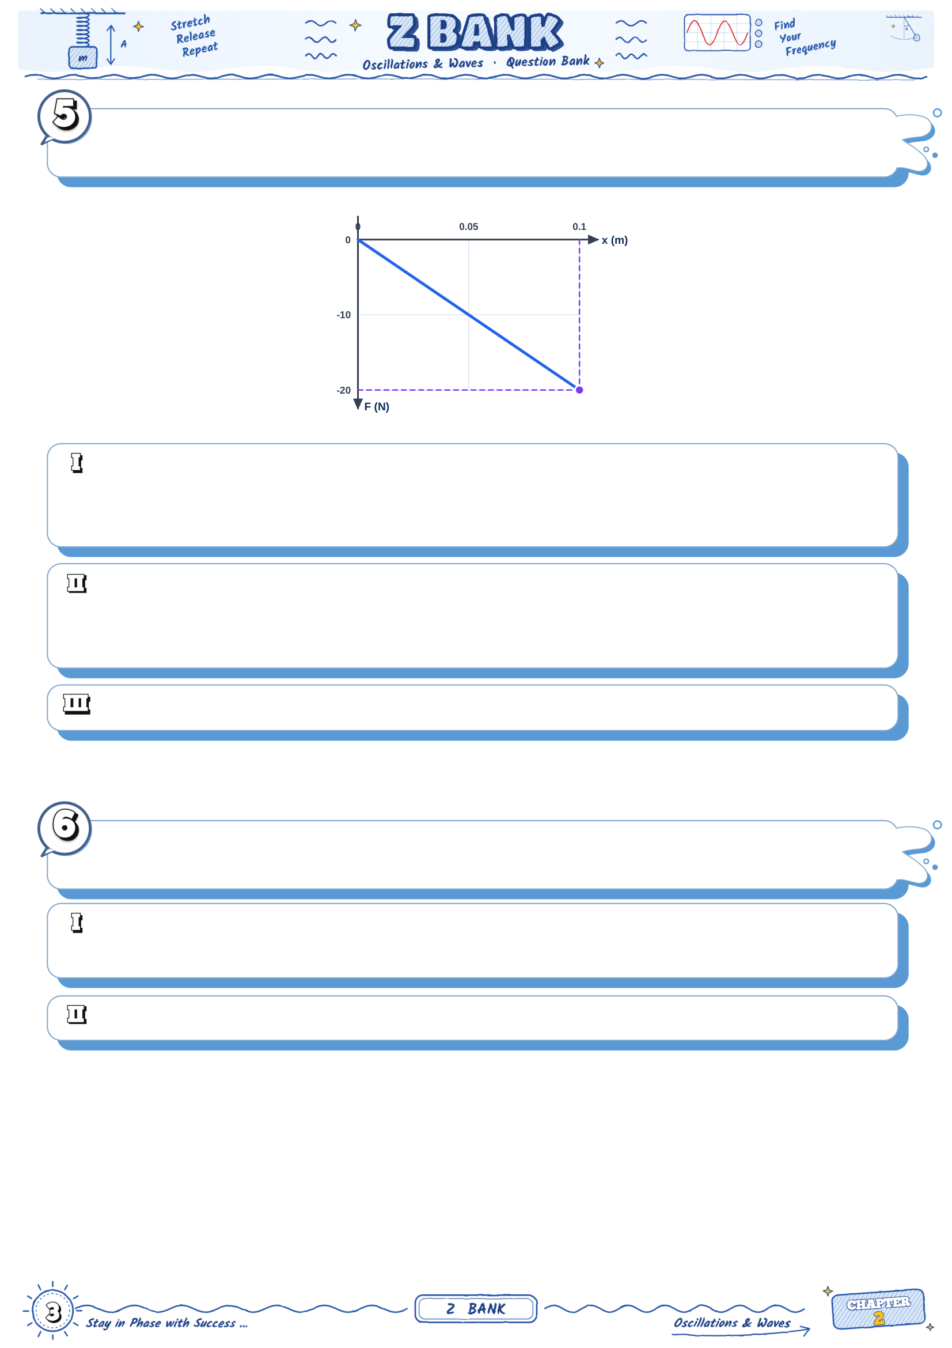
The graph shows the restoring force F acting on a body attached to a spring against its
displacement x from the equilibrium position:
The spring constant equals ............
a) 2 N/m
b) 20 N/m
c) 200 N/m
d) 2000 N/m
If the mass of the body is 2 kg, its periodic time is ............
a) 0.628 s
b) 0.314 s
c) 6.28 s
d) 0.1 s
What does the negative slope of the line mean?
A body in simple harmonic motion has a maximum speed of 2 m/s and a maximum
acceleration of 40 m/s²:
Its angular frequency equals ............
a) 80 rad/s
b) 20 rad/s
c) 0.05 rad/s
d) 40 rad/s
Find the amplitude and the periodic time.

Slide 4

Two identical bodies, each of mass m, oscillate horizontally on two springs: spring A of
constant k and spring B of constant 4k, as shown:
The ratio of the periodic times T_{A} / T_{B} equals ............
a) 4
b) 1/2
c) 1/4
d) 2
What mass must be fixed to spring B so that its periodic time equals that of A?
A body of mass 0.2 kg oscillates on a horizontal spring of constant 80 N/m with an
amplitude of 10 cm:
The total mechanical energy of the oscillator is ............
a) 0.8 J
b) 0.4 J
c) 4 J
d) 0.04 J
Calculate the maximum speed of the body.
Calculate its speed when the displacement is 5 cm.

Slide 5
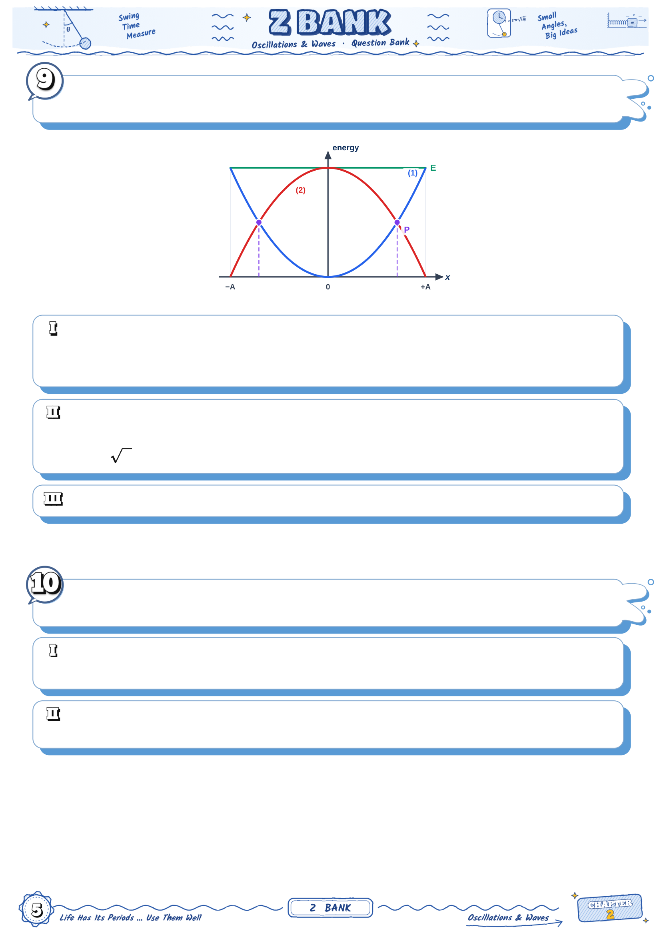
The graph shows two energy curves (1) and (2) of a body in simple harmonic motion
against its displacement x, together with the total energy E:
The curve that represents the kinetic energy is ............
a) curve (1)
b) none of them
c) the line E
d) curve (2)
At point P the kinetic and potential energies are equal. Its displacement is ............
a) A / 2
b) A / 4
c) A / 2
d) A
Find the ratio KE : PE when x = A/2.
A body oscillates in simple harmonic motion with a periodic time of 1.2 s, starting from the
equilibrium position (x = A sin ωt):
The shortest time taken to move from x = 0 to x = A/2 is ............
a) 0.3 s
b) 0.15 s
c) 0.1 s
d) 0.2 s
Find the time taken to move from x = A/2 to x = A, and explain why it is longer than the
first half.

Slide 6
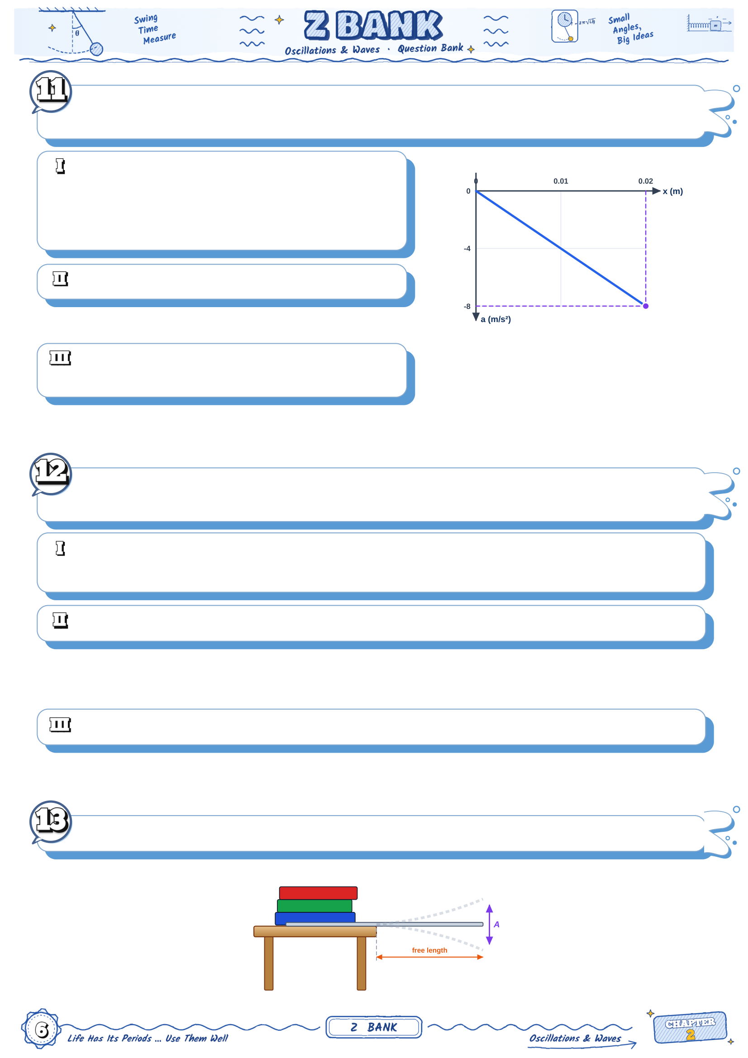
The graph shows the acceleration a of a body in simple harmonic motion against its
displacement x:
The angular frequency of the motion is
............
a) 400 rad/s
b) 4 rad/s
c) 0.05 rad/s
d) 20 rad/s
Calculate the periodic time.
What property of simple harmonic motion
does this graph show?
The displacement of a body in simple harmonic motion is x = 0.1 sin (5π t), where x is in
metres and t in seconds:
The displacement of the body at t = 0.1 s is ............
a) zero
b) 0.05 m
c) 0.1 m
d) −0.1 m
Find the velocity and the acceleration of the body at that instant.
Find the periodic time.
A steel ruler is clamped at the edge of a table and its free end is set vibrating, as shown:

Slide 7
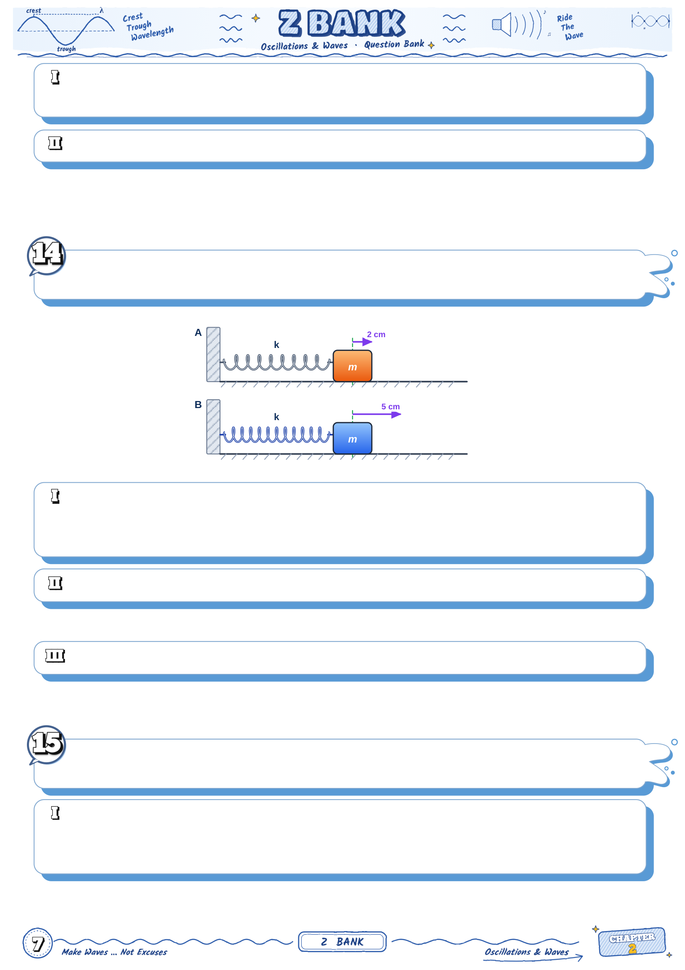
As the amplitude of the vibration slowly decreases, the periodic time ............
a) increases
b) decreases
c) remains constant
d) becomes zero
If the free length of the ruler is made shorter, what happens to the frequency? Explain.
Two identical bodies on two identical springs are displaced from equilibrium by 2 cm (A)
and 5 cm (B) and released at the same moment, as shown:
The body that reaches the equilibrium position first is ............
a) A
b) B
c) both at the same time
d) it cannot be known
Find the ratio of their maximum speeds v_{A} : v_{B}.
Find the ratio of their total energies E_{A} : E_{B}.
The amplitude of a mass–spring oscillator is doubled, the mass and the spring being
unchanged:
Which of the following is correct?
a) the periodic time is doubled
b) the maximum speed is doubled
c) the total energy is doubled
d) the maximum acceleration is quadrupled

Slide 8
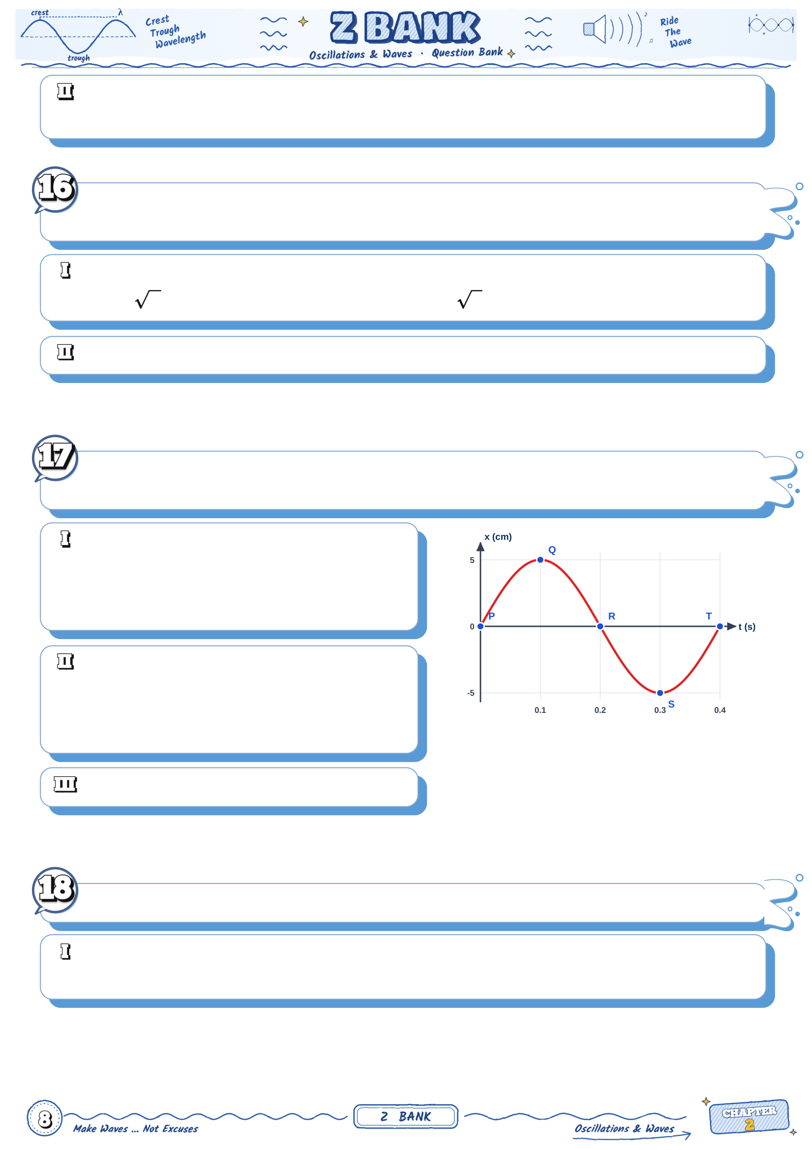
The total energy becomes ............
a) 2 times
b) the same
c) 4 times
d) half
The spring of a mass–spring oscillator is replaced by one 4 times stiffer, and the mass is
doubled:
The new periodic time T′ in terms of the old one T is ............
a) T / 2
b) T / 2
c) T 2
d) 2T
How does the frequency change?
The graph shows the displacement of a body in simple harmonic motion against time. P, Q,
R, S and T are five points on the curve:
The speed of the body is maximum at
............
a) P, R and T
b) Q and S
c) Q only
d) S only
The acceleration is maximum and positive
at ............
a) Q
b) P
c) R
d) S
At which points is the restoring force zero?
A body oscillates with an amplitude of 10 cm and an angular frequency of 10 rad/s:
Its speed when its displacement is 6 cm equals ............
a) 1 m/s
b) 0.6 m/s
c) 0.8 m/s
d) 0.36 m/s

Slide 9
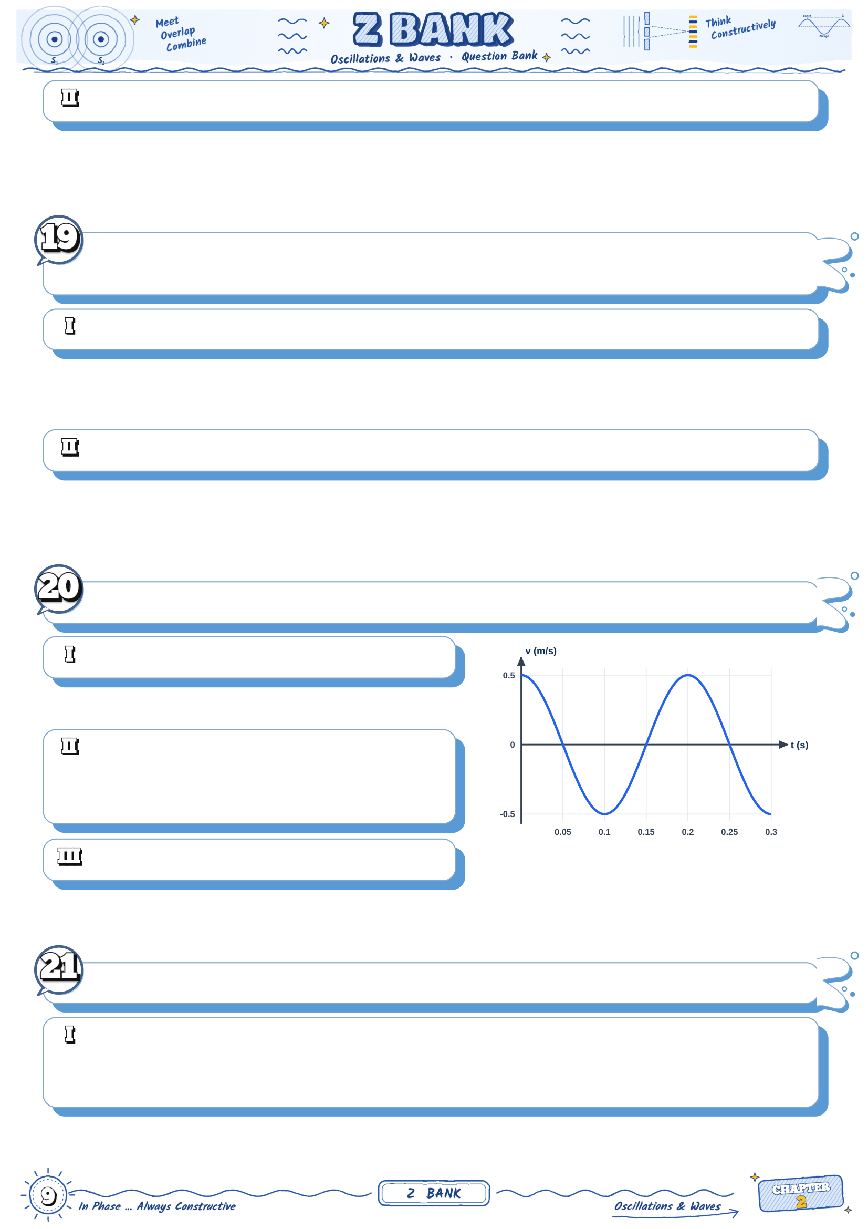
At what displacement is its speed half the maximum speed?
The speed of a body in simple harmonic motion is 0.8 m/s when its displacement is 6 cm,
and 0.6 m/s when its displacement is 8 cm:
Find the angular frequency of the motion.
Find the amplitude.
The graph shows how the velocity of a body in simple harmonic motion changes with time:
Find the angular frequency.
The amplitude of the motion is ............
a) 1.59 cm
b) 15.7 cm
c) 0.1 cm
d) 3.14 cm
Where is the body at t = 0?
Choose the correct answer:
When the displacement of a body in simple harmonic motion is A/3, the ratio KE : PE
equals ............
a) 3
b) 8
c) 9
d) 1/8

Slide 10
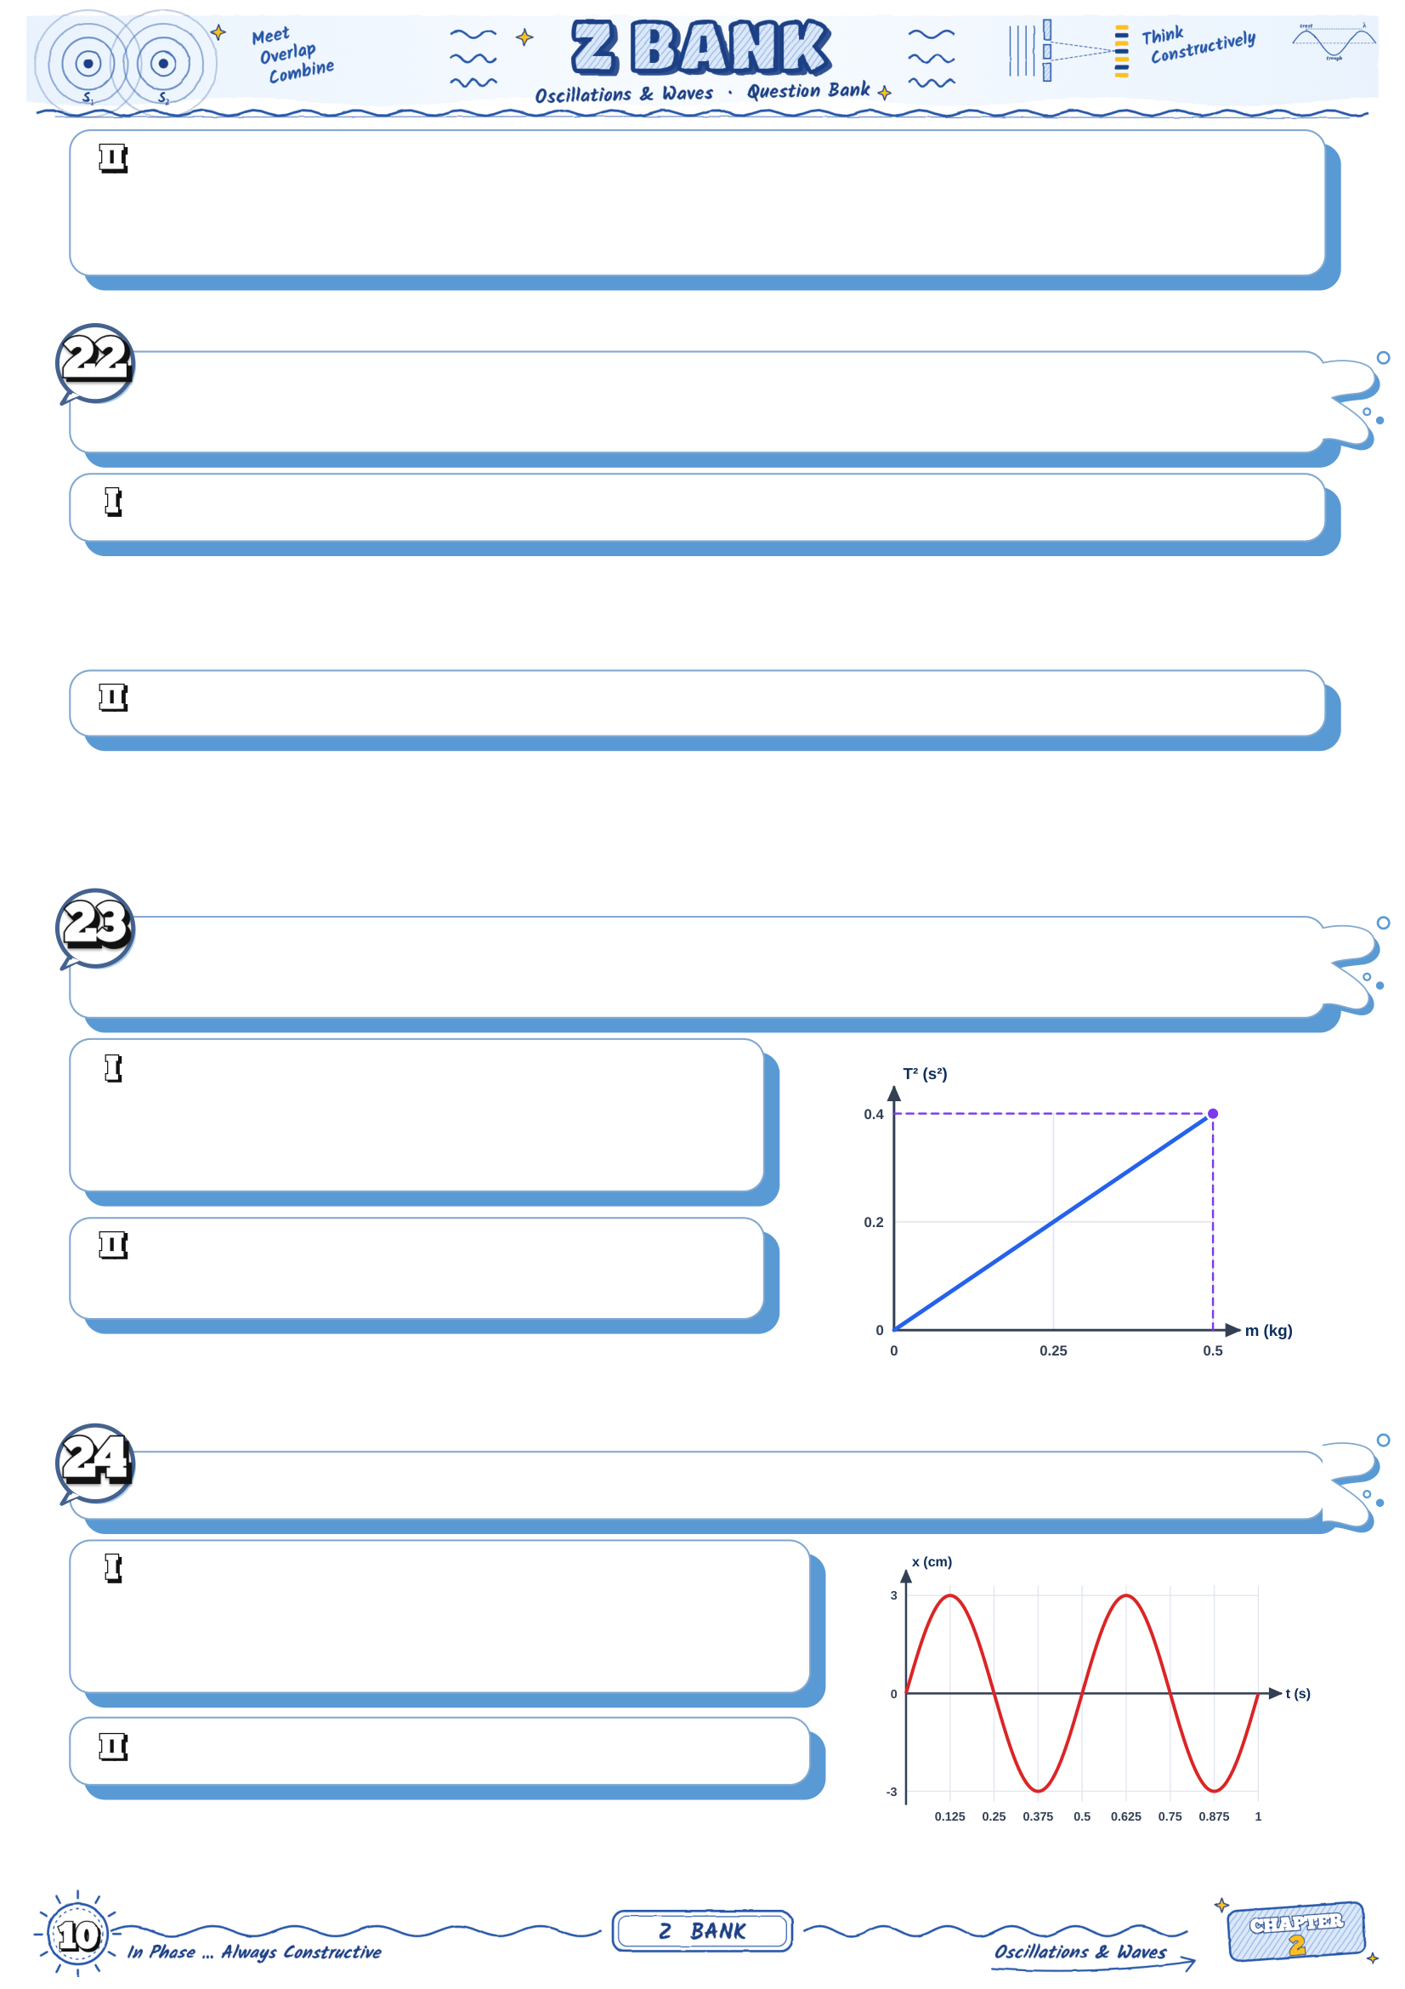
A body of mass 0.5 kg oscillates with an amplitude of 4 cm and a frequency of 5 Hz. The
maximum restoring force on it is ............
a) 19.7 N
b) 9.86 N
c) 39.4 N
d) 0.63 N
A student finds that a body of unknown mass m₁ on a spring oscillates with a periodic
time of 0.5 s. When a mass of 0.3 kg is added, the periodic time becomes 0.7 s:
Find the mass m₁.
Find the spring constant.
The graph shows the square of the periodic time T² of a mass–spring oscillator against
the mass m:
The spring constant equals ............
a) 49.3 N/m
b) 0.8 N/m
c) 24.6 N/m
d) 98.6 N/m
Find the periodic time when a mass of 0.8 kg
is used.
The graph shows the displacement–time curve of a body in simple harmonic motion:
The angular frequency of the motion is ............
a) 6.28 rad/s
b) 3.14 rad/s
c) 12.56 rad/s
d) 2 rad/s
Write the equation of the displacement in metres.

Slide 11
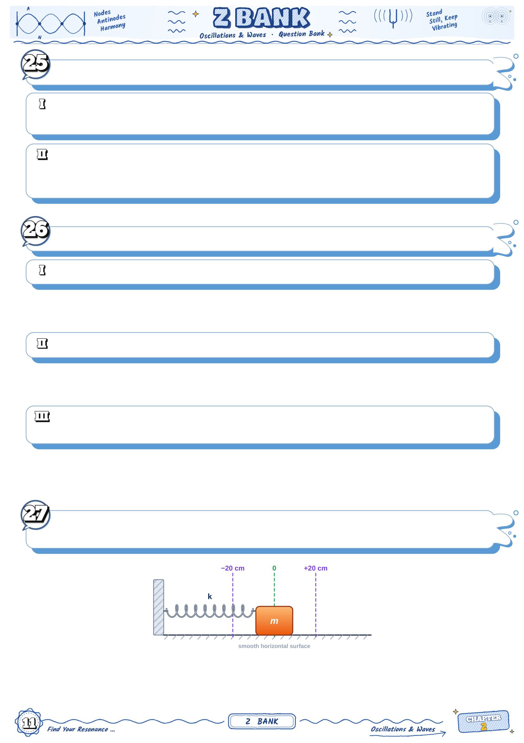
A body starts its simple harmonic motion from the equilibrium position (x = A sin ωt):
At t = T/8 the ratio KE : PE equals ............
a) 1 : 1
b) 1 : 3
c) 3 : 1
d) 1 : 2
A body oscillates with an amplitude of 2.5 cm and a maximum acceleration of 10 m/s². Its
frequency is ............
a) 3.18 Hz
b) 20 Hz
c) 0.314 Hz
d) 400 Hz
Give the scientific reason for each of the following:
The periodic time of a mass–spring oscillator does not depend on the amplitude.
The speed of the oscillating body is maximum at the equilibrium position.
A horizontal mass–spring oscillator has the same periodic time on the Moon as on the
Earth.
A body of mass 1 kg oscillates on a horizontal spring of constant 100 N/m with an
amplitude of 20 cm:

Slide 12

Its speed at a displacement of 12 cm equals ............
a) 2 m/s
b) 1.6 m/s
c) 1.2 m/s
d) 0.8 m/s
Find the kinetic and potential energies at that point, and check that their sum is constant.
The displacement of a body is x = 6 sin (π t), where x is in cm and t in seconds:
The first moment at which x = 3 cm is ............
a) 0.5 s
b) 1/12 s
c) 1/3 s
d) 1/6 s
Find the speed of the body at that moment.
A body in simple harmonic motion has an acceleration of magnitude 8 m/s² when its
displacement is 2 cm:
Its angular frequency equals ............
a) 400 rad/s
b) 4 rad/s
c) 2 rad/s
d) 20 rad/s
At what displacement is the magnitude of its acceleration 12 m/s²?
Find the periodic time.
Two bodies, each of mass 1 kg, oscillate on two springs of constants k₁ = 100 N/m and k₂
= 400 N/m, both with the same amplitude of 5 cm:
The ratio of their frequencies f₁ / f₂ equals ............
a) 2
b) 4
c) 1/4
d) 1/2

Slide 13

Find the ratio of their total energies E₁ / E₂.
Find the ratio of their maximum speeds.
A body oscillates in simple harmonic motion with an amplitude of 10 cm and a periodic
time of 2.4 s:
The shortest time the body takes to move directly from x = +5 cm to x = −5 cm is ............
a) 0.2 s
b) 0.8 s
c) 0.4 s
d) 1.2 s
Find the average speed of the body during this interval, and compare it with its maximum
speed.
During one complete oscillation, for how long is the body more than 5 cm away from the
equilibrium position?
When the displacement of a body in simple harmonic motion is 3 cm, the magnitude of its
acceleration is 12 m/s² and its speed is 0.8 m/s:
The angular frequency of the motion is ............
a) 400 rad/s
b) 20 rad/s
c) 4 rad/s
d) 26.7 rad/s
Find the amplitude and the maximum speed.

Slide 14
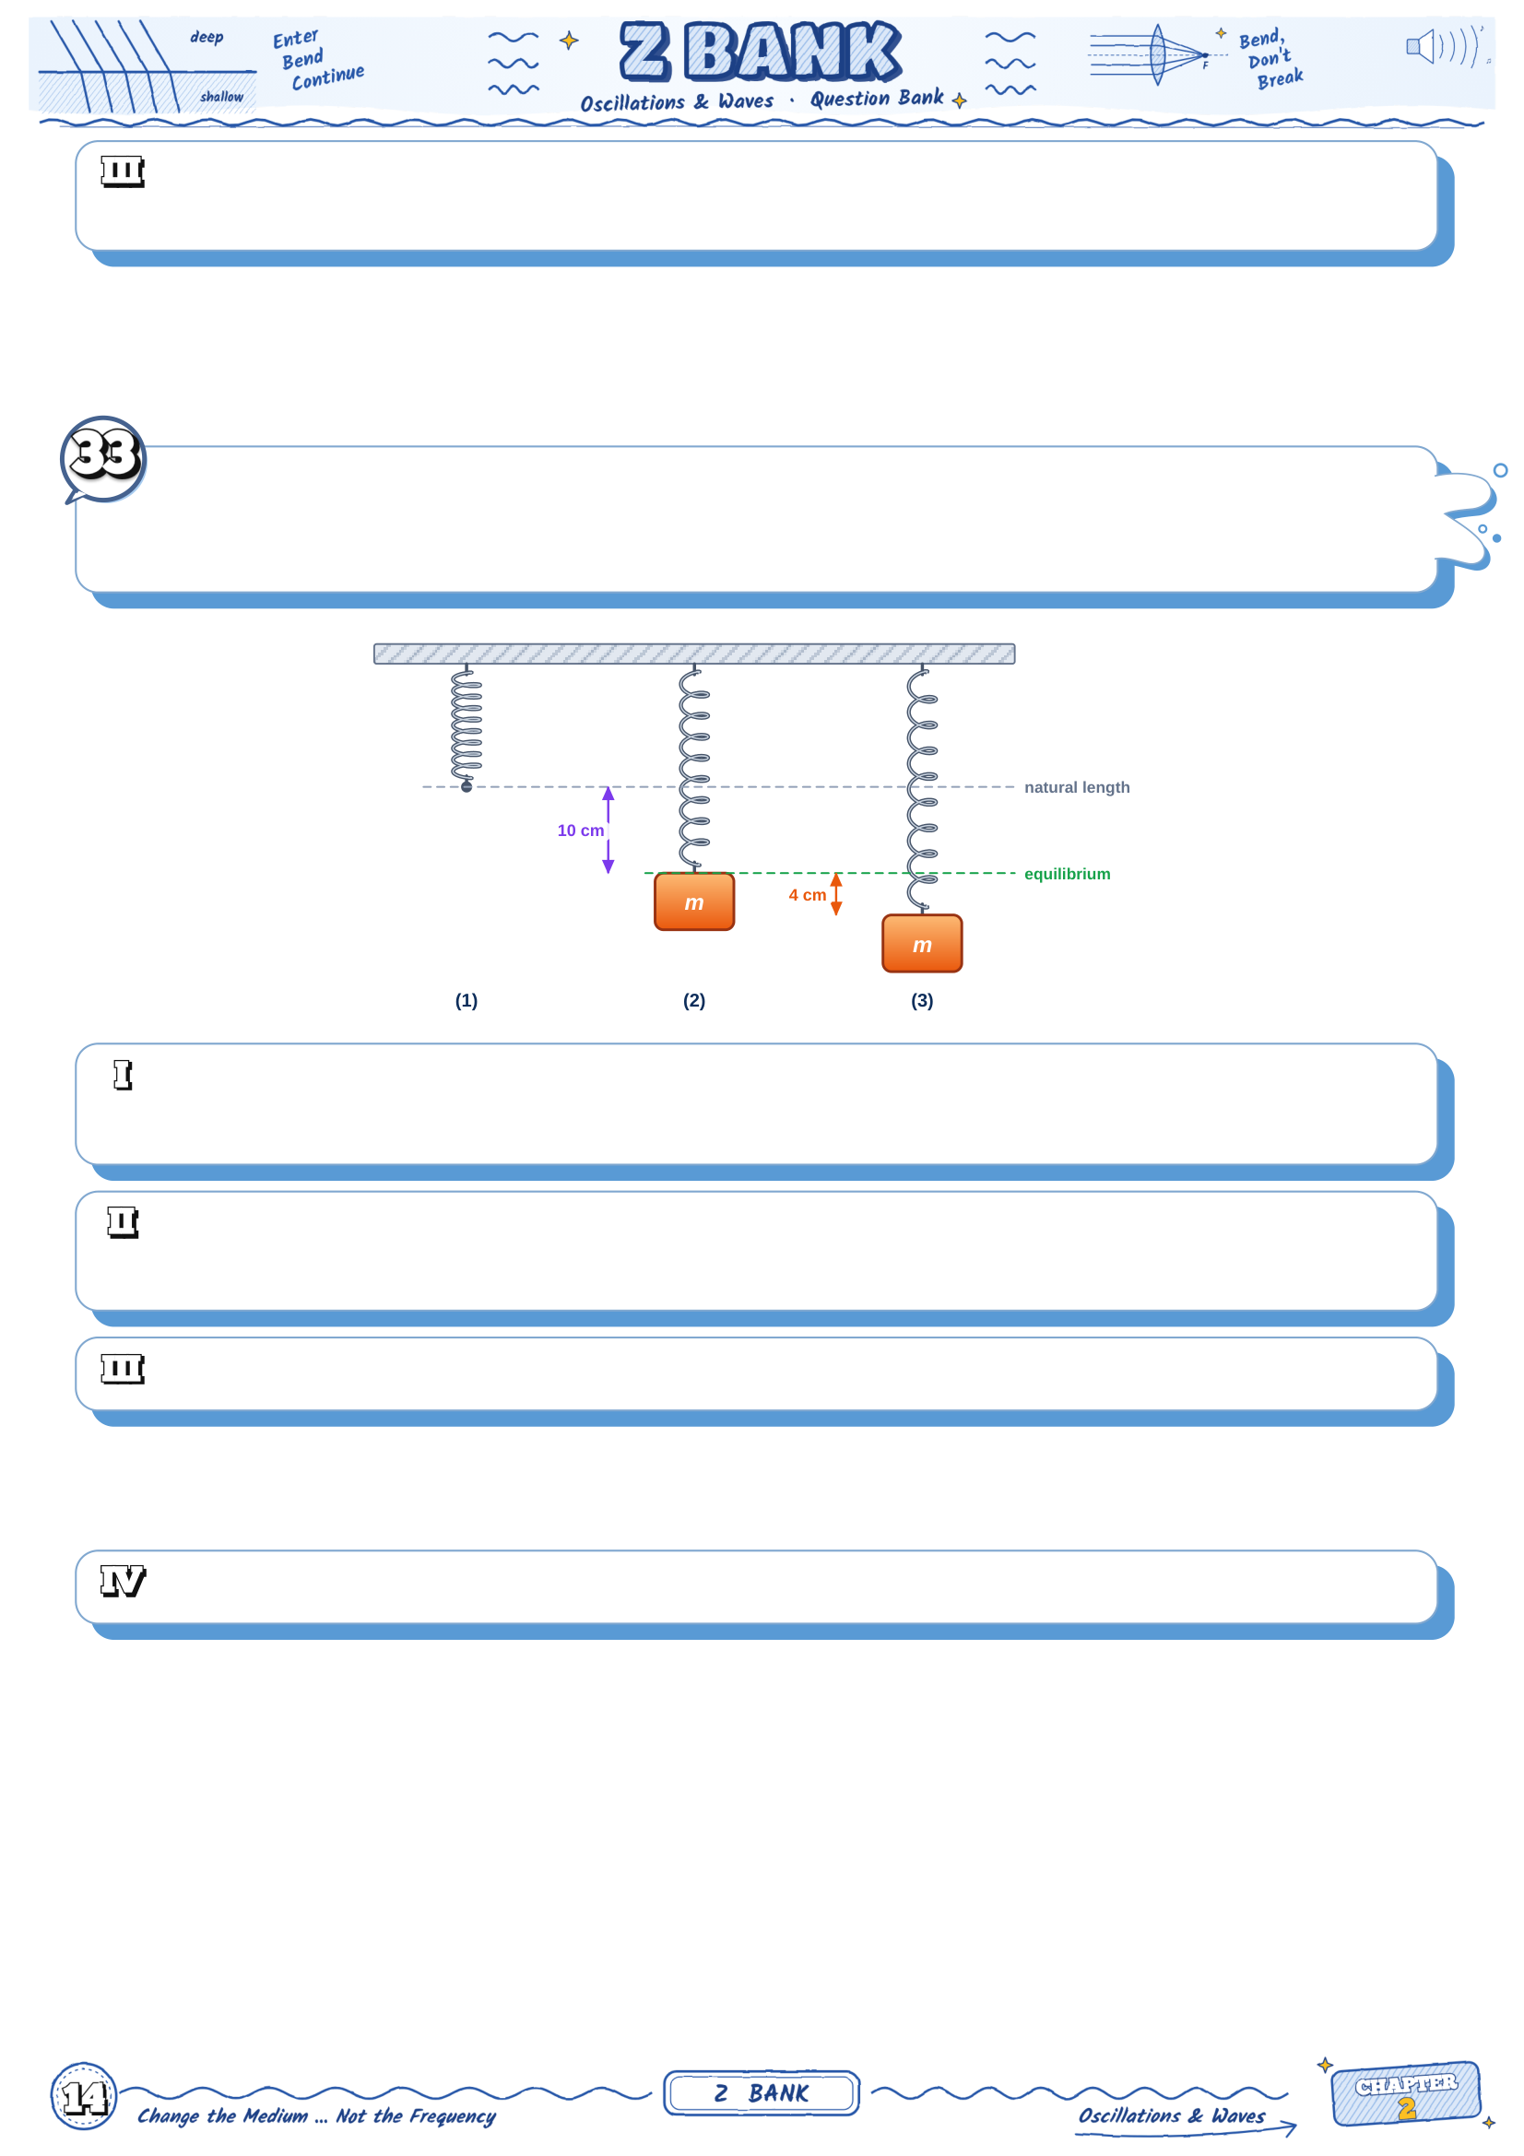
The body is moving away from the equilibrium position. How long does it take to reach the
extreme position?
A light spring hangs vertically. When a body of mass 0.4 kg is hung from it, the spring
stretches 10 cm and the body rests at its equilibrium position. The body is then pulled 4
cm further down and released (g = 10 m/s²):
The spring constant equals ............
a) 4 N/m
b) 400 N/m
c) 0.04 N/m
d) 40 N/m
The periodic time of the oscillation equals ............
a) 0.628 s
b) 0.2 s
c) 6.28 s
d) 0.0628 s
Find the greatest and the smallest tension in the spring during the motion.
What is the largest amplitude for which the spring is never compressed during the motion?

Slide 15
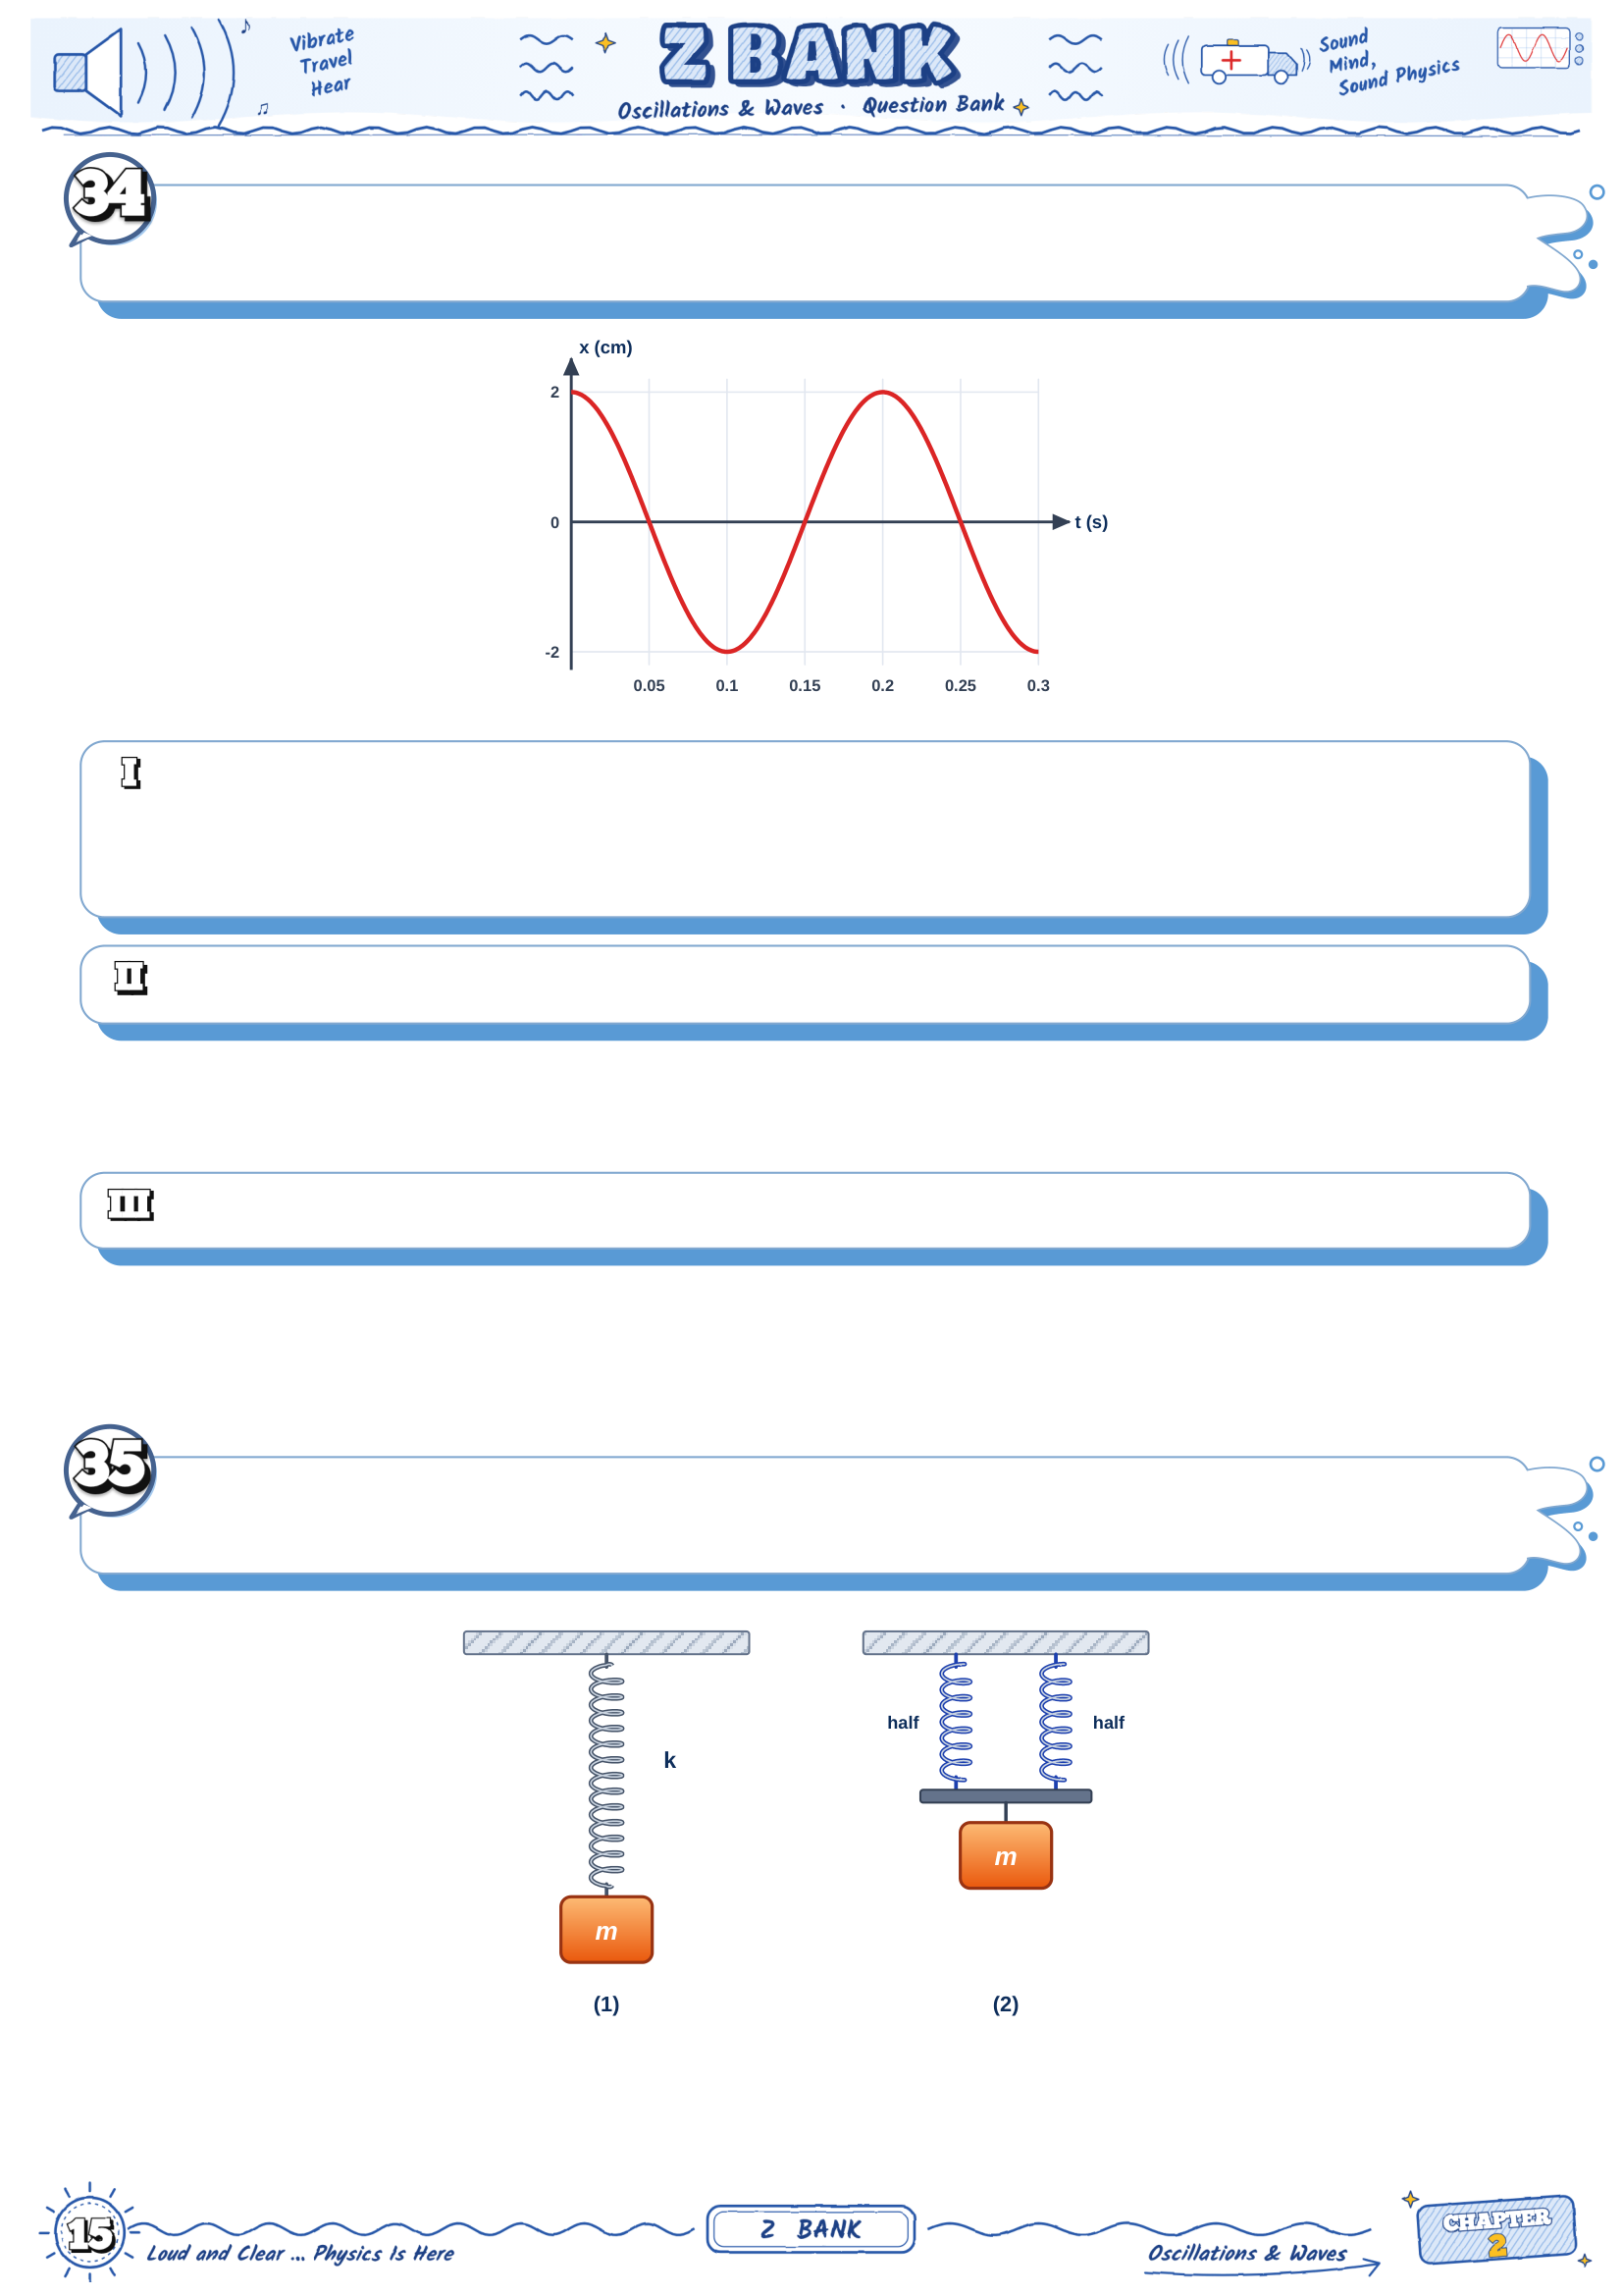
The graph shows the displacement of a body of mass 0.5 kg attached to a horizontal
spring against time:
The spring constant equals ............
a) 157 N/m
b) 98.6 N/m
c) 493 N/m
d) 4930 N/m
Find the speed of the body when its displacement is 1 cm.
Find the first moment after t = 0 at which the kinetic energy equals the potential energy.
A body hung from a spring oscillates vertically with a periodic time of 0.8 s. The spring is
then cut into two equal halves, as shown:

Slide 16

The spring constant of each half is ............
a) k / 2
b) 2k
c) k
d) 4k
If the body is hung from one half only, its periodic time becomes ............
a) 0.566 s
b) 0.4 s
c) 1.13 s
d) 0.8 s
The body is hung from the two halves side by side, as in figure (2). Find its periodic time.
A block of mass 0.5 kg on a smooth horizontal surface oscillates on a spring of constant
50 N/m with an amplitude of 8 cm. At the moment the block reaches an extreme position,
a second block of mass 0.5 kg is placed gently on it and moves with it:
The amplitude of the new motion is ............
a) 4 cm
b) 5.66 cm
c) 11.3 cm
d) 8 cm
Find the periodic time before and after adding the block.
Find the maximum speed before and after, and show that the total energy has not
changed.
The displacement of a body in simple harmonic motion is x = 0.04 sin (10π t), where x is in
metres and t in seconds:
The first moment at which the speed of the body is half its maximum speed is ............
a) 1/60 s
b) 1/15 s
c) 1/20 s
d) 1/30 s

Slide 17

Find the second moment at which this happens, and the acceleration of the body at these
two moments.
Find the distance travelled by the body from t = 0 to t = 0.25 s.
A body of mass 0.5 kg moves in simple harmonic motion. Its kinetic energy is 0.27 J when
its displacement is 3 cm, and 0.11 J when its displacement is 5 cm:
The spring constant equals ............
a) 100 N/m
b) 200 N/m
c) 400 N/m
d) 80 N/m
Find the total energy and the amplitude.
Find the maximum speed and the periodic time.
Two mass–spring oscillators A and B have the same total energy. The mass of A is twice
the mass of B, and the spring constant of A is 4 times that of B:
The ratio of their amplitudes A_{A} / A_{B} equals ............
a) 2
b) 1/2
c) 1/4
d) 1/ 2
The ratio of their maximum speeds v_{A} / v_{B} equals ............
a)
2
b) 1/2
c) 2
d) 1/ 2

Slide 18

Find the ratio of their periodic times and the ratio of their maximum accelerations.
A body of mass 0.3 kg on a spring starts its simple harmonic motion from the equilibrium
position (x = A sin ωt). It is 2 cm away from the equilibrium position for the first time at t
= 0.05 s, and it reaches an extreme position for the first time at t = 0.15 s:
The periodic time of the motion is ............
a) 0.15 s
b) 0.3 s
c) 0.6 s
d) 1.2 s
The amplitude of the motion is ............
a) 4 cm
b) 2 cm
c) 2.83 cm
d) 8 cm
Find the spring constant and the total energy of the oscillator.
Chapter 2 · Lesson 1
Every question solved step by step
ω = k / m = 50 / 0.5 = 100
ω = 10 rad/s
d) 10 rad/s
T = 2π / ω = (2 × 3.14) / 10
T = 0.628 s
a) 0.628 s

Slide 19

Comparing with x = A sin (ωt) :
A = 0.05 m
b) 0.05 m
ω = 20 rad/s
f = ω / 2π = 20 / 6.28 = 3.18 Hz
c) 3.18 Hz
F = −k x : proportional to the displacement x,
and the negative sign means it points towards x = 0.
b) directed towards the equilibrium position and proportional to the displacement
At x = 0 all the energy is kinetic, so the speed is maximum : v_{max} = ωA.
a) the equilibrium position
a = −ω² x : its magnitude is largest where |x| is largest, at x = ±A.
c) the two extreme positions
The largest displacement read from the graph is 4 cm.
A = 4 cm
b) 4 cm
One complete cycle takes T = 0.8 s
f = 1 / T = 1 / 0.8 = 1.25 Hz
c) 1.25 Hz
ω = 2π / T = 6.28 / 0.8 = 7.85 rad/s
ω = 7.85 rad/s
F = −k x → k = |F| / x
k = 20 / 0.1 = 200 N/m
c) 200 N/m
T = 2π m / k = 6.28 × 2 / 200
T = 6.28 × 0.1 = 0.628 s
a) 0.628 s

Slide 20

The restoring force is always opposite to the displacement (F = −kx):
it always pulls the body back towards the equilibrium position.
F is always opposite to x
a_{max} / v_{max} = ω² A / ωA = ω
ω = 40 / 2 = 20 rad/s
b) 20 rad/s
A = v_{max} / ω = 2 / 20 = 0.1 m
T = 2π / ω = 6.28 / 20 = 0.314 s
A = 0.1 m , T = 0.314 s
T ∝ 1 / k → T_{A} / T_{B} = 4k / k = 2
d) 2
T_{B} = 2π M / 4k must equal T_{A} = 2π m / k
M / 4k = m / k → M = 4m
M = 4m
E = ½ k A² = ½ × 80 × (0.1)²
E = 0.4 J
b) 0.4 J
At x = 0 all the energy is kinetic : ½ m v_{max}² = E
v_{max} = 2E / m = 2 × 0.4 / 0.2 = 2 m/s
v_{max} = 2 m/s
PE = ½ k x² = ½ × 80 × (0.05)² = 0.1 J
KE = E − PE = 0.4 − 0.1 = 0.3 J
v = 2 KE / m = 2 × 0.3 / 0.2 = 3 ≈ 1.73 m/s
v ≈ 1.73 m/s
The kinetic energy is maximum at x = 0 and zero at x = ±A → curve (2).
Curve (1) is the potential energy ½kx², zero at x = 0.
d) curve (2)

Slide 21

PE = KE = E/2 → ½ k x² = ½ (½ k A²)
x² = A² / 2 → x = A / 2 ≈ 0.71 A
c) A / 2
PE = ½ k (A/2)² = E / 4
KE = E − E/4 = 3E / 4
KE : PE = 3 : 1
KE : PE = 3 : 1
A/2 = A sin (ωt) → sin (ωt) = 0.5 → ωt = π/6
t = (π/6) / (2π/T) = T / 12 = 1.2 / 12 = 0.1 s
c) 0.1 s
from 0 to A takes T/4 = 0.3 s
from A/2 to A : 0.3 − 0.1 = 0.2 s
the body slows down as it approaches the extreme position, so the second half takes
longer
t = 0.2 s
a = −ω² x → ω² = |a| / x = 8 / 0.02 = 400
ω = 20 rad/s
d) 20 rad/s
T = 2π / ω = 6.28 / 20 = 0.314 s
T = 0.314 s
The acceleration is proportional to the displacement and always opposite to it (a = −ω²x).
a ∝ −x
x = 0.1 sin (5π × 0.1) = 0.1 sin (π/2)
x = 0.1 × 1 = 0.1 m (an extreme position)
c) 0.1 m
At an extreme position the body stops for an instant : v = 0
a = −ω² x = −(5 × 3.14)² × 0.1 = −246.5 × 0.1 ≈ −24.6 m/s²
v = 0 , a ≈ −24.6 m/s²

Slide 22

ω = 5π → T = 2π / ω = 2π / 5π = 0.4 s
T = 0.4 s
The periodic time of simple harmonic motion does not depend on the amplitude;
that is why the pitch of the sound stays the same.
c) remains constant
A shorter free length is stiffer (a larger k),
f = (1 / 2π) k / m → the frequency increases (a higher pitch).
the frequency increases
Both take T/4, and T = 2π m / k does not depend on the amplitude.
c) both at the same time
v_{max} = ωA, with the same ω
v_{A} : v_{B} = 2 : 5
2 : 5
E = ½ k A² → E ∝ A²
E_{A} : E_{B} = 2² : 5² = 4 : 25
4 : 25
T = 2π m/k : unchanged
v_{max} = ωA : doubled
E = ½kA² : ×4
a_{max} = ω²A : doubled
b) the maximum speed is doubled
E ∝ A² → E′ / E = 2² = 4
c) 4 times
T′ / T = m′ / m × k / k′ = 2 × 1/4
T′ / T = 2 / 2 = 1 / 2
a) T / 2

Slide 23

f ∝ 1 / T → f′ = 2 f ≈ 1.41 f
f′ = 2 f
The speed is maximum where x = 0 (the steepest parts of the curve) : P, R and T.
a) P, R and T
a = −ω² x is largest and positive where x = −A : point S.
d) S
F = −k x = 0 where x = 0 : P, R and T.
P, R and T
energy : ½ k A² = ½ k x² + ½ m v² → v = ω A² − x²
v = 10 × 0.01 − 0.0036 = 10 × 0.08 = 0.8 m/s
c) 0.8 m/s
v = v_{max} / 2 → ω A² − x² = ωA / 2
A² − x² = A² / 4 → x = ( 3 / 2) A
x = 0.866 × 10 = 8.66 cm
x ≈ 8.66 cm
v² = ω² (A² − x²) for both positions
0.64 = ω² (A² − 0.0036) and 0.36 = ω² (A² − 0.0064)
subtracting : 0.28 = ω² × 0.0028 → ω² = 100 → ω = 10 rad/s
ω = 10 rad/s
A² = 0.64 / 100 + 0.0036 = 0.0064 + 0.0036 = 0.01
A = 0.1 m = 10 cm
A = 10 cm
T = 0.2 s (one complete cycle)
ω = 2π / T = 6.28 / 0.2 = 31.4 rad/s
ω = 31.4 rad/s

Slide 24

v_{max} = ωA → A = 0.5 / 31.4 = 0.0159 m ≈ 1.59 cm
a) 1.59 cm
At t = 0 the speed is maximum, so the body is at the equilibrium position.
at the equilibrium position
PE = ½ k (A/3)² = E / 9
KE = E − E/9 = 8E / 9
KE : PE = 8
b) 8
ω = 2π f = 31.4 rad/s
F_{max} = m ω² A = 0.5 × 986 × 0.04 ≈ 19.7 N
a) 19.7 N
T² ∝ m → (0.7 / 0.5)² = (m₁ + 0.3) / m₁
1.96 m₁ = m₁ + 0.3
0.96 m₁ = 0.3 → m₁ ≈ 0.31 kg
m₁ ≈ 0.31 kg
k = 4π² m₁ / T² = 39.44 × 0.3125 / 0.25
k ≈ 49.3 N/m
k ≈ 49.3 N/m
T² = (4π² / k) m → slope = 4π² / k
slope = 0.4 / 0.5 = 0.8 s²/kg
k = 4π² / 0.8 = 39.44 / 0.8 ≈ 49.3 N/m
a) 49.3 N/m
T² = 0.8 × 0.8 = 0.64 s²
T = 0.8 s
T = 0.8 s

Slide 25

T = 0.5 s
ω = 2π / T = 6.28 / 0.5 = 12.56 rad/s
c) 12.56 rad/s
A = 3 cm = 0.03 m , ω = 12.56 rad/s
x = 0.03 sin (12.56 t)
x = A sin (2π/T × T/8) = A sin 45° = A / 2
PE = ½ k A² / 2 = E / 2 → KE = E / 2
KE : PE = 1 : 1
a) 1 : 1
ω² = a_{max} / A = 10 / 0.025 = 400 → ω = 20 rad/s
f = ω / 2π = 20 / 6.28 = 3.18 Hz
a) 3.18 Hz
A larger amplitude gives a larger restoring force and a larger acceleration,
so the longer path is covered faster in the same time : T = 2π m/k contains no A.
T depends only on m and k
There the potential energy is zero, so all the energy is kinetic.
PE = 0 → KE is maximum
T = 2π m/k does not contain g; the mass and the spring do not change.
T does not depend on g
ω = 100 / 1 = 10 rad/s
v = ω A² − x² = 10 × 0.04 − 0.0144 = 10 × 0.16 = 1.6 m/s
b) 1.6 m/s
KE = ½ m v² = ½ × 1 × (1.6)² = 1.28 J
PE = ½ k x² = ½ × 100 × (0.12)² = 0.72 J
KE + PE = 2 J = ½ k A² = ½ × 100 × (0.2)² ✓
KE = 1.28 J , PE = 0.72 J

Slide 26

3 = 6 sin (πt) → sin (πt) = 0.5 → πt = π/6
t = 1/6 s ≈ 0.167 s
d) 1/6 s
v = ω A² − x² = π 36 − 9 = 3.14 × 5.2
v ≈ 16.3 cm/s
v ≈ 16.3 cm/s
|a| = ω² x → ω² = 8 / 0.02 = 400
ω = 20 rad/s
d) 20 rad/s
x = |a| / ω² = 12 / 400 = 0.03 m
x = 3 cm
T = 2π / ω = 6.28 / 20 = 0.314 s
T = 0.314 s
ω₁ = 100 / 1 = 10 rad/s , ω₂ = 400 / 1 = 20 rad/s
f₁ / f₂ = ω₁ / ω₂ = 1/2
d) 1/2
E = ½ k A², with the same A → E ∝ k
E₁ / E₂ = 100 / 400 = 1/4
(E₁ = 0.125 J , E₂ = 0.5 J)
E₁ / E₂ = 1/4
v_{max} = ωA → v₁ / v₂ = 10 / 20 = 1/2
(v₁ = 0.5 m/s , v₂ = 1 m/s)
1/2
from x = 0 to x = A/2 : A/2 = A sin (ωt) → sin (ωt) = ½ → ωt = π/6
t = (π/6) / (2π/T) = T / 12 = 2.4 / 12 = 0.2 s
from +A/2 to 0 takes 0.2 s and from 0 to −A/2 takes another 0.2 s
t = 0.2 + 0.2 = 0.4 s
c) 0.4 s

Slide 27

average speed = distance / time = 0.1 / 0.4 = 0.25 m/s
v_{max} = ωA = (2π / T) A = (6.28 / 2.4) × 0.1 ≈ 0.262 m/s
the average is less than v_{max} because the speed is maximum only at x = 0
average = 0.25 m/s , v_{max} ≈ 0.262 m/s
in one oscillation the body crosses the region −A/2 < x < +A/2 twice,
and each crossing takes 2 × T/12 = T/6
time inside the region = 2 × T/6 = T/3 = 0.8 s
time outside = T − T/3 = 2.4 − 0.8 = 1.6 s
t = 1.6 s
|a| = ω² x → ω² = 12 / 0.03 = 400
ω = 20 rad/s
b) 20 rad/s
v = ω A² − x² → 0.8 = 20 A² − 0.0009
A² − 0.0009 = 0.04 → A² = 0.0016 + 0.0009 = 0.0025
A = 0.05 m = 5 cm
v_{max} = ωA = 20 × 0.05 = 1 m/s
A = 5 cm , v_{max} = 1 m/s
T = 2π / ω = 6.28 / 20 = 0.314 s
x = A sin θ → sin θ = 3 / 5 = 0.6 → θ = 36.87°
the extreme position is at θ = 90° : the remaining angle is 90° − 36.87° = 53.13°
t = (53.13 / 360) × 0.314 ≈ 0.046 s
t ≈ 0.046 s
at equilibrium the spring force balances the weight : k e = m g
k = m g / e = (0.4 × 10) / 0.1 = 40 N/m
d) 40 N/m
T = 2π m / k = 6.28 × 0.4 / 40 = 6.28 × 0.1 = 0.628 s
(the same as 2π e / g = 6.28 × 0.1 / 10)
a) 0.628 s
the amplitude is 4 cm about the equilibrium position (extension 10 cm)
lowest point : extension = 10 + 4 = 14 cm → T_{max} = 40 × 0.14 = 5.6 N
highest point : extension = 10 − 4 = 6 cm → T_{min} = 40 × 0.06 = 2.4 N
T_{max} = 5.6 N , T_{min} = 2.4 N

Slide 28

at the highest point the extension is 10 cm − A
the spring is never compressed if 10 − A ≥ 0
A ≤ 10 cm (the static extension)
A_{max} = 10 cm
from the graph : A = 2 cm , T = 0.2 s
ω = 2π / T = 6.28 / 0.2 = 31.4 rad/s
k = m ω² = 0.5 × (31.4)² = 0.5 × 986 ≈ 493 N/m
c) 493 N/m
v = ω A² − x² = 31.4 × 0.02² − 0.01²
v = 31.4 × 0.0003 = 31.4 × 0.0173 ≈ 0.544 m/s
v ≈ 0.544 m/s
KE = PE = E/2 → ½ k x² = ¼ k A² → x = A / 2
the body starts at x = A : x = A cos (ωt) → cos (ωt) = 1 / 2 → ωt = π/4
t = (π/4) / (2π/T) = T / 8 = 0.2 / 8 = 0.025 s
t = 0.025 s
the same force F stretches the whole spring x and each half only x/2
k_{half} = F / (x/2) = 2 F / x = 2k
b) 2k
T ∝ 1 / k → T′ = T / 2 = 0.8 / 1.414 ≈ 0.566 s
a) 0.566 s
both halves stretch the same distance x
total force = 2k x + 2k x = 4k x → the pair acts as one spring 4k
T″ = T / 4 = 0.8 / 2 = 0.4 s
T″ = 0.4 s
at the extreme position the speed is zero, and adding the block there gives it no speed
so the body is still at rest at 8 cm from equilibrium : A = 8 cm
d) 8 cm

Slide 29

before : T₁ = 2π 0.5 / 50 = 6.28 × 0.1 = 0.628 s
after : T₂ = 2π 1 / 50 = 6.28 × 0.141 ≈ 0.888 s
T₁ = 0.628 s , T₂ ≈ 0.888 s
ω₁ = 50 / 0.5 = 10 rad/s → v₁ = 10 × 0.08 = 0.8 m/s
ω₂ = 50 / 1 ≈ 7.07 rad/s → v₂ = 7.07 × 0.08 ≈ 0.566 m/s
E = ½ k A² = ½ × 50 × (0.08)² = 0.16 J in both cases (k and A did not change)
check : ½ × 1 × (0.566)² ≈ 0.16 J
v₁ = 0.8 m/s , v₂ ≈ 0.566 m/s , E = 0.16 J
v = v_{max} / 2 → ω A² − x² = ωA / 2 → x = ( 3 / 2) A
sin (10π t) = 3 / 2 → 10π t = π/3
t = 1/30 s
d) 1/30 s
sin (10π t) = 3 / 2 again when 10π t = 2π/3 → t = 1/15 s
at both moments x = ( 3 / 2) × 0.04 ≈ 0.0346 m
a = −ω² x = −(10 × 3.14)² × 0.0346 = −986 × 0.0346 ≈ −34.2 m/s²
t = 1/15 s , a ≈ −34.2 m/s²
ω = 10π → T = 2π / ω = 0.2 s
0.25 s = T + T/4
one oscillation covers 4A and a quarter oscillation (from x = 0 to x = A) covers A
distance = 4A + A = 5A = 5 × 4 = 20 cm
distance = 20 cm
the total energy is constant : KE₁ + ½ k x₁² = KE₂ + ½ k x₂²
0.27 − 0.11 = ½ k (0.05² − 0.03²) = ½ k × 0.0016
0.16 = 0.0008 k → k = 200 N/m
b) 200 N/m
E = KE₁ + ½ k x₁² = 0.27 + ½ × 200 × 0.0009 = 0.27 + 0.09 = 0.36 J
E = ½ k A² → A² = 2 × 0.36 / 200 = 0.0036 → A = 0.06 m
E = 0.36 J , A = 6 cm
½ m v_{max}² = E → v_{max} = 2 × 0.36 / 0.5 = 1.44 = 1.2 m/s
ω = k / m = 200 / 0.5 = 20 rad/s → T = 6.28 / 20 = 0.314 s
check : ωA = 20 × 0.06 = 1.2 m/s
v_{max} = 1.2 m/s , T = 0.314 s

Slide 30

E = ½ k A² is the same → k_{A} A_{A}² = k_{B} A_{B}²
A_{A} / A_{B} = k_{B} / k_{A} = 1/4 = 1/2
b) 1/2
E = ½ m v_{max}² is the same → v_{A} / v_{B} = m_{B} / m_{A}
v_{A} / v_{B} = 1/2 = 1/ 2
d) 1/ 2
T = 2π m / k → T_{A} / T_{B} = (m_{A} / m_{B}) × (k_{B} / k_{A}) = 2 × 1/4 = 1/ 2
a_{max} = ω² A = (k / m) A
a_{A} / a_{B} = (k_{A} / k_{B}) × (m_{B} / m_{A}) × (A_{A} / A_{B}) = 4 × ½ × ½ = 1
T_{A} / T_{B} = 1/ 2 , a_{A} / a_{B} = 1
from the equilibrium position to an extreme position takes a quarter of a cycle
T / 4 = 0.15 s → T = 0.6 s
c) 0.6 s
ω t = (2π / 0.6) × 0.05 = π/6
x = A sin (π/6) → 2 = A × 0.5 → A = 4 cm
a) 4 cm
ω = 2π / T = 6.28 / 0.6 ≈ 10.47 rad/s
k = m ω² = 0.3 × (10.47)² = 0.3 × 109.6 ≈ 32.9 N/m
E = ½ k A² = ½ × 32.9 × (0.04)² ≈ 0.0263 J
k ≈ 32.9 N/m , E ≈ 0.0263 J

