Slide 1
Task 08- Step B
Decode the following object code into assembly code:
00: e3a00002
04: eb000006
08: e0811080
0c: e2514005
10: ca000000
14: e0244004
18: e3a00000
1c: e3a07001
20: ef000000
24: e2000003
28: e1a0f00e

Slide 2
Task 08- Step B
Decode the following object code into assembly code:
00: e3a00002
04: eb000006
08: e0811080
0c: e2514005
10: ca000000
14: e0244004
18: e3a00000
1c: e3a07001
20: ef000000
24: e2000003
28: e1a0f00e
1110 0011 1010 0000 0000 0000 0000 0010

Slide 3
Task 08- Step B
Decode the following object code into assembly code:
00: e3a00002
04: eb000006
08: e0811080
0c: e2514005
10: ca000000
14: e0244004
18: e3a00000
1c: e3a07001
20: ef000000
24: e2000003
28: e1a0f00e
1110 00 1 1101 0 0000 0000 0000 00000010

Slide 4
Task 08- Step B
Decode the following object code into assembly code:
00: e3a00002
04: eb000006
08: e0811080
0c: e2514005
10: ca000000
14: e0244004
18: e3a00000
1c: e3a07001
20: ef000000
24: e2000003
28: e1a0f00e
1110 00 1 1101 0 0000 0000 0000 00000010
AL I MOV S Rn Rd #rot #2

Slide 5
Task 08- Step B
Decode the following object code into assembly code:
00: e3a00002
04: eb000006
08: e0811080
0c: e2514005
10: ca000000
14: e0244004
18: e3a00000
1c: e3a07001
20: ef000000
24: e2000003
28: e1a0f00e
1110 00 1 1101 0 0000 0000 0000 00000010
AL I MOV S Rn Rd #rot #2 MOV r0, #2

Slide 6
Task 08- Step B
Decode the following object code into assembly code:
00: e3a00002
04: eb000006
08: e0811080
0c: e2514005
10: ca000000
14: e0244004
18: e3a00000
1c: e3a07001
20: ef000000
24: e2000003
28: e1a0f00e
1110 00 1 1101 0 0000 0000 0000 00000010
AL I MOV S Rn Rd #rot #2 MOV r0, #2
1110 1011 0000 0000 0000 0000 0000 0110

Slide 7
Task 08- Step B
Decode the following object code into assembly code:
00: e3a00002
04: eb000006
08: e0811080
0c: e2514005
10: ca000000
14: e0244004
18: e3a00000
1c: e3a07001
20: ef000000
24: e2000003
28: e1a0f00e
1110 00 1 1101 0 0000 0000 0000 00000010
AL I MOV S Rn Rd #rot #2 MOV r0, #2
1110 101 1 0000 0000 0000 0000 0000 0110
AL B L offset

Slide 8
Task 08- Step B
Decode the following object code into assembly code:
00: e3a00002
04: eb000006
08: e0811080
0c: e2514005
10: ca000000
14: e0244004
18: e3a00000
1c: e3a07001
20: ef000000
24: e2000003
28: e1a0f00e
1110 00 1 1101 0 0000 0000 0000 00000010
AL I MOV S Rn Rd #rot #2 MOV r0, #2
1110 101 1 0000 0000 0000 0000 0000 0110
AL B L jump addr = pc + offset*4 = 0x0c + 0x18

Slide 9
Task 08- Step B
Decode the following object code into assembly code:
00: e3a00002
04: eb000006
08: e0811080
0c: e2514005
10: ca000000
14: e0244004
18: e3a00000
1c: e3a07001
20: ef000000
24: e2000003
28: e1a0f00e
1110 00 1 1101 0 0000 0000 0000 00000010
AL I MOV S Rn Rd #rot #2 MOV r0, #2
1110 101 1 0000 0000 0000 0000 0000 0110
AL B L jump addr = 0x24

Slide 10
Task 08- Step B
Decode the following object code into assembly code:
00: e3a00002
04: eb000006
08: e0811080
0c: e2514005
10: ca000000
14: e0244004
18: e3a00000
1c: e3a07001
20: ef000000
24: e2000003
28: e1a0f00e
1110 00 1 1101 0 0000 0000 0000 00000010
AL I MOV S Rn Rd #rot #2 MOV r0, #2
1110 101 1 0000 0000 0000 0000 0000 0110
AL B L jump addr = 0x24 BL 0x24

Slide 11
Task 08- Step B
Decode the following object code into assembly code:
00: e3a00002
04: eb000006
08: e0811080
0c: e2514005
10: ca000000
14: e0244004
18: e3a00000
1c: e3a07001
20: ef000000
24: e2000003
28: e1a0f00e
1110 00 1 1101 0 0000 0000 0000 00000010
AL I MOV S Rn Rd #rot #2 MOV r0, #2
1110 101 1 0000 0000 0000 0000 0000 0110
AL B L jump addr = 0x24 BL 0x24
1110 0000 1000 0001 0001 0000 1000 0000

Slide 12
Task 08- Step B
Decode the following object code into assembly code:
00: e3a00002
04: eb000006
08: e0811080
0c: e2514005
10: ca000000
14: e0244004
18: e3a00000
1c: e3a07001
20: ef000000
24: e2000003
28: e1a0f00e
1110 00 1 1101 0 0000 0000 0000 00000010
AL I MOV S Rn Rd #rot #2 MOV r0, #2
1110 101 1 0000 0000 0000 0000 0000 0110
AL B L jump addr = 0x24 BL 0x24
1110 00 0 0100 0 0001 0001 00001 00 0 0000
AL I

Slide 13
Task 08- Step B
Decode the following object code into assembly code:
00: e3a00002
04: eb000006
08: e0811080
0c: e2514005
10: ca000000
14: e0244004
18: e3a00000
1c: e3a07001
20: ef000000
24: e2000003
28: e1a0f00e
1110 00 1 1101 0 0000 0000 0000 00000010
AL I MOV S Rn Rd #rot #2 MOV r0, #2
1110 101 1 0000 0000 0000 0000 0000 0110
AL B L jump addr = 0x24 BL 0x24
1110 00 0 0100 0 0001 0001 00001 00 0 0000
AL I ADD S Rn Rd #shift LSL Rm

Slide 14
Task 08- Step B
Decode the following object code into assembly code:
00: e3a00002
04: eb000006
08: e0811080
0c: e2514005
10: ca000000
14: e0244004
18: e3a00000
1c: e3a07001
20: ef000000
24: e2000003
28: e1a0f00e
1110 00 1 1101 0 0000 0000 0000 00000010
AL I MOV S Rn Rd #rot #2 MOV r0, #2
1110 101 1 0000 0000 0000 0000 0000 0110
AL B L jump addr = 0x24 BL 0x24
1110 00 0 0100 0 0001 0001 00001 00 0 0000
AL I ADD S Rn Rd #shift LSL Rm ADD r1,r1,r0 #1
.. Continue ....

Slide 15
Task 08- Step A
Decode the following object code into assembly code:
Use Symbol Table
00: e28f401c
04: e5940000
08: e59f4018
0c: e0800004
10: e59f4014
14: e5843000
18: e3a07001
1c: e3a00000
20: ef000000
24: 000004d2
28: 12345678
2c: 00000000
1110 0010 1000 1111 0100 0000 0001 1100
Symbol Table
a | 0x24
x | 0x2c

Slide 16
Task 08- Step A
Decode the following object code into assembly code:
Use Symbol Table
00: e28f401c
04: e5940000
08: e59f4018
0c: e0800004
10: e59f4014
14: e5843000
18: e3a07001
1c: e3a00000
20: ef000000
24: 000004d2
28: 12345678
2c: 00000000
1110 00 1 0100 0 1111 0100 0000 0001 1100
AL I ADD S Rn Rd #0x1c
Symbol Table
a | 0x24
x | 0x2c

Slide 17
Task 08- Step A
Decode the following object code into assembly code:
Use Symbol Table
00: e28f401c
04: e5940000
08: e59f4018
0c: e0800004
10: e59f4014
14: e5843000
18: e3a07001
1c: e3a00000
20: ef000000
24: 000004d2
28: 12345678
2c: 00000000
1110 00 1 0100 0 1111 0100 0000 0001 1100
AL I ADD S Rn Rd #0x1c ADD r4,pc,#0x1c
Symbol Table
a | 0x24
x | 0x2c

Slide 18
Task 08- Step A
Decode the following object code into assembly code:
Use Symbol Table
00: e28f401c
04: e5940000
08: e59f4018
0c: e0800004
10: e59f4014
14: e5843000
18: e3a07001
1c: e3a00000
20: ef000000
24: 000004d2
28: 12345678
2c: 00000000
1110 00 1 0100 0 1111 0100 0000 0001 1100
AL I ADD S Rn Rd #0x1c ADD r4,pc,#0x1c
addr = pc + 0x1c = 8 + 0x1c = 0x24
Symbol Table
a | 0x24
x | 0x2c

Slide 19
Task 08- Step A
Decode the following object code into assembly code:
Use Symbol Table
00: e28f401c
04: e5940000
08: e59f4018
0c: e0800004
10: e59f4014
14: e5843000
18: e3a07001
1c: e3a00000
20: ef000000
24: 000004d2
28: 12345678
2c: 00000000
1110 00 1 0100 0 1111 0100 0000 0001 1100
AL I ADD S Rn Rd #0x1c ADD r4,pc,#0x1c
addr = pc + 0x1c = 8 + 0x1c = 0x24
= a (Symbol Table)
Symbol Table
a | 0x24
x | 0x2c

Slide 20
Task 08- Step A
Decode the following object code into assembly code:
Use Symbol Table
00: e28f401c
04: e5940000
08: e59f4018
0c: e0800004
10: e59f4014
14: e5843000
18: e3a07001
1c: e3a00000
20: ef000000
24: 000004d2
28: 12345678
2c: 00000000
1110 00 1 0100 0 1111 0100 0000 0001 1100
AL I ADD S Rn Rd #0x1c ADD r4,pc,#0x1c
addr = pc + 0x1c = 8 + 0x1c = 0x24
= a (Symbol Table)
→ ADR r4, a
Symbol Table
a | 0x24
x | 0x2c

Slide 21
Task 08- Step A,C
Decode the following object code into assembly code:
Use Symbol Table
00: e28f401c
04: e5940000
08: e59f4018
0c: e0800004
10: e59f4014
14: e5843000
18: e3a07001
1c: e3a00000
20: ef000000
24: 000004d2
28: 12345678
2c: 00000000
1110 00 1 0100 0 1111 0100 0000 0001 1100
AL I ADD S Rn Rd #0x1c ADR r4, a
... Continue ...
Symbol Table
a | 0x24
x | 0x2c

Slide 22
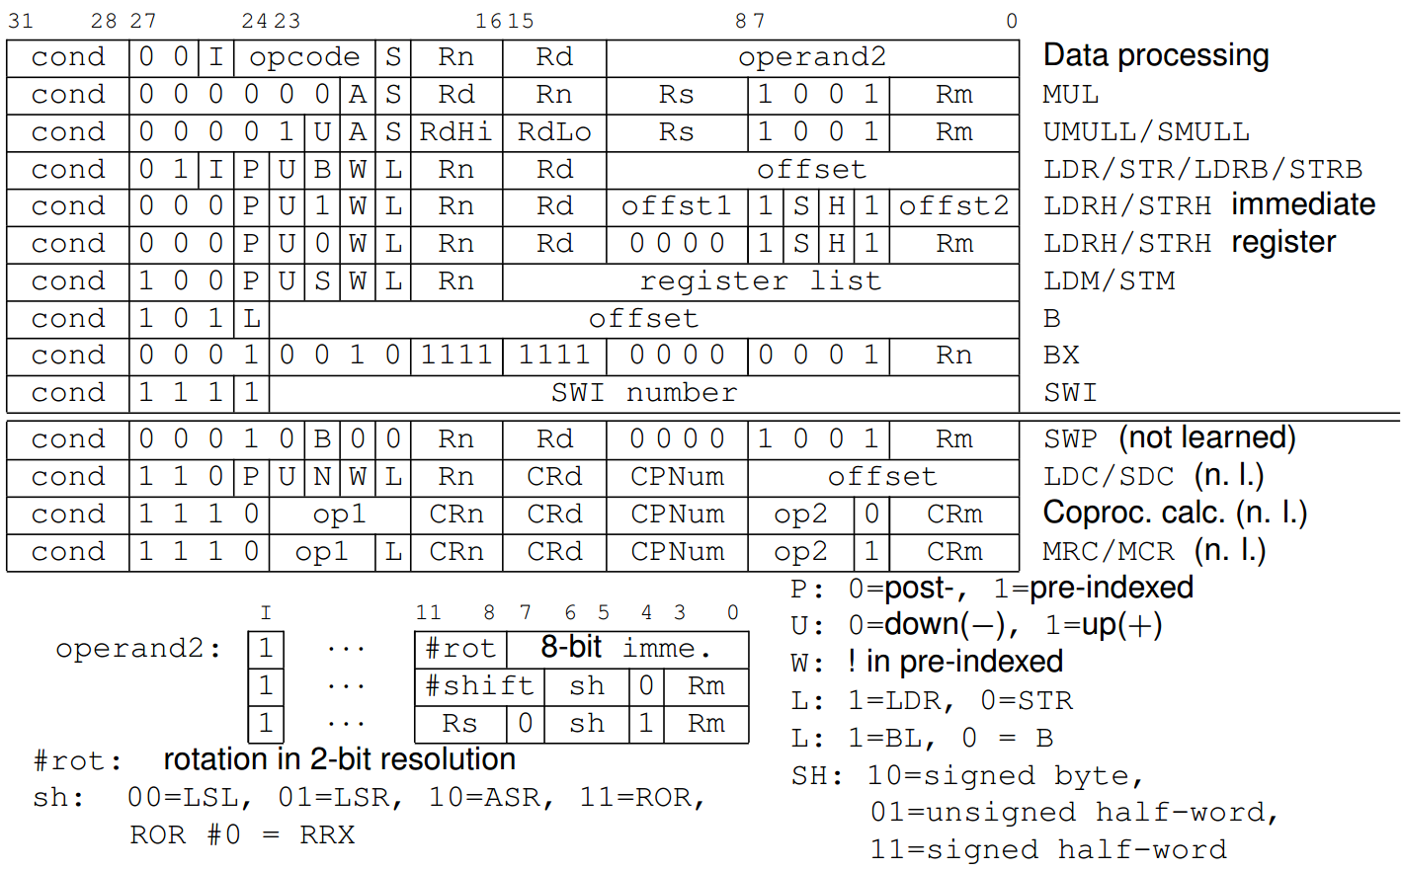

ARM Instruction Set Format (I)

Slide 23
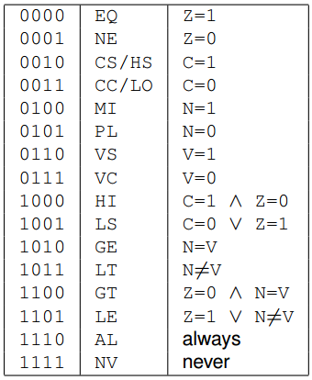
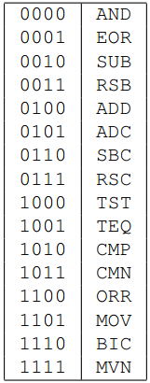

ARM Instruction Set Format (II)
cond
opcode
MSR / MRS : special case of data processing
Notes:
C.. 연산의 결과가 32비트를 넘어설때, V.. 연산의 결과가 32비트를 넘어서 Sign 비트가 상실될때,

Slide 24
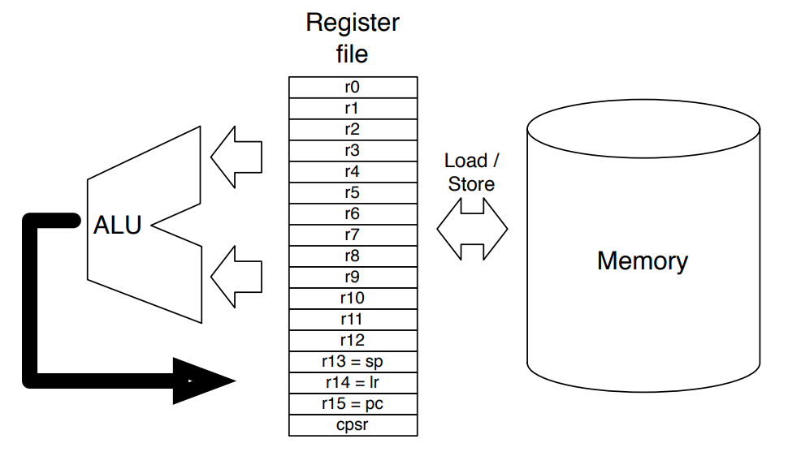
Simplified View of ARM Computer in User-Mode
Memory
. . . . . . .

