Slide 1
Task 09- Step B, A, C
Write an assembly function code that inputs from the keyboard and return the decimal number. (Step B)
int readnum()
Write an assembly function code that displays the decimal number passed by argument and return the number of chars displayed. Display ‘\n’ at the end. (Step A)
int printnum(num)
The above functions should be called from the following C code. Complete the program as follows: (Step C)
gcc –marm –O1 –o lab9 lab9-c.c lab9-ba.s
** refer to Task07 **

Slide 2
Task 09- C Program
“lab9-c.c” code
int readnum();
int printnum(int num);
main()
{
int a, b, c, d, e, op, res;
a = readnum();
b = readnum();
c = readnum();
d = readnum();
e = readnum();
op = readnum();
switch (op) {
case 1:
res = a + b;
break;
case 2:
res = a + b + c;
break;
case 3:
res = a + b - c;
break;
case 4:
res = a - b + c - d;
break;
default:
res = a - b + c + d + e;
}
res = printnum(res);
printnum(res);
}

Slide 3
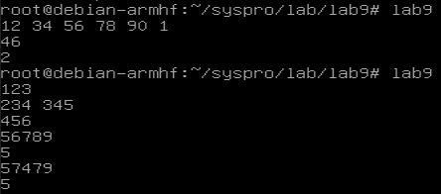
Task 09- Assembly Program
“lab9-ba.s” code
Example
.text
.global readnum
.global printnum
readnum:
. . .
. . .
printnum:
. . .
. . .

