Slide 1
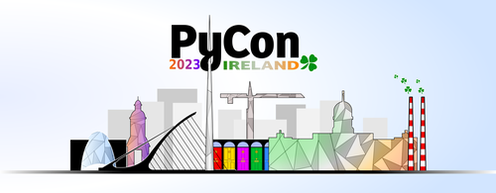
Unleashing the Power of Generative AI: Python API Integration with ChatGPT, DALL-E, and D-ID Studio
Eoin Halpin,
Tom Halpin​​
11/11/2023

Slide 2
Agenda
Presenters
AI Models
Large Language Models (LLMs)​ - ChatGPT
Image Generation Models – DALL-E
Image Manipulation Models – D-ID Studio​
Integration Considerations
Availability of APIs
AI Model Integration Examples – ChatGPT, DALL-E, D-ID Studio
Template GitHub Repository
Pace of change
Conclusions

Slide 3

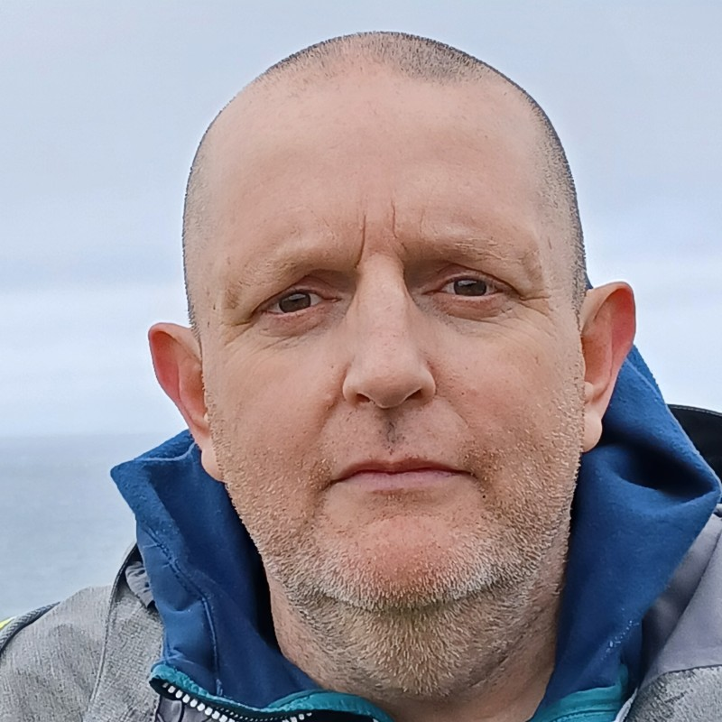
Presenters
Eoin Halpin:
Analyst - Project/Program Management
Member of agile, customer-facing teams focused on delivering value to stakeholders.
Help organizations and customers to gain valuable insights from data.
Tom Halpin:
Distinguished Engineer – DevOps Enablement.
Help teams move to a DevOps model in support of product-aligned value streams.
Facilitate adaption of the associated culture, practices, and tools in organizations.

Slide 4
AI Models and Categories
AI Models:
Many diverse AI models each with unique capabilities.
Large Language Models (LLMs):
Definition: LLMs are advanced AI models that understand and generate human-like text.
Applications: Language translation, content generation, chatbots, and more.
Key Features: Multimodal capabilities (understand and generate content in multiple modes or types of data i.e. text, images or video), natural language understanding.
Example: ChatGPT which is an LLM-based chatbot.
Importance: Transforming the way we interact with AI.

Slide 5
AI Models and Categories
Image Generation Models:
Definition: Image generation models specialize in creating visual content.
Applications: Art creation, design, visual content generation.
Example: DALL-E, which generates images from textual descriptions.
Importance: Enabling AI to generate visual art and design.
Image Manipulation Models:
Definition: Models focused on modifying and processing images.
Applications: Privacy protection, image enhancement, facial anonymization.
Example: D-ID Studio, which anonymizes faces in images.
Importance: Enabling AI to manipulate images and enhance visual data.

Slide 6



AI Models Covered
ChatGPT:
Overview: ChatGPT is a conversational AI model by OpenAI.
Use Cases: Customer support, virtual assistants, interactive user experiences.
Integrations: Easily integrated into applications, websites, and products.
DALL-E:
Overview: DALL-E is an AI model by OpenAI.
Creativity Unleashed: Generates images from textual descriptions.
Diverse Applications: Art creation, content generation, design.
Integrations: Enable developers to use DALL-E's creative capabilities.
D-ID Studio:
Overview: D-ID Studio is a creative tool by D-ID.
Functionality: Image and video manipulation, facial anonymization.
Applications: Privacy protection, content creation, media editing.
Integrations: Flexible and can be integrated into various platforms.

Slide 7
Importance of Integrations
Greenfield Integrations:
The blue pill - wake up in your bed and believe whatever you want to believe.
The select few.
Limited only by the imagination.
Brownfield Integrations:
The red pill - stay in wonderland and see how deep the rabbit hole goes.
Majority of companies have the challenge of integrating new technologies with existing technologies.
Large companies have complex IT portfolios with hundreds of strategic applications supporting a broad customer base via a dynamic workforce.
Massive opportunities to integrate AI Models & LLMs into enterprise systems to unlock hereto hidden potential.
Potential Benefits: Enhanced customer experiences, automation, and efficiencies.

Slide 8
Key Considerations for Enterprise Integrations
Valid Use Case: The use cases chosen need to be aligned with strategic organizational objectives.
Data Accessibility: Need to link AI Models with internal systems.
Real-time Interactions: Live data allows for up-to-the-minute decisions
Security and Compliance: Must ensure data integrity, protection and regulatory adherence.
Data Quality: Ensuring data consistency and relevancy for AI Models & LLMs is essential.
Workflow Automation: Streamline business processes with AI-powered automation.
Scalability and Maintainability: Design integrations for growth and long-term sustainability.

Slide 9
Availability of APIs
OpenAI and D-ID API: ChatGPT, DALL-E and D-ID Studio have APIs for developers.
Ease of Access: Quick and straightforward integration into various projects.
Community Collaboration: Developers can leverage the capabilities of advanced AI models with ease.
Developers' Portal: Access documentation and resources for integration with the AI Models.

Slide 10
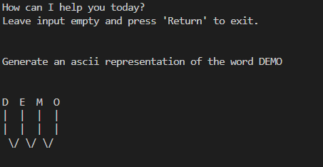
ChatGPT Integration
Site - https://chat.openai.com/
API - https://platform.openai.com/docs/guides/gpt
API Key - https://platform.openai.com/account/api-keys
GitHub Repository - https://github.com/genai-musings/chatting-with-ChatGPT
Docker Image - https://hub.docker.com/r/genaimusings/chatting-with-chatgpt

Slide 11
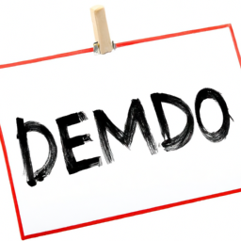
DALL-E Integration
Site - https://openai.com/dall-e-2
API - https://platform.openai.com/docs/guides/images/image-generation?context=node
API Key - https://platform.openai.com/account/api-keys
GitHub Repository - https://github.com/genai-musings/dallying-with-DALL-E
Docker Image - https://hub.docker.com/r/genaimusings/dallying-with-dall-e

Slide 12
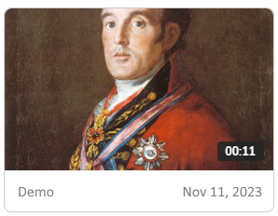
D-ID Studio Integration
Site - https://www.d-id.com/
API - https://docs.d-id.com/reference/get-started
API Key - https://studio.d-id.com/account-settings
GitHub Repository - https://github.com/genai-musings/dawdling-with-D-ID
Docker Image - https://hub.docker.com/r/genaimusings/dawdling-with-d-id

Slide 13
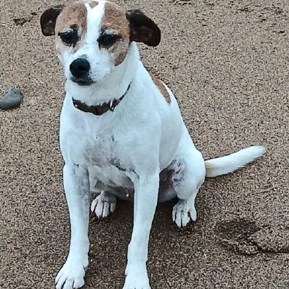
Template, Repo Template
Site - https://www.cyberdynesystems.ie
API – https://www.cyberdynesystems.ie/dev/api
API Key - https://www.cyberdynesystems.ie/dev/keys
GitHub Repository - https://github.com/genai-musings/template-repo-template
Docker Image - https://hub.docker.com/r/genaimusings/template-repo-template

Slide 14
Pace of Change
OpenAI Inaugural DevDay (Nov 6th) Key Announcements:
GPT-4 Turbo: Unveiled upgraded LLM. Knowledge of world events up to April 2023. More powerful and cost-effective for developers. 128k context window in a single prompt, allowing book scale content generation.
Copyright Shield: To protect customers against potential copyright lawsuits. Addresses potential copyright infringement issues related to usage of OpenAI products.
Custom GPTs: ChatGPT-like chatbots. Empowers users to tailor ChatGPT for specific personal or professional use cases without needing any development/coding knowhow. Custom GPTs can be developed for individual or enterprise use and/or sold via the GPT Store.
GPT Store : AI App Store allowing users to create and sell new GPTs. Equivalent of Apples’ App Store. No coding skills required to build and monetize custom GPTs.
Assistants API: Allows the creation of agent like experiences within applications.
.

Slide 15
Conclusions
AI Models and LLMs are reshaping industries and are about to reshape even more industries.
Briefly explored features of ChatGPT, D-ID Studio, and DALL-E.
Focused on the Integrations and APIs available specifically how they can allow the power of AI Models and LLMs to be leveraged to create exciting solutions.
Provided sample “workloads” utilizing the API available and shared the code for those workloads via open-sourced GitHub repositories which include full CI/CD functionality.
Provided a template GitHub repository which can be used to create workloads for other AI Models via the associated APIs.
Pace of change is astounding, shared key announcements from OpenAI’s inaugural DevDay event.

Slide 16
Q&A & Thanks

