Slide 1
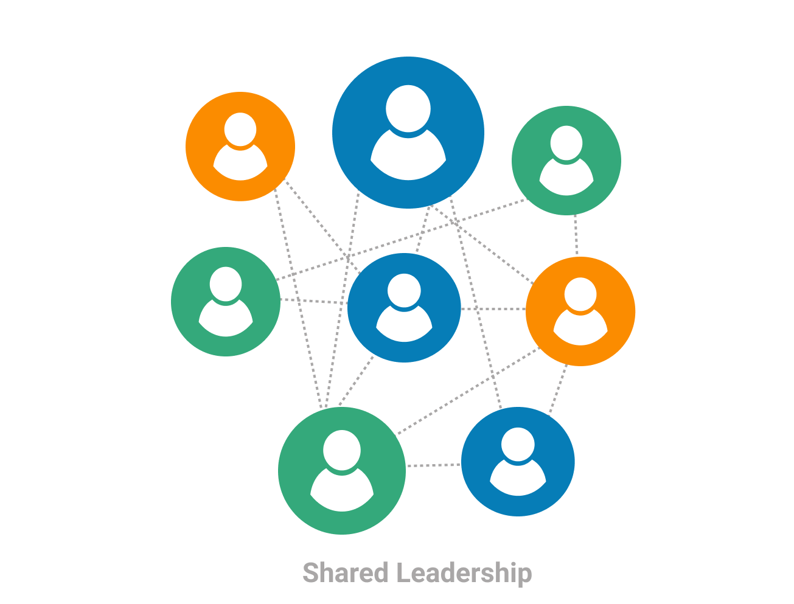
Abstract generation for final project
Genady Kogan
Notes:
.

Slide 2
Introduction
Motivation:
Experience of the students
Implementing one of the available algorithms
Analyze and compare the effectiveness of methods
What is an abstract?
An abstract is a condensed, self-contained overview of an essay or report that is typically about 200 to 250 words depending on the field of study and abstract type. These short introductions do not provide insight or analysis; they summarize the content, research methods, and conclusion reached in an essay or report from a third-person point of view. Additionally, they do not address outside information or present new [1, 2].
Types of abstracts:
Informative Abstracts
Descriptive Abstracts
Critical Abstracts
Highlight Abstracts
¹Gudivada, V. N. (2018). Natural language core tasks and applications. In Handbook of statistics (Vol. 38, pp. 403-428). Elsevier.
²Rao, C. R., & Gudivada, V. N. (2018). Computational analysis and understanding of natural languages: principles, methods and applications. Elsevier.

Slide 3

Abstract Generator - Online Abstract Maker
https://www.editpad.org/tool/abstract-generator
https://quillbot.com/summarize?utm_medium=paid_search&utm_source=google&utm_campaign=summarize_premium&campaign_type=search
https://www.phdresearchproposal.org/abstract-generator/
https://www.classgist.com/abstract-generator.aspx
https://www.scholarcy.com/what-makes-a-good-abstract/
https://assignzen.com/free-writing-tools/abstract-generator/
https://www.nelsenso.net/en/abstract-online.aspx

Slide 4
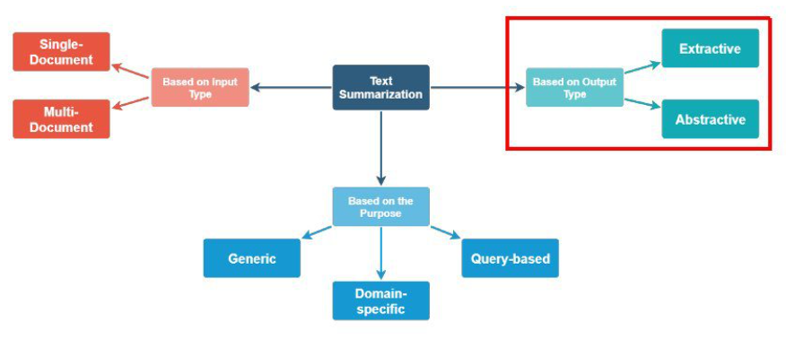
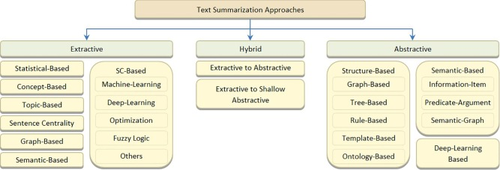
Text summarization
Automated text summarization
Text summarization based on output type
Extractive
Extractive summarization methods work just like that. It takes the text, ranks all the sentences according to the understanding and relevance of the text, and presents you with the most important sentences.
This method does not create new words or phrases, it just takes the already existing words and phrases and presents only that. You can imagine this as taking a page of text and marking the most important sentences using a highlighter.
Abstractive
Abstractive summarization, on the other hand, tries to guess the meaning of the whole text and presents the meaning to you. It creates words and phrases, puts them together in a meaningful way, and along with that, adds the most important facts found in the text. This way, abstractive summarization techniques are more complex than extractive summarization techniques and are also computationally more expensive.

Slide 5
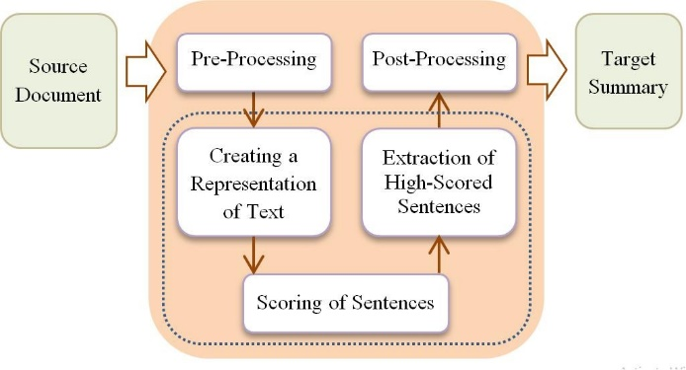
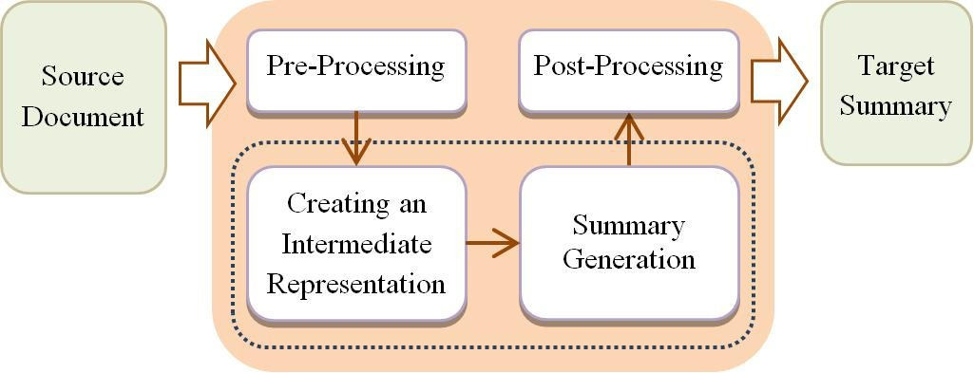
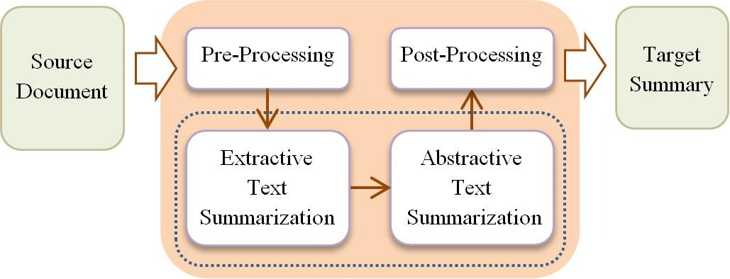
System architecture
The challenge of how to make computer understand the document with any extension and how to make it generate the summary is the main motivation. Reducing the time and effort of the user of reading through entire document to know what the document is about is also the driving force behind this work. To summarize large documents of the text will be difficult for human beings
Extractive text summarization
Abstractive text summarization
Hybrid text summarization

Slide 6
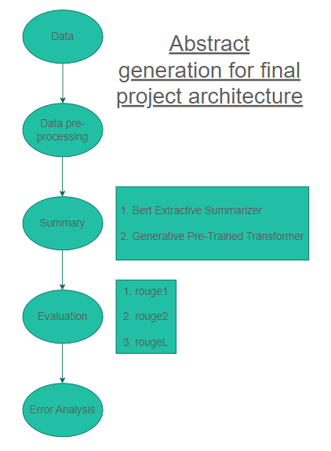
Extractive text summarization
The extractive text summarization system architecture that consists of:
Pre-processing of the input text.
Post-processing like: reordering the extracted sentences, replacing pronouns with their antecedents, replacing the relative temporal expression with actual dates, etc. [3].
The processing tasks as follows:
Creating a suitable representation of the input text to facilitate the text analysis (e.g. N-gram, bag-of-words, graphs, etc.) [4].
Scoring of sentences: ranking sentences based on the input text representation [5].
Extraction of high-scored sentences: selecting the most important sentences from the input document(s) and concatenating them to create the [5, 6]. The generated summary length depends on the preferred compression rate using a length cutoff or threshold to limit the size of the summary and preserve the same order of the generated sentences as the input text [7].
³ Gupta, S., & Gupta, S. K. (2019). Abstractive summarization: An overview of the state of the art. Expert Systems with Applications, 121, 49-65.
⁴ Joshi, M., Wang, H., & McClean, S. (2018). Dense semantic graph and its application in single document summarisation. In Emerging Ideas on Information Filtering and Retrieval (pp. 55-67). Springer, Cham.
⁵Nenkova, A., & McKeown, K. (2012). A survey of text summarization techniques. In Mining text data (pp. 43-76). Springer, Boston, MA
⁶Zhu, J., Zhou, L., Li, H., Zhang, J., Zhou, Y., & Zong, C. (2017, November). Augmenting neural sentence summarization through extractive summarization. In National CCF Conference on Natural Language Processing and Chinese Computing (pp. 16-28). Springer, Cham.
⁷Wang, S., Zhao, X., Li, B., Ge, B., & Tang, D. (2017, June). Integrating extractive and abstractive models for long text summarization. In 2017 IEEE International Congress on Big Data (BigData Congress) (pp. 305-312). IEEE.

Slide 7

Extractive text summarization
Disadvantages: The extractive approach is far from the method that human experts write summaries [8]. Drawbacks of the generated extractive summary include:
Redundancy in some summary sentences [8].
Extracted sentences can be longer than average [3].
Temporal expressions conflicts in the multi-document case because extractive summaries are selected from different input documents [3].
Lack of semantics and cohesion in summary sentences [8] because of the incorrect link between sentences and non-resolved co-reference relationships [9] and “dangling” anaphora (Gupta & Lehal, 2010).
Important information spread across sentences. Conflicting information may not be covered [3]. The output summary may be unfair for input texts that consist of several topics [8]. Summaries can overcome this issue only if the summary is long enough.
Advantages: The extractive approach is faster and simpler than the abstractive approach. This approach leads to a higher accuracy because of the direct extraction of sentences so readers read the summary with the exact terminologies that exist in the original text [10].
⁸ Moratanch, N., & Chitrakala, S. (2017, January). A survey on extractive text summarization. In 2017 international conference on computer, communication and signal processing (ICCCSP) (pp. 1-6). IEEE.
⁹ Lloret, E., Romá-Ferri, M. T. & Palomar, M. (2011). COMPENDIUM: A text summarization system for generating abstracts of research papers. Paper presented at the natural language processing and information systems, Berlin, Heidelberg.
¹⁰ Tandel, A., Modi, B., Gupta, P., Wagle, S. & Khedkar, S. (2016). Multi-document text summarization – a survey. Paper presented at the 2016 International Conference on Data Mining and Advanced Computing (SAPIENCE).

Slide 8
Project implementation
Method
Statistical-Based - these methods extract important sentences and words from the source text based on the statistical analysis of a set of features. The “most important” sentence is defined as the “most favorably positioned”, the “most frequent”, etc.
Semantic-Based – Latent Semantic Analysis (LSA) is a commonly used semantic-based extractive ATS method. LSA is an unsupervised technique that represents text semantics based on the observed co-occurrence of words.
Pros: It requires less processor capacity and memory [11]. It does not require any extra linguistic knowledge or complex linguistic processing and it is language independent [12].
Cons: Some important sentences may be not included in the summary because they have less score than others. Similar sentences may be included in the summary because they have high scores.
Pros: LSA is a language-independent technique and generates semantically related sentences in the summary [11]. To improve the sentence selection for the summary, a large set of training data is required [8]. Relatively simple regression models can achieve better results than other classifiers [11].
Cons: The generated summary depends on the quality of the semantic representation of the input text. Computing SVD consumes a large time [11]. It requires a large data set of manually created extractive summaries such that each sentence in the original training documents can be labeled as either “summary” or “non-summary” [8]
¹¹ Agarwal, P., & Mehta, S. (2018). Empirical analysis of five nature-inspired algorithms on real parameter optimization problems. Artificial Intelligence Review, 50(3), 383-439.
¹² Ko, Y., & Seo, J. (2008). An effective sentence-extraction technique using contextual information and statistical approaches for text summarization. Pattern Recognition Letters, 29(9), 1366-1371

Slide 9
Project implementation
Details of the steps, part 1
1. Data
2. Data pre-processing
Requirements:
pdf2docx
docx2txt
pandasnltk
bert_extractive_summarizer
torch
rouge_score
Selecting 10 (see slide 14) journals belong to the fields of computer and education study. In this journals researches using.
The Technology Acceptance Model (TAM) is an information system theory that models how users come to accept and use a technology.
read_only_pdf_text(self)
remove_abstract_from_pdf()
pdf_preprocessing()
get_blocks_from_pdf()
get_data_from_blocks()
https://github.com/genakogan/information-retrieval

Slide 10

Project implementation
Details of the steps, part 2
3. Summary
bert_extractive_summarizer()
BERT is an open source machine learning framework for natural language processing (NLP). BERT is designed to help computers understand the meaning of ambiguous language in text by using surrounding text to establish context. The BERT framework was pre-trained using text from Wikipedia and can be fine-tuned with question and answer datasets.
This tool utilizes the HuggingFace Pytorch transformers library to run extractive summarizations. This works by first embedding the sentences, then running a clustering algorithm, finding the sentences that are closest to the cluster's centroids. This library also uses coreference techniques, utilizing the https://github.com/huggingface/neuralcoref library to resolve words in summaries that need more context. The greedyness of the neuralcoref library can be tweaked in the CoreferenceHandler class.
As of the most recent version of bert-extractive-summarizer, by default, CUDA is used if a gpu is available.
¹³ Radford, A., Wu, J., Child, R., Luan, D., Amodei, D., & Sutskever, I. (2019). Language models are unsupervised multitask learners. OpenAI blog, 1(8), 9.

Slide 11
Project implementation
Details of the steps, part 2.2
3. Summary
GPT2
GPT-2 is a large transformer-based language model with 1.5 billion parameters, trained on a dataset of 8 million web pages. GPT-2 is trained with a simple objective: predict the next word, given all of the previous words within some text. The diversity of the dataset causes this simple goal to contain naturally occurring demonstrations of many tasks across diverse domains. GPT-2 is a direct scale-up of GPT, with more than 10X the parameters and trained on more than 10X the amount of data.
GPT-2 is a model with absolute position embeddings so it’s usually advised to pad the inputs on the right rather than the left.
GPT-2 was trained with a causal language modeling (CLM) objective and is therefore powerful at predicting the next token in a sequence. Leveraging this feature allows GPT-2 to generate syntactically coherent text as it can be observed in the run_generation.py example script.
The PyTorch models can take the past as input, which is the previously computed key/value attention pairs. Using this past value prevents the model from re-computing pre-computed values in the context of text generation.

Slide 12
Project implementation
Details of the steps, part 3
evaluation(model_abstract)
rouge1
rouge2
rougeL
4. Evaluation
Example ROUGE1:
Reference Tokens: ['John','really','loves','data','science'](n_r=5)
Candidate Tokens: ['John','loves','data','science'] (n_can=4)
Captured Tokens: ['John','loves','data','science'] (n_cap=4)
Rouge-1 Recall = n_cap/n_r = 4/5
Rouge-1 Precision = n_cap/n_can = 4/4
ROUGE stands for Recall-Oriented Understudy for Gisting Evaluation. It is essentially a set of metrics for evaluating automatic summarization of texts as well as machine translations.
ROUGE-1 refers to the overlap of unigram (each word) between the system and reference summaries [14].
ROUGE-2 refers to the overlap of bigrams between the system and reference summaries [14].
ROUGE-L: Longest Common Subsequence (LCS) based statistics. Longest common subsequence problem takes into account sentence level structure similarity naturally and identifies longest co-occurring in sequence n-grams automatically [15].
¹⁴ Lin, Chin-Yew and E.H. Hovy 2003. Automatic Evaluation of Summaries Using N-gram Co-occurrence Statistics. In Proceedings of 2003 Language Technology Conference (HLT-NAACL 2003), Edmonton, Canada, May 27 - June 1, 2003.
¹⁵ Lin, Chin-Yew and Franz Josef Och. 2004. Automatic Evaluation of Machine Translation Quality Using Longest Common Subsequence and Skip-Bigram Statistics. In Proceedings of the 42nd Annual Meeting of the Association for Computational Linguistics (ACL 2004), Barcelona, Spain, July 21 - 26, 2004.

Slide 13
Project implementation
Details of the steps, part 4.1
Precision results
 | rouge1 |  | rouge2 |  | rougeL
 | BERT | GPT2 | BERT | GPT2 | BERT | GPT2
1 | 0.315 | 0.17 | 0.212 | 0.17 | 0.05 | 0.11
2 | 0.331 | 0.278 | 0.121 | 0.103 | 0.192 | 0.183
3 | 0.177 | 0.234 | 0.038 | 0.067 | 0.09 | 0.13
4 | 0.355 | 0.348 | 0.112 | 0.145 | 0.236 | 0.243
5 | 0.347 | 0.3 | 0.118 | 0.112 | 0.176 | 0.192
6 | 0.302 | 0.301 | 0.07 | 0.08 | 0.15 | 0.13
7 | 0.441 | 0.441 | 0.333 | 0.333 | 0.411 | 0.412
8 | 0.194 | 0.221 | 0.06 | 0.051 | 0.116 | 0.116
9 | 0.257 | 0.234 | 0.09 | 0.07 | 0.144 | 0.121
10 | 0.22 | 0.285 | 0.06 | 0.05 | 0.14 | 0.156
Average | 0.2939 | 0.2812 | 0.1214 | 0.1181 | 0.1705 | 0.1793
5. Error analysis

Slide 14
Project implementation
Details of the steps, part 4.2
Bert
GPT2
Introdaction | 90%
Literaure review | 20%
Methodology | 60%
Results | 40%
Conclusions | 50%
Discussion | 30%
Introdaction | 70%
Literaure review | 20%
Methodology | 60%
Results | 30%
Conclusions | 50%
Discussion | 30%
5. Error analysis
Percentage shows with what probability the sentence was selected from particular part.
Mun, Y. P., Khalid, H., & Nadarajah, D. (2017). Millennials’ perception on mobile payment services in Malaysia. Procedia Computer Science, 124, 397-404.
King, W. R., & He, J. (2006). A meta-analysis of the technology acceptance model. Information & management, 43(6), 740-755.
Park, E. S., & Park, M. S. (2020). Factors of the technology acceptance model for construction IT. Applied Sciences, 10(22), 8299.
Suki, N. M., & Suki, N. M. (2011). Exploring the relationship between perceived usefulness, perceived ease of use, perceived enjoyment, attitude and subscribers’ intention towards using 3G mobile services. Journal of Information Technology Management, 22(1), 1-7.
Mada, I. G. N. C. W., & Putri, P. Y. A. (2021, April). Technology Acceptance Model (TAM) for Analysis of Online Banking use in PT Bank Rakyat Indonesia, Tbk. Gianyar Branch. In WARDS 2020: Proceedings of the 3rd Warmadewa Research and Development Seminar, WARDS 2020, 21 December 2020, Denpasar-Bali, Indonesia (p. 149). European Alliance for Innovation.
Masrom, M. (2007). Technology acceptance model and e-learning. Technology, 21(24), 81.
Kusumadewi, A. N., Lubis, N. A., Prastiyo, R., & Tamara, D. (2021). Technology Acceptance Model (TAM) in the Use of Online Learning Applications During the Covid-19 Pandemic for Parents of Elementary School Students. Edunesia: Jurnal Ilmiah Pendidikan, 2(1), 272-292.
Salleh, S. M., Musa, J., Jaidin, J. H., & Shahrill, M. (2021). Development of TVET Teachers' Beliefs about Technology Enriched Instruction through Professional Development Workshops: Application of the Technology Acceptance Model. Journal of Technical Education and Training, 13(2), 25-33.
Arifin, W. N., & Yusoff, M. S. B. (2016). Confirmatory factor analysis of the Universiti Sains Malaysia emotional quotient inventory among medical students in Malaysia. Sage Open, 6(2), 2158244016650240.
A Study of Using Technology Acceptance Model and Its Effect on Improving Road Pavement Smoothness in Taiwan

Slide 15

Thank you for your attention!!!

