Slide 1
Algorithms and Running Time
DATA STRUCTURES · LESSON 1
Exercises with solutions and step-by-step explanations · 2023–2024

Slide 2


What Is an Algorithm?
An algorithm is…
A correct algorithm
A method for carrying out a given task in a finite number of steps.
An algorithm is correct if, for every input instance, it halts with the correct output.
A finite sequence of unambiguous instructions such that, for every legal input, the desired output is produced.

Slide 3


Designing Algorithms
Simplify first
Combine the pieces
When developing an algorithm, break the problem down to the simplest possible level.
The full solution is really a collection of basic algorithms, each applied as needed to solve the complex problem.
This way we can write simple, clear basic algorithms that are easy to test, maintain and update inside the full program.

Slide 4




How We Count Operations
In Questions 1–9 we count how many times each line of code is executed. Every solution uses the same four rules:
Simple statements
Loop headers
An assignment, test or return that is not inside a loop runs exactly once.
A loop test runs one more time than the loop body — the last test fails and ends the loop. for i ← 1 to n: header n + 1, body n.
Nested loops
if statements
The inner loop runs completely on every pass of the outer loop → multiply. If the inner bound depends on the outer variable, add up the passes (Σ).
The condition is always evaluated, but the body runs only when it is true — its count can depend on the input (best / worst case).
Notes:
These four rules are used in every solution that follows.

Slide 5

Question 1
Count how many times the body of the while loop is executed in the following code:
sum ← 0
i ← 1
while i ≤ n do
sum ← sum + i
i ← i + 1
What to find
How many times do the two statements inside the loop run?
Give the answer as a function of n, and count how many times every other line runs too.

Slide 6

Solution to Question 1
Code | Times executed
sum ← 0 | 1
i ← 1 | 1
while i ≤ n do | n + 1
sum ← sum + i | n
i ← i + 1 | n
Total | 3n + 3
Answer
The loop body runs n times.
Total work: 3n + 3 operations → linear, Θ(n).
Pattern to remember
A loop test always runs one more time than the loop body: the body runs n times, the test n + 1 times.
Notes:
Body: n times. Test: n+1. Total 3n+3.

Slide 7

Question 1 — Explanation
1
Before the loop. sum ← 0 and i ← 1 run once each.
Check: n = 3
2
Trace i. i starts at 1 and grows by 1 at the end of every pass, so the body runs with i = 1, 2, …, n — exactly n passes.
Passes with i = 1, 2, 3 → body runs 3 times.
3
The loop test. i ≤ n is checked before every pass plus one final time: after pass n we have i = n + 1, the test fails and the loop ends. So the test runs n + 1 times.
Tests with i = 1, 2, 3, 4 → test runs 4 = n + 1 times.
Total: 1 + 1 + 4 + 3 + 3 = 12 = 3·3 + 3.
4
The body. Each of the two statements runs once per pass → n times each.
5
Total: 1 + 1 + (n + 1) + n + n = 3n + 3. The count grows linearly with n: Θ(n).

Slide 8
Question 2
Count how many times the body of the for loop is executed in the following code:
sum ← 0
for i ← 1 to n do
sum ← sum + i
What to find
How many times does sum ← sum + i run, and how many times is the loop header checked?

Slide 9
Solution to Question 2
Code | Times executed
sum ← 0 | 1
for i ← 1 to n do | n + 1
sum ← sum + i | n
Total | 2n + 2
Answer
The loop body runs n times.
Total work: 2n + 2 operations → Θ(n).
Why n + 1 for the header?
The header sets / increases i and compares it with n. The comparison succeeds for i = 1, …, n and fails once for i = n + 1.
Notes:
Body: n. Header: n+1. Total 2n+2.

Slide 10
Question 2 — Explanation
1
A for loop is a while loop in disguise. for i ← 1 to n do body means: i ← 1, then while i ≤ n do { body; i ← i + 1 }.
Check: n = 4
Header checks: i = 1, 2, 3, 4, 5 → 5 = n + 1.
2
Header. The check i ≤ n succeeds for i = 1, 2, …, n and fails once for i = n + 1 → n + 1 times.
Body: 4 = n times.
sum = 1 + 2 + 3 + 4 = 10 = 4·5/2.
3
Body. sum ← sum + i runs once for every successful check → n times.
4
Total: 1 + (n + 1) + n = 2n + 2 = Θ(n).
5
Result. After the loop, sum = 1 + 2 + … + n = n(n + 1)/2 — a large value, but computed with only linear work.

Slide 11
Question 3
Count how many times the body of the for loop is executed in the following code:
sum ← 0
prod ← 1
for i ← 1 to n do
sum ← sum + i
prod ← prod * i
What to find
The body now has two statements. Does that change the number of passes? Count every line.

Slide 12
Solution to Question 3
Code | Times executed
sum ← 0 | 1
prod ← 1 | 1
for i ← 1 to n do | n + 1
sum ← sum + i | n
prod ← prod * i | n
Total | 3n + 3
Answer
The loop body runs n times.
Each of its two statements runs n times. Total: 3n + 3 → Θ(n).
Values after the loop
sum = 1 + 2 + … + n = n(n + 1)/2
prod = 1 · 2 · … · n = n!
Notes:
Body: n passes (each statement n times). Total 3n+3.

Slide 13
Question 3 — Explanation
1
Same header as Question 2. for i ← 1 to n is checked n + 1 times, so there are n passes.
Check: n = 3
sum = 1 + 2 + 3 = 6
2
Two statements in the body. Adding a statement does not change the number of passes — each statement simply runs once per pass → n times each.
prod = 1 · 2 · 3 = 6 = 3!
Total: 1 + 1 + 4 + 3 + 3 = 12 = 3·3 + 3.
3
Total: 1 + 1 + (n + 1) + n + n = 3n + 3 = Θ(n).
4
Key idea. The loop header decides how many passes there are; the body decides how much work each pass costs. Work in the loop = (number of passes) × (cost of one pass).

Slide 14
Question 4
Count how many times the body of the inner for loop is executed in the following code:
sum ← 0
for i ← 1 to n do
for j ← 1 to n do
sum ← sum + i*j
What to find
How many times does sum ← sum + i*j run? How many times is each loop header checked?

Slide 15
Solution to Question 4
Code | Times executed
sum ← 0 | 1
for i ← 1 to n do | n + 1
for j ← 1 to n do | n(n + 1) = n² + n
sum ← sum + i*j | n · n = n²
Total | 2n² + 2n + 2
Answer
The inner body runs n² times.
Total: 2n² + 2n + 2 → quadratic, Θ(n²).
Rule
When the inner loop's bounds do not depend on the outer variable, multiply the numbers of passes: n × n.
Notes:
Inner body: n^2. Inner header n(n+1). Total 2n^2+2n+2.

Slide 16
Question 4 — Explanation
1
Outer loop. for i ← 1 to n: header checked n + 1 times, n passes.
Check: n = 2
Pairs (i, j): (1,1), (1,2), (2,1), (2,2) → body runs 4 = 2² times.
2
Inner header. On every outer pass, the inner loop starts again from j = 1, and its header is checked n + 1 times. Over n outer passes: n · (n + 1) = n² + n.
Inner header: 2 · 3 = 6 checks (j = 1, 2, 3 for each i).
3
Inner body. n inner passes for each of the n values of i: n · n = n².
Total: 1 + 3 + 6 + 4 = 14 = 2·4 + 2·2 + 2.
4
Total: 1 + (n + 1) + (n² + n) + n² = 2n² + 2n + 2 = Θ(n²).
5
Why multiply? The inner bound (n) does not depend on i, so every outer pass does exactly the same amount of work.

Slide 17
Question 5
An array A is given. The following algorithm counts how many elements appear exactly once in the array. How many times is the addition occurs ← occurs + 1 executed?
Count_singles(A)
singles ← 0
for i ← 1 to length[A] do
occurs ← 0
for j ← 1 to length[A] do
if A[i] = A[j] then
occurs ← occurs + 1
if occurs = 1 then
singles ← singles + 1
return singles
What to find
Let n = length[A].
Count every line. Watch out: some lines are inside an if — do they always run?

Slide 18
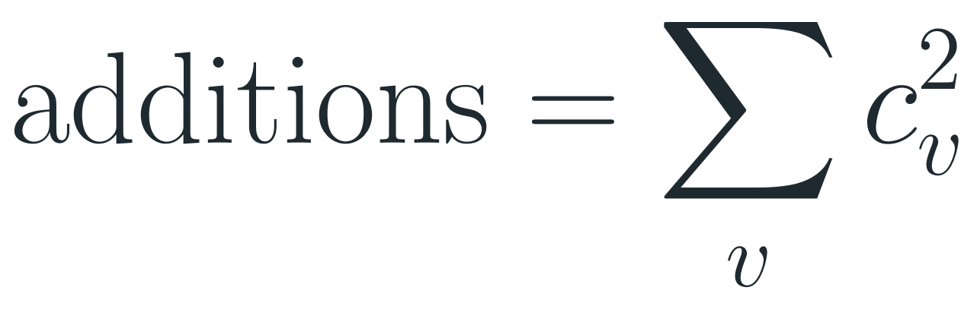
Solution to Question 5
Code | Times executed
singles ← 0 | 1
for i ← 1 to length[A] do | n + 1
occurs ← 0 | n
for j ← 1 to length[A] do | n(n + 1)
if A[i] = A[j] then | n²
occurs ← occurs + 1 | n … n²
if occurs = 1 then | n
singles ← singles + 1 | 0 … n
return singles | 1
Answer
Between n and n² times
Best case (all elements distinct): n. Worst case (all equal): n².
Exactly:
$$additions=\sum_{v}{c_{v}^{2}}$$
$$c_{v}=number of copies of value v$$
Why a range?
n = length[A]. Highlighted rows are inside an if: their count depends on the data.
Both highlighted lines are inside an if, so they run only when the condition is true.
If all elements are equal, occurs ← occurs + 1 runs n² times — but then no element is single, so singles ← singles + 1 runs 0 times.
Notes:
occurs+1 runs between n (all distinct) and n^2 (all equal); exactly sum of c_v^2. Comparisons always n^2.

Slide 19
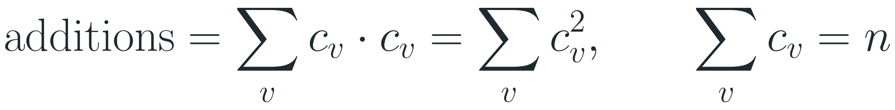
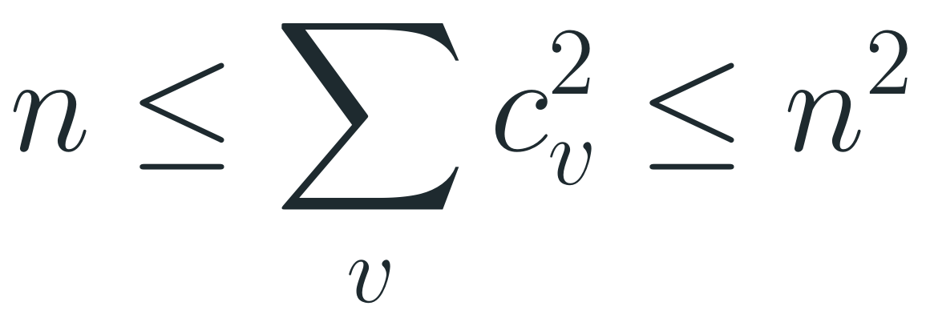
Question 5 — Explanation
1
Lines outside the if statements are counted as in Question 4. In particular the comparison A[i] = A[j] runs exactly n² times — once for every pair (i, j).
Example
2
The addition is inside the if, so it runs once for every pair (i, j) with A[i] = A[j]. The pair j = i always matches, so there are at least n such pairs.
A = [5, 3, 5, 7], n = 4
value 5: c = 2 → 2² = 4
3
value 3: c = 1 → 1² = 1
Group by value. If value v has c copies, each copy matches all c copies, so v gives c · c = c² matching pairs. Summing over all values v (with c of v copies each):
value 7: c = 1 → 1² = 1
$$additions=\sum_{v}{c_{v}·c_{v}}=\sum_{v}{c_{v}^{2}}, \sum_{v}{c_{v}}=n$$
Additions = 6 (between n = 4 and n² = 16)
singles = 2 (the 3 and the 7)
4
Best case: all elements distinct → each value has 1 copy → n additions. Worst case: all equal → one value with n copies → n² additions:
$$n≤\sum_{v}{c_{v}^{2}}≤n^{2}$$
5
singles ← singles + 1 runs once for each element that appears exactly once → between 0 and n times.
6
Running time: the n² comparisons happen for every input, so the algorithm is Θ(n²) in all cases.

Slide 20
Question 6
How many times is the addition k ← k + 1 executed in the following code?
Assume n = 4 — fill in the trace table:
F(n)
k ← 0
for i ← 1 to n do
for j ← 1 to i do
k ← k + 1
i
j
k

Slide 21
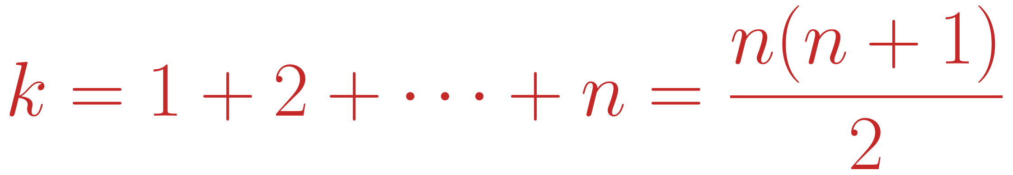
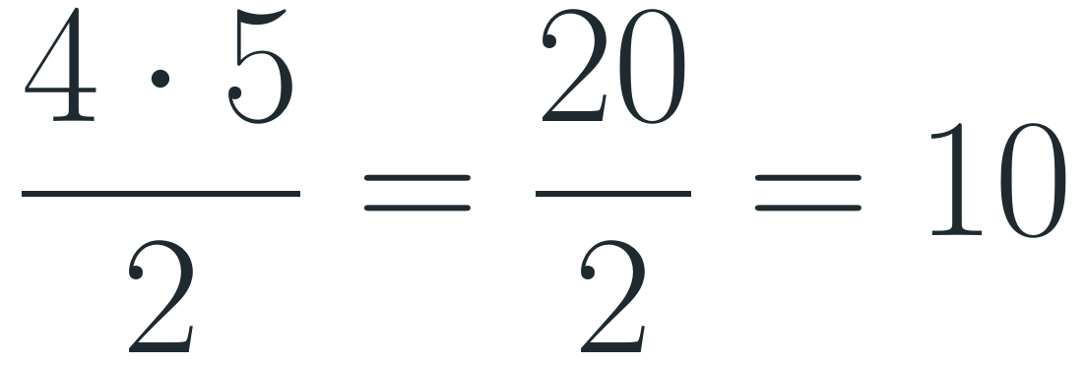
Solution to Question 6
F(n)
k ← 0
for i ← 1 to n do
for j ← 1 to i do
k ← k + 1
Answer
$$k=1+2+⋯+n=\frac{n(n+1)}{2}$$
For n = 4:
$$\frac{4·5}{2}=\frac{20}{2}=10$$
Trace for n = 4 (one column per execution of k ← k + 1):
i | 1 | 2 | 2 | 3 | 3 | 3 | 4 | 4 | 4 | 4
j | 1 | 1 | 2 | 1 | 2 | 3 | 1 | 2 | 3 | 4
k | 1 | 2 | 3 | 4 | 5 | 6 | 7 | 8 | 9 | 10
— the last value of k in the trace table. Growth: Θ(n²).
Notes:
k = 1+2+...+n = n(n+1)/2; n=4 gives 10.

Slide 22
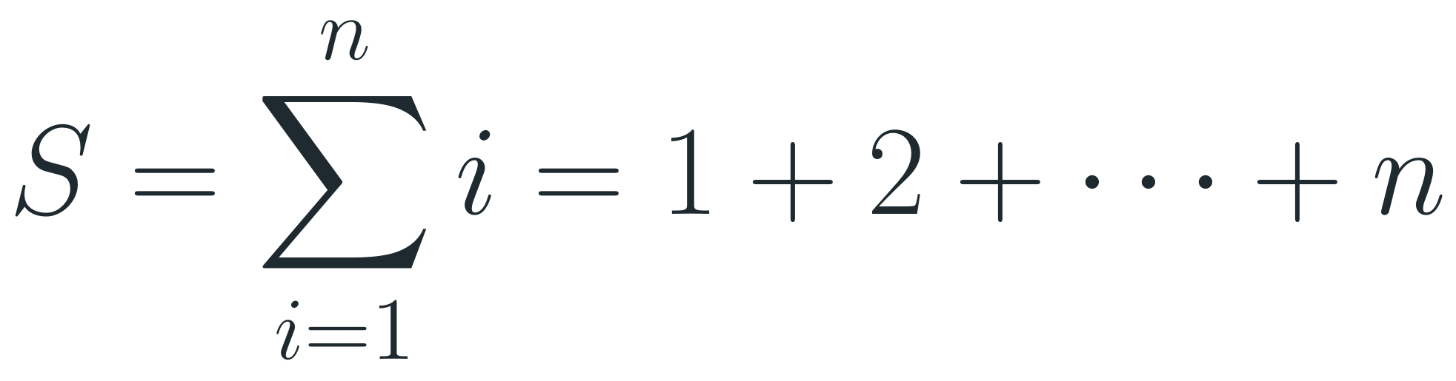
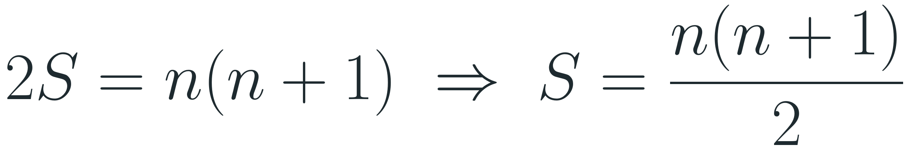
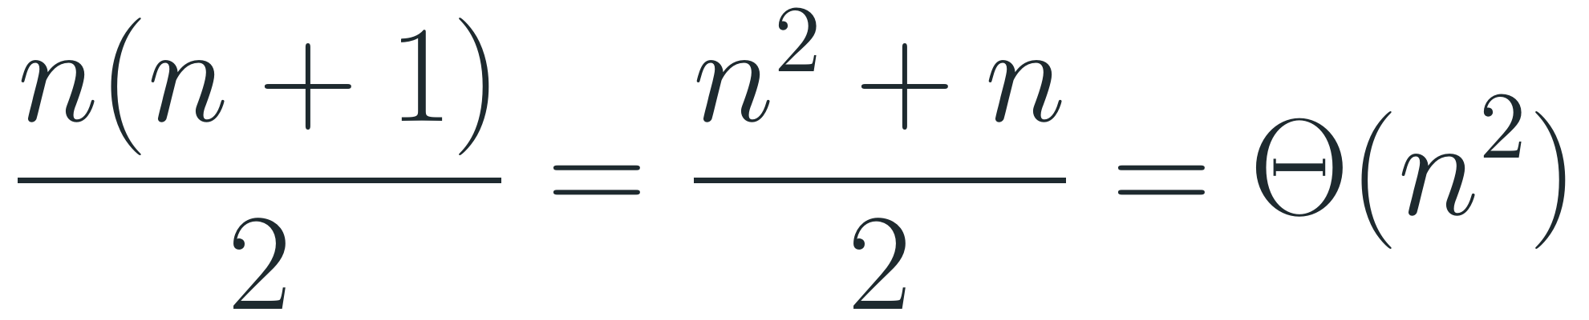
Question 6 — Explanation
1
The inner bound depends on i. For a fixed i, j runs from 1 to i, so k ← k + 1 runs exactly i times on that outer pass.
Gauss pairing, n = 4
2
Add up the outer passes: i = 1 gives 1, i = 2 gives 2, …, i = n gives n:
1 + 2 + 3 + 4
$$S=\sum_{i=1}^{n}{i}=1+2+⋯+n$$
+ 4 + 3 + 2 + 1
= 5 + 5 + 5 + 5
2S = 4 · 5 = 20
3
Gauss's trick. Write S forwards and backwards and add: every column sums to n + 1, and there are n columns:
S = 10
$$2S=n(n+1) ⇒ S=\frac{n(n+1)}{2}$$
4
Check with n = 4: 1 + 2 + 3 + 4 = 10 = 4·5/2 — exactly the final value of k in the trace table (k starts at 0 and grows by 1 per addition).
5
Growth: about half the work of Question 4, but the same order of growth:
$$\frac{n(n+1)}{2}=\frac{n^{2}+n}{2}=Θ(n^{2})$$

Slide 23
Question 7
Count how many times the body of the inner while loop is executed in the following code:
Trace for n = 4 — one row per pass of the outer loop:
F(n)
k ← 0
i ← 1
q ← 1
r ← 4
while i ≤ n do
j ← 0
while j < q do
k ← k + 1
j ← j + 1
q ← q * r
i ← i + 1
n | i | q | r | j | k
4 | 1 | 1 | 4 | 0 → 1 | 0 + 1 = 1
4 | 2 | 4 | 4 | 0 → 4 | 1 + 4 = 5
4 | 3 | 16 | 4 | 0 → 16 | 5 + 16 = 21
4 | 4 | 64 | 4 | 0 → 64 | 21 + 64 = 85
In each pass j counts from 0 up to q, so the inner body runs q times and k grows by q. After the 4th pass i = 5 > 4 and the loop ends: k = 85.

Slide 24

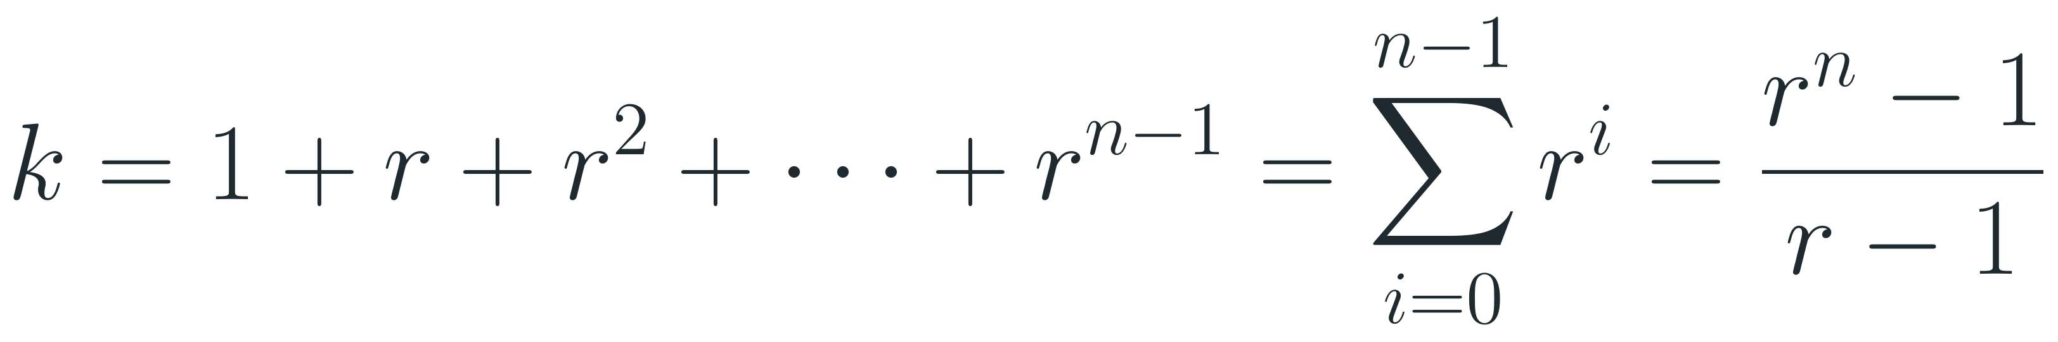
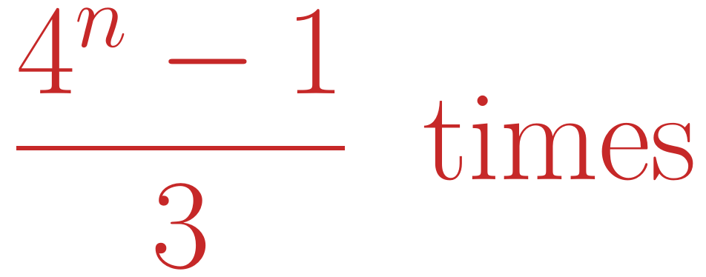
Solution to Question 7
Trace for n = 4, r = 4:
Answer
i | q at start of pass | j takes the values | inner passes | k after pass
1 | 1 | 0 | 1 | 1
2 | 4 | 0, 1, 2, 3 | 4 | 1 + 4 = 5
3 | 16 | 0, 1, …, 15 | 16 | 5 + 16 = 21
4 | 64 | 0, 1, …, 63 | 64 | 21 + 64 = 85
5 | 256 | outer test 5 ≤ 4 fails → the loop ends
$$\frac{4^{n}−1}{3} times$$
For n = 4: (256 − 1)/3 = 85, as in the table. Exponential growth: Θ(4ⁿ).
Watch the last term
General formula
The outer loop runs n times, so q takes the values r⁰, r¹, …, rⁿ⁻¹. The sum has n terms and stops at exponent n − 1.
$$k=1+r+r^{2}+⋯+r^{n−1}=\sum_{i=0}^{n−1}{r^{i}}=\frac{r^{n}−1}{r−1}$$
Summing up to rⁿ would count one pass too many (341 instead of 85 for n = 4).
Notes:
Inner body runs 1+4+...+4^(n-1) = (4^n-1)/3 times; n=4 gives 85.

Slide 25
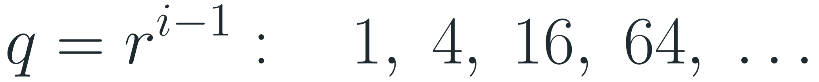
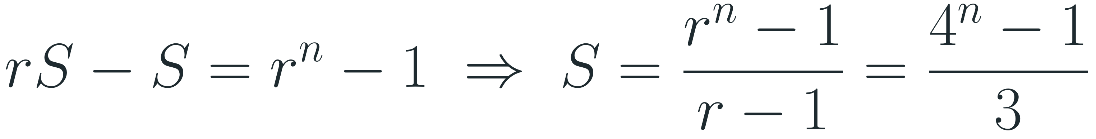
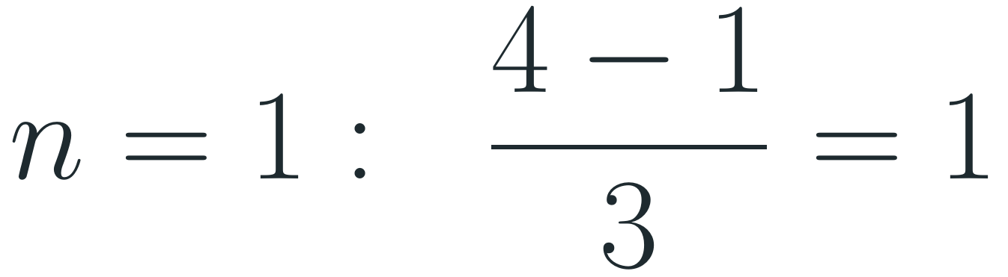
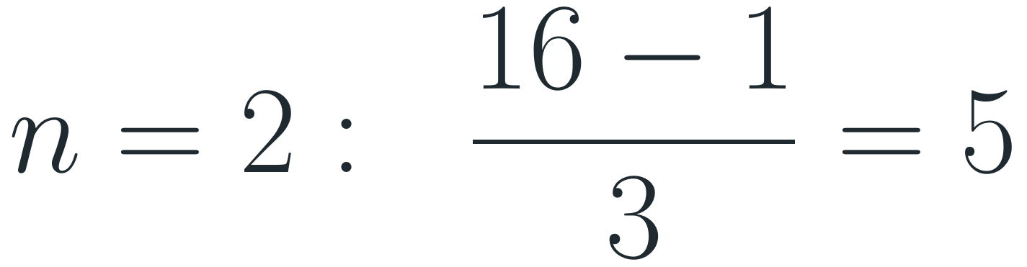
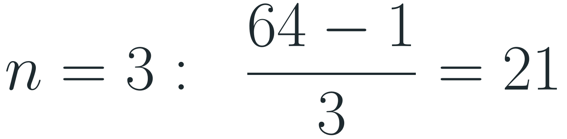
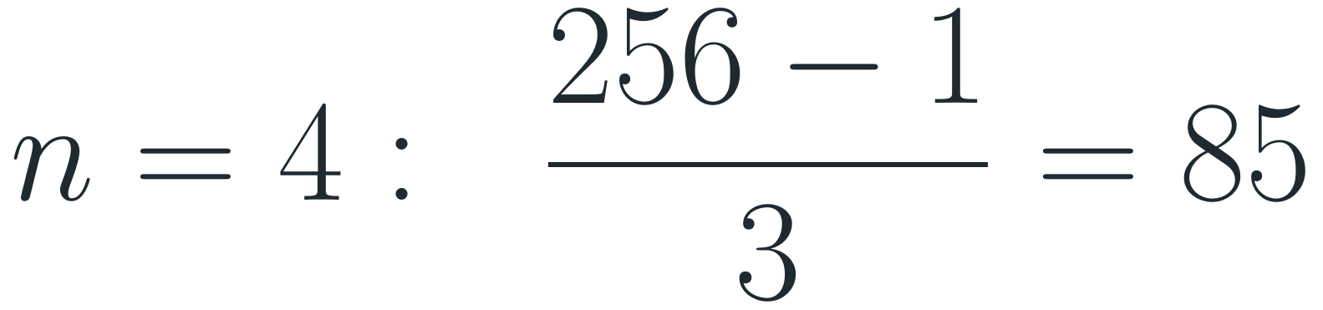
Question 7 — Explanation
1
Outer loop: i runs 1, 2, …, n → n passes (same pattern as Question 1).
Check the formula
2
q grows geometrically: q starts at 1 and is multiplied by r = 4 after each outer pass, so on pass number i:
$$n=1: \frac{4−1}{3}=1$$
$$q=r^{i−1}: 1, 4, 16, 64, …$$
$$n=2: \frac{16−1}{3}=5$$
3
Inner loop: j starts at 0 and runs while j < q, growing by 1 → exactly q passes (j = 0, 1, …, q − 1).
$$n=3: \frac{64−1}{3}=21$$
4
Add them up: a geometric series with n terms (the last exponent is n − 1, not n):
$$n=4: \frac{256−1}{3}=85$$
$$S=1+r+r^{2}+⋯+r^{n−1}$$
5
Sum it: multiply by r and subtract — everything cancels except two terms:
These match the k column of the trace table: k starts at 0 and grows by 1 per inner pass.
$$rS−S=r^{n}−1 ⇒ S=\frac{r^{n}−1}{r−1}=\frac{4^{n}−1}{3}$$
6
Growth: Θ(4ⁿ) — exponential, even though the code is just two nested loops: the inner loop gets 4× longer on every outer pass.

Slide 26
Question 8
(a) Count how many times the body of the while loop is executed in the following code.
(b) What is the value of the variable i when the while loop ends? (as a function of n)
Trace it — fill in k and i after each pass:
T(n)
k ← 0
i ← 1
while i < n do
k ← k + 1
i ← i * 2
k
i

Slide 27
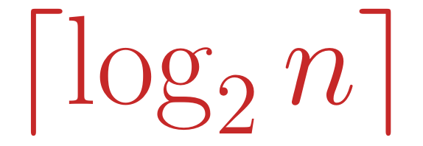
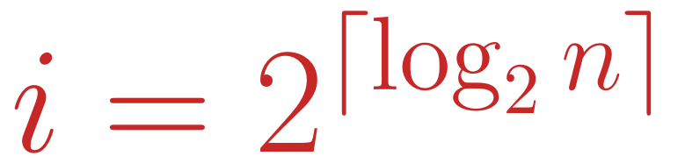
Solution to Question 8
Trace: after k passes of the loop, i has doubled k times.
Answer
k | 0 | 1 | 2 | 3 | 4 | 5 | 6 | 7 | 8
i | 1 | 2 | 4 | 8 | 16 | 32 | 64 | 128 | 256
(a) Number of passes of the body:
$$\left\lceil \log_{2}n\right\rceil$$
(b) Final value of i — the smallest power of 2 that is ≥ n:
Derivation
$$i=2^{\left\lceil \log_{2}n\right\rceil }$$
After k passes i = 2ᵏ, and the loop stops at the first k with:
$$2^{k}≥n ⇔ k≥\log_{2}n ⇒ k=\left\lceil \log_{2}n\right\rceil$$
(For n ≤ 1 the loop does not run and i = 1.)
Example: n = 100
$$\log_{2}100≈6.64 ⇒ \left\lceil \log_{2}100\right\rceil =7$$
i = 1, 2, 4, 8, 16, 32, 64 are all < 100 → 7 passes; then i = 128 ≥ 100 ends the loop.
Notes:
(a) ceil(log2 n) passes. (b) i = 2^ceil(log2 n). n=100: 7 passes, i=128.

Slide 28
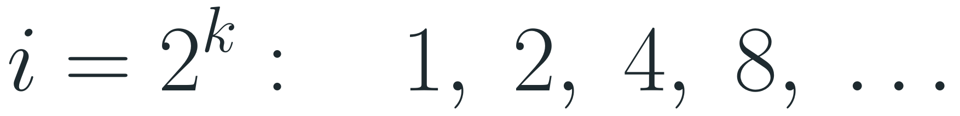
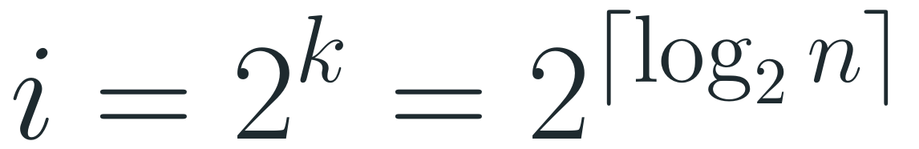
Question 8 — Explanation
1
Trace i: i starts at 1 and doubles on every pass, so after k passes:
Examples
$$i=2^{k}: 1, 2, 4, 8, …$$
n = 64: log₂ 64 = 6 → 6 passes, i = 64
2
When does it stop? The loop runs while i < n, so it stops at the first k for which 2ᵏ ≥ n.
n = 100: log₂ 100 ≈ 6.64 → 7 passes, i = 128
3
Solve for k — the smallest whole number with this property is the number of passes (a):
n = 128: log₂ 128 = 7 → 7 passes, i = 128
$$2^{k}≥n ⇔ k≥\log_{2}n ⇒ k=\left\lceil \log_{2}n\right\rceil$$
n = 129: log₂ 129 ≈ 7.01 → 8 passes, i = 256
4
Final value (b): if n is a power of 2, then i = n exactly; otherwise i is the next power of 2 above n:
$$i=2^{k}=2^{\left\lceil \log_{2}n\right\rceil }$$
5
Growth: Θ(log n). Doubling reaches n very quickly — the same idea makes binary search fast.

Slide 29
Question 9
How many times is the multiplication k ← k * 2 executed in the following code?
T(n)
for i ← 1 to n do
k ← 1
while k < i do
k ← k * 2
Hint — reuse Question 8
A loop that starts at 1 and doubles while it is < n runs ⌈log₂ n⌉ times.
QUESTION 8
while i < n do
i ← i * 2 ⌈log₂ n⌉ passes

Slide 30
Solution to Question 9 — Step 1: Trace the Code
i | values of k (start at 1, double until k ≥ i) | multiplications
1 | 1 | 0
2 | 1 → 2 | 1
3 | 1 → 2 → 4 | 2
4 | 1 → 2 → 4 | 2
5 | 1 → 2 → 4 → 8 | 3
6 | 1 → 2 → 4 → 8 | 3
7 | 1 → 2 → 4 → 8 | 3
8 | 1 → 2 → 4 → 8 | 3
Total multiplications for n = 8 |  | 17
How to read a row
For each i, k starts at 1 and is doubled while k < i.
Every arrow → is one execution of k ← k * 2.
Example i = 5: 1 → 2 → 4 → 8. Three arrows, so 3 multiplications. Then 8 ≥ 5 and the inner loop stops.
For n = 8
0 + 1 + 2 + 2 + 3 + 3 + 3 + 3 = 17 multiplications.
Notes:
Trace for n = 8. Each arrow is one multiplication. Total 17.

Slide 31
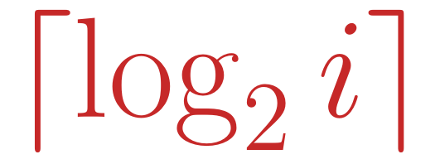
Solution to Question 9 — Step 2: The Pattern
Group the passes by the number of multiplications they do:
Rule for pass i
multiplications | passes i | how many passes
0 | 1 | 1
1 | 2 | 1
2 | 3, 4 | 2
3 | 5, 6, 7, 8 | 4
4 | 9, 10, …, 16 | 8
5 | 17, 18, …, 32 | 16
Pass i does as many multiplications as the number of times we must double 1 to reach at least i:
$$\left\lceil \log_{2}i\right\rceil$$
(log₂ i rounded up). This is exactly Question 8 with n replaced by i.
Examples
i = 5: log₂ 5 ≈ 2.32 → rounded up 3
Each time i passes a power of 2, one more doubling is needed.
i = 8: log₂ 8 = 3 → 3
i = 9: log₂ 9 ≈ 3.17 → rounded up 4
Notes:
Pass i does ceil(log2 i) multiplications: the number of doublings needed to get from 1 to at least i.

Slide 32
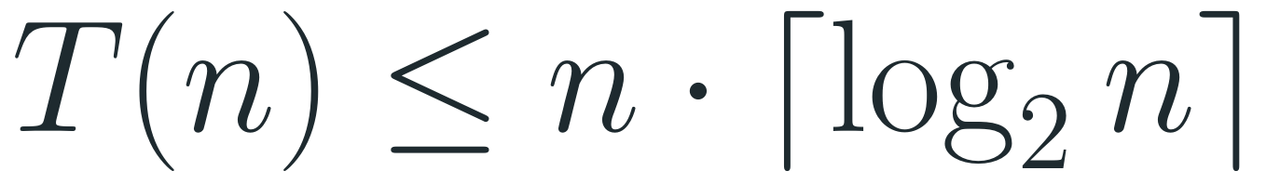
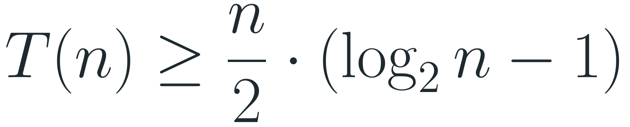

Solution to Question 9 — Step 3: Add It Up
1
The total is the sum over all passes:
Check the numbers
$$T(n)=\left\lceil \log_{2}1\right\rceil +\left\lceil \log_{2}2\right\rceil +⋯+\left\lceil \log_{2}n\right\rceil$$
Exact count vs. n · log₂ n:
2
Not more than: there are n passes, and no pass does more than ⌈log₂ n⌉ multiplications:
n | exact T(n) | n · log₂ n
8 | 17 | 24
16 | 49 | 64
1024 | 9217 | 10240
$$T(n)≤n·\left\lceil \log_{2}n\right\rceil$$
3
Not less than: the last half of the passes (i > n/2) each do at least log₂ n − 1 multiplications:
$$T(n)≥\frac{n}{2}·(\log_{2}n−1)$$
4
Both limits grow like n · log₂ n, so the answer is:
Same as log₂(n!)
$$T(n)=Θ(nlogn)$$
Without rounding, log₂ 1 + log₂ 2 + … + log₂ n = log₂(1 · 2 · … · n) = log₂(n!), which is also Θ(n log n).
Notes:
Total between (n/2)(log2 n - 1) and n*ceil(log2 n), so about n log2 n: Theta(n log n).

Slide 33
Question 10
An array of n elements is given.
How many comparisons between array elements are needed to find the maximum element?
7
3
9
1
6
4
What to find
Write an algorithm and count only comparisons between two array elements — not loop-counter tests.
A[0]
A[1]
A[2]
A[3]
A[4]
A[5]
n = 6 in this example — which element is the largest, and how few comparisons can prove it?

Slide 34
Solution to Question 10
Code | Times executed
max_Search(A)
Max ← A[0] | 1
for i ← 1 to n − 1 do | n
if A[i] > Max then | n − 1
Max ← A[i] | 0 … n − 1
return Max | 1
Answer
n − 1 comparisons
Always exactly n − 1 — in the best, worst and average case.
Notes on the code
The array is A[0 … n − 1], so the loop goes from 1 to n − 1 (1-based version: Max ← A[1], for i ← 2 to n).
Highlighted: the only line that compares array elements. Array indices: A[0 … n − 1].
Max ← A[i] runs only when a new maximum is found: between 0 and n − 1 times.
Notes:
n-1 comparisons in every case.

Slide 35
Question 10 — Explanation
1
Idea: keep the largest value seen so far in Max. Start with Max ← A[0] — no comparison is needed yet.
Example
A = [4, 9, 2, 7, 5], n = 5
2
Scan the rest: each of the other n − 1 elements is compared with Max exactly once → n − 1 element comparisons.
9 > 4? yes → Max = 9
2 > 9? no
3
What we don't count: the loop test i ≤ n − 1 compares indices, not array elements.
7 > 9? no
5 > 9? no
4
Independent of the data: the number of comparisons is always n − 1. Only the number of assignments Max ← A[i] depends on the data: 0 (maximum is first) up to n − 1 (array sorted in increasing order).
4 = n − 1 comparisons, 1 assignment
5
n − 1 is optimal: every element except the maximum must lose at least one comparison to be ruled out, and each comparison has only one loser. So no algorithm can use fewer than n − 1.

Slide 36
Question 11
An array of n elements is given.
How many comparisons between two array elements are needed to find the two largest numbers?
7
3
9
1
6
4
REMINDER — QUESTION 10 (1-BASED)
max_Search(A)
Max ← A[1]
for i ← 2 to length[A] do
if A[i] > Max then
Max ← A[i]
return Max
A[0]
A[1]
A[2]
A[3]
A[4]
A[5]
Here the answer would be 9 and 7. Can you reuse the algorithm from Question 10?

Slide 37
Solution to Question 11
Code | Comparisons
max2_Search(A)
n ← size(A)
Max1 ← A[0]; index ← 0
for i ← 1 to n − 1 do
if A[i] > Max1 then | n − 1
Max1 ← A[i]; index ← i
A' ← A without A[index] | 0
Max2 ← A'[0]
for i ← 1 to n − 2 do
if A'[i] > Max2 then | n − 2
Max2 ← A'[i]
return Max1, Max2
Total element comparisons | 2n − 3
Answer
(n − 1) + (n − 2) = 2n − 3
comparisons with this two-pass algorithm. Removing A[index] moves elements but compares none.
Can we do better?
Yes — 2n − 3 is what this algorithm uses. A tournament needs only n + ⌈log₂ n⌉ − 2 comparisons (see the next slide).
Notes:
(n-1)+(n-2) = 2n-3 comparisons with this algorithm. Returns Max1 and Max2.

Slide 38

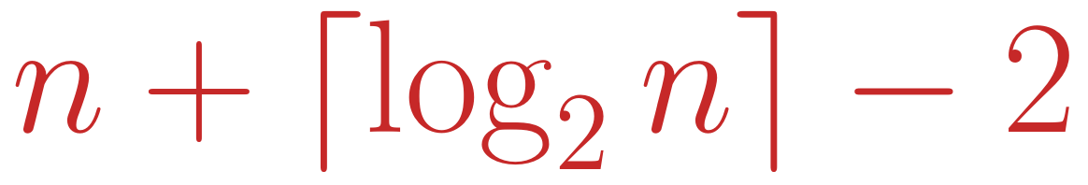
Question 11 — Explanation
1
Pass 1 = Question 10: find the largest element and remember its position → n − 1 comparisons.
Going further: a tournament
Pair the elements in a knockout tournament: n − 1 matches find the maximum (each match eliminates one element).
2
Remove it: copying A without A[index] moves elements but compares none. n − 1 elements remain.
3
Pass 2: the maximum of the remaining n − 1 elements is the second largest → (n − 1) − 1 = n − 2 comparisons.
The second largest lost only to the maximum, so it is one of the ≤ ⌈log₂ n⌉ elements the maximum beat. The best of them costs ⌈log₂ n⌉ − 1 more comparisons.
4
Total: (n − 1) + (n − 2) = 2n − 3 = Θ(n). If the maximum appears twice, Max2 = Max1 — still correct.
Total — and this is optimal:
$$n+\left\lceil \log_{2}n\right\rceil −2$$
n = 8: 9 comparisons instead of 13.

Slide 39
Thank you

