Slide 1
Recurrence Relations
DATA STRUCTURES · LESSON 3
Iteration method, master method and recursion trees - exercises with step-by-step solutions

Slide 2



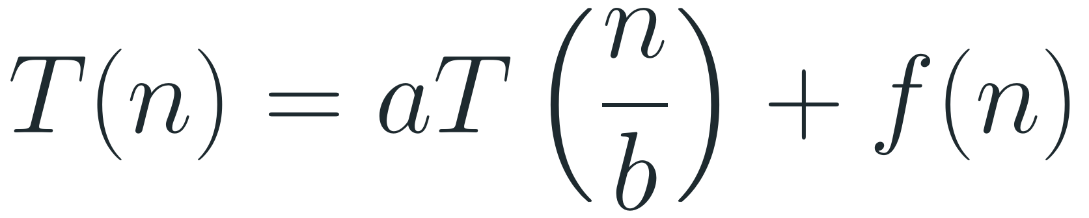
Methods for Solving Recurrences
A recurrence describes the running time of a recursive algorithm in terms of its running time on smaller inputs. We will use three methods to solve recurrences:
1. Iteration method
2. Master method
3. Recursion tree (optional)
Substitute the recurrence into itself again and again until the base case is reached.
For recurrences of the form
Draw the tree of recursive calls.
$$T(n)=aT(\frac{n}{b})+f(n)$$
Compute the work on every level, then add the levels.
Then bound the resulting sum.
compare f(n) with the critical power n^{c}, where c = log_{b} a.

Slide 3

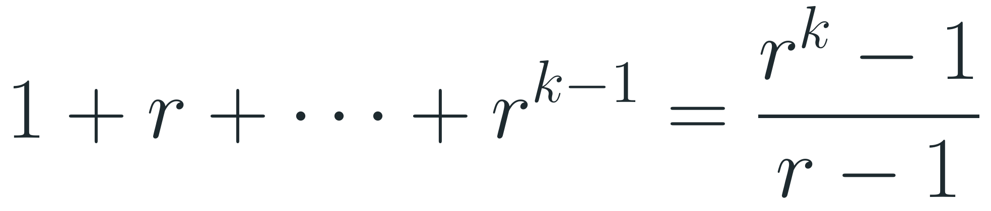
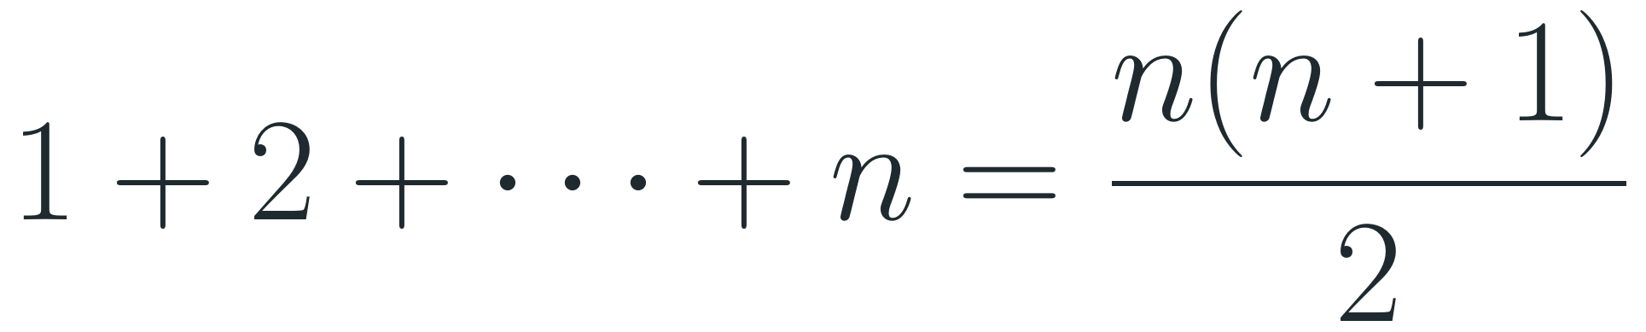
The Iteration Method
1
Expand: replace T(·) on the right side by its own definition, again and again.
Useful sums
Arithmetic:
2
Find the pattern: after i expansions, write the expression as a formula in i.
$$1+2+⋯+n=\frac{n(n+1)}{2}$$
3
Reach the base case: choose i so that the argument becomes the base case (for example n − i = 0 or n / 2ⁱ = 1).
Geometric (r ≠ 1):
$$1+r+⋯+r^{k−1}=\frac{r^{k}−1}{r−1}$$
4
Sum and bound: compute or bound the sum that appeared (arithmetic or geometric series, log(n!), …).
Logarithms:
$$log1+log2+⋯+logn=log(n!)=Θ(nlogn)$$

Slide 4

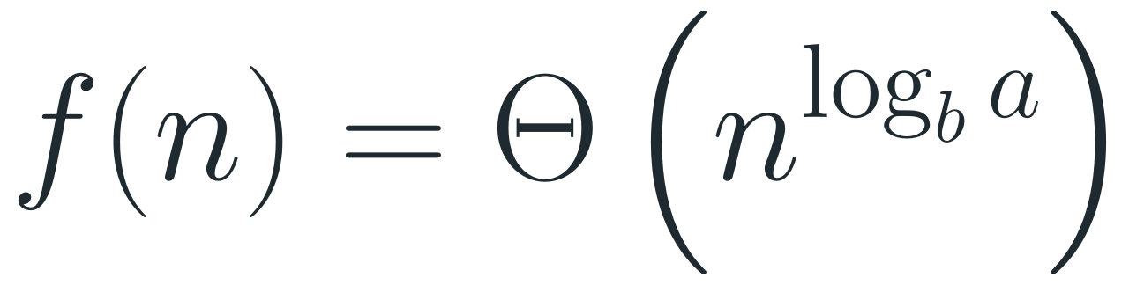
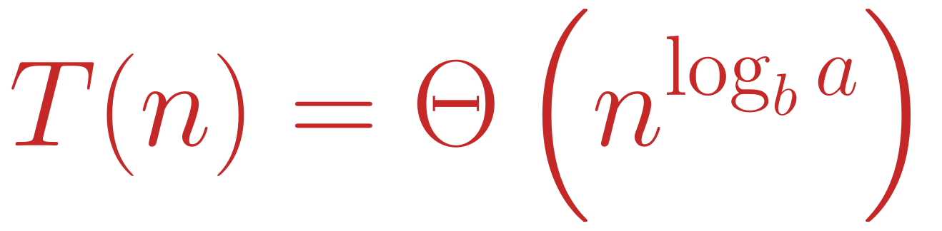
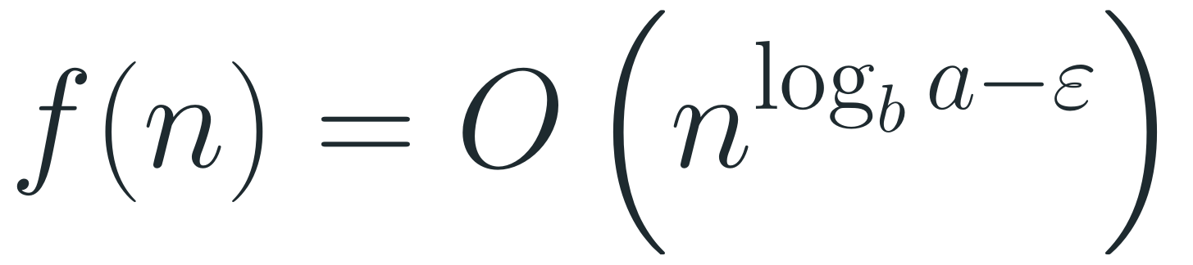
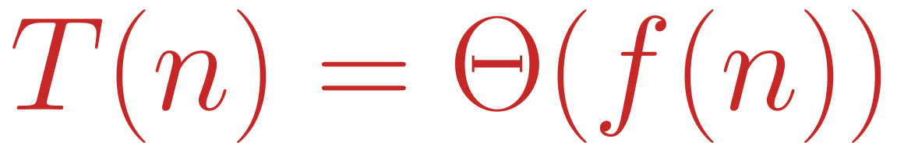
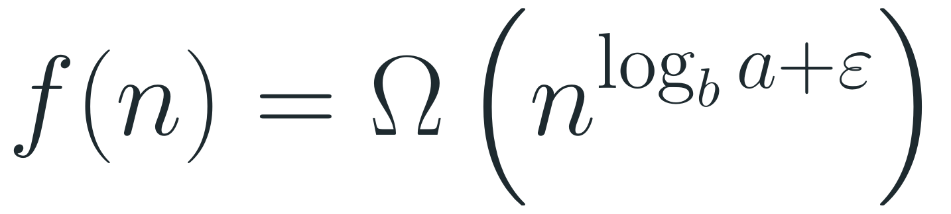
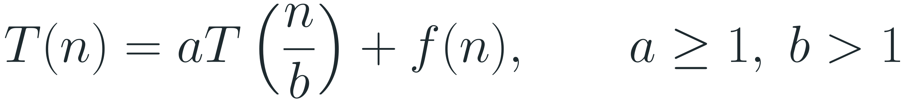
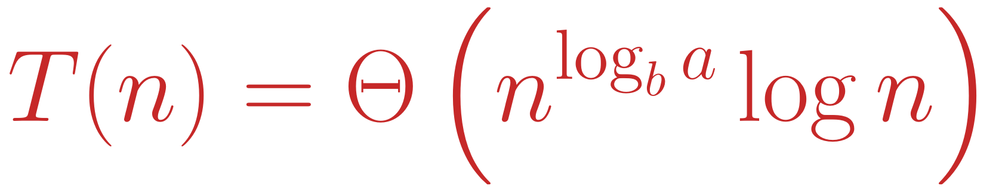
The Master Method
Setting
$$T(n)=aT(\frac{n}{b})+f(n), a≥1, b>1$$
Idea (informal): compare f(n) with the critical power n^{c}, c = log_{b} a, and see which one is dominant.
Case 1 - leaves dominate
Case 2 - balanced
Case 3 - root dominates
If
If
If
$$f(n)=O(n^{\log_{b}a−ε})$$
$$f(n)=Θ(n^{\log_{b}a})$$
$$f(n)=Ω(n^{\log_{b}a+ε})$$
for some ε > 0
then
for some ε > 0, and a·f(n/b) ≤ c·f(n) for some c < 1 and all large n
then
$$T(n)=Θ(n^{\log_{b}a}logn)$$
$$T(n)=Θ(n^{\log_{b}a})$$
then
$$T(n)=Θ(f(n))$$

Slide 5
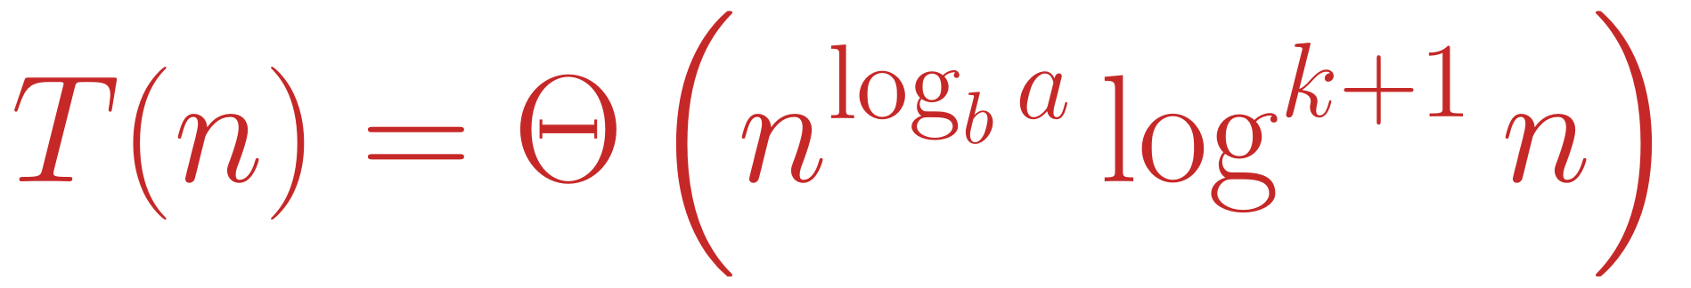
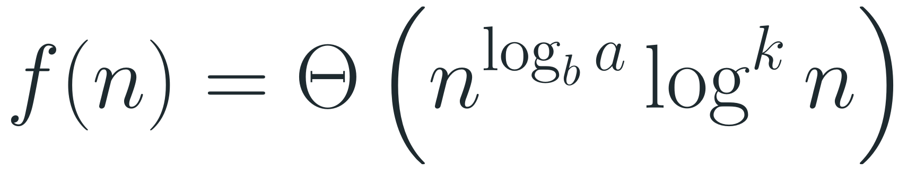
Master Method - Extended Case 2 and Recipe
1
Read off a, b and f(n).
Extended case 2
If, for some k ≥ 0,
2
Compute the critical power n^{c}, where c = log_{b} a.
$$f(n)=Θ(n^{\log_{b}a}\log^{k}n)$$
3
Compare f(n) with it: polynomially smaller → case 1, same → case 2, polynomially larger → case 3 (check the regularity condition).
then
$$T(n)=Θ(n^{\log_{b}a}\log^{k+1}n)$$
4
Write the answer for that case.
With k = 0 this is exactly case 2.

Slide 6
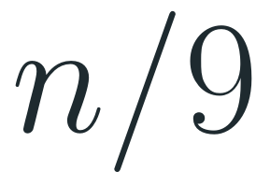

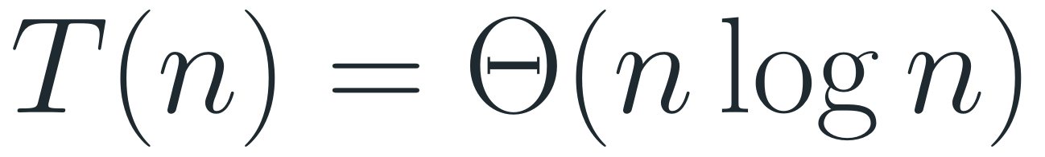
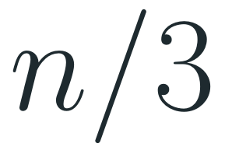

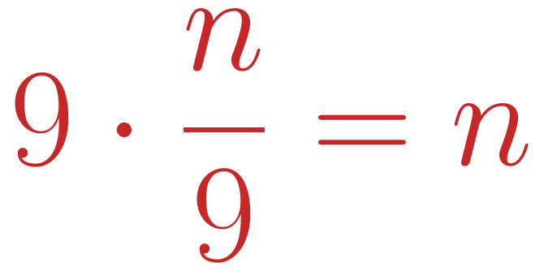
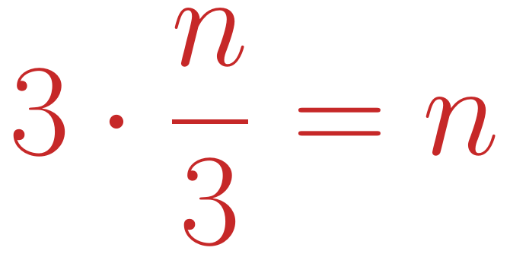

The Recursion Tree Method (Optional)
1
Draw the tree of recursive calls; write the extra work f of each call inside its node.
$$n$$
$$=n$$
2
Compute the total work on each level of the tree.
$$n/3$$
$$n/3$$
$$n/3$$
$$3·\frac{n}{3}=n$$
3
Add up all levels to get the total work.
$$n/9$$
$$n/9$$
$$n/9$$
$$n/9$$
$$n/9$$
$$n/9$$
$$n/9$$
$$n/9$$
$$n/9$$
$$9·\frac{n}{9}=n$$
4
Example T(n) = 3T(n/3) + n: every level costs n, and there are log₃ n levels, so
⋮
$$T(n)=Θ(nlogn)$$
$$1 1 1 ⋯ 1 (n leaves)$$
$$=n$$

Slide 7

Exercise 1
The following algorithm computes n!. Write its recurrence relation and solve it. What is the running-time complexity?
fact(n)
if (n == 0)
return 1
return n * fact(n - 1)
What to find
A recurrence T(n) for the running time, and its solution as Θ(·).
Hint: how many recursive calls does one call make, and on what input size?

Slide 8
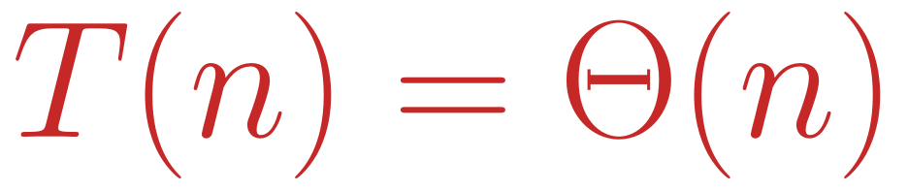
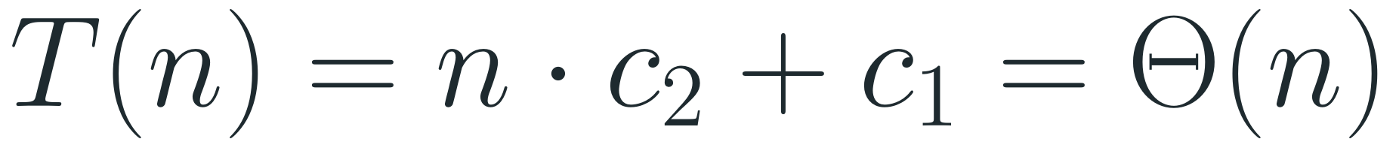
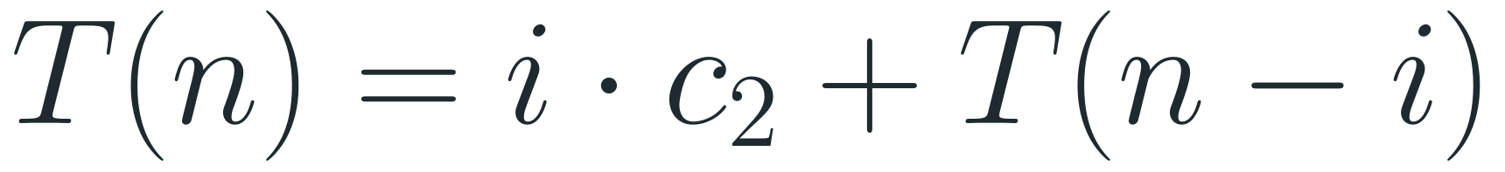
Solution to Exercise 1
1
Recurrence. The base case costs a constant c₁; otherwise one call does constant work c₂ plus one call on n − 1:
Answer
$$T(0)=c_{1}, T(n)=T(n−1)+c_{2} (n>0)$$
$$T(n)=Θ(n)$$
2
Expand:
The algorithm makes n + 1 calls, each doing constant work.
$$T(n)=c_{2}+T(n−1)=2c_{2}+T(n−2)=3c_{2}+T(n−3)$$
3
Pattern after i steps:
$$T(n)=i·c_{2}+T(n−i)$$
4
Base case n − i = 0, i.e. i = n:
$$T(n)=n·c_{2}+c_{1}=Θ(n)$$

Slide 9

Exercise 1 - Explanation
1
What c₁ and c₂ mean: c₁ is the cost of the test n == 0 plus return 1. c₂ is the cost of the test, the multiplication and the call itself - all constants.
Check: fact(3)
The calls and their costs:
2
Each expansion adds one c₂ and lowers the argument by 1, so after i expansions we have i · c₂ + T(n − i).
call | cost
fact(3) | c₂
fact(2) | c₂
fact(1) | c₂
fact(0) | c₁
total | 3c₂ + c₁
3
We stop at the base case T(0), which happens after exactly n expansions.
4
Linear time: n · c₂ + c₁ grows like n, so T(n) = Θ(n) (and in particular O(n)).

Slide 10
Exercise 2
The following algorithm finds the maximum of an unsorted array A[left … right]. Write its recurrence relation and solve it.
max(left, right)
if (left == right)
return A[left]
else
c = (left + right) / 2
m1 = max(left, c)
m2 = max(c + 1, right)
return (m1 > m2) ? m1 : m2
What to find
Let n = right − left + 1 be the size of the range.
How many recursive calls, and on what sizes?

Slide 11
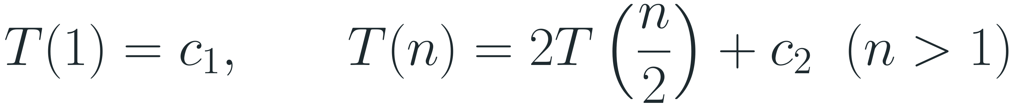
Solution to Exercise 2
1
Recurrence (n a power of 2). One element costs c₁; otherwise constant work c₂ plus two calls on halves:
Answer
$$T(1)=c_{1}, T(n)=2T(\frac{n}{2})+c_{2} (n>1)$$
$$T(n)=Θ(n)$$
Same order as a simple loop over the array.
2
Expand:
$$T(n)=c_{2}+2T(\frac{n}{2})=3c_{2}+4T(\frac{n}{4})=7c_{2}+8T(\frac{n}{8})$$
3
Pattern after i steps (the constants 1, 3, 7 are 2ⁱ − 1):
$$T(n)=(1+2+⋯+2^{i−1}) c_{2}+2^{i} T(\frac{n}{2^{i}})=(2^{i}−1) c_{2}+2^{i} T(\frac{n}{2^{i}})$$
4
Base case n / 2ⁱ = 1, i.e. 2ⁱ = n:
$$T(n)=(n−1) c_{2}+n c_{1}=Θ(n)$$

Slide 12
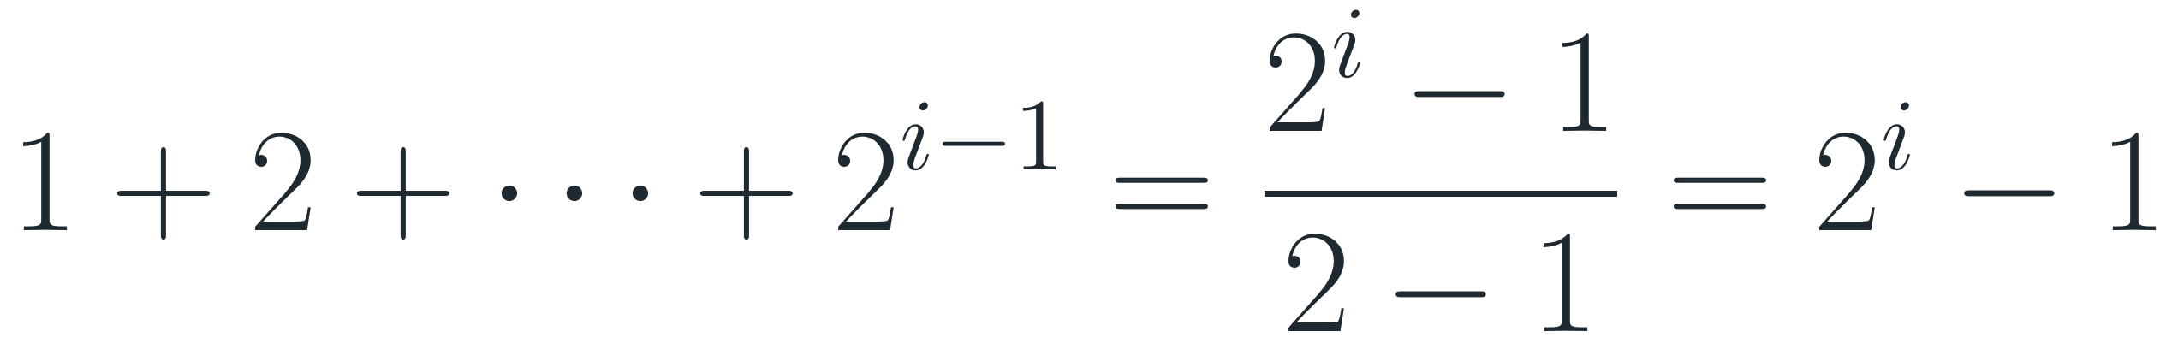
Exercise 2 - Explanation
1
The geometric sum. 1 + 2 + 4 + ⋯ + 2ⁱ⁻¹ has i terms, each double the previous one:
Check: n = 8
$$1+2+⋯+2^{i−1}=\frac{2^{i}−1}{2−1}=2^{i}−1$$
Calls on each level of the recursion:
2
Counting calls: the recursion tree has n leaves (one per element, cost c₁) and n − 1 inner calls (cost c₂ each). That is exactly (n − 1)c₂ + nc₁.
size | calls | cost
8 | 1 | c₂
4 | 2 | 2c₂
2 | 4 | 4c₂
1 | 8 | 8c₁
total |  | 7c₂ + 8c₁
3
Link to Lesson 1: each inner call does one comparison m1 > m2, so the algorithm uses n − 1 comparisons - the same as the simple loop.

Slide 13
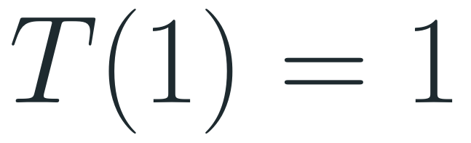
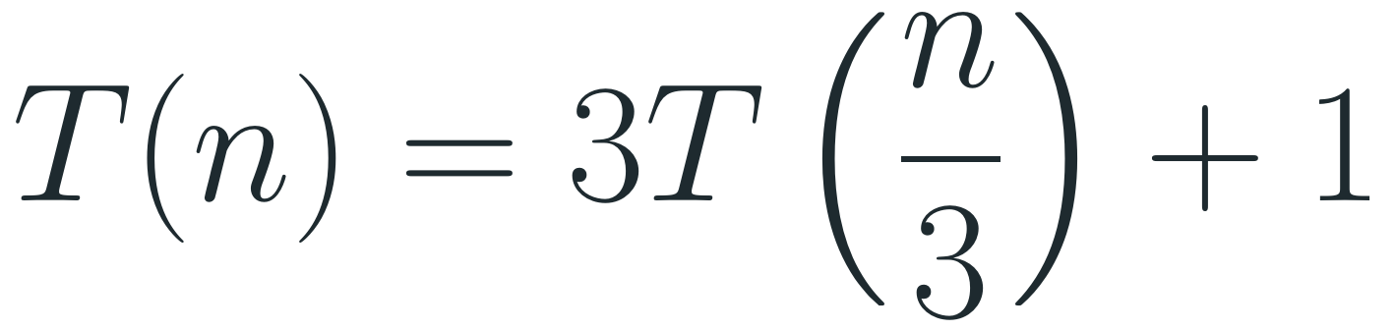
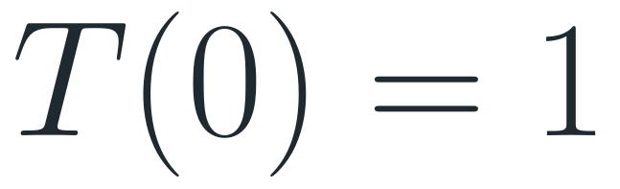
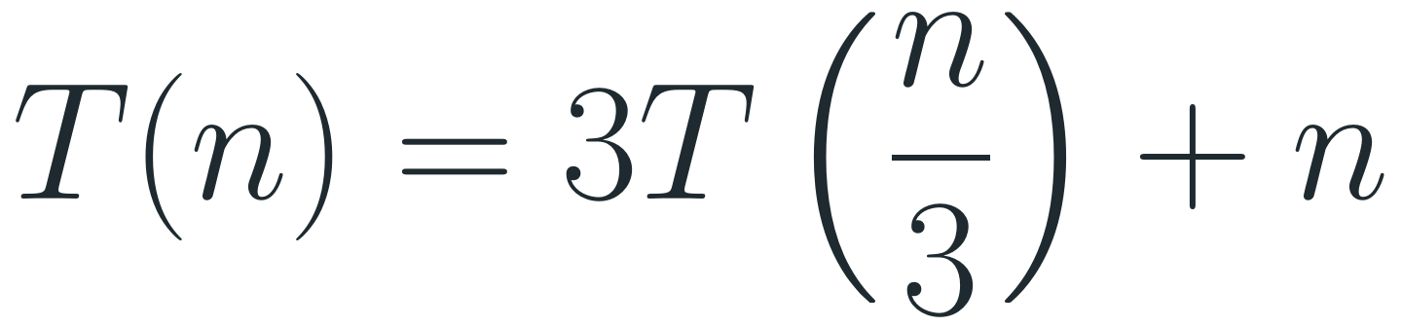
Exercise 3
Solve each recurrence using the iteration method:
Part 1
Part 2
Part 3
$$T(0)=1$$
$$T(1)=1$$
$$T(1)=1$$
$$T(n)=T(n−1)+logn, n>0$$
$$T(n)=3T(\frac{n}{3})+1$$
$$T(n)=3T(\frac{n}{3})+n$$

Slide 14

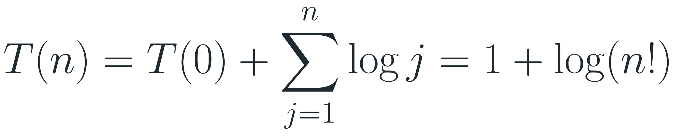
Solution to Exercise 3 - Part 1
1
Expand:
Answer
$$T(n)=T(n−1)+logn=T(n−2)+log(n−1)+logn$$
$$=T(n−3)+log(n−2)+log(n−1)+logn$$
$$T(n)=1+log(n!)=Θ(nlogn)$$
2
Pattern after k steps:
$$T(n)=T(n−k)+log(n−k+1)+⋯+log(n−1)+logn$$
3
Base case n − k = 0, i.e. k = n:
$$T(n)=T(0)+\sum_{j=1}^{n}{logj}=1+log(n!)$$
4
Bound: log(n!) = Θ(n log n) (next slide), so
$$T(n)=Θ(nlogn)$$

Slide 15
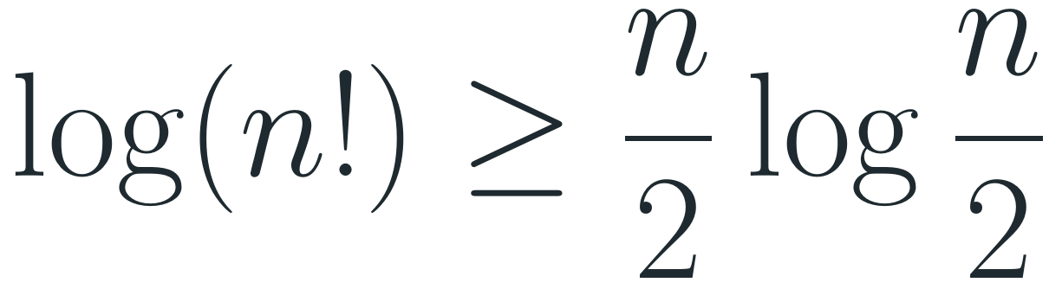
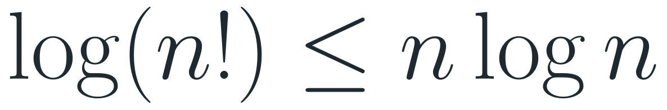
Exercise 3, Part 1 - Explanation
1
Each expansion adds one log term and lowers the argument by 1, so we collect log n, log(n − 1), …, log 1. (log 1 = 0, so the sum can start at j = 1 or j = 2.)
Check the numbers
log base 2:
2
Combine the logs with log a + log b = log(a · b):
n | 1 + log(n!) | n log n
4 | ≈ 5.6 | 8
8 | ≈ 16.3 | 24
16 | ≈ 45.3 | 64
$$log1+log2+⋯+logn=log(1·2⋯n)=log(n!)$$
3
Upper bound: every factor is ≤ n, so n! ≤ nⁿ:
$$log(n!)≤nlogn$$
4
Lower bound: the largest n/2 factors are each ≥ n/2:
$$log(n!)≥\frac{n}{2}log\frac{n}{2}$$

Slide 16
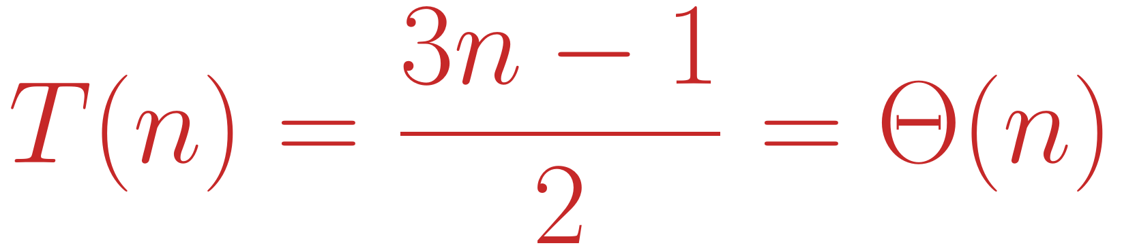
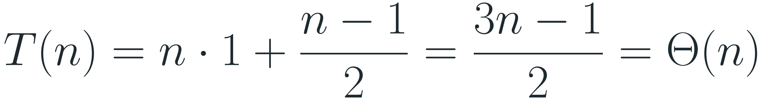
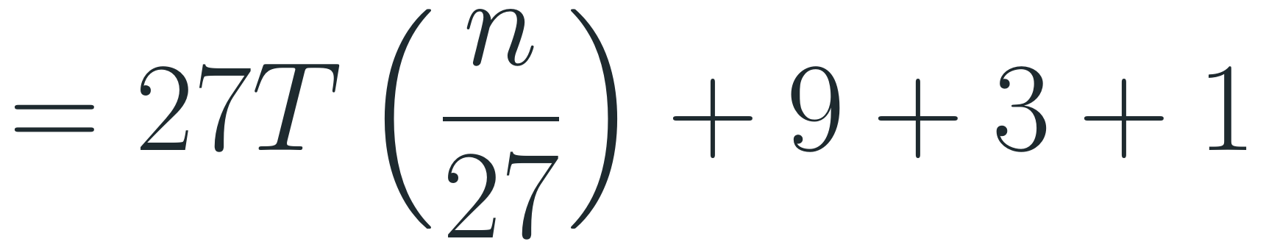
Solution to Exercise 3 - Part 2
1
Expand:
Answer
$$T(n)=3T(\frac{n}{3})+1=3(3T(\frac{n}{9})+1)+1=9T(\frac{n}{9})+3+1$$
$$T(n)=\frac{3n−1}{2}=Θ(n)$$
$$=27T(\frac{n}{27})+9+3+1$$
2
Pattern after k steps - a geometric sum:
$$T(n)=3^{k} T(\frac{n}{3^{k}})+(1+3+⋯+3^{k−1})=3^{k} T(\frac{n}{3^{k}})+\frac{3^{k}−1}{2}$$
3
Base case n / 3ᵏ = 1, i.e. 3ᵏ = n:
$$T(n)=n·1+\frac{n−1}{2}=\frac{3n−1}{2}=Θ(n)$$

Slide 17
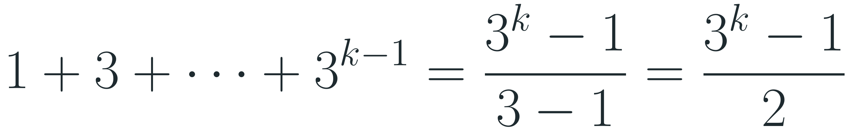
Exercise 3, Part 2 - Explanation
1
The geometric sum has k terms with ratio 3:
Check the formula
$$1+3+⋯+3^{k−1}=\frac{3^{k}−1}{3−1}=\frac{3^{k}−1}{2}$$
Compute T directly and compare with (3n − 1)/2:
2
Where the work is: the leaves (n of them, cost 1 each) cost n; all inner calls together cost only (n − 1)/2. The leaves dominate - that is master-method case 1.
n | T(n) directly | (3n − 1)/2
1 | 1 | 1
3 | 3·1 + 1 = 4 | 4
9 | 3·4 + 1 = 13 | 13
27 | 3·13 + 1 = 40 | 40
3
Why linear: the extra work per call is constant, and the recursion tree has about 1.5n nodes in total.

Slide 18
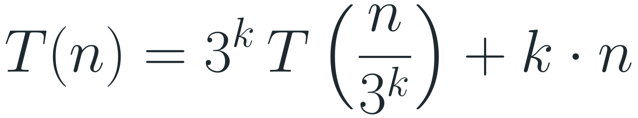
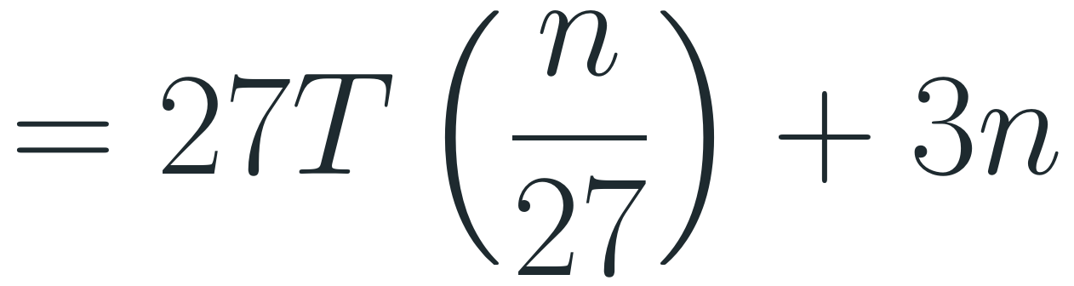
Solution to Exercise 3 - Part 3
1
Expand:
Answer
$$T(n)=3T(\frac{n}{3})+n=3(3T(\frac{n}{9})+\frac{n}{3})+n=9T(\frac{n}{9})+2n$$
$$T(n)=n+n\log_{3}n=Θ(nlogn)$$
$$=27T(\frac{n}{27})+3n$$
2
Pattern after k steps - every step adds exactly n:
$$T(n)=3^{k} T(\frac{n}{3^{k}})+k·n$$
3
Base case n / 3ᵏ = 1, i.e. k = log₃ n:
$$T(n)=n·T(1)+n\log_{3}n=n+n\log_{3}n=Θ(nlogn)$$

Slide 19
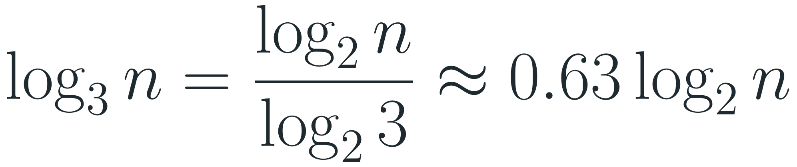
Exercise 3, Part 3 - Explanation
1
Every level costs n: level j has 3ʲ calls, each doing n / 3ʲ extra work - together exactly n (see the recursion-tree slide).
Check the formula
Compute T directly and compare with n + n·log₃ n:
2
There are log₃ n levels above the leaves, so the inner work is n log₃ n; the n leaves add n more.
n | T(n) directly | n + n log₃ n
3 | 3·1 + 3 = 6 | 3 + 3 = 6
9 | 3·6 + 9 = 27 | 9 + 18 = 27
27 | 3·27 + 27 = 108 | 27 + 81 = 108
3
The base of the log does not matter - it only changes a constant factor:
$$\log_{3}n=\frac{\log_{2}n}{\log_{2}3}≈0.63\log_{2}n$$

Slide 20
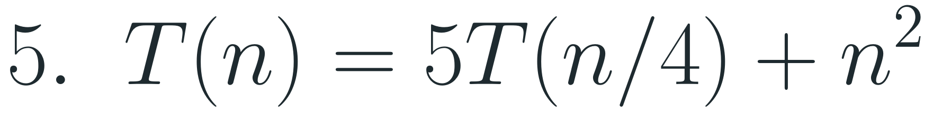
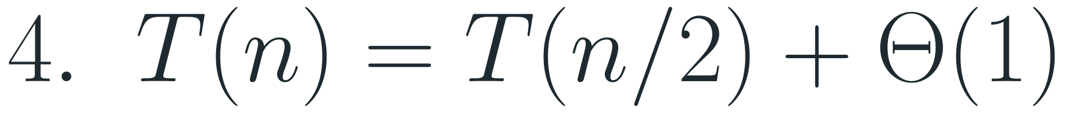
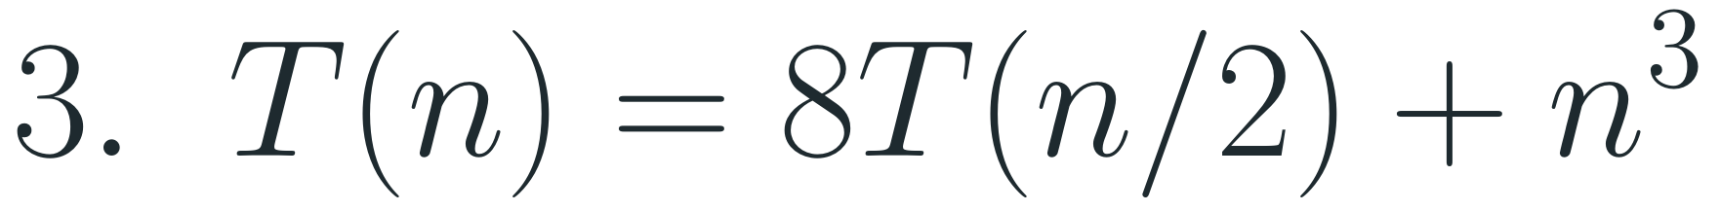
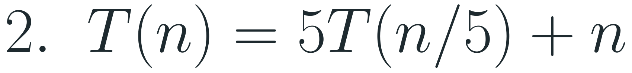
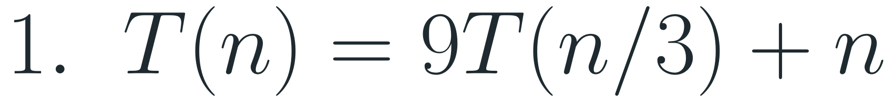
Exercise 4
Solve each recurrence using the master method:
Recurrences
Recipe
$$1. T(n)=9T(n/3)+n$$
1. Read off a, b, f(n).
2. Compute the critical power n^{c}, c = log_{b} a.
$$2. T(n)=5T(n/5)+n$$
3. Compare f(n) with it and pick the case.
$$3. T(n)=8T(n/2)+n^{3}$$
4. In case 3, check a·f(n/b) ≤ c·f(n) with c < 1.
$$4. T(n)=T(n/2)+Θ(1)$$
$$5. T(n)=5T(n/4)+n^{2}$$

Slide 21
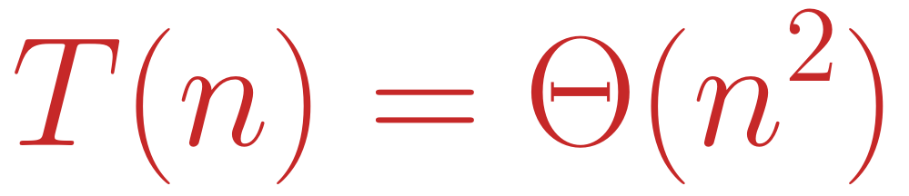
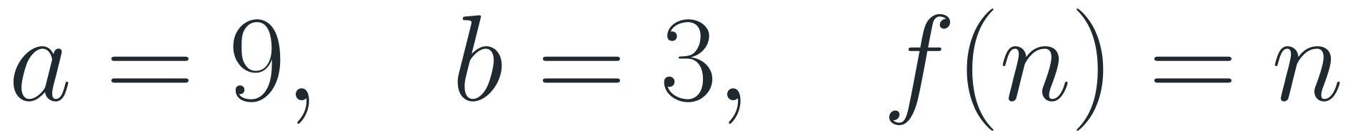
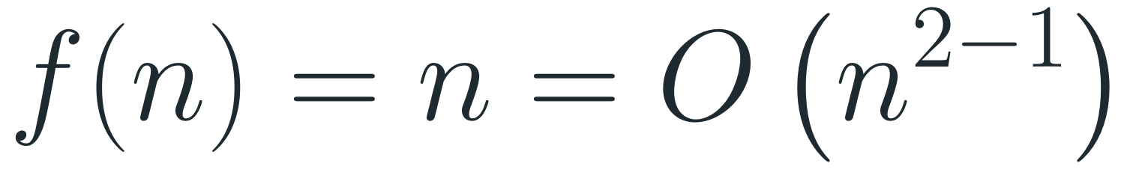
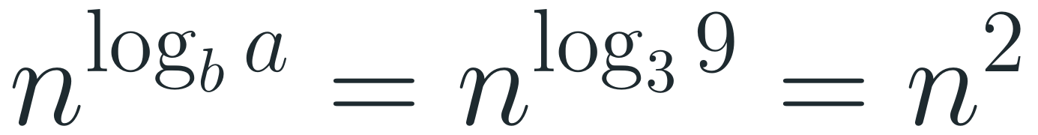
Exercise 4.1 - T(n) = 9T(n/3) + n
1
Read off:
Answer
$$a=9, b=3, f(n)=n$$
$$T(n)=Θ(n^{2})$$
2
Critical power:
$$n^{\log_{b}a}=n^{\log_{3}9}=n^{2}$$
Case 1
3
Compare: f(n) = n is polynomially smaller than n² (take ε = 1):
$$f(n)=n=O(n^{2−1})$$
Intuition
The tree has 9^{log₃ n} = n² leaves, and the leaves outweigh the work n at the root. Any ε with 0 < ε ≤ 1 works.
4
Case 1:
$$T(n)=Θ(n^{2})$$
Notes:
Case 1: Theta(n^2).

Slide 22
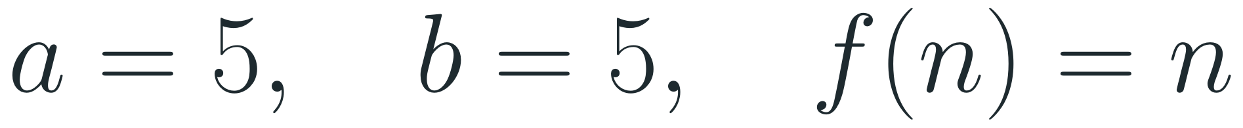
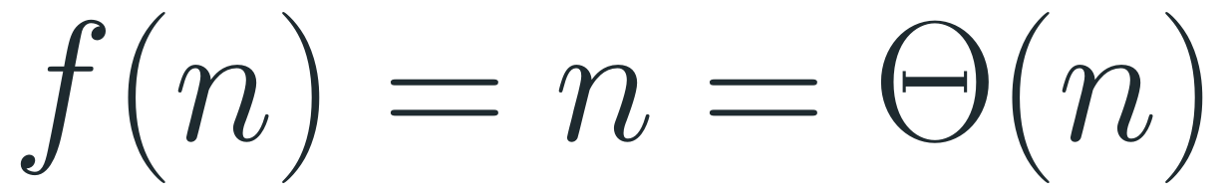
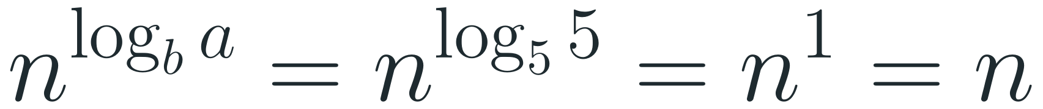
Exercise 4.2 - T(n) = 5T(n/5) + n
1
Read off:
Answer
$$a=5, b=5, f(n)=n$$
$$T(n)=Θ(nlogn)$$
2
Critical power:
Case 2 - the answer keeps the factor n.
$$n^{\log_{b}a}=n^{\log_{5}5}=n^{1}=n$$
3
Compare: f(n) grows exactly like the critical power:
$$f(n)=n=Θ(n)$$
Intuition
4
Case 2:
Every level of the tree costs n (5ʲ calls × n/5ʲ), and there are log₅ n levels - just like Exercise 3, Part 3.
$$T(n)=Θ(nlogn)$$
Notes:
Case 2: Theta(n log n).

Slide 23
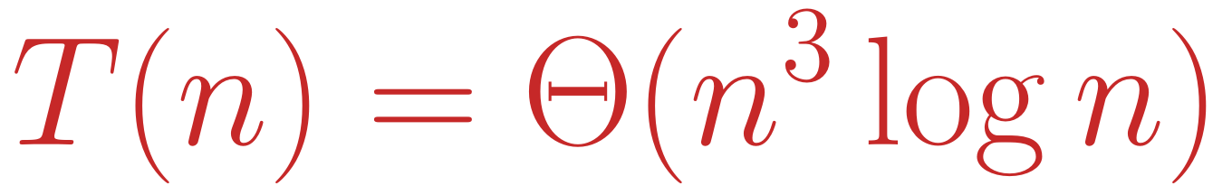
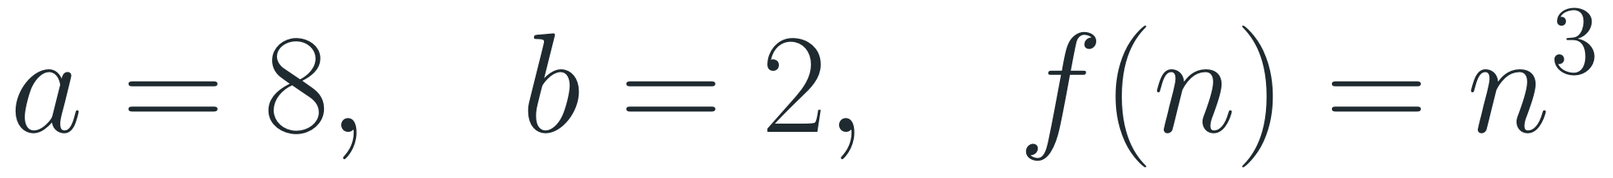


Exercise 4.3 - T(n) = 8T(n/2) + n³
1
Read off:
Answer
$$a=8, b=2, f(n)=n^{3}$$
$$T(n)=Θ(n^{3}logn)$$
2
Critical power:
Case 2
$$n^{\log_{b}a}=n^{\log_{2}8}=n^{3}$$
3
Compare: f(n) is exactly the critical power:
Intuition
$$f(n)=n^{3}=Θ(n^{3})$$
Level j has 8ʲ calls, each costing (n/2ʲ)³ = n³/8ʲ, so every level costs n³ - and there are log₂ n levels.
4
Case 2:
$$T(n)=Θ(n^{3}logn)$$
Notes:
Case 2: Theta(n^3 log n).

Slide 24




Exercise 4.4 - T(n) = T(n/2) + Θ(1)
1
Read off:
Answer
$$a=1, b=2, f(n)=Θ(1)$$
$$T(n)=Θ(logn)$$
2
Critical power:
Case 2
$$n^{\log_{b}a}=n^{\log_{2}1}=n^{0}=1$$
3
Compare: f(n) is a constant, just like n⁰ = 1:
Intuition
$$f(n)=Θ(1)=Θ(n^{0})$$
This is binary search: one call on half the input plus constant work. The input halves log₂ n times.
4
Case 2:
$$T(n)=Θ(n^{0}logn)=Θ(logn)$$
Notes:
Case 2: Theta(log n).

Slide 25



Exercise 4.5 - T(n) = 5T(n/4) + n²
1
Read off and critical power:
Answer
$$a=5, b=4, f(n)=n^{2}, n^{\log_{4}5}≈n^{1.16}$$
$$T(n)=Θ(n^{2})$$
2
Compare: n² is polynomially larger. Take ε = 2 − log₄ 5 ≈ 0.84 > 0:
Case 3
$$f(n)=n^{2}=Ω(n^{\log_{4}5+ε})$$
Intuition
3
Regularity condition: we need a·f(n/b) ≤ c·f(n) with c < 1:
log₄ 5 = ln 5 / ln 4 ≈ 1.16 < 2. Each level costs 5/16 of the level above, so the root's work n² dominates.
$$5(\frac{n}{4})^{2}=\frac{5}{16} n^{2}≤c n^{2} with c=\frac{5}{16}<1$$
4
Case 3:
$$T(n)=Θ(f(n))=Θ(n^{2})$$
Notes:
Case 3: Theta(n^2); regularity with c = 5/16.

Slide 26
Summary - Exercise 4
recurrence | a, b | critical power | f(n) | case | T(n)
9T(n/3) + n | 9, 3 | n² | n | 1 | Θ(n²)
5T(n/5) + n | 5, 5 | n | n | 2 | Θ(n log n)
8T(n/2) + n³ | 8, 2 | n³ | n³ | 2 | Θ(n³ log n)
T(n/2) + Θ(1) | 1, 2 | 1 | Θ(1) | 2 | Θ(log n)
5T(n/4) + n² | 5, 4 | ≈ n^{1.16} | n² | 3 | Θ(n²)
Notes:
Summary of all five master-method answers.

