Slide 1
Asymptotic Notation
DATA STRUCTURES · LESSON 2
O, Ω and Θ — definitions, exercises and step-by-step solutions 2026-2027

Slide 2

Why Asymptotic Analysis?
1
The growth rate of an algorithm's running time is a simple way to describe its efficiency and to compare different algorithms that solve the same problem.
O — Big O
Asymptotic upper bound on the running time.
2
For large enough inputs, constant factors and lower-order terms in the exact running-time formula become negligible compared with the effect of the input size itself.
Ω — Big Omega
3
Studying inputs that are large enough for only the growth rate to matter is called the asymptotic efficiency of algorithms.
Asymptotic lower bound on the running time.
4
The question is: how does the running time behave as the input size tends to infinity? This growth rate is also called the order of the running time.
Θ — Big Theta
Asymptotic tight bound on the running time.

Slide 3

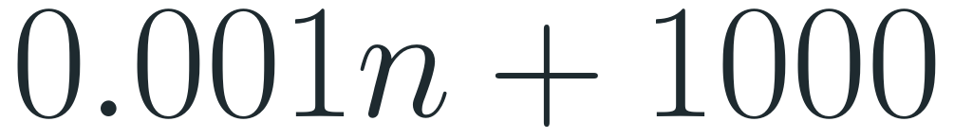
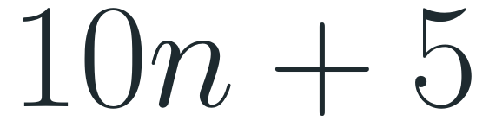
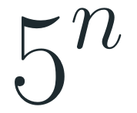

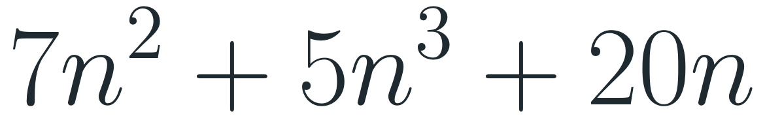
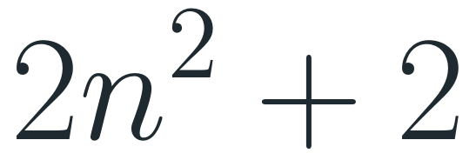
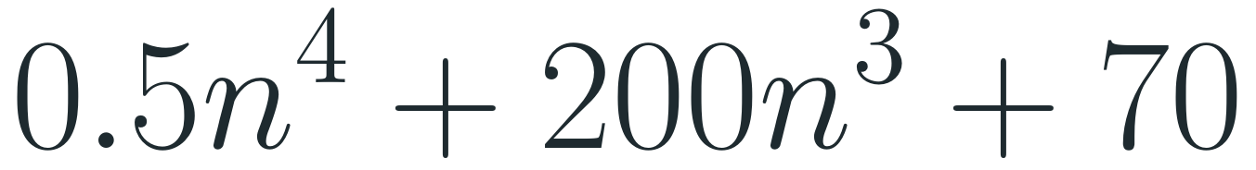
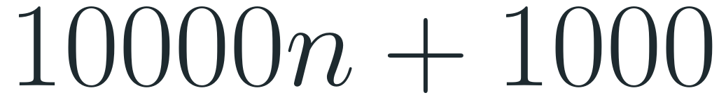
Exercise — Order of Growth
Below are the running-time functions of several algorithms. Determine the order of growth (Big O) of each one:
$$10n+5$$
$$0.5n^{4}+200n^{3}+70$$
How to find the order
1. Find the term that grows fastest as n → ∞.
$$7n^{2}+5n^{3}+20n$$
$$100$$
2. Drop its constant factor.
3. Drop all other terms.
A function with no n at all is O(1).
$$5^{n}$$
$$0.001n+1000$$
$$10000n+1000$$
$$2n^{2}+2$$

Slide 4
Solution — Order of Growth
function | fastest-growing term | order | why
10n + 5 | 10n | O(n) | linear term beats the constant
0.5n⁴ + 200n³ + 70 | 0.5n⁴ | O(n⁴) | n⁴ wins once n > 400, despite 200 > 0.5
7n² + 5n³ + 20n | 5n³ | O(n³) | the order of the terms does not matter
100 | 100 | O(1) | a constant does not grow
5ⁿ | 5ⁿ | O(5ⁿ) | exponential — the base matters
0.001n + 1000 | 0.001n | O(n) | a tiny factor is still linear
10000n + 1000 | 10000n | O(n) | a huge factor is still linear
2n² + 2 | 2n² | O(n²) | quadratic term dominates
Notes:
Keep the fastest-growing term, drop constants.

Slide 5
Asymptotic Bounds
So far we used O without a precise definition. We now give mathematical definitions that tell exactly when one function is O of another, and add two more notations. Together they are called asymptotic bounds:
O — upper bound
Ω — lower bound
Θ — tight bound
“Big O”
“Big Omega”
“Big Theta”
f grows no faster than g
f grows at least as fast as g
f grows exactly as fast as g

Slide 6
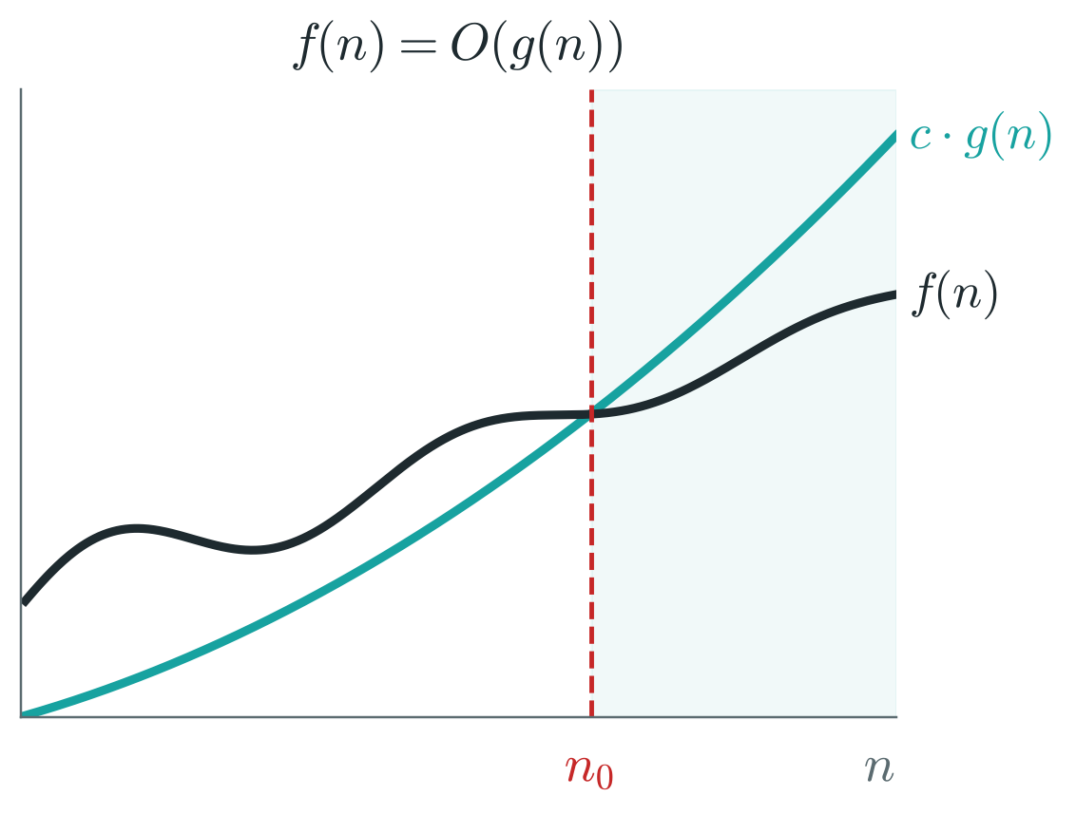

The O Notation
Definition
f(n) = O(g(n)) if there exist positive constants c and n₀ such that
$$f(n)≤c·g(n) for all n≥n_{0}$$
Meaning: to the right of n₀, f(n) always lies on or below c · g(n). g is an upper bound on the growth of f.
Examples of O(n) functions
$$2n+11, 1000n+1, 0.25n+6, 7n$$

Slide 7
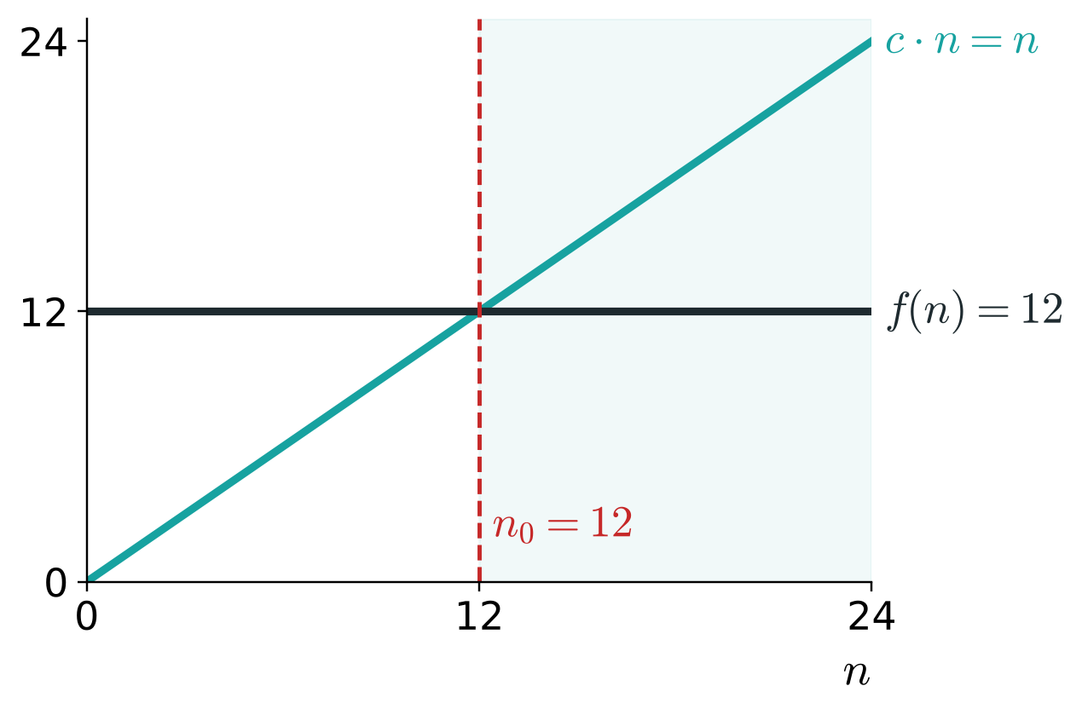
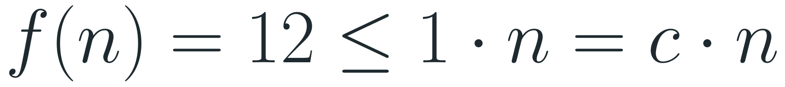
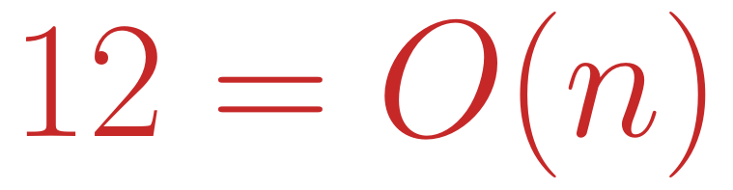
The O Notation — Example
1
O(n) means a linear upper bound: some linear function c · n stays above f(n) for all large n.
2
Constant running times are also O(n). Let us prove that f(n) = 12 is O(n).
3
Choose c = 1 and n₀ = 12. For every n ≥ 12:
$$f(n)=12≤1·n=c·n$$
4
So the definition holds, and
$$12=O(n)$$

Slide 8
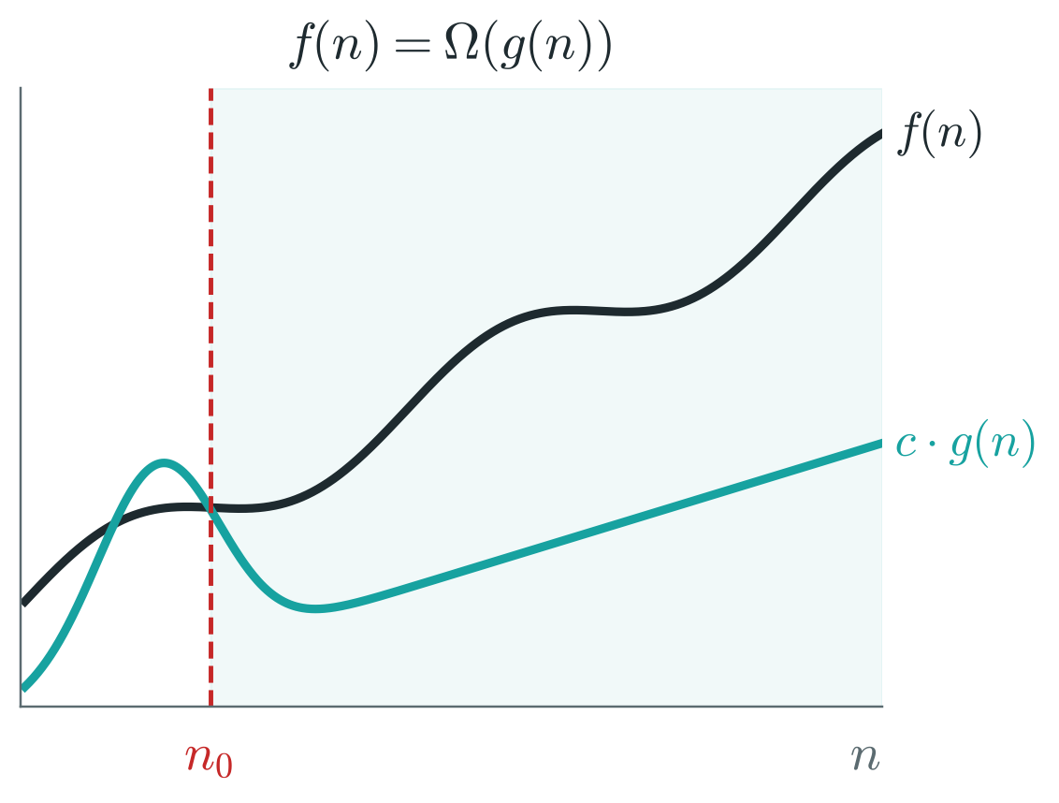
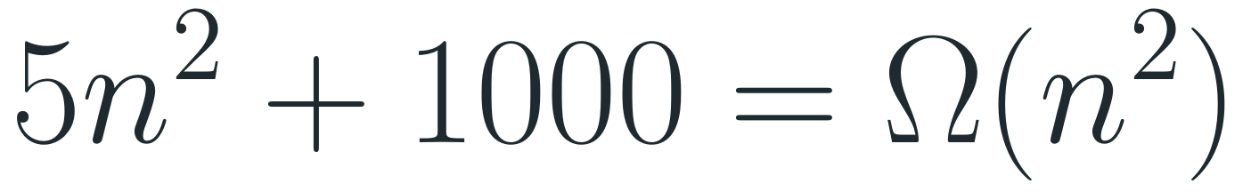
The Ω Notation
Definition
O gives an upper bound; Ω gives a lower bound. f(n) = Ω(g(n)) if there exist positive constants c and n₀ such that
$$f(n)≥c·g(n) for all n≥n_{0}$$
Meaning: to the right of n₀, f(n) always lies on or above c · g(n).
Examples
$$2n+3=Ω(n), 2n+3=Ω(1)$$
$$5n^{2}+1000=Ω(n^{2})$$
$$n^{4}+3n^{2}+2n+2=Ω(n^{4}) and also Ω(n^{2})$$

Slide 9


Properties of O and Ω
Theorem (duality)
Reflexivity
For any two functions f(n) and g(n):
For every function f(n):
$$f(n)=O(g(n)) ⇔ g(n)=Ω(f(n))$$
$$f(n)=O(f(n)), f(n)=Ω(f(n))$$
Transitivity
$$f(n)=O(g(n)) and g(n)=O(h(n)) ⇒ f(n)=O(h(n))$$
$$f(n)=Ω(g(n)) and g(n)=Ω(h(n)) ⇒ f(n)=Ω(h(n))$$

Slide 10
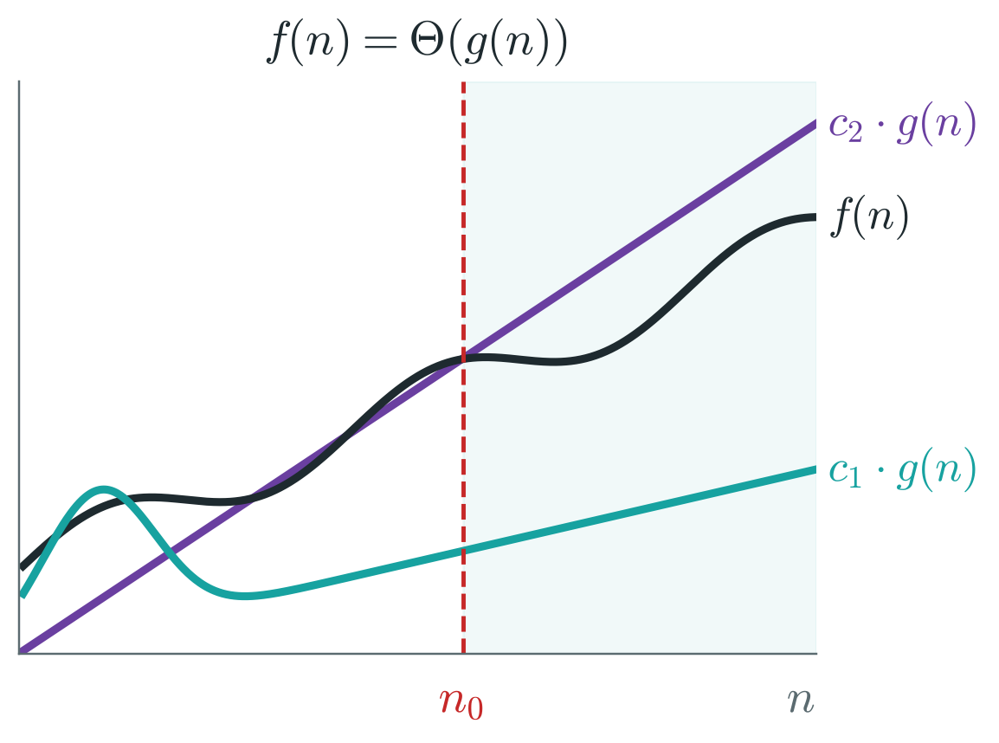
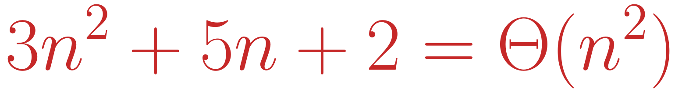
The Θ Notation
Definition
f(n) = Θ(g(n)) if there exist positive constants c₁, c₂ and n₀ such that
$$c_{1}·g(n)≤f(n)≤c_{2}·g(n) for all n≥n_{0}$$
f is bounded from above and from below by multiples of g — it behaves like g. This is a tight bound.
Example
$$3n^{2}+5n+2=O(n^{2}) and 3n^{2}+5n+2=Ω(n^{2})$$
so n² is both an upper and a lower bound:
$$3n^{2}+5n+2=Θ(n^{2})$$

Slide 11

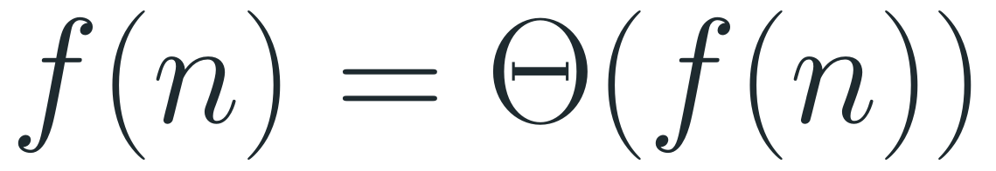
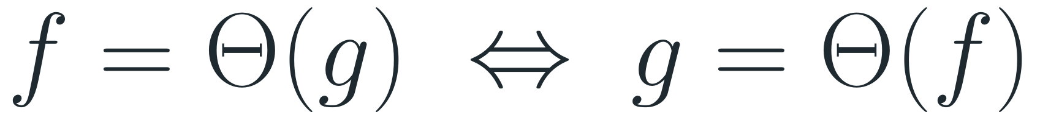
Properties of Θ
Theorem
For any two functions f(n) and g(n):
$$f(n)=Θ(g(n)) ⇔ f(n)=O(g(n)) and f(n)=Ω(g(n))$$
Transitivity
Reflexivity
Symmetry
$$f=Θ(g), g=Θ(h) ⇒ f=Θ(h)$$
$$f(n)=Θ(f(n))$$
$$f=Θ(g) ⇔ g=Θ(f)$$

Slide 12
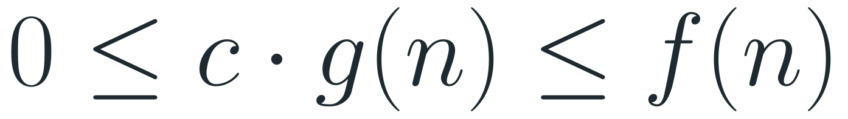
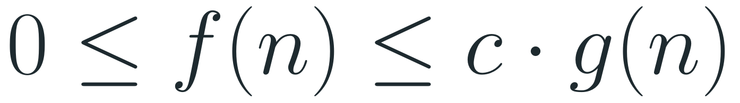
Summary: O, Ω and Θ
O(g(n)) — upper bound
Ω(g(n)) — lower bound
Θ(g(n)) — tight bound
$$0≤f(n)≤c·g(n)$$
$$0≤c·g(n)≤f(n)$$
$$0≤c_{1}g(n)≤f(n)≤c_{2}g(n)$$
for all n ≥ n₀ — f lies on or below c · g(n)
for all n ≥ n₀ — f lies on or above c · g(n)
for all n ≥ n₀ — f lies between c₁g(n) and c₂g(n)

Slide 13

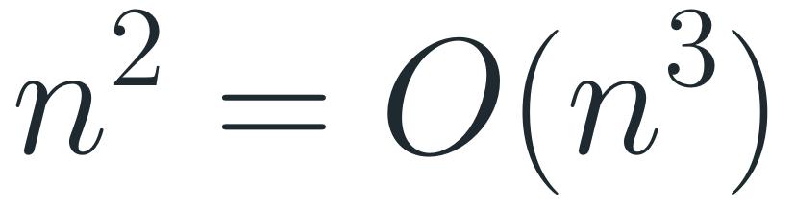
Question 1
Prove the following claim using the definition of O:
Claim
Definition to use
$$n^{2}=O(n^{3})$$
f(n) = O(g(n)) if there are positive constants c and n₀ such that
$$f(n)≤c·g(n) for all n≥n_{0}$$

Slide 14

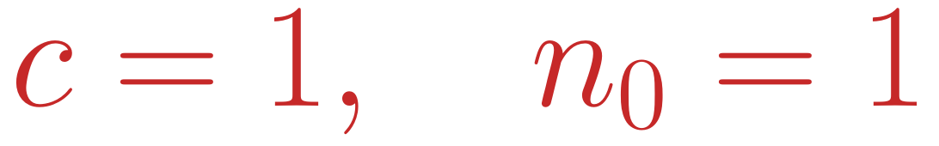
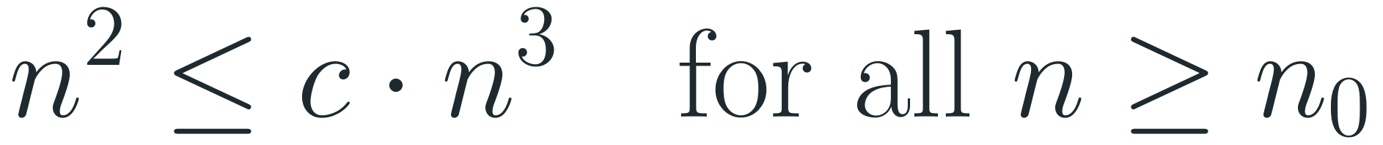
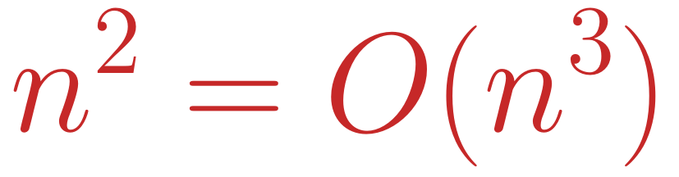
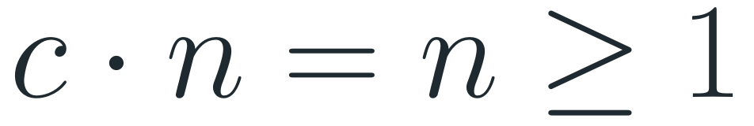
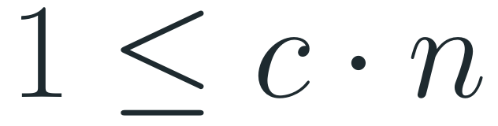
Solution to Question 1
1
By the definition of O we must find positive constants c and n₀ such that
Answer
$$n^{2}≤c·n^{3} for all n≥n_{0}$$
Constants that work:
$$c=1, n_{0}=1$$
2
Divide both sides by n² (allowed, because n² > 0):
Other pairs work too — for example c = 1/2 with n₀ = 2. The definition only asks that some pair exists.
$$1≤c·n$$
3
Choose c = 1 and n₀ = 1. Then for every n ≥ 1:
$$c·n=n≥1$$
4
The inequality holds for all n ≥ 1, therefore
$$n^{2}=O(n^{3})$$

Slide 15

Question 1 — Explanation
1
What we prove: n² grows no faster than n³ — from some point on, n² stays below a constant multiple of n³.
Check the numbers
n² is never above n³ for n ≥ 1:
2
Why divide by n²: it turns the condition into a very simple one, 1 ≤ c · n.
n | n² | 1 · n³
1 | 1 | 1
2 | 4 | 8
3 | 9 | 27
10 | 100 | 1000
3
The hardest case is the smallest n. c · n grows with n, so if 1 ≤ c · n₀ holds, it holds for every larger n too. Any pair with c · n₀ ≥ 1 is a valid answer.
4
Be careful: c must be one fixed number for all n ≥ n₀ at once. Saying “1/n → 0, so any c works” is not enough — c = 0.01 fails for n₀ = 1, because 0.01 · 1 < 1.

Slide 16
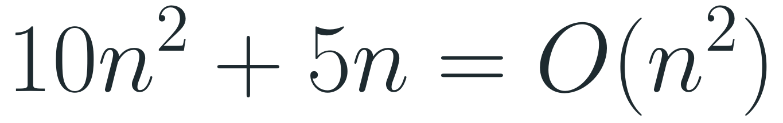
Question 2
The running time of an algorithm is 10n² + 5n. Show, using the definition, that it is in O(n²):
Claim
Definition to use
$$10n^{2}+5n=O(n^{2})$$
f(n) = O(g(n)) if there are positive constants c and n₀ such that
$$f(n)≤c·g(n) for all n≥n_{0}$$

Slide 17
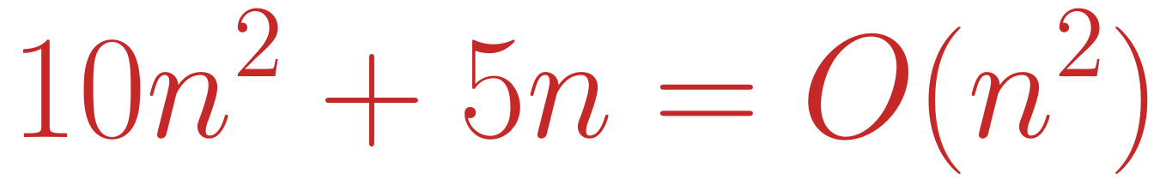
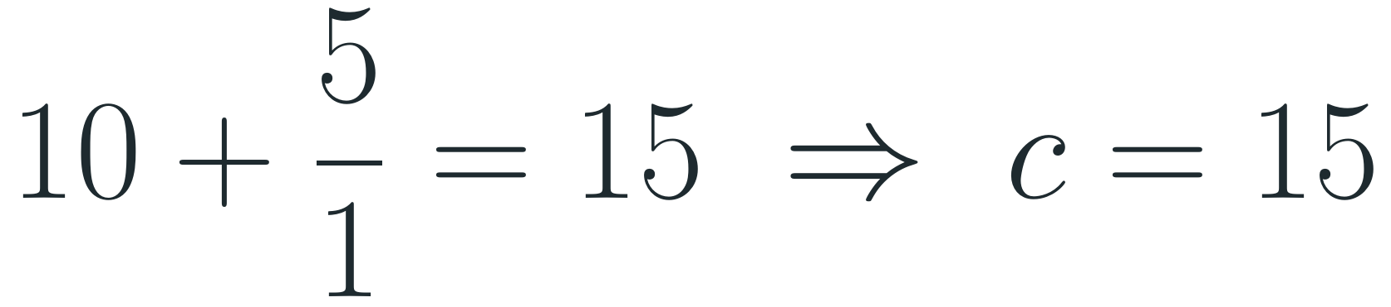
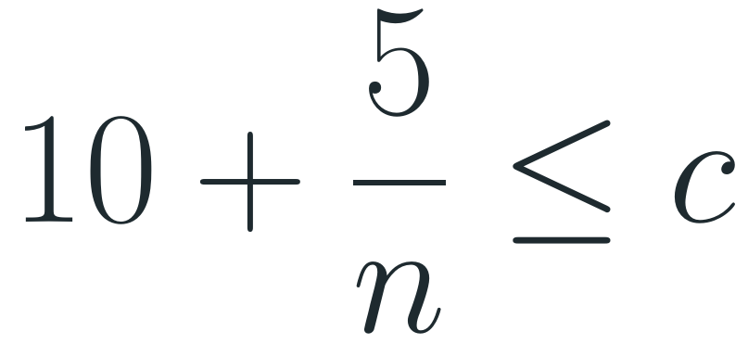
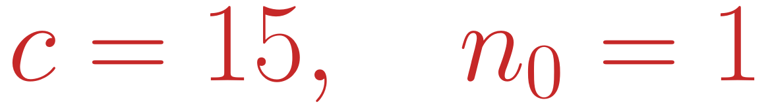
Solution to Question 2
1
We must find positive constants c and n₀ such that
Answer
$$10n^{2}+5n≤c·n^{2} for all n≥n_{0}$$
Constants that work:
2
Divide both sides by n² > 0:
$$c=15, n_{0}=1$$
$$10+\frac{5}{n}≤c$$
Another valid pair: n₀ = 5 and c = 11.
3
5/n gets smaller as n grows, so the left side is largest at the smallest n, n = n₀. Choose n₀ = 1:
$$10+\frac{5}{1}=15 ⇒ c=15$$
4
Direct check: for n ≥ 1 we have 5n ≤ 5n², so
$$10n^{2}+5n≤10n^{2}+5n^{2}=15n^{2}$$
$$10n^{2}+5n=O(n^{2})$$

Slide 18
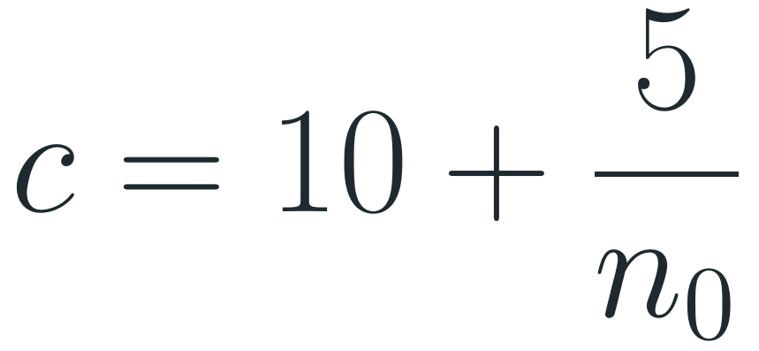
Question 2 — Explanation
1
Intuition: for large n the term 10n² dominates; 5n is small in comparison, so the whole expression behaves like 10n².
Check: c = 15, n₀ = 1
The left column never exceeds the right one:
2
Why c must be bigger than 10: 10 + 5/n is always greater than 10, so c = 10 never works — c needs extra room for the 5n term.
n | 10n² + 5n | 15n²
1 | 15 | 15
2 | 50 | 60
5 | 275 | 375
10 | 1050 | 1500
3
How to choose: pick n₀ first, then take c as the value of the left side at n = n₀ (its worst case):
$$c=10+\frac{5}{n_{0}}$$
4
Trade-off: a larger n₀ gives a smaller c — n₀ = 1 → c = 15, n₀ = 5 → c = 11, n₀ = 50 → c = 10.1.

Slide 19
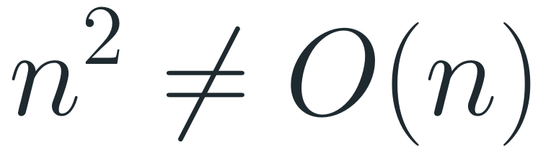
Question 3
Prove or disprove the following claim:
Claim
What to use
$$n^{2}≠O(n)$$
f(n) = O(g(n)) if there are positive constants c and n₀ such that
$$f(n)≤c·g(n) for all n≥n_{0}$$
To show that f is not O(g), assume it is and reach a contradiction.

Slide 20
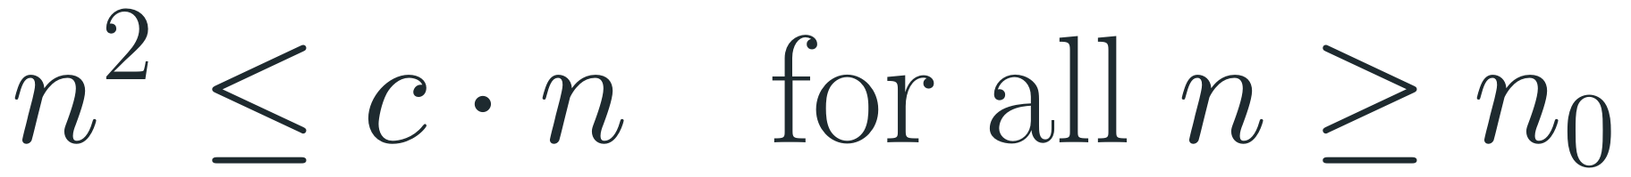
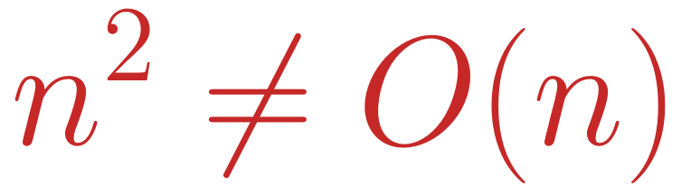
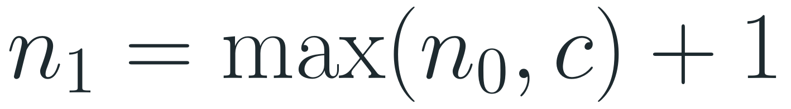
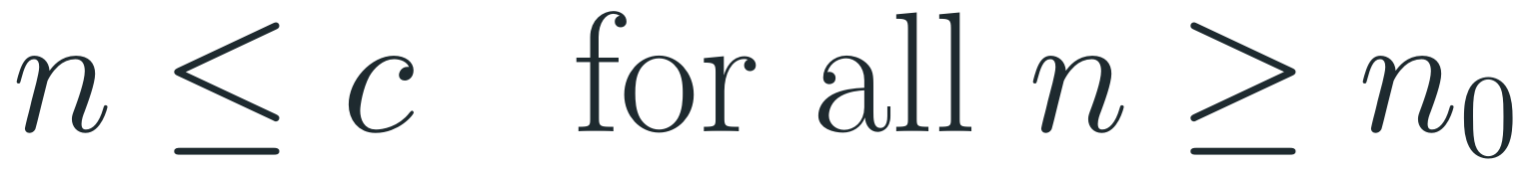
Solution to Question 3
1
Assume the opposite: n² = O(n). Then there are constants c > 0 and n₀ such that
Answer
$$n^{2}≤c·n for all n≥n_{0}$$
The claim is true:
$$n^{2}≠O(n)$$
2
Divide both sides by n > 0:
$$n≤c for all n≥n_{0}$$
3
Take a number larger than both n₀ and c:
$$n_{1}=max(n_{0},c)+1$$
4
n₁ ≥ n₀, but n₁ > c — this contradicts step 2. So the assumption is false.

Slide 21
Question 3 — Explanation
1
Strategy: to prove that f is not O(g), assume it is and show that this leads to something impossible (proof by contradiction).
Try c = 100
n² ≤ 100 · n breaks once n > 100:
2
The impossible statement: step 2 says that n — which keeps growing — stays below a fixed number c for all n ≥ n₀. No fixed number can stay above all natural numbers.
n | n² | 100 · n
10 | 100 | 1000
100 | 10 000 | 10 000
101 | 10 201 | 10 100
1000 | 1 000 000 | 100 000
3
Whatever c we try, it fails: n² / (c · n) = n / c, which becomes larger than 1 as soon as n > c.
4
Meaning: n² grows strictly faster than n. No constant multiple of n can bound n² from above.

Slide 22
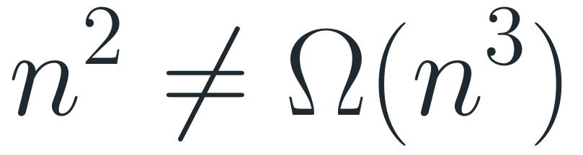
Question 4
Prove or disprove the following claim:
Claim
What to use
$$n^{2}≠Ω(n^{3})$$
f(n) = Ω(g(n)) if there are positive constants c and n₀ such that
$$f(n)≥c·g(n) for all n≥n_{0}$$
To show that f is not Ω(g), assume it is and reach a contradiction.

Slide 23
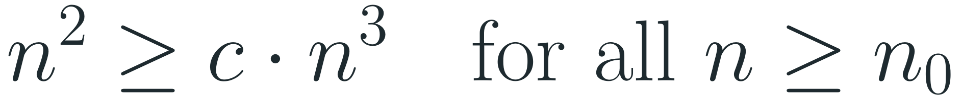
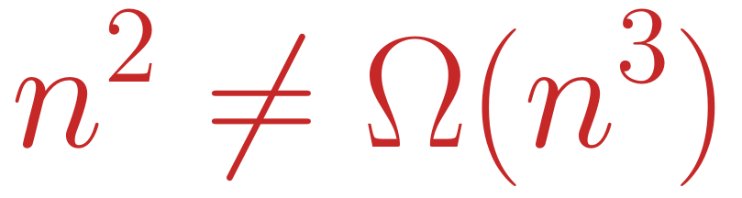
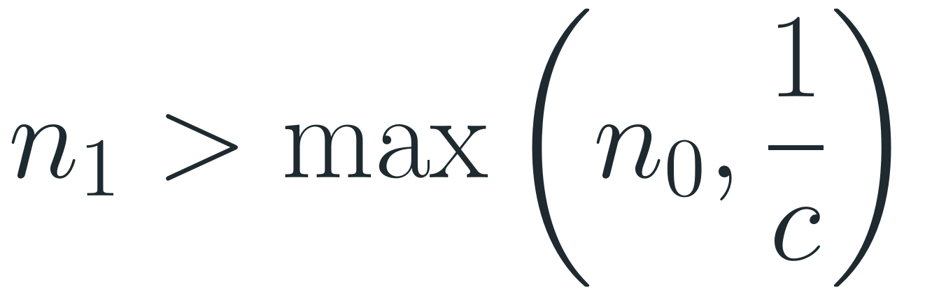
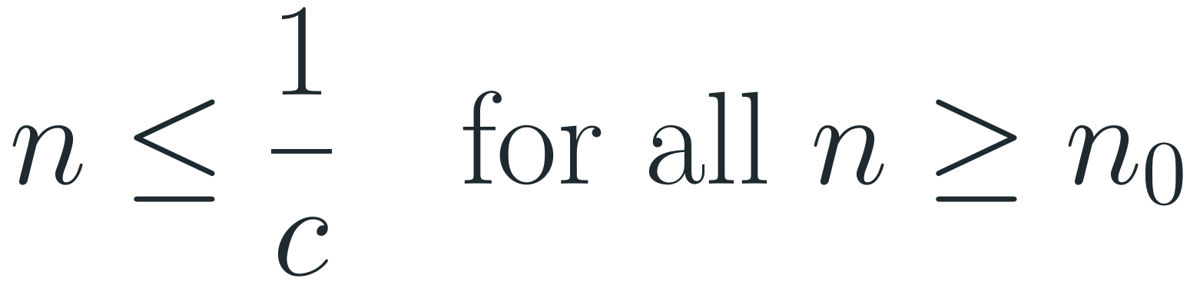
Solution to Question 4
1
Assume the opposite: n² = Ω(n³). Then there are constants c > 0 and n₀ such that
Answer
$$n^{2}≥c·n^{3} for all n≥n_{0}$$
The claim is true:
$$n^{2}≠Ω(n^{3})$$
2
Divide both sides by c · n² > 0:
$$n≤\frac{1}{c} for all n≥n_{0}$$
3
Choose a natural number larger than both n₀ and 1/c:
$$n_{1}>max(n_{0},\frac{1}{c})$$
4
n₁ ≥ n₀, so by step 2 n₁ ≤ 1/c — but we chose n₁ > 1/c. Contradiction, so the assumption is false.

Slide 24
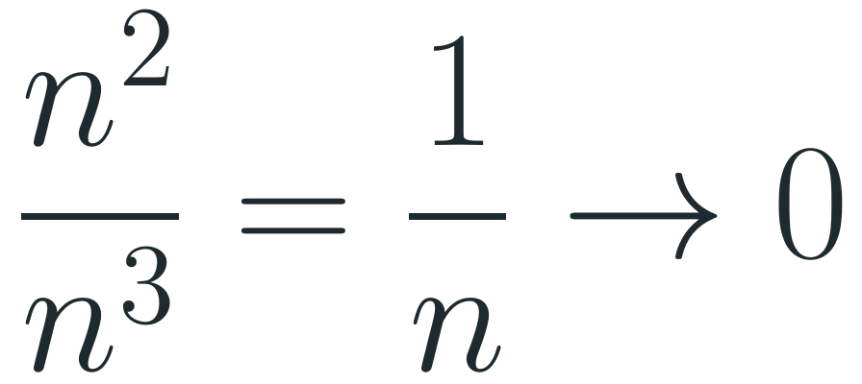
Question 4 — Explanation
1
What Ω would mean here: n² is at least a fixed fraction c of n³ for all large n.
Try c = 0.01
n² ≥ 0.01 · n³ breaks once n > 100:
2
But the fraction shrinks to zero:
$$\frac{n^{2}}{n^{3}}=\frac{1}{n}→0$$
n | n² | 0.01 · n³
10 | 100 | 10
100 | 10 000 | 10 000
200 | 40 000 | 80 000
3
Whatever c > 0 we choose, 1/n drops below c as soon as n > 1/c — so n² falls below c · n³.
4
Meaning: n² grows strictly slower than n³, so n³ cannot be a lower bound for n².

Slide 25
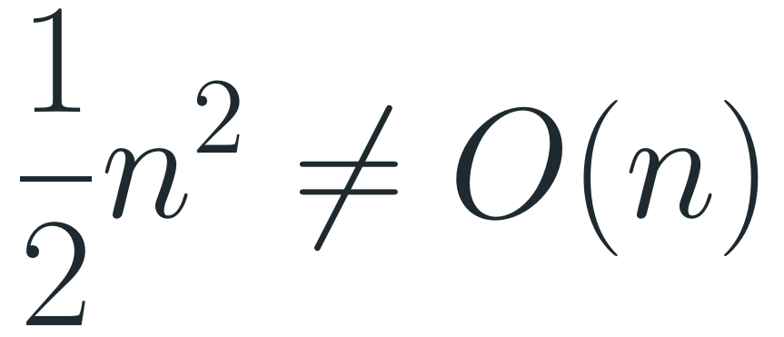
Question 5
Prove or disprove the following claim:
Claim
What to use
$$\frac{1}{2}n^{2}≠O(n)$$
f(n) = O(g(n)) if there are positive constants c and n₀ such that
$$f(n)≤c·g(n) for all n≥n_{0}$$

Slide 26
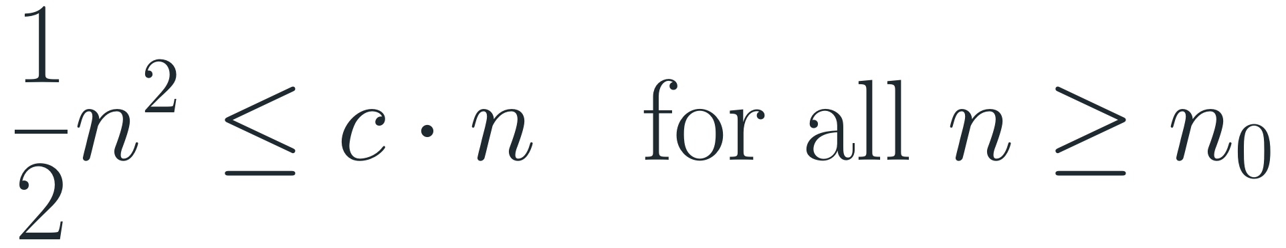
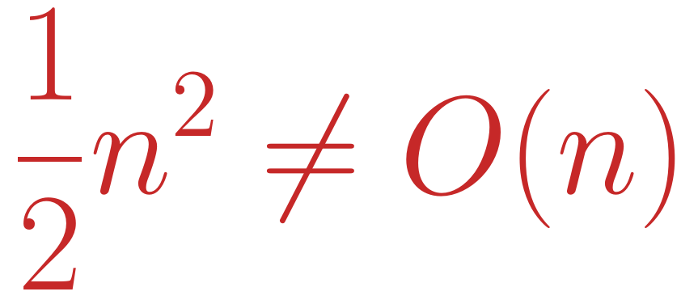
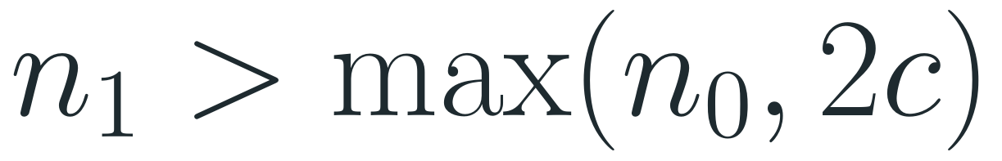
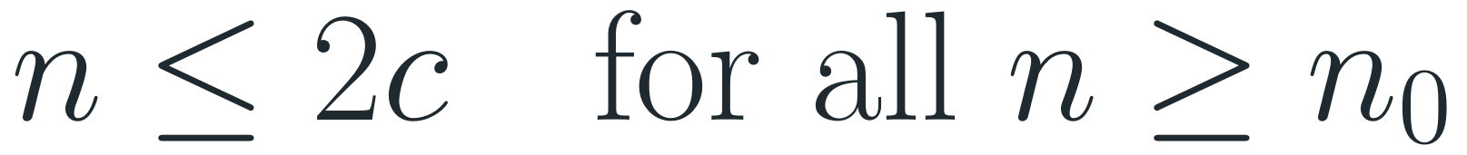
Solution to Question 5
1
Assume the opposite: ½n² = O(n). Then there are constants c > 0 and n₀ such that
Answer
$$\frac{1}{2}n^{2}≤c·n for all n≥n_{0}$$
The claim is true:
$$\frac{1}{2}n^{2}≠O(n)$$
2
Multiply both sides by 2 / n > 0:
$$n≤2c for all n≥n_{0}$$
3
Choose a natural number larger than both n₀ and 2c:
$$n_{1}>max(n_{0},2c)$$
4
n₁ ≥ n₀, so by step 2 n₁ ≤ 2c — but we chose n₁ > 2c. Contradiction, so the assumption is false.

Slide 27
Question 5 — Explanation
1
Same idea as Question 3: a function that keeps growing (n) cannot stay below a fixed number (2c).
Try c = 10
½n² ≤ 10 · n breaks once n > 20:
2
The factor ½ does not help. Constant factors never change the order of growth: ½n² is still quadratic, and a quadratic function always overtakes c · n.
n | ½ n² | 10 · n
10 | 50 | 100
20 | 200 | 200
30 | 450 | 300
3
Where it breaks: ½n² ≤ c · n is the same as n ≤ 2c, so it fails for every n > 2c.

Slide 28
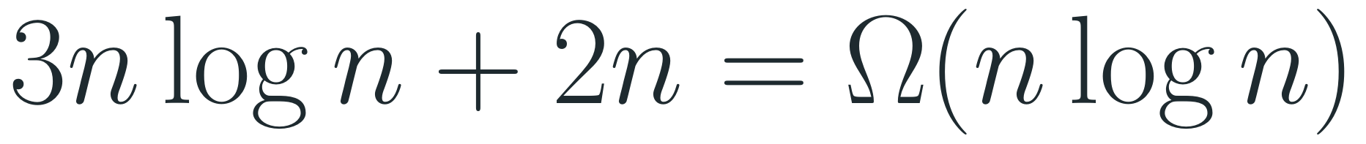
Question 6 (Exam 2018, Semester A, Moed B)
Prove or disprove the following claim (log is base 2):
Claim
Definition to use
$$3nlogn+2n=Ω(nlogn)$$
f(n) = Ω(g(n)) if there are positive constants c and n₀ such that
$$f(n)≥c·g(n) for all n≥n_{0}$$

Slide 29
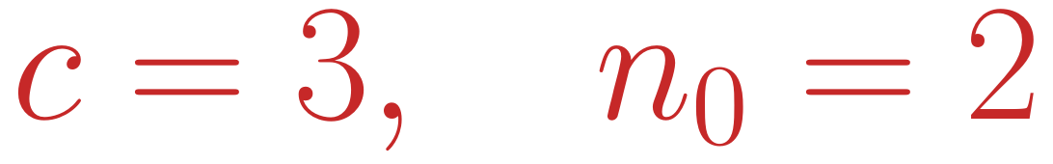
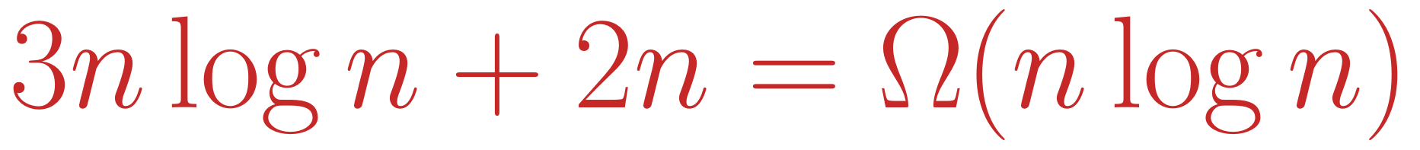

Solution to Question 6
1
We must find positive constants c and n₀ such that
Answer
$$c·nlogn≤3nlogn+2n for all n≥n_{0}$$
The claim is true, with
2
For n ≥ 2 we have n log n > 0, so we may divide by it:
$$c=3, n_{0}=2$$
$$c≤3+\frac{2}{logn}$$
3
The fraction 2 / log n is positive, so the right side is always greater than 3. Therefore c = 3 works for every n ≥ 2.
4
With c = 3 and n₀ = 2 the definition holds, so the claim is true:
$$3nlogn+2n=Ω(nlogn)$$

Slide 30

Question 6 — Explanation
1
For a lower bound we may drop positive terms. Removing + 2n only makes the function smaller, so 3n log n + 2n ≥ 3n log n — that is exactly the inequality with c = 3.
Check: c = 3
3 · n log n never exceeds f(n):
2
n | 3n log n | 3n log n + 2n
2 | 6 | 10
4 | 24 | 32
8 | 72 | 88
16 | 192 | 224
Why n₀ = 2: log 1 = 0, so at n = 1 we cannot divide by n log n. From n = 2 on, log n ≥ 1 > 0.
3
In fact the bound is tight. For n ≥ 2 we also have 2n ≤ 2n log n, so 3n log n + 2n ≤ 5n log n. Together:
$$3nlogn+2n=Θ(nlogn)$$

Slide 31

Question 7 (Exam 2018, Semester A, Moed B)
Prove or disprove the following claim:
Claim
Definition to use
$$(n+1)^{5}=O(n^{5})$$
f(n) = O(g(n)) if there are positive constants c and n₀ such that
$$f(n)≤c·g(n) for all n≥n_{0}$$

Slide 32




Solution to Question 7
1
We must find positive constants c and n₀ such that
Answer
$$(n+1)^{5}≤c·n^{5} for all n≥n_{0}$$
The claim is true, with
2
Divide both sides by n⁵ > 0:
$$c=32, n_{0}=1$$
$$(\frac{n+1}{n})^{5}=(1+\frac{1}{n})^{5}≤c$$
3
For n ≥ 1 we have 1/n ≤ 1, so 1 + 1/n ≤ 2 and therefore
$$(1+\frac{1}{n})^{5}≤2^{5}=32$$
4
With c = 32 and n₀ = 1 the definition holds, so the claim is true:
$$(n+1)^{5}=O(n^{5})$$

Slide 33
Question 7 — Explanation
1
Intuition: expanding gives
Check: c = 32
$$(n+1)^{5}=n^{5}+5n^{4}+10n^{3}+10n^{2}+5n+1$$
(n + 1)⁵ never exceeds 32 · n⁵:
2
The leading term is n⁵, and all other terms grow more slowly — so the order is n⁵.
n | (n + 1)⁵ | 32 · n⁵
1 | 32 | 32
2 | 243 | 1 024
10 | 161 051 | 3 200 000
3
The worst case is n = 1: there (1 + 1/n)⁵ = 2⁵ = 32 exactly. For larger n the ratio (n+1)⁵ / n⁵ gets smaller and approaches 1, so c = 32 is enough everywhere.

Slide 34

Question 8
Prove that for any real constants a and b with b > 0:
Claim
Definition to use
$$(n+a)^{b}=Θ(n^{b})$$
f(n) = Θ(g(n)) if there are positive constants c₁, c₂ and n₀ such that
$$c_{1}g(n)≤f(n)≤c_{2}g(n) for all n≥n_{0}$$

Slide 35



Solution to Question 8 — Part 1
1
Goal: find positive constants c₁, c₂ and n₀ such that
Result of part 1
$$c_{1}n^{b}≤(n+a)^{b}≤c_{2}n^{b} for all n≥n_{0}$$
For every n ≥ n₀, where
2
Plan: first trap n + a between two multiples of n (no powers yet), then raise everything to the power b.
$$n_{0}=max(1, 2|a|)$$
we have
3
Lower bound. If n ≥ 2|a|, then |a| ≤ n/2, so
$$0<\frac{n}{2}≤n+a≤2n$$
$$n+a≥n−|a|≥n−\frac{n}{2}=\frac{n}{2}$$
4
Upper bound. If n ≥ 2|a|, then also |a| ≤ n, so
$$n+a≤n+|a|≤n+n=2n$$

Slide 36




Solution to Question 8 — Part 2
5
All three quantities n/2, n + a and 2n are positive, and b > 0. Raising positive numbers to a power b > 0 is increasing (a bigger base gives a bigger result), so it keeps the inequalities:
Answer
The claim holds:
6
Raise every part to the power b:
$$(n+a)^{b}=Θ(n^{b})$$
$$(\frac{n}{2})^{b}≤(n+a)^{b}≤(2n)^{b}$$
for every real a and every b > 0.
7
Split the powers:
$$(\frac{1}{2})^{b}n^{b}≤(n+a)^{b}≤2^{b}n^{b}$$
8
This is exactly the Θ definition with
$$c_{1}=(\frac{1}{2})^{b}, c_{2}=2^{b}, n_{0}=max(1, 2|a|)$$

Slide 37
Question 8 — Explanation
1
Intuition: once n is much larger than |a|, adding a changes n by at most a factor of 2. Raising to the power b changes it by at most a factor of 2ᵇ — a constant, so the order of growth does not change.
Example: a = −10, b = 3
n₀ = 20, c₁ = 1/8, c₂ = 8:
2
n | n³ / 8 | (n − 10)³ | 8 · n³
20 | 1 000 | 1 000 | 64 000
40 | 8 000 | 27 000 | 512 000
Why n₀ = max(1, 2|a|): we need n ≥ 2|a| for both bounds, and n₀ must be positive (if a = 0, then 2|a| = 0).
3
Why positivity matters: for a real power b we need a positive base. The lower bound n + a ≥ n/2 > 0 guarantees it.

