Slide 2
“The chip select should be the driving force in the state machine. An initial negedge should move us out of IDLE and the posedge should move us back to IDLE. This way we can continuously clock out data while the CS line is low instead of us clocking out X bytes and then having to wait for a new negedge. I imagine a typical read transaction to be the command/address byte followed by us clocking out the data incrementing the register access address internally when we've clocked out the full register value.
The master would control the number of clock edges sent, and put us back to IDLE with a rising CS edge”

Slide 3
Notes:
“I also simplified the code a lot, instead of trying to implement a queue and writing to RAM I'm just making the data available in a data register. The SPI slave module can read directly from the register and return data to the master, we don't even really have to worry about read/write bits. We can just enter a state machine where we dump the memory contents if we receive a particular command byte from the master.”

Slide 4
Oh and one more thing to note, I have set the RAM up as 64 blocks of 32bits each. I'll store each 24bit packed in 1 block, with the first 8 bits as 0's. When reading out from RAM I think you have to make the ram_read_data bus 32 bits wide, and then discard/ignore the 8 MSB's.

Slide 5
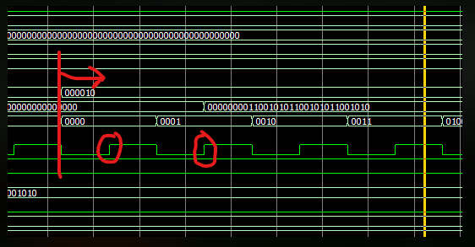
Aug 30
“FYI I found that the RAM requires two clock cycles to read from. I included a picture of the timing below. When you set an address to read from the data will be available on the second positive edge following the address change. All changes in the RAM module happen on the positive clock edges, so you should change the read address and clock out the data on negedges”
6 logic input as a 6bit address from RAM
32 logic input as the 32bit data from RAM
(MSB 8 bits are 0, 24bit are the data)
addr
data

Slide 6
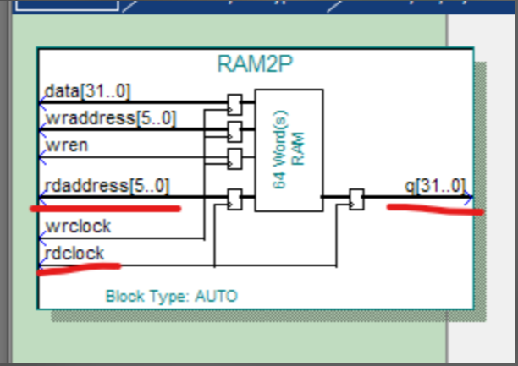
Sept 3
“you would have access to the read address, read clock and q output bus. I'd control writing to it with the other lines”

Slide 7
Sept 6

