Slide 1
WordprocessingML Basics

Slide 2
Disclaimer
The information contained in this slide deck represents the current view of Microsoft Corporation on the issues discussed as of the date of publication. Because Microsoft must respond to changing market conditions, it should not be interpreted to be a commitment on the part of Microsoft, and Microsoft cannot guarantee the accuracy of any information presented after the date of publication.
This slide deck is for informational purposes only. MICROSOFT MAKES NO WARRANTIES, EXPRESS, IMPLIED OR STATUTORY, AS TO THE INFORMATION IN THIS DOCUMENT.
Complying with all applicable copyright laws is the responsibility of the user. Without limiting the rights under copyright, no part of this slide deck may be reproduced, stored in or introduced into a retrieval system, or transmitted in any form or by any means (electronic, mechanical, photocopying, recording, or otherwise), or for any purpose, without the express written permission of Microsoft Corporation.
Microsoft may have patents, patent applications, trademarks, copyrights, or other intellectual property rights covering subject matter in this slide deck. Except as expressly provided in any written license agreement from Microsoft, the furnishing of this slide deck does not give you any license to these patents, trademarks, copyrights, or other intellectual property.
Unless otherwise noted, the example companies, organizations, products, domain names, e-mail addresses, logos, people, places and events depicted herein are fictitious, and no association with any real company, organization, product, domain name, email address, logo, person, place or event is intended or should be inferred.
© 2006 Microsoft Corporation. All rights reserved.
Microsoft, 2007 Microsoft Office System, .NET Framework 3.0, Visual Studio, and Windows Vista are either registered trademarks or trademarks of Microsoft Corporation in the United States and/or other countries.
The names of actual companies and products mentioned herein may be the trademarks of their respective owners.

Slide 3
Objectives
This module covers the essentials of creating and reading WordprocessingML documents:
Document architecture
The main document part
Paragraphs, runs, text
Images
Hyperlinks
Tables

Slide 4

WordprocessingML Document Architecture
Document
properties
body
A WordprocessingML file is a collection of multiple “stories”:
The main story
Header(s) / Footer(s)
Footnote(s) / Endnote(s)
Subdocuments
Comment(s)
comments
images
footnotes/endnotes
numberingDefinitions
headers/footers
styles
fontTable
customXML

Slide 5
Main Document Part

Slide 6
Main Document Part
The top-level element in the start part (e.g., document.xml) is document
Document has two optional child elements:
The background element, which specifies the settings for the background for the document
The body element, which contains the content of the main story
Notes:
Body is where the action is – background is just a simple element for setting a background color, gradient, or image.

Slide 7
Block-level Elements
The body element contains the main document story, made up of block-level elements:
Paragraphs
Tables
Custom XML markup
Alternate format chunks
Subdocuments
Final section properties
Future extensibility containers
Nested elements: a table may contain a table which contains a paragraph, etc.
Notes:
Explain future extensibility containers.
Block-level content can't defy XML rules; show graphically how customXml tags can surround multiple paragraphs but can't start in one paragraph and end in a different one.

Slide 8
Inline Structures
The <w:p> paragraph element contains inline structures:
Runs (containing <w:t> text regions)
Custom Markup (can occur at block or inline level)
Annotations (comments, tracked changes, bookmarks)
DrawingML elements
Fields (date, page number, document creator, etc.)
Hyperlinks

Slide 9
Paragraphs, Runs, and Text

Slide 10
Paragraphs <w:p>
The most basic unit of a WordprocessingML document
Contains three pieces of information:
Paragraph properties
Inline content
optional revision IDs used for document merge and compare
A paragraph may occur at any location which allows block level content:
At the top-most level within a story (e.g. header, footer, main document)
Nested within a table cell
Nested within a structured document tag or annotation markers
Notes:
Explain revision IDs.

Slide 11
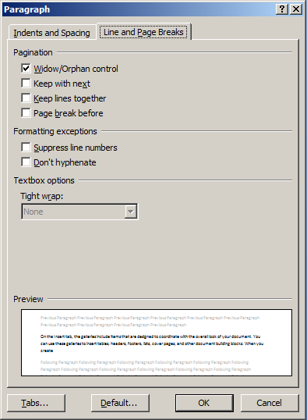
Paragraph Properties
Can be set directly on a paragraph (below) or in a paragraph style
24 total property settings
<w:p>
<w:pPr>
<w:widowControl w:val=“on” />
<w:keepNext/>
<w:keepLines/>
<w:pageBreakBefore/>
<w:suppressLineNumbers />
<w:suppressAutoHyphens />
<w:textBoxTightWrap />
</w:pPr>
… runs, paragraph content …
</w:p>
Notes:
Many of the properties have names that look familiar from the paragraph-properties dialog in Word.

Slide 12
Runs <w:r>
A run is a region of text with a common set of properties
All text must be contained within runs
All runs must be contained within paragraphs
A run contains three types of information:
Run properties
Run content (text, fields, soft line breaks, pictures, etc.)
Optional revision IDs for document comparison

Slide 13
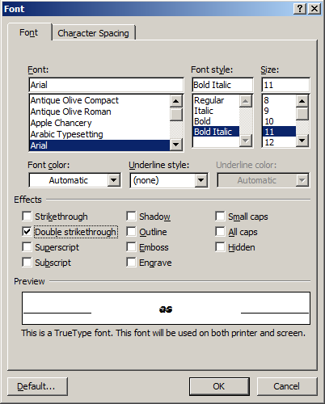
Run Properties
Define formatting for individual characters
Font attributes, size/position, etc.
24 total properties
<w:r>
<w:rPr>
<w:rFonts w:ascii=“Arial” w:hAnsi=“Arial” w:cs=“Arial” />
<w:b/>
<w:i/>
<w:sz w:val=“11” />
<w:dstrike w:val=“true” />
Notes:
Note how bold and italic are represented, as in HTML.

Slide 14
Run Content
Runs may contain various inline structures:
Text
Deleted text
Soft line breaks
Field codes, deleted field codes
Footnote/endnote reference marks
Fields: page numbers, dates, document properties, etc.
Tabs
Ruby text
DrawingML content
Embedded objects
Pictures

Slide 15

Paragraph Example
Simple text formatting at the run level:
<w:p>
<w:r>
<w:t>The quick</w:t>
</w:r>
<w:r>
<w:rPr>
<w:i/>
</w:rPr>
<w:t>brown</w:t>
</w:r>
<w:r>
<w:t>fox.</w:t>
</w:r>
</w:p>
Run properties specify italics

Slide 16
Text <w:t>
This is the only element in the main story that can contain text – all other text is in attribute values
Three other types of text are allowed in runs:
Deleted text <w:delText>
Field code <w:instrText>
Deleted field codes <w:delInstrText>
Text nodes contain the displayed text and nothing more
This simplifies search, localization, and similar tasks
Notes:
WML's approach to text is very flat: just a bunch of paragraphs, each with a bunch of runs. By contrast, HTML or ODF are more hierarchical.
Sample sentence to demonstrate on whiteboard: This sentence is bold, but has italics inside of it and a plain word, and then more bold. (Show how Open XML and ODF encode this sentence.)
Note that it's easier to convert from a flat structure to a hierarchical one than the other way around, because converting hierarchical to flat requires keeping track of the "state" of properties that may have been set at higher levels.

Slide 17
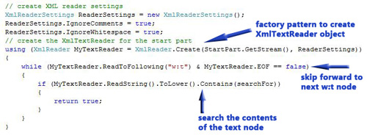
Searching Open XML text
To create a simple text search utility:
Use XmlReader.Create() factory pattern
Looks only to the <w:t> nodes
Extremely fast and simple
Notes:
The classic demo: use the minimal DOCX parts, manually create “Hello World.”

Slide 18
Run/Text Structure: Not Predictable
Producers may break run/text elements arbitrarily
Never assume anything about run/text structure!
<w:p>
<w:r>
<w:t>These examples are functionally identical.</w:t>
</w:r>
</w:p>
<w:p>
<w:r>
<w:t xml:space=“preserve”>These </w:t>
<w:t xml:space=“preserve”>examples </w:t>
</w:r>
<w:r>
<w:t xml:space=“preserve”>are </w:t>
<w:t xml:space=“preserve”>functionally </w:t>
</w:r>
<w:r>
<w:t>identical.</w:t>
</w:r>
</w:p>

Slide 19
Fields
A sample of another type of inline content
Fields are auto-filled by the application when the document is opened
77 total field types
Examples: author, date, createdate, page#, time, formula
<w:p>
<w:fldSimple w:instr=" DATE \@ &quot;d MMMM yyyy&quot; \* MERGEFORMAT“/>
</w:p>
DEMO

Slide 20
Revision IDs (RSIDs)
RSID values are used to identify a set of changes that were made during the same editing session
Found in many elements:
Paragraphs, runs, sections, styles
Table rows, table properties, charts, diagrams
Optional, but recommended for applications that modify existing documents
Sample revision IDs table (from settings part):
<w:rsids>
<w:rsidRoot w:val="008142D8" />
<w:rsid w:val="00102433" />
<w:rsid w:val="008142D8" />
<w:rsid w:val="00903906" />
</w:rsids>
DEMO

Slide 21
Images AND hYPERLINKS

Slide 22
Images
An image is a w:pict element inside a run <w:r>
The v:imagedata element is defined in VML:
xmlns:v="urn:schemas-microsoft-com:vml"
The actual image is referenced via a relationship:
The relationship points to an image part in the package:
<w:pict> <v:shape id="_x0000_i1025" type="#_x0000_t75" style="width:250; height:200"> <v:imagedata r:id="rId4"/> </v:shape> </w:pict>
<Relationship Id="rId4”
Type="http://schemas.openxmlformats.org/officeDocument/2006/relationships/image”
Target="image1.jpg"/>
Notes:
This is the simpler legacy VML approach, we also cover the DrawingML approach in lab 04.
Images can be in the package, in the file system, or at a URL.

Slide 23
Hyperlinks
A hyperlink is nested inside a paragraph, outside a run:
The destination is stored in a relationship:
<w:p> <w:hyperlink r:id=“linkRel1"> <w:r> <w:rPr> <w:color w:val="0000FF" w:themeColor="hyperlink" /> <w:u w:val="single" /> </w:rPr> <w:t>Click here for OpenXmlDeveloper.org.</w:t> </w:r> </w:hyperlink> </w:p>
<Relationship Id=“linkRel1“
Type="http://schemas.openxmlformats.org/officeDocument/2006/relationships/hyperlink”
Target="http://www.openxmldeveloper.org" TargetMode="External" />
DEMO
Notes:
Demo here to show both images and hyperlinks. (ImagesHyperlinks.docx)

Slide 24
Hyperlink Destinations
Hyperlinks can link to three types of destinations:
Intradocument: a bookmark contained within the current WordprocessingML document.
Interdocument: another WordprocessingML package; may optionally specify a bookmark within that package.
Other destinations: any other valid URI location, such as the web-page example shown previously.

Slide 25
WordprocessingML Tables

Slide 26
Tables
Tables are a set of paragraphs which are arranged into rows and columns
In WordprocessingML, tables are block level content, and are specified using the tbl element
Analogous to the HTML <table> element
Notes:
Show markup for a simple table, add it to the document.

Slide 27
What’s in a WordprocessingML table?
<w:tbl>
<w:tblPr>
<w:tblStyle w:val=“TableGrid”/>
<w:tblW w:w=“0” w:type=“auto”/>
<w:tblLook w:val=“01E0”/>
</w:tblPr>
<w:tblGrid>
<w:gridCol w:w=“2952”/>
<w:gridCol w:w=“2952”/>
<w:gridCol w:w=“2952”/>
</w:tblGrid>
<w:tr>
<w:tc>
<w:tcPr>
<w:tcW w:w=“2952” w:type=“dxa”/>
</w:tcPr>
<w:p>
<w:r>
<w:t>1,1</w:t>
</w:r>
</w:p>
</w:tc>
<w:tc>
<w:tcPr>
<w:tcW w:w=“2952” w:type=“dxa”/>
</w:tcPr>
<w:p>
<w:r>
<w:t>1,2</w:t>
</w:r>
</w:p>
</w:tc>
</w:tr>
</w:tbl>
Four types of content:
Properties
Grid
Rows
Cells
DEMO
Notes:
Note unit of measure: if not specified, default is “dxa” == 1/20th of a point (1440 per inch)
DEMO: MinimalTable.docx

Slide 28
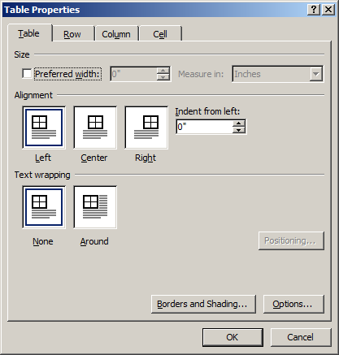
Table Properties
The tblPr section specifies various properties that apply to the entire table
<w:tblPr>
<w:tblStyle w:val=“TableGrid”/>
<w:tblW w:w=“0” w:type=“auto”/>
<w:tblLook w:val=“01E0”/>
</w:tblPr>
Sizing , alignment, text wrap
Table styles (rows/columns per band, conditional formatting flags)
Borders, cell margins, shading
Table property revisions

Slide 29
Table Rows <w:tr>
The <w:tr> element defines a table row
Analogous to the HTML <tr> tag
Table rows can contain:
Table row properties
Custom XML markup
Table cell content
<w:tbl>
<w:tblPr/>
<w:tblGrid/>
<w:tr>
… row content …
</w:tr>
<w:tr>
… row content …
</w:tr>
</w:tbl>

Slide 30
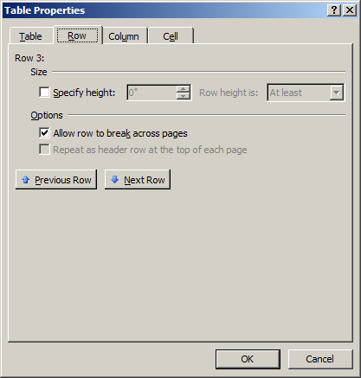
Table Row Properties <w:trPr>
Overrides various properties for this row:
Row height
Breaking across pages
Conditional formatting
Many other properties
<w:trPr>
<w:trHeight w:val=“144”/>
<w:cantSplit />
</w:trPr>

Slide 31
Table Cells <w:tc>
The tc element defines the contents of a table cell
Analogous to the HTML <td> tag
Table cells can contain:
Cell properties
Any block-level content
Table cells must contain at least one paragraph, even if it’s empty
Tables may be nested
<w:tbl>
<w:tblPr/>
<w:tblGrid/>
<w:tr>
<w:tc>
… cell content …
</w:tc>
<w:tc>
… cell content …
</w:tc>
</w:tr>
</w:tbl>

Slide 32
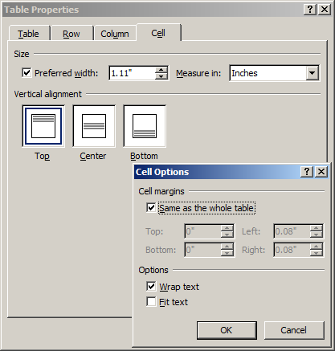
Table Cell Properties <w:tcPr>
Overrides various properties for cell values:
Preferred width
Vertical alignment
Cell margins
Text wrap
Many other properties
<w:tcPr>
<w:tcW/>
<w:vAlign/>
<w:tcMar/>
<w:noWrap/>
</w:tcPr>

Slide 33
Table Layout Concepts
Table layout is determined by multiple properties:
The table grid
Table-level properties (example: preferred width)
Row-level properties (example: indentation before/after)
Cell-level properties (example: preferred width)
These properties may contradict one another, and it is the responsibility of the consuming application to resolve those conflicts
The table must satisfy the grid at all times

Slide 34
AutoFit Table Layout
An AutoFit table dynamically resizes to fit its content
The resizing algorithm that Office uses is based on the published W3C spec for table AutoFit, with provisions for gridBefore/gridAfter

Slide 35
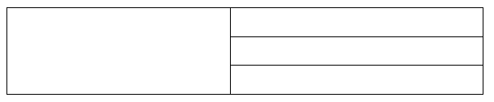
Vertical Cell Merges
So far, we've looked at tables as if they have strict definitions of rows
But cells can span multiple rows:
Vertically merged cell

Slide 36
Vertical Cell Merges
Cells are merged vertically using the vmerge element
A vMerge element of type "restart" begins or restarts a vertically merged region
A vMerge element of type "continue" continues a vertical merge (Word uses “continue” as the default for vMerge type)
Cells in the same grid column after a “restart” are merged vertically until the last “continue”
Only the contents of the first cell are rendered – the other cells don’t exist after the merge
DEMO

