Slide 1
WordprocessingML Advanced

Slide 2
Disclaimer
The information contained in this slide deck represents the current view of Microsoft Corporation on the issues discussed as of the date of publication. Because Microsoft must respond to changing market conditions, it should not be interpreted to be a commitment on the part of Microsoft, and Microsoft cannot guarantee the accuracy of any information presented after the date of publication.
This slide deck is for informational purposes only. MICROSOFT MAKES NO WARRANTIES, EXPRESS, IMPLIED OR STATUTORY, AS TO THE INFORMATION IN THIS DOCUMENT.
Complying with all applicable copyright laws is the responsibility of the user. Without limiting the rights under copyright, no part of this slide deck may be reproduced, stored in or introduced into a retrieval system, or transmitted in any form or by any means (electronic, mechanical, photocopying, recording, or otherwise), or for any purpose, without the express written permission of Microsoft Corporation.
Microsoft may have patents, patent applications, trademarks, copyrights, or other intellectual property rights covering subject matter in this slide deck. Except as expressly provided in any written license agreement from Microsoft, the furnishing of this slide deck does not give you any license to these patents, trademarks, copyrights, or other intellectual property.
Unless otherwise noted, the example companies, organizations, products, domain names, e-mail addresses, logos, people, places and events depicted herein are fictitious, and no association with any real company, organization, product, domain name, email address, logo, person, place or event is intended or should be inferred.
© 2006 Microsoft Corporation. All rights reserved.
Microsoft, 2007 Microsoft Office System, .NET Framework 3.0, Visual Studio, and Windows Vista are either registered trademarks or trademarks of Microsoft Corporation in the United States and/or other countries.
The names of actual companies and products mentioned herein may be the trademarks of their respective owners.

Slide 3
Objectives
This module will build on our understanding of the basics of WordprocessingML. Topics covered include:
Styles
Stories
Glossary
Subdocuments
Document Sections
Headers/Footers

Slide 4
Styles

Slide 5
Styles
A style defines a specific set of values for formatting properties that may be applied as a single logical unit
For example, the Normal style in Word 2007 defines these formatting properties:
Font = Calibri (body)
Font Size = 11 point
Font Language = Word default (as configured by user)
Justification = Left
Line Spacing = Single
Widow/Orphan control

Slide 6
Styles Storage
Within a WordprocessingML package, styles are stored in a unique part
The styles part is the target of an implicit relationship from the document part, with this relationship type:
http://schemas.openxmlformats.org/wordprocessingml/2006/styles
The styles part has this content type: vnd-openxmlformats.officedocument.wordprocessingml-styles+xml
DEMO
Notes:
Demonstrate dropping simple/fancy style parts into the same document to change style settings.

Slide 7
Styles Storage
The styles part contains style definitions in <style> elements:
<w:styles xmlns:w="http://schemas.openxmlformats.org/wordprocessingml/2006/main">
+ <w:docDefaults>
+ <w:latentStyles w:defLockedState="0" w:defUIPriority="99" w:defSemiHidden="1" w:defUnhideWhenUsed="1" w:defQFormat="0" w:count="267">
+ <w:style w:type="paragraph" w:default="1" w:styleId="Normal">
+ <w:style w:type="character" w:default="1" w:styleId="DefaultParagraphFont">
+ <w:style w:type="table" w:default="1" w:styleId="TableNormal">
+ <w:style w:type="numbering" w:default="1" w:styleId="NoList">
</w:styles>
NOTE: latentStyles are not used (saved by Word but are optional)

Slide 8
Style Definitions
A style is defined using the style element
The style definition contains three pieces of information:
Common style properties. These properties apply to all styles, regardless of their type.
The style type. Six types of styles may be defined: paragraph, character, linked (paragraph+character), table, list (numbering), and default.
Type-specific properties. Example: cell spacing in a table style.

Slide 9
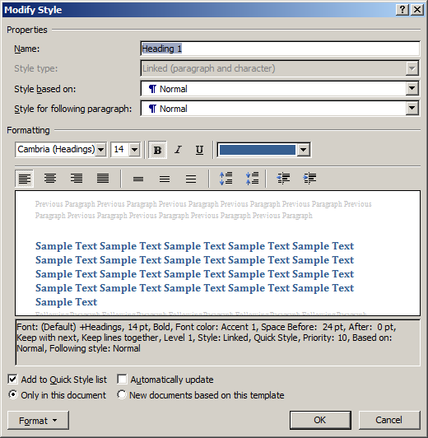
Common Style Properties
All style types share a set of common properties:
Style name
Parent style on which this style is based
Many other properties (see §2.7)
<w:style w:type=“paragraph” w:styleId=“Heading1”>
<w:name w:val=“Heading 1”/>
<w:basedOn w:val=“Normal”/>
… other property settings …
</w:style>
Notes:
Note that Style ID may be the no-spaces compressed version of the style name (“Default Paragraph Font” has an ID of DefaultParagraphFont) or may be something slightly different in some cases (“Normal Table” has an ID of TableNormal).

Slide 10
Style Types
WordprocessingML supports six different types of styles:
Paragraph styles
Character styles
Linked styles
Table styles
List styles
Default style (linked type, but applies when no style specified)
Let’s look at each of these in more detail …

Slide 11
Paragraph Styles
Paragraph styles apply to the contents of an entire paragraph as well as the paragraph mark
This means they can affect the paragraph properties as well as the text formatting
They cannot be applied to sub-paragraph ranges
A paragraph style has both a set of run properties (rPr) and paragraph properties (pPr)
The run properties are the set of properties applied to each run in the paragraph
Notes:
Sets the default for all runs within a paragraph, but can’t be applied directly to a run (“sub-paragraph range”).
The “next paragraph” concept is the paragraph(s) that follow(s) a paragraph defined in this style. – see 2.7.3.10

Slide 12
Paragraph Styles Example
Step 1: define a paragraph style in the styles.xml part:
<w:style w:type=“paragraph” w:styleid=“TestParagraphStyle”>
<w:name w:val=“Test Paragraph Style”/>
<w:qformat/>
<w:rsid w:val=“009E253E”/>
<w:pPr>
<w:pStyle w:val=“TestParagraphStyle”/>
<w:spacing w:line=“480” w:lineRule=“auto”/>
<w:ind w:firstLine=“1440”/>
</w:pPr>
<w:rPr>
<w:rFonts w:ascii=“Algerian” w:hAnsi=“Algerian”/>
<w:b/>
<w:color w:val=“ED1C24”>
<w:sz w:val=“40”/>
</w:rPr>
</w:style>
Common Properties
Paragraph Properties
Character (Run) Properties

Slide 13

Paragraph Styles Example
Step 2: apply the style in the document.xml part, using the pStyle element of the paragraph properties:
RESULT: the paragraph is displayed with the style applied …
<w:p>
<w:pPr>
<w:pStyle w:val=“TestParagraphStyle”/>
</w:pPr>
<w:r>
<w:t>Text</w:t>
</w:r>
</w:p>

Slide 14
Character Styles Example
Applied to runs instead of paragraphs
Can be applied to any run in the document
Can only specify run properties
can’t specify paragraph properties such as indentation
<w:style w:type=“character” w:styleId=“TestCharacterStyle”>
w:name w:val=“Test Character Style”/>
<w:priority w:val=“99”/>
<w:qformat/>
<w:rsid w:val=“00E07041”>
<w:rPr>
<w:rfonts w:ascii=“Courier New” w:hAnsi=“Courier New”/>
<w:color w:val=“FFF200”/>
<w:u w:val=“single”/>
</w:rPr>
</w:style>
Common Properties
Character (Run) Properties

Slide 15

Character Styles Example
Applying a character style to a run:
The result:
<w:r>
<w:t xml:space=“preserve”>This is some text which is of a character style</w:t>
</w:r>
<w:r w:rsidRPr=“00E07041”>
<w:rPr>
<w:rStyle w:val=“TestCharacterStyle”/>
</w:rPr>
<w:t>right here</w:t>
</w:r>
<w:r>
<w:t>.</w:t>
</w:r>

Slide 16
Linked Styles
Linked styles contain both a paragraph style and character style
The two styles are connected by the link element
This tells the consumer that it should mask the fact that these are two different styles at runtime
From the user’s point of view, the same style can be applied to paragraphs or runs of characters
Notes:
Note that there is no guaranteed relationship between the two linked styles – they could be entirely different, but under the same name as a linked style.

Slide 17
Linked Styles Example
Each style uses the link element to point to the other style’s w:styleId value:
<w:style w:type=“paragraph” w:styleId=“TestLinkedStyle”>
<w:name w:val=“Test Linked Style”/>
<w:link w:val=“TestLinkedStyleChar”/>
<w:qformat/>
<w:rsid w:val=“00A438CE”/>
<w:pPr>
… paragraph properties are defined here …
</w:pPr>
</w:style>
<w:style w:type=“character” w:styleId=“TestLinkedStyleChar”>
<w:name w:val=“Test Linked Style Char”/>
<w:basedOn w:val=“DefaultParagraphFont”/>
<w:link w:val=“TestLinkedStyle”/>
<w:rsid w:val=“00A438CE”/>
<w:rPr>
… run properties are defined here …
</w:rPr>
</w:style>
Notes:
The document’s pStyle property can refer to TestLinkedStyle
The document’s rStyle property can refer to TestLinkedStyleChar

Slide 18
Numbering Styles
Numbering styles are styles which define the structure of a multi-level numbering format
Unlike other styles, numbering styles are never directly referenced by content in the document
Instead, content (paragraphs in a list) refers to a numbering definition instance via the numId and ilvl elements
Numbering definition instances are based on an abstract numbering definition
Abstract numbering definitions define paragraph properties for up to 9 hierarchical levels
Notes:
Numbering styles are also known as “list styles.”
A list is NOT a container, unlike in HTML – show this. Each list item is simply a paragraph, and any paragraph may be a list item. Consecutive paragraphs that are list items appear to be a single list, but there is no concept of a “list” in Open XML, only paragraphs that are list items.

Slide 19
Numbering Styles
In the style part, numbering styles only have a single property, a reference to an abstract numbering definition:
The abstract numbering definition is stored in the numbering part
<w:style w:type="numbering" w:styleId="TestNumberingStyle">
<w:name w:val="Test Numbering Style" />
<w:priority w:val="99" />
<w:rsid w:val="0045009F" />
<w:pPr>
<w:numPr>
<w:numId w:val="1”/>
</w:numPr>
</w:pPr>
</w:style>
Notes:
Word stores the numbering part as numbering.xml.

Slide 20
Abstract Numbering Definition (abstractNum)
Common Numbering
Properties
<w:abstractNum w:abstractNumId="0">
<w:nsid w:val="FFFFFF80" />
<w:multiLevelType w:val="singleLevel" />
<w:tmpl w:val="36EE9B9C" />
<w:lvl w:ilvl="0">
<w:start w:val="1" />
<w:numFmt w:val="bullet" />
<w:pStyle w:val="ListBullet5" />
<w:lvlText w:val="•" />
<w:lvlJc w:val="left" />
<w:pPr>
<w:tabs>
<w:tab w:val="num" w:pos="1800" />
</w:tabs>
<w:ind w:left="1800" w:hanging="360" />
</w:pPr>
<w:rPr>
<w:rFonts w:ascii="Symbol" w:hAnsi="Symbol" w:hint="default" />
</w:rPr>
</w:lvl>
</w:abstractNum>
Numbering Levels
(up to 9)
Notes:
Could be multilevel, in which case the w:lvl section repeats for each level.
Single-level, multi-level, hybrid multi-level.

Slide 21
Numbering Level Properties
Properties defined within the w:lvl element:
Starting number value
Number format code – for example, One vs. 1 vs. 1st
Restart level (which level’s presence should cause this level to restart)
Associated paragraph style
Legal numbering?
Forces the numbering from previous levels to be displayed using Arabic numbers at this level (e.g. level 1 = ARTICLE III, level 2 = 3.1)
Numbering suffix (tab/space/nothing)
Number format text
Specifies both the static text and the level text
Syntax to specify other level text: %#; where # = level number
CONTINUED …

Slide 22
Numbering Level Properties (continued)
More properties defined within the w:lvl element:
Reference to an image (for picture bullets)
Number justification (left/center/right)
Paragraph properties for this level
Run properties for the numbering value itself
Level number (zero-based)
Tentative property
Specifies that the list level is currently unused and can be redefined without changing content

Slide 23
Numbering Definition Instance (num)
Can be referenced by paragraphs within the document
Specifies two pieces of information:
Abstract numbering reference (abstractNumId)
Optional level overrides (lvlOverride)
May override the starting value for this level
May override the numbering for this level
<w:num w:numId=“6”>
<w:abstractNumId w:val=“4”/>
<w:lvlOverride w:ilvl=“1”>
<w:lvl w:ilvl=“1”>
<w:lvlText w:val=“%1)”/>
<w:lvlJc w:val=“left”/>
<w:pPr>
<w:ind w:left=“360” w:hanging=“360”/>
</w:pPr>
</w:lvl>
</w:lvlOverride>
</w:num>

Slide 24
Numbering-Style Reference
Each numbered item is a separate paragraph
Within numbering properties (numPr), the item is associated with:
A numbering definition instance (numId)
A level within that definition (ilvl)
<w:p>
<w:pPr>
<w:numPr>
<w:ilvl w:val="0" />
<w:numId w:val="0" />
</w:numPr>
</w:pPr>
<w:r>
<w:t>this is the text for this item</w:t>
</w:r>
</w:p>
DEMO
Notes:
The number style exists only to give a style a name. Actual definition of the details is in the numbering definition instance.

Slide 25
Table Styles
Table styles supply formatting information for:
Table elements (borders, margins, shading, etc.)
Cell content (paragraph properties)
<w:style w:type="table" w:styleId="TableGrid">
<w:name w:val="Table Grid" />
<w:rsid w:val="00B07540" />
<w:pPr>
… paragraph properties …
</w:pPr>
<w:tblPr>
<w:tblInd w:w="0" w:type="dxa" />
<w:tblBorders>
… border properties …
</w:tblBorders>
<w:tblCellMar>
… cell-margin properties …
</w:tblCellMar>
</w:tblPr>
</w:style>
Paragraph
Properties
Table
Properties

Slide 26
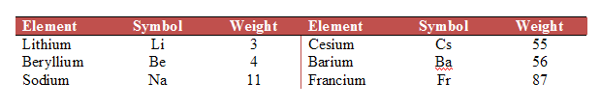
Table Styles
A table style is associated with a table via the table’s tblStyle element, which appears in the table properties
<w:tbl>
<w:tblPr>
<w:tblStyle w:val=“Style20”/>
<w:tblW w:w=“5000” w:type=“pct”/>
<w:tblLook w:val=“0220”/>
</w:tblPr>
… tblGrid, table rows and cells …
</w:tbl>
Table style Style20 is applied to the table

Slide 27
Table Styles: Applying Part of a Style
The entire table style may not apply to a specific table
The tblLook element indicates which sections to apply
The value of tblLook is a hexadecimal bit mask:
0x0020=Apply first row conditional formatting
0x0040=Apply last row conditional formatting
0x0080=Apply first column conditional formatting
0x0100=Apply last column conditional formatting
0x0200=Do not apply row banding conditional formatting
0x0400=Do not apply column banding conditional formatting
Default if tblLook is omitted = apply the entire style
DEMO
Notes:
Sum of applicable sections = tblLook value
Note how 200 applies to the previous slide: first-row formatting, no row banding

Slide 28
Table-Section Styling Priorities
Top left, top right, bottom left, bottom right
First column, last column
First row, last row
Banded rows, even row banding
Banded columns, even column banding
Whole table
(application order is bottom to top)

Slide 29
Style Inheritance
Styles may inherit from other styles of the same type (paragraph, character, table, etc.)
The basedOn element indicates the parent style
Example:
Test style inherits from …
Heading 1 style, which inherits from …
Normal style

Slide 30
What if we have no Style?
Document default settings are stored in the styles part, within the docDefaults element
In previous versions of Word, these were hard-coded and could not be changed
<w:docDefaults>
<w:rPrDefault>
<w:rPr>
… default run properties …
</w:rPr>
</w:rPrDefault>
<w:pPrDefault>
<w:pPr>
… default paragraph properties …
</w:pPr>
</w:pPrDefault>
</w:docDefaults>

Slide 31
Style Inheritance
How can we determine which settings will be applied?
Start from the document defaults
Trace the style-inheritance hierarchy
At each level, any property settings override settings from the basedOn styles above it
When Word saves a document, only properties that do not match their inherited values (i.e., overridden) are saved.

Slide 32
Style Application: top-down order
Table | Characters | Paragraph | List Item
Document Defaults
Table
Numbering
Paragraph
Character
Direct Formatting
Notes:
Multiple style ‘types’ can be applied to the same text within a file, so properties are applied in a specific order.
List item = the number/bullet/etc that prefixes the content of the item.

Slide 33
Latent Styles
The other piece of style information stored in the document
Stores properties about styles without saving the actual style in the file
Needed because the document may not have access to its template
Latent style properties:
Style lockdown (can style be used?)
UI sorting priority
Use as top-level format
Unhide when used
Notes:
Latent styles are used to store information about “uninstantiated” styles.

Slide 34
Stories

Slide 35
Stories
WordprocessingML documents have many stories:
The main story
Header(s) / Footer(s)
Footnote(s) / Endnote(s)
Subdocuments
Comment(s)
Each story is defined by two things:
It is a unique region containing block-level content
All stories share the same set of properties (styles, numbering definitions, settings)
Exception: the Glossary document has its own properties

Slide 36
Glossary Document
The glossary document stores supplementary document content: rich document content which travels with the document to be accessible, but is not displayed
Example: AutoText entries are stored in the glossary
Unlike all other document stories, the glossary uses its own set of styles, numbering, comments, etc.
It is essentially a separate document within a WordprocessingML package

Slide 37
Glossary Document Structure
The glossary contains a set of docPart items
Any block-level content may be included in a docPart
<w:docParts>
<w:docPart>
<w:docPartPr>
… properties: name, category, guid, type, behavior …
</w:docPartPr>
… content for this glossary entry (document part) …
</w:docPart>
<w:docPart>
<w:docPartPr>
… properties: name, category, guid, type, behavior …
</w:docPartPr>
… content for this glossary entry (document part) …
</w:docPart>
</w:docParts>
Notes:
Glossary and document building blocks are closely related concepts. See the screencast on Channel 9 posted 12/1/2006 about document building blocks.

Slide 38
Glossary Document Entries
Each entry in the glossary document consists of two components:
The entry’s properties
The entry’s contents
The first specifies information about the entry (e.g. its classification) for when it is inserted, the latter stores the block level content which constitutes the entry
The glossary document also has separate copies of all the relationships that the main document has
Its own styles, numbering, fonts, comments, headers, footers, etc.

Slide 39
Subdocuments

Slide 40
Subdocuments
Subdocuments provide a way for a single document to be divided into parts
These parts are each full documents and can be edited and manipulated independently
Subdocuments don’t know they’re part of something bigger – they’re just stand-alone documents
Master Document
Subdocument
Subdocument
Subdocument
Notes:
The Ecma Office Open XML spec uses this architecture.
Master document may contain any other type of content, not just subdocument references.
Note development scenarios: could create subdocuments on the fly, master document collates a set of reports, etc.

Slide 41
Subdocuments: how it works
Main document part contains subDoc elements that indicate where to insert subdocuments
The subdocument’s location is stored in a relationship
Master Document
Part1.docx
Part2.docx
Part3.docx
Document.xml:
<w:body>
<w:subDoc r:id=“rId1”/>
<w:subDoc r:id=“rId2”/>
<w:subDoc r:id=“rId3”/>
Document.xml.rels:
<Relationship Id=“rId1” Type=“…/subDocument” Target=“Part1.docx” TargetMode=“external”/>
<Relationship Id=“rId2” Type=“…/subDocument” Target=“Part2.docx” TargetMode=“external”/>
<Relationship Id=“rId3” Type=“…/subDocument” Target=“Part3.docx” TargetMode=“external”/>
DEMO
Notes:
Word bug: must have a paragraph between each subdoc!

Slide 42
Sections

Slide 43
Document Sections
A document may be divided into sections
These allow grouping at a higher level than paragraphs
Vary landscape/portrait orientation, margins or other settings
Each section has a sectPr element (inside pPr) where properties may be defined for that section:
<w:sectPr>
<w:pgSz w:w="12240" w:h="15840"/>
<w:pgMar w:top="1440" w:right="1800" w:bottom="1440“ w:left="1800“
w:header="720" w:footer="720" w:gutter="0"/>
<w:cols w:space="720"/>
<w:docGrid w:linePitch="360"/>
</w:sectPr>
Notes:
Note developer usage: adding specially formatted report to a document, etc.

Slide 44
Section Breaks
Sections are defined in two ways:
Insertion of a section break – a section break is a paragraph mark which also delimits a section
The last paragraph in the document – the final paragraph is always a section break
Every document has at least one section

Slide 45
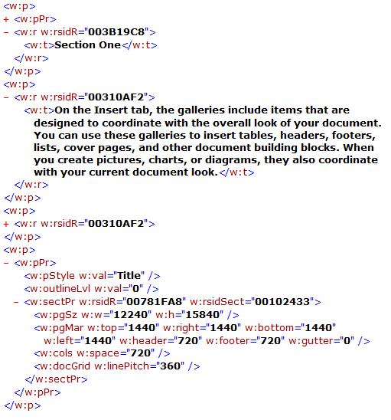
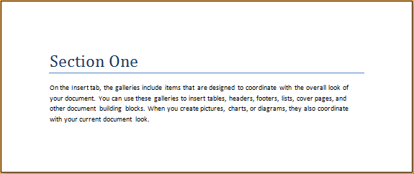
Section Breaks = <sectPr>
Occurs in paragraph properties, within a paragraph
Properties refer to content that comes before them

Slide 46
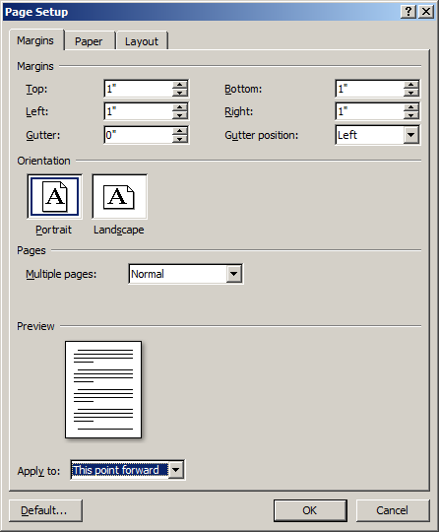
Section Properties
Each section has its own settings for the properties exposed in Word’s Page Setup dialog
<w:sectPr>
<w:pgSz w:w="12240" w:h="15840" />
<w:pgMar w:top="1440" w:right="1440" w:bottom="1440" w:left="1440" w:header="720" w:footer="720" w:gutter="0" />
<w:cols w:space="720" />
<w:docGrid w:linePitch="360" />
</w:sectPr>
Notes:
Note 1440 twips per inch.
“This point forward” can cause confusion, because these property settings will be stored in a <sectPr> at the END of the section, although you’re setting the settings at the BEGINNING of the section.

Slide 47
Section Break Types
Four types of section breaks:
Next page (start on next page) -- default type
Even (start on next even page)
<w:type w:val=“evenPage”>
Odd (start on next odd page)
<w:type w:val=“oddPage”>
Continuous (starts on next paragraph)
<w:type w:val=“continuous”>
(since a continuous section break doesn’t end a page, it may not specify page-level properties)

Slide 48
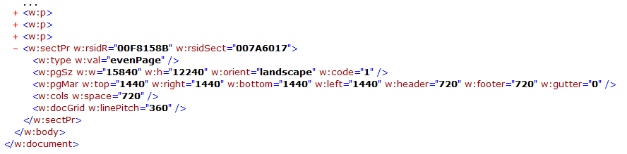
Final Section Properties
The <sectPr> element always occurs inside the last paragraph of the section, with one exception
The final set of section properties is the final element inside the <body>, at the same level as paragraphs
The entire document must have section properties, and this architecture enables enforcement of that requirement via XML Schema
DEMO

Slide 49
Headers/Footers

Slide 50
Headers and Footers
Headers and footers are stories in a WordprocessingML document
Like the main document story, they can contain text, graphics or data fields (page number, date, document title, etc.) – any block-level content
Headers/footers are anchored to Sections
Each section may have up to three headers or footers defined:
First-page
Odd-numbered pages (default)
Even-numbered pages

Slide 51
Using a Header or Footer
Each header or footer is stored in its own part
E.g., header1.xml/footer1.xml
Header main element = hdr
Footer main element = ftr
The main document has relationships to these parts:
Defined in _rels (document.xml.rels)
Referenced in the body of the document, within section properties (sectPr) elements:
w:headerReference = header part
w:footerReference = footer part
DEMO
Notes:
Create a simple document, go through the parts and relationships for headers and footers.

