Slide 1
Selecting and Implementing the Right Remote Support Solution for Your Institution
Blake Adams and Gene Liverman
University of West Georgia

Slide 2
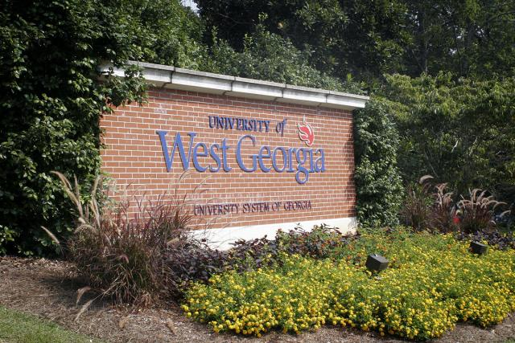
The University of West Georgia
45 Miles west of Atlanta
Approximately 1,500 faculty/staff members
Approximately 4,500 workstations/laptops/etc
Approximately 10,000 students
58 IT Staff members
3 Service Desk Representatives
11 Desktop Support Specialists
6 Web Design/Developers

Slide 3
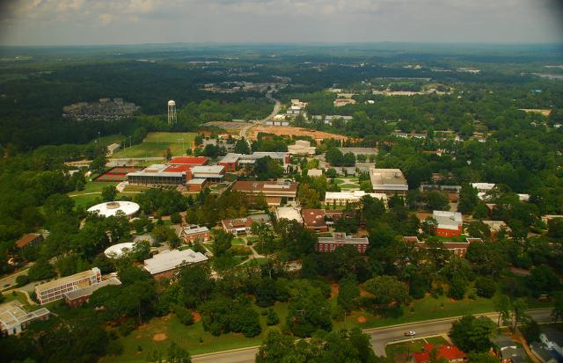
The University of West Georgia
January of 2008 – Campus IT reorganized from distributed to centralized support.
Increased volume of calls to the Service Desk with no additional staffing.
Maintain consistent level of customer support across campus.
Experts located geographically distant from some customers.

Slide 4
How do we support all these Users?!?!!
Additional Staffing:
Desktop Support Technician (Tier II)
Salary and Fringe - ~$50,000
Annual Operating Expense (space, equipment, training) - ~$3,000
Total Annual Cost - ~$38,000 - $43,000
Service Desk Support Technician (Tier I)
Salary and Fringe - ~$40,000
Annual Operating Expense - ~$3,000
Total Annual Cost - ~$33,000-$36,000
Remote Support Solution
Start Up and Annual Maintenance depend on solution
Do Nothing
The price is right, but the problem is ignored rather than addressed.

Slide 5
The Remote Support Option
Access to customers, regardless of location (on Campus, out of the Country)
Improve ability of first tier support to resolve issues without dispatching a desktop technician. (e.g. – walk users through Office Suite issues)
Ability for desktop technicians to resolve issues remotely.
Ability to “see what the user sees”
Ability to see end user machine specs (processor speed, RAM, HD Size/Space remaining, processes running)
Maximize use of specialists
Reduce cost per contact
Reduce time to respond/resolve

Slide 6
Points to Consider
Appliance based vs. Software as a Service
Scalability
Track Record
Concurrent vs. Named licensing
Platform support at client and customer level
Cost

Slide 7

What we looked at…
LogMeIn – Rescue
Software as a service
Licensed per seat (Tech 1, Tech II, Tech III)
Technician OS support – Windows w/IE or Firefox.
Supports customer end – Windows, Mac, Windows Mobile, Blackberry, Symbian (Nokia)
$1,188 yearly subscription (+ $768.00 for mobile device support)/seat.
Assuming 6 seats, total annual cost = 11,736.00

Slide 8
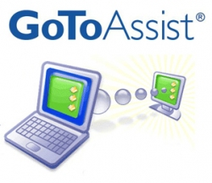
What we looked at…
Centrix – GotoAssist Express
Named Licensing ( Gene Liverman MUST use the Gene Liverman account).
Technician OS support – Windows w/IE
Supports customer end – Windows, Mac (no mobile support)
$660.00/yr subscription.
Named Licensing mandated decision on where to assign licenses. For the purpose of this purchase, we considered Service Desk and Desktop Support Techs.
(12 Desktop+4 Service Desk)*$660.00 = $10,560 annual cost

Slide 9

What we looked at…
Bomgar (B200)
Appliance based solution
Unlimited users/token based use.
Client based for technician use – Windows, Mac, Linux.
Supports customer end – Windows, Mac, SSH/Telnet, Blackberry, Windows Mobile
Customizable interface
Atlanta Presence (HQ – Mississippi)
Higher Ed Presence – UAB, UF, MIT.
Tiered options (B100, B200, B300, B400, Virtual Appliance)
Server ($2995) + 4 licenses ($5400)+ Maintenance ($1600)= $9,995
Annual cost: $1600

Slide 10
Why West Georgia Chose Bomgar
The cost of a Remote Support solution was less expensive and less risky than additional staffing.
Network and System Administrators liked the idea of internal support traffic staying on campus
Concurrent licensing = account for every member of ITS
Chosen appliance (B200) scalable to 20 concurrent seats.
Annual Maintenance vs. Yearly Subscription was much lower.
Customized customer portal and chat interface
Impressive Higher Ed presence
Ease of support of the appliance – updates and patches can be installed by a layperson
Supports multiple domains – allows for leveraging by departments outside of ITS.

Slide 11
How we are using it.
Service Desk – Email client issues, VPN setups, and password reset assistance.
Desktop Support – Resolving multiple issues from their office, sharing sessions with other technicians.
Web Innovations – Helping end users resolve web based issues.
Distance Education – Sharing accounts with faculty members so they can assist students at home.

Slide 12
Common Use Cases
Doing quick fixes remotely instead of traveling 5-15 minutes each way for 2 minutes worth of work
Working on multiple computers at the same time
Helping users connect to our VPN from home
Helping users understand how to connect and Use MS Remote Desktop

Slide 13
Customer Experience
When I help a user remotely…
We talk on the phone
They navigate to http://support.westga.edu in IE or Safari
They click on Gene Liverman in the list of representatives.
I tell them to click Run/Open when prompted and that they may need to clicking Run an additional time.
They show up in my Personal queue.
I double click on their session and it connects us.
I then ask them to click “Allow shared control” so that I can control their computer.
If they are on Vista or Windows 7 I also as for elevated rights.

Slide 14
Demo Time
Blake is going to be a user at home trying to connect to the campus VPN
I will start a Bomgar session with him to troubleshoot his connection issues
I will find that he has missed a step in the setup and will help him correct it.
I will then walk him through using connecting to a computer inside our campus firewall.
Notes:
We can connect to its-pass-v1.uwg.westga.edu if no other machine is available.

