Slide 1
World Domination, One Instant Message at a Time
Gene Liverman
University of West Georgia

Slide 2
About Me
I love all OS’s (yes, even Windows)
Linux since 2004 (started with Gentoo)
1-person IT shop, desktop support, sysadmin, architect
Embraced the DevOps culture
Puppet since 2013 (automation rocks!)
Oooo, something shiny…

Slide 3
The plan… originally
fires not included

Slide 4

Tools
Integrations
Hubot
Lita
HipChat by Atlassian
Google Talk / Pidgin
Web Hooks
Jenkins
GitLab
Puppet
Foreman
SSH
PowerShell
IPAM (IPControl)
Racking servers… oh, wait…

Slide 5

Hubot
Created by GitHub - https://hubot.github.com
“Hubot is your company's robot. Install him in your company to dramatically improve and reduce employee efficiency.”
Written in Coffeescript
Runs on Node.js
Sits in your chat room just like a person
Talks to you
Goes off and does work and then reports back

Slide 6

Lita
Like Hubot but written in Ruby
https://www.lita.io

Slide 7

Made by Atlassian
Integrates with most anything
Free hosted version
Paid + version with added features
On-prem version too (paid)

Slide 8
Google Talk & Pidgin
Google Talk is our primary IM platform
Many user utilize Pidgin
HipChat has limited Jabber support

Slide 9
Jenkins
Used for running tests on Puppet code
Used for automating deployments
Banner code trees
Integrations:
Trigger jobs
Check job status

Slide 10
GitLab
In-house version of GitHub
Private Puppet code
Website
Scripts
Banner code trees
Integrations:
Get recent changes
List branches
PR’s and Issue tracker

Slide 11
Puppet
Automation and configuration management
Has agents on servers
Collects data about servers, stores in PuppetDB
Integrations:
Query PuppetDB
Run Puppet agent on demand

Slide 12
Foreman
Management tool for Puppet
SSL certificate authority
Report viewer for Puppet
Puppet External Node Classifier (ENC)
Integrations:
Sign certs
Assign classes
Change environments

Slide 13
SSH to Servers
Use for scenarios like:
Remote in
Run one command
Sign off
Also, check & restart services

Slide 14
PowerShell
Basically the same as SSH just on Windows

Slide 15
IPControl
Our IP Address Management (IPAM) tool
Interact with their API

Slide 16
Getting Started
Setup HipChat
Integrated GitLab
and GitHub
Added Jenkins build status
Scripted output from web hook receiver
Installed Hubot
Pugs…

Slide 17

/pug me

Slide 18

Yep, that’s what happened to the plan.
Many moons later…
the revelation that Rock Eagle is just around the corner hits

Slide 19

Resume Research
Plant some trees
R10k
PuppetDB
https://github.com/genebean/hubot-scripts-by-genebean

Slide 20
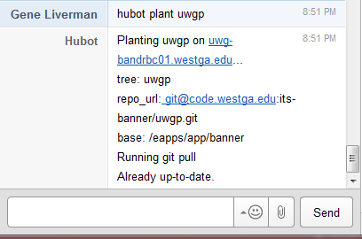
tree_planter.coffee
HipChat
What’s happening
Hubot acknowledges command
Parses message
Creates JSON payload
Posts to web hook receiver
Prints all output returned by tree_planter

Slide 21
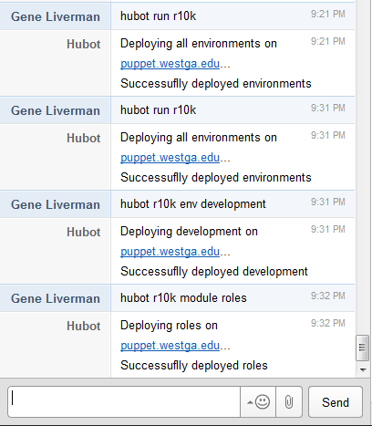
r10k.coffee
HipChat
What’s happening
Acknowledges command
ssh’s to Puppet server using keys
Runs r10k via passwordless sudo, limits output to error level
Prints any output
Upon success Hubot displays a message

Slide 22
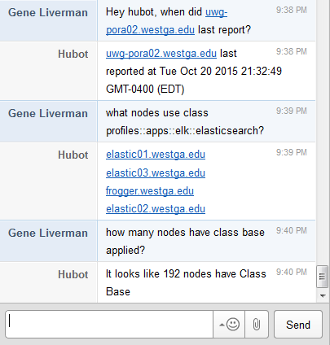
puppetdb.coffee
HipChat
What’s happening
Hubot is eaves dropping on all conversations listening for key phrases
He parses key words
Calls PuppetDB’s API
Parses returned JSON
Including sorting and counting
Answers the question

Slide 23

Well, script in this case.
Coffeescript on Node.js is a bit more complex than bash…
good tools are worth the learning curve.

Slide 24

What’s Next?
More PuppetDB
Sign certs in Foreman
Query Elasticsearch
Run commands on Windows
Maybe via a second bot
Maybe via PowerShell Server
Integrate with ticket system
Integrate with Zabbix

Slide 25
And then…

Slide 26
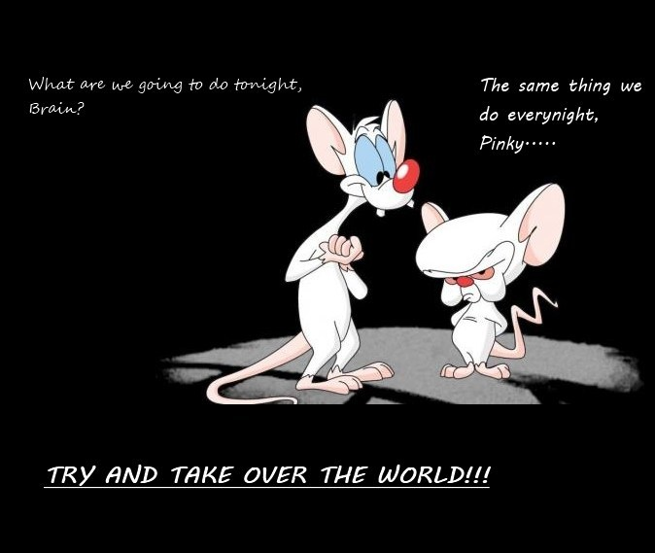

Slide 27
Questions?
gliverma@westga.edu
@technicalissues
GeneBean on GitHub

