Slide 1

Dual-CMS Routing
How We Took Our New CMS Live
One URI at a Time

Slide 2



About me
Systems Integration Architect @ UWG
SysAdmin of both Windows and Linux
Recovering SPARC Solaris Admin
F5 Load Balancer, SAN, VMware, & Hyper-V Admin
Coder
Ruby & PowerShell mostly
PHP-dabbler
Automator of things with Puppet
Linux & Open Source Advocate
Data Center junkie
Mac aficionado
GeneBean | @technicalissues | geneliverman

Slide 3
The Challenge
Move from OpenText to Omni Update
Keep current URL
Do the migration in phases
Phase 1 includes:
the front page of www.westga.edu
~ top 40 sites by traffic
Legacy subdomains / custom URL’s
Notes:
Roughly 260 sites total
Lots of name based virtual hosts in use

Slide 4
Ideas & Opportunities
Use a whitelist based on URI’s
Site already fronted by F5’s -- iRules for the win!
Don’t have an F5? Stay tuned… ( NGINX to the rescue )
Implement high availability / redundancy
Go 100% HTTPS
2014 - http://bit.ly/GoogleHTTPSBonus
OpenText site’s https version was busted
Notes:
A URI is like a URL except it doesn't account for the protocol.
Already knew that F5 could do “things” based on URI / URL ( hold off on talking about iRules )
Expected to keep www up 24x7 -- needed infrastructure to support that
Keep our visitor’s actions private from others

Slide 5
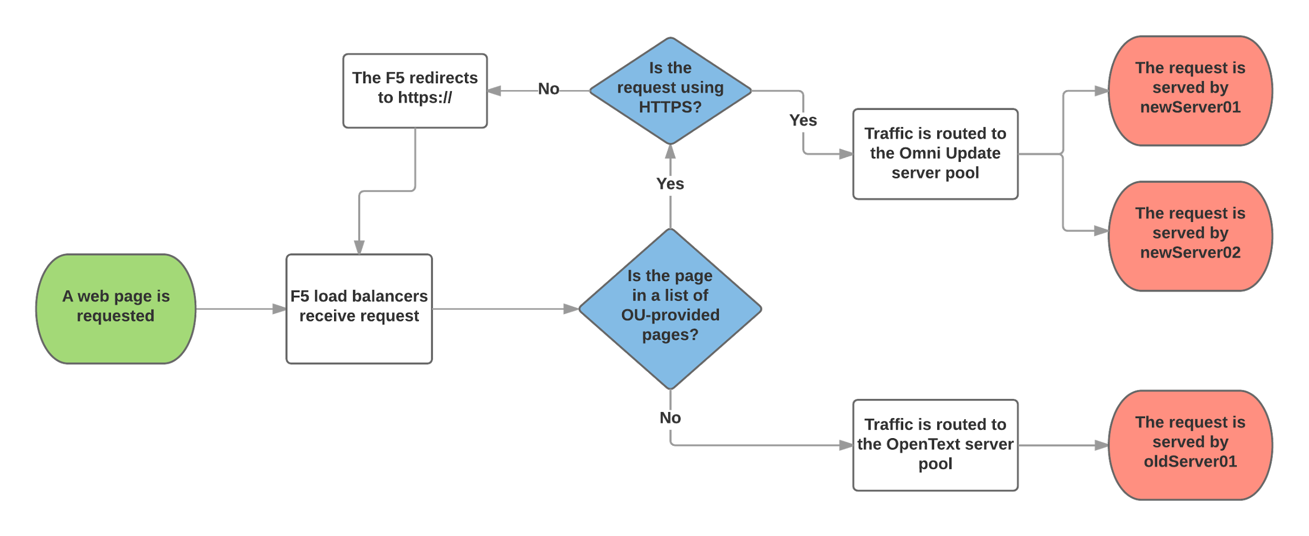
The Design
Notes:
( DO NOT go into detail, that comes next. )
New site’s traffic follows upper path
New backend is load balanced based on active connections, persistence is cookie based with source as a fallback.
Old site’s traffic follows lower path

Slide 6
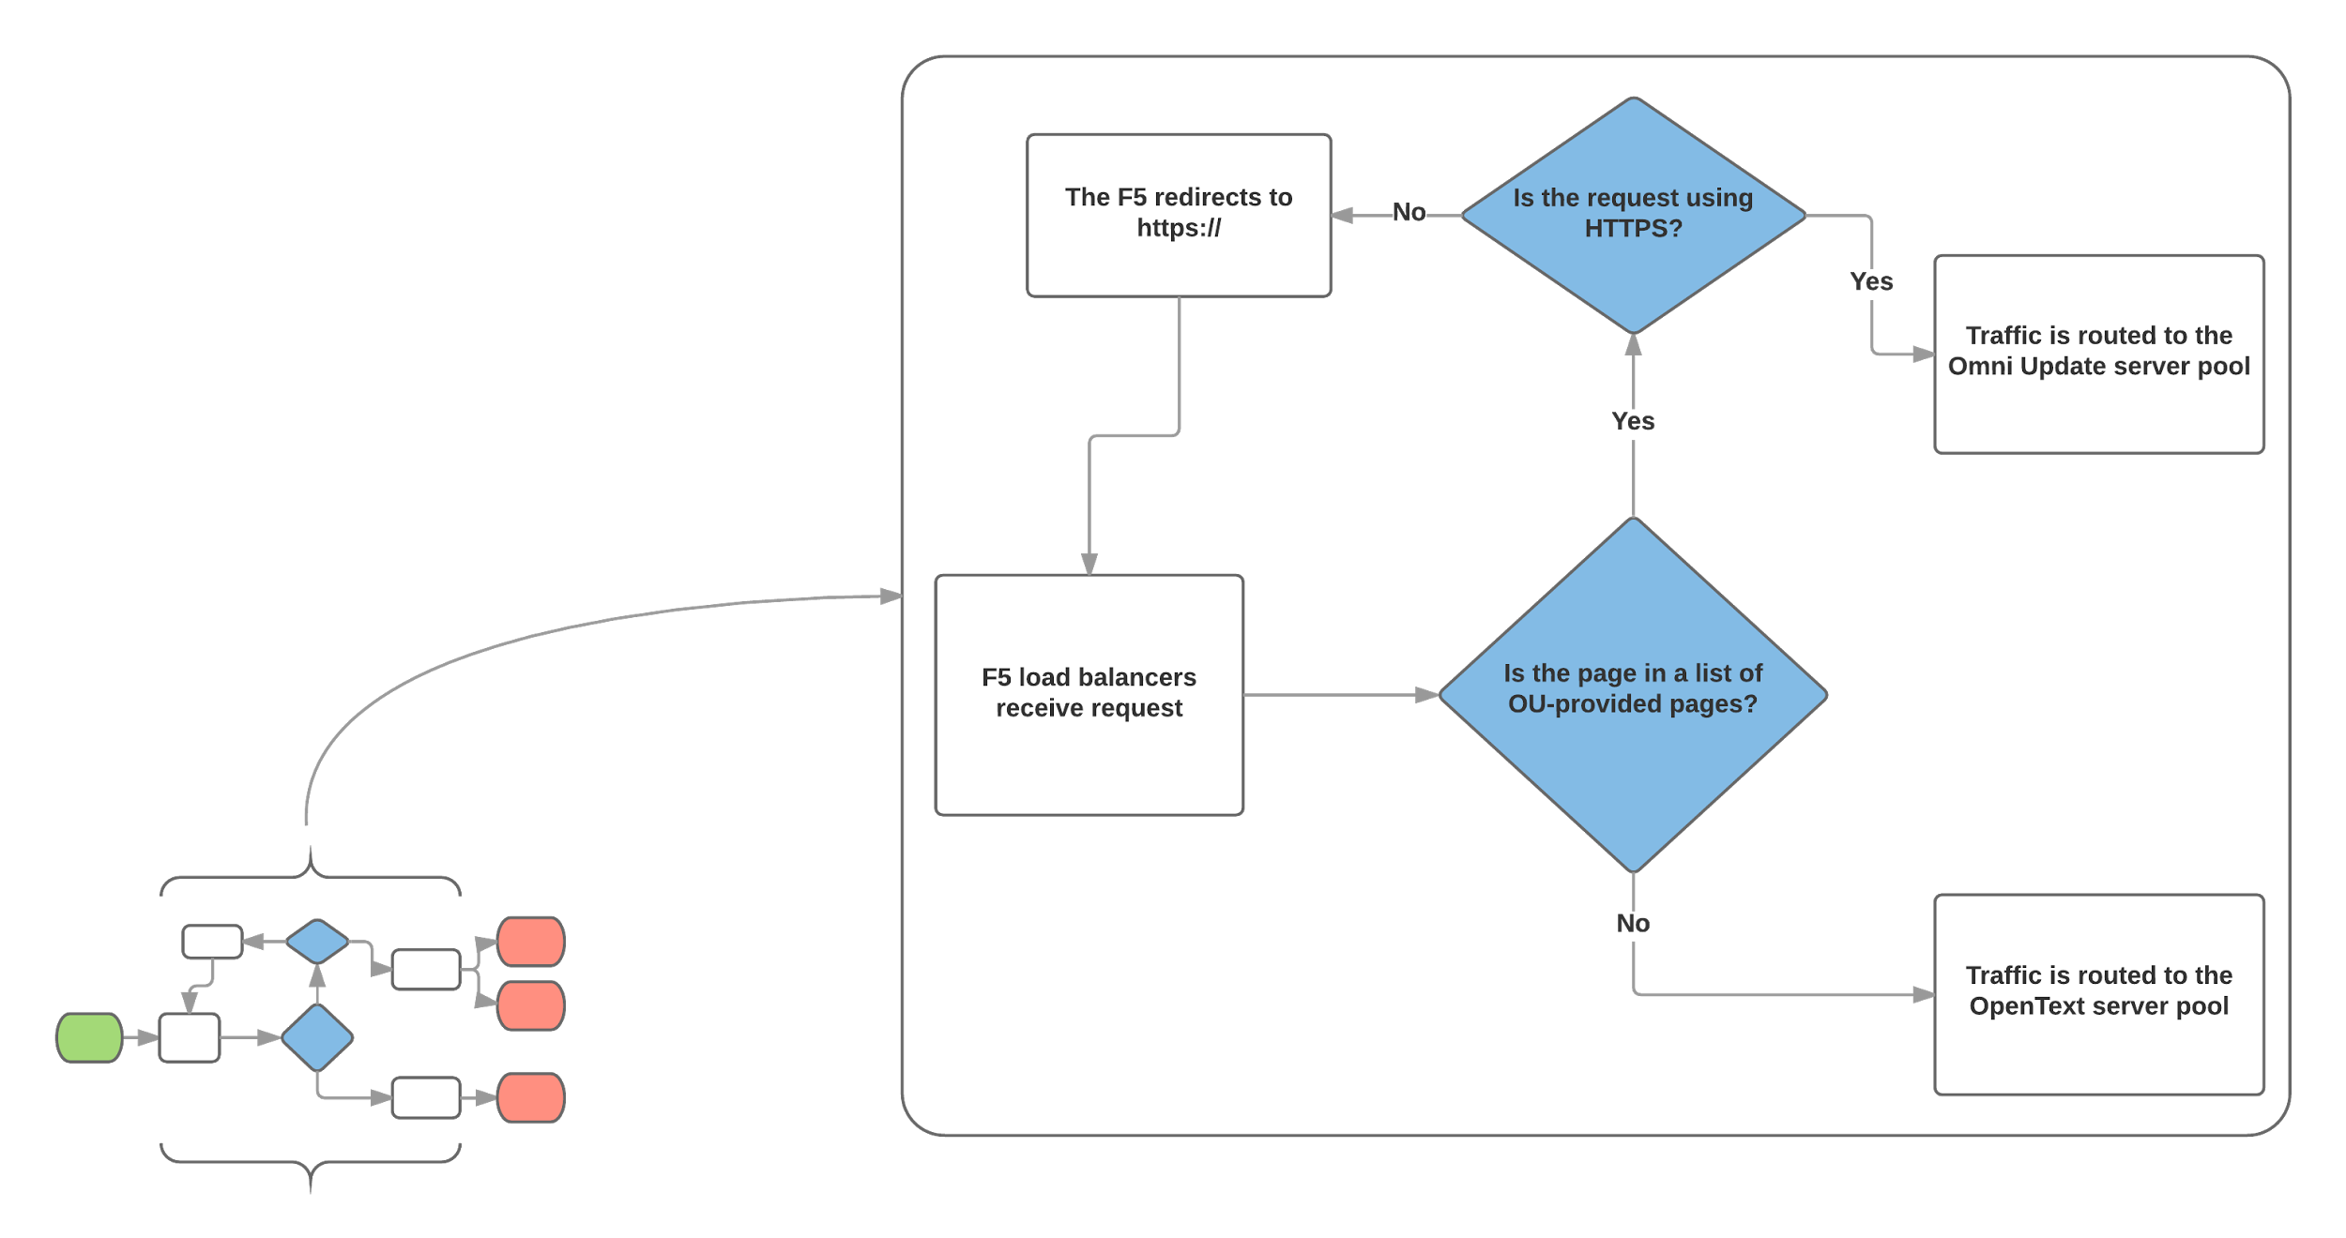
Route old to old, new to new
Notes:
Unless it's in the whitelist it goes to the old server

Slide 7
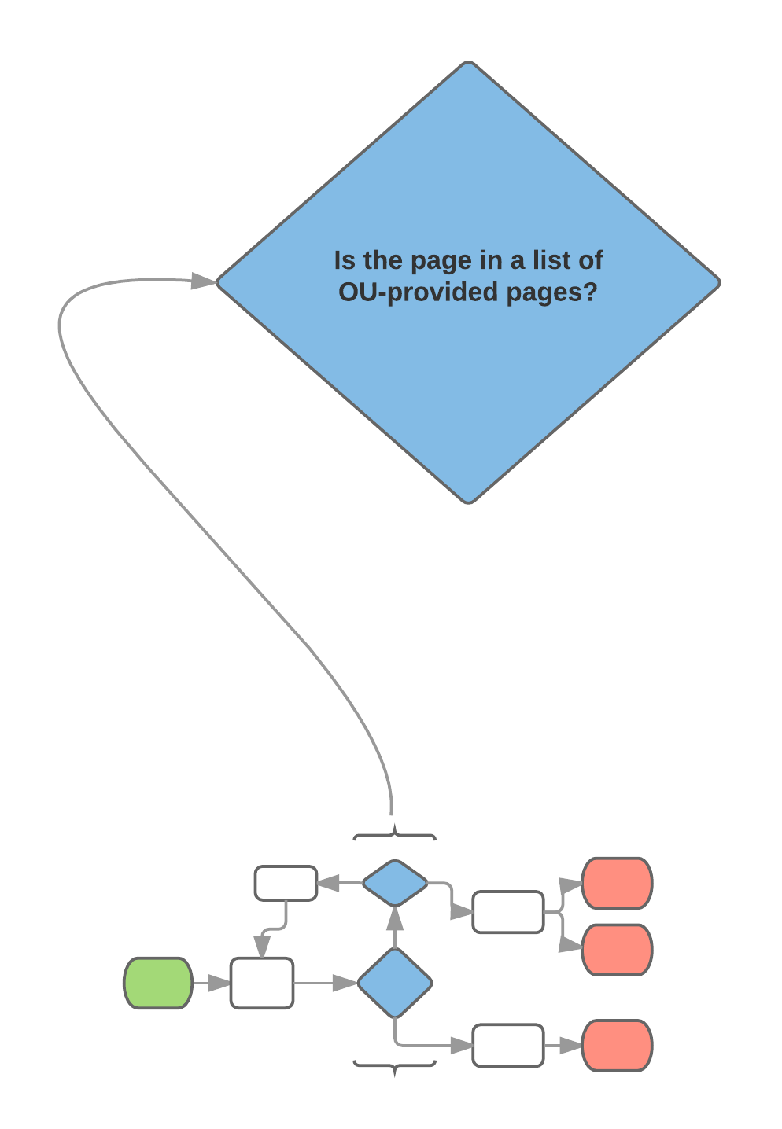
Whitelisting
Keep a list of migrated URI’s
Check each request against the list
Send migrated requests to new CMS on HTTPS
Send everything else to old CMS
Facilitate rapid de-migration
Notes:
Details of the same points come next…

Slide 8
Keep a list of migrated URI’s
Prod and Dev version of list
Tracked in Git
Edits via GitLab web interface
Diffs sent to admins
List deployment is copy / paste

Slide 9
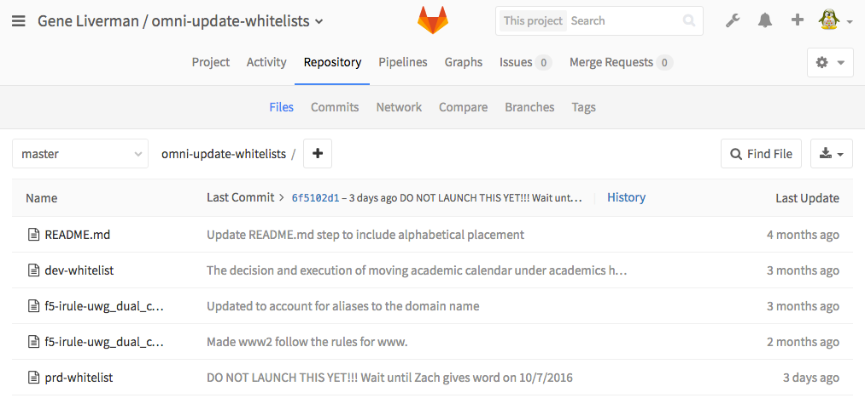
Project in GitLab
Notes:
Two lists are kept
-- allows for testing
Code for iRule is tracked here
-- dev and prod differ only in host names
ReadMe documents the whitelist editing process

Slide 10
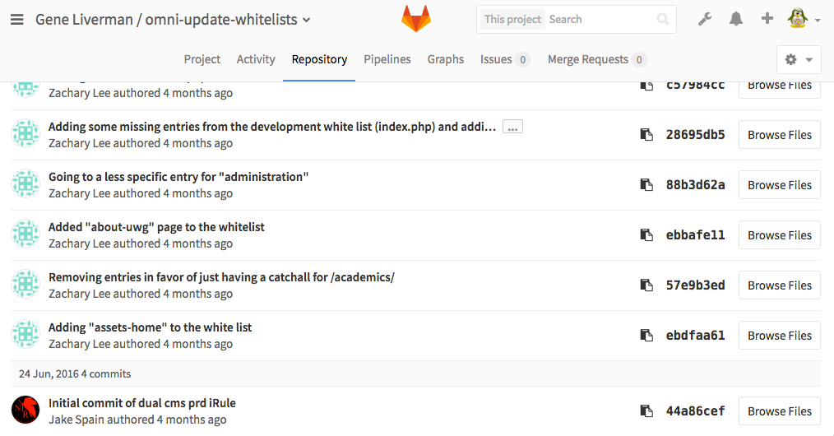
Git Changelog
Notes:
Who did what when is tracked
Every change can be easily undone and that undo can be tracked
Anyone on the project can see any part of the project -- transparency

Slide 11
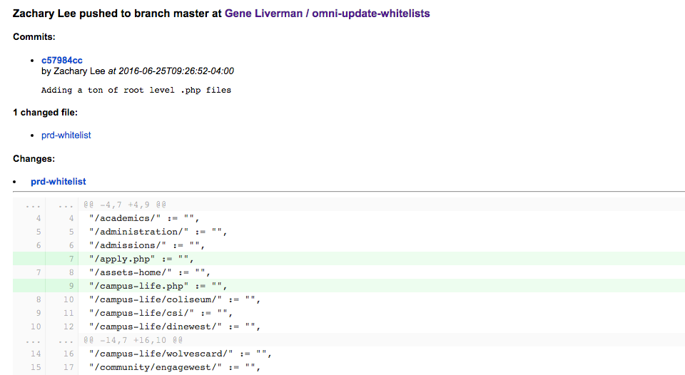
Diff Email
Notes:
Every change ( commit ) generates an email like this
Easy way to keep all participants up to speed on what’s going on.

Slide 12
Check each request against the list
Use iRule to process each request
Use Data Group for the whitelist
Set backend pool using iRule
Notes:
Per F5 website:
“An iRule, in its most simple terminology, is a script that executes against network traffic passing through an F5 device”
“A data-group is a particular type of memory structure within iRules. It is effectively a list in a key -> value pair format consisting of IP addresses/subnets, strings, or integers. You can have just a list of keys, or a list of matched keys and values in this unique structure”

Slide 13
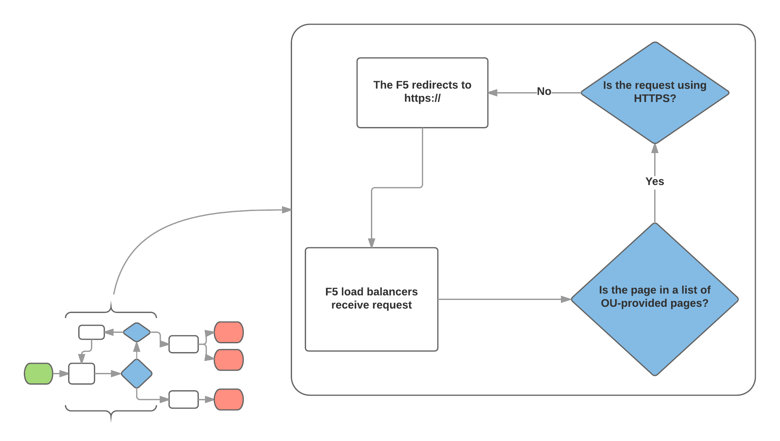
Send migrated requests to new CMS on HTTPS
Redirect insecure migrated requests
Start process all over

Slide 14
Send everything else to old CMS
if { ([HTTP::host] equals "www.westga.edu") or ([HTTP::host] equals "www2.westga.edu") } {
Requests to www / www2 not in whitelist
Determine if secure
Set appropriate pool for Open Text backend
} else {
Requests to some other domain
Determine if secure
Set appropriate pool for Open Text backend
}
Notes:
Alternate domains only apply to ones not moved to dedicated IP’s
Domains going away fall under this rule
These will be EoL’ed with our old web server
Domains we plan to keep are have been moved to their own unique IP address on the F5.
Routed to vhosts on alternate ports

Slide 15
Directory or File?
Some content wasn’t rendering if the trailing / was missing
set uri_parts [split [HTTP::uri] "/" ]
set end_of_uri [lindex $uri_parts end]
if { (not ("$end_of_uri" equals "")) and
(not ("$end_of_uri" contains ".")) } {
set modified_uri "[HTTP::uri]/"
HTTP::uri $modified_uri
}
Notes:
Without the trailing slash some content seemed to lose all style sheets.
Particularly true on ~ sites.
The fix: if the last part of a URI doesn’t contain a dot then it’s not a file and we can tack a slash onto it without issue.

Slide 16
Facilitate rapid de-migration
Scenario: www.westga.edu/some_department gets migrated and an issue is found that didn’t show up in testing.
Pages on Open Text still exist
Reverting migration equals deleting one line from a text file
After undoing migration new pages still exist on Omni Update servers

Slide 17
Alternate Pathways
Port | Usage
80 | Processed by iRule
443 | Processed by iRule
8080 | Sent directly to OpenText server
8443 | Sent directly to first Omni Update server
9443 | Sent directly to first Omni Update server
Same on both dev and prod
Used for testing and verification (esp. on load balanced pair)

Slide 18
Gotchas
Assets such as CSS -- don’t use same path on new server
Each URI can only be active on one server
User-added iFrames + HTTPS conversion
Some providers don’t offer HTTPS
Browser caching
Syncing content in a HA environment

Slide 19
Syncing content in a HA environment
Omni Update publishes to first server with SFTP
When service account logs out:
/sync-www.txt is updated with current time
Rsync is triggered to second server by pam_exec
Clean-up rsync is run by cron every 5 minutes
Current sync-status visible in browser:
1st server: https://www.westga.edu:8443/sync-www.txt
2nd server: https://www.westga.edu:9443/sync-www.txt

Slide 20
Triggering a sync
Sync by way of pam_exec:
/etc/pam.d/sshd:
# Use pam_exec.so to sync data between web servers session optional pam_exec.so /usr/local/bin/pam-sync-www.sh
Sync by way of root’s crontab:
*/12 * * * * /usr/local/bin/sync-www.sh

Slide 21
Kicker Script Overview
pam-sync-www.sh:
( [ "${PAM_TYPE}" == "close_session" ] &&
[ "${PAM_USER}" == "${trigger_user}" ] ) || exit 0
Only run script body on our service account’s logout
Exit success for every other scenario

Slide 22
Sync Script Overview
sync-www.sh:
On work when run by root
Uses lock file to keep from running multiple instances
Uses hostname to determine if being run on dev or prod
Updates sync-www.txt
Runs “rsync -avr --delete-after” of document root
Logging:
All commands sent to logger
Rsync output along with start and end times logged to file

Slide 23
Demo Time
www.westga.edu
Notes:
http://www.westga.edu:8080
https://www.westga.edu:8443
https://www.westga.edu:9443
https://www.westga.edu

Slide 24

https://www.westga.edu

Slide 25
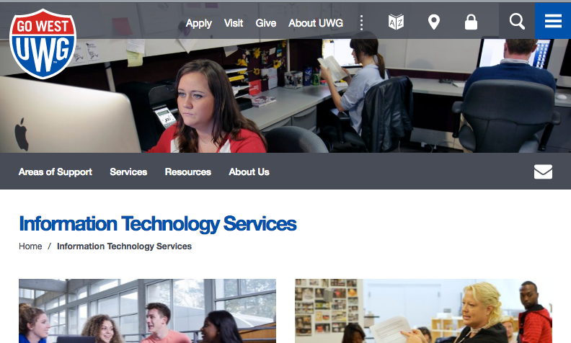
https://www.westga.edu/its

Slide 26
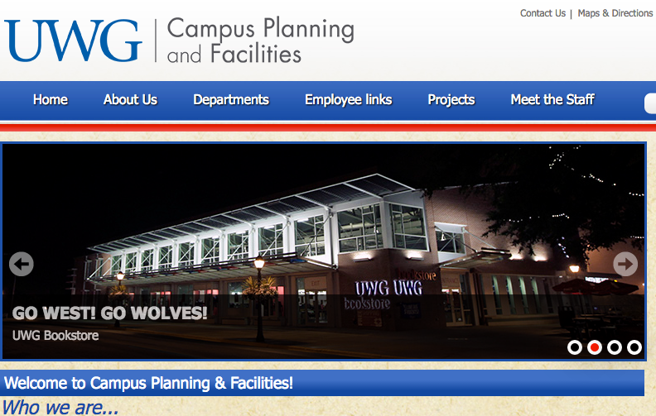
http://www.westga.edu/cpf/index.php

Slide 27
No F5, no problem.
Got NGINX?

Slide 28
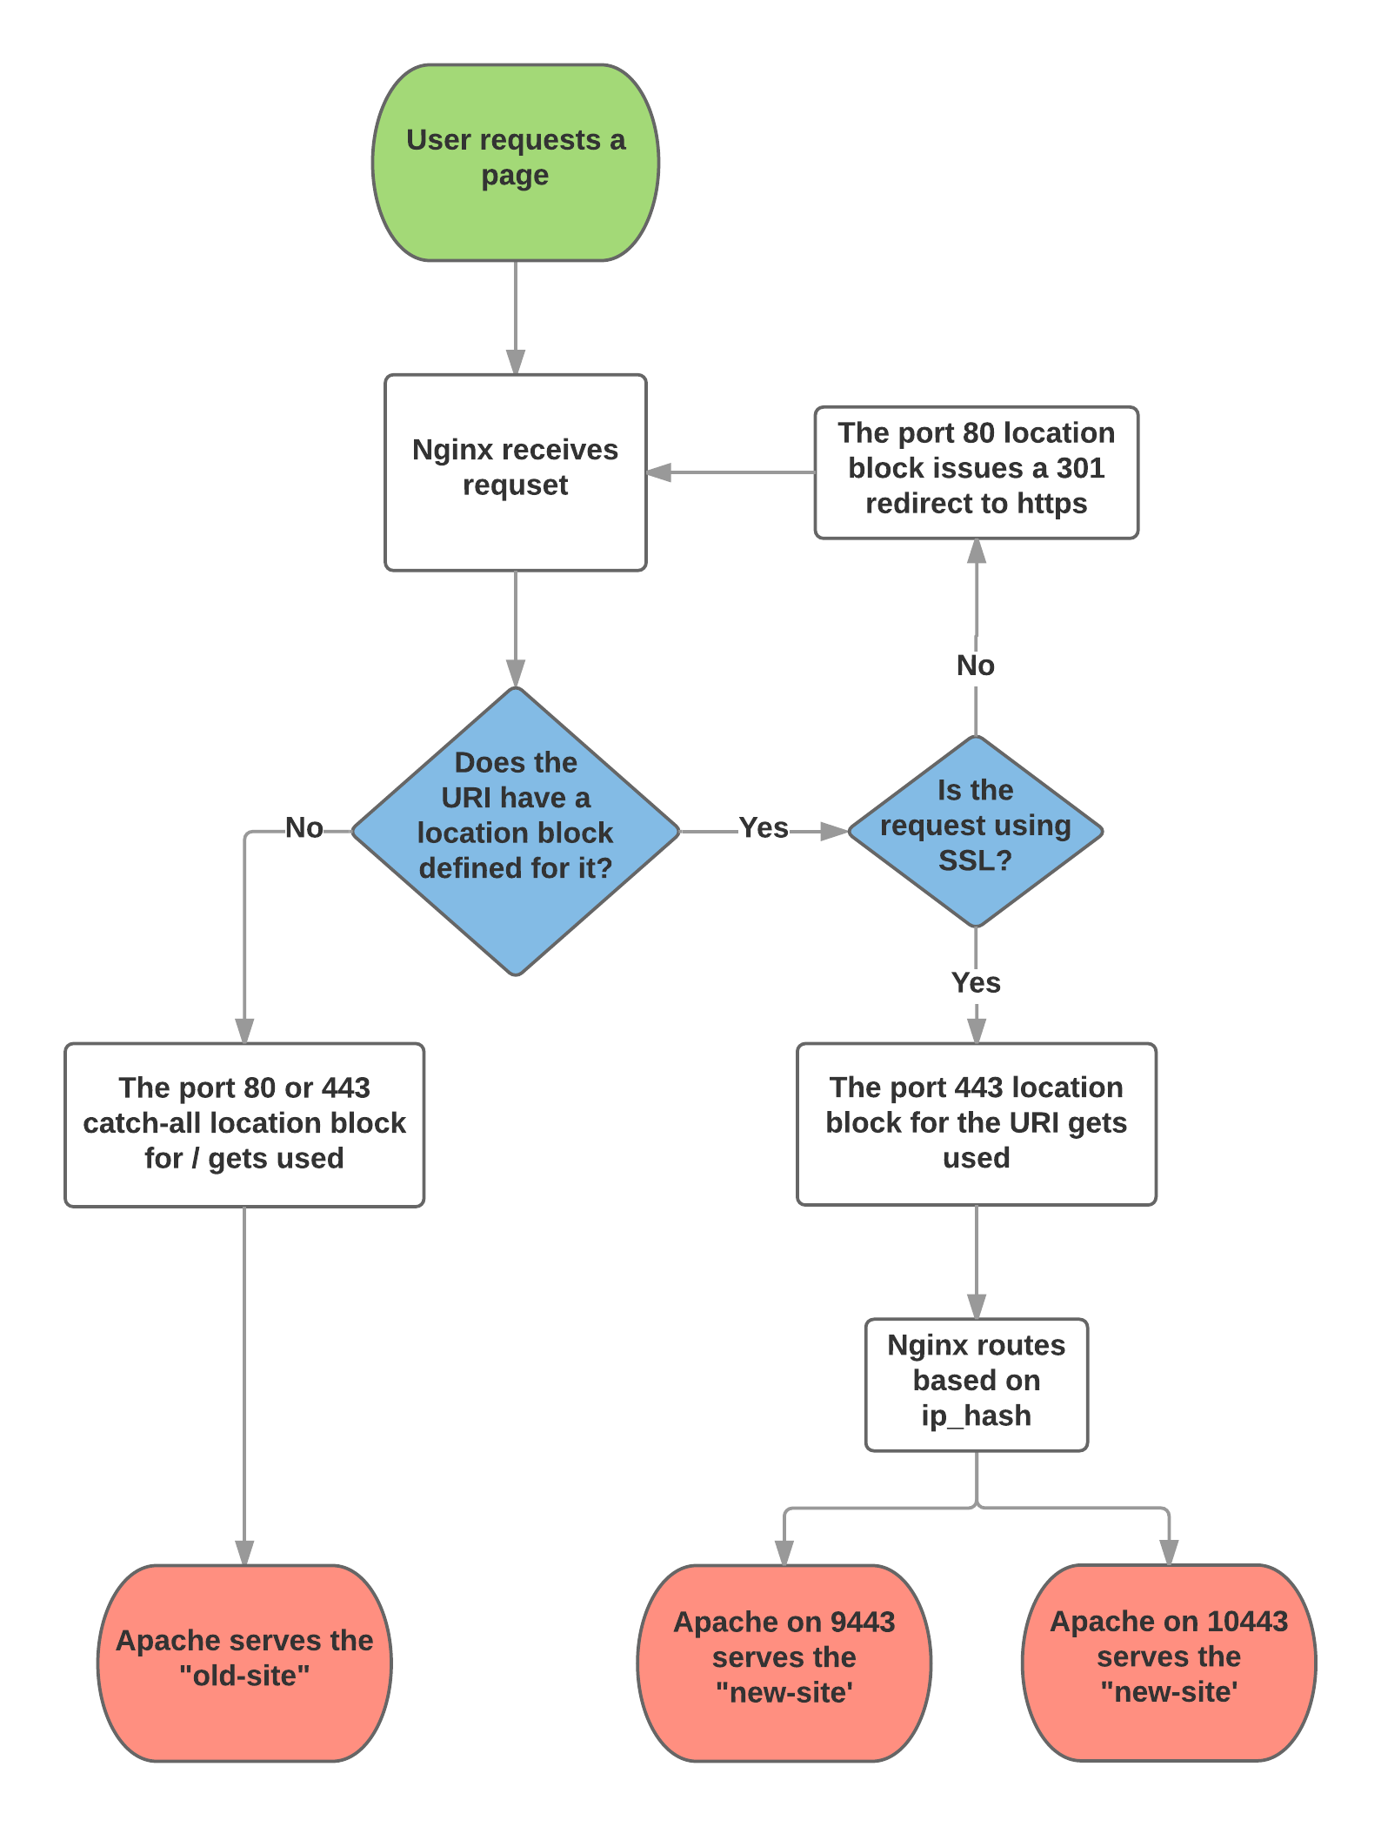
Nginx Setup
Tools Used
Just a reverse proxy
Doesn’t serve any content
Working demo on my GitHub
Vagrant for demo
One CentOS 7 VM
Nginx instead of F5
Apache vhosts for backends

Slide 29
Demo Time
https://github.com/genebean/nginx-uri-proxy

Slide 30
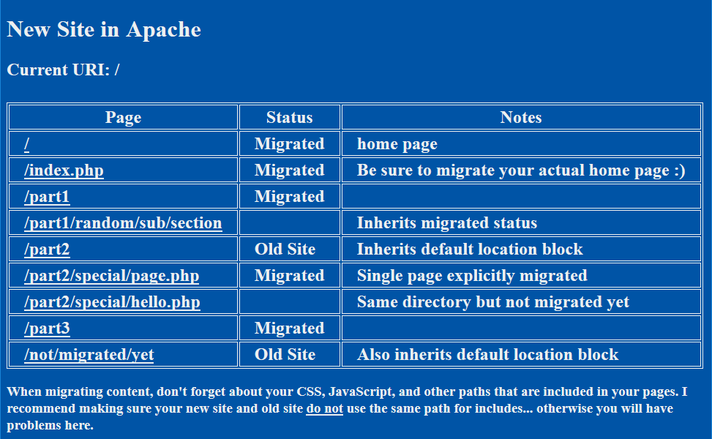

Slide 31
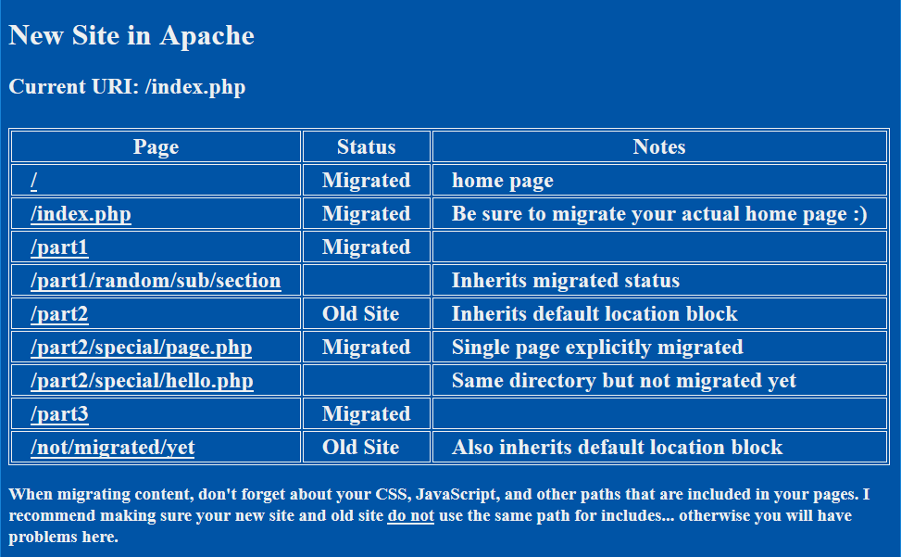

Slide 32
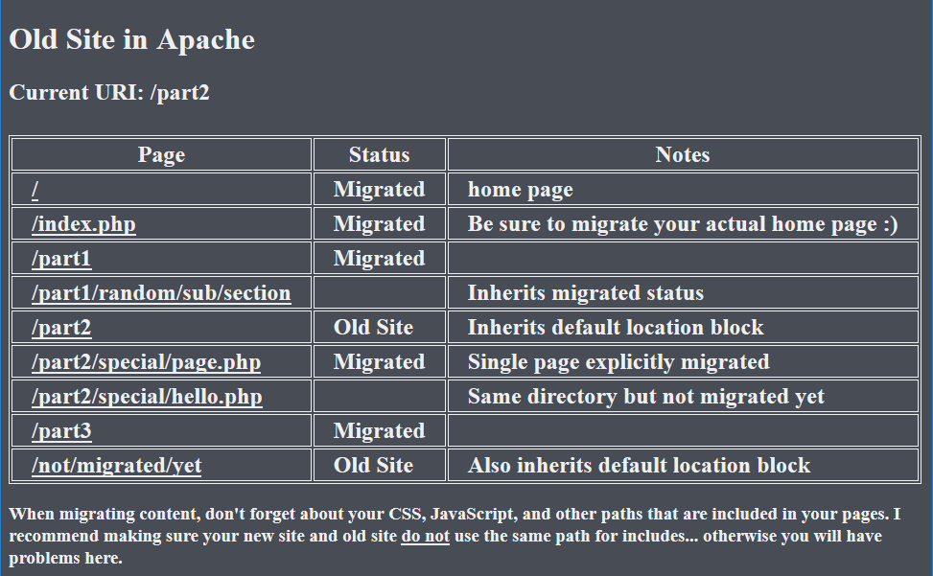

Slide 33


Slide 34
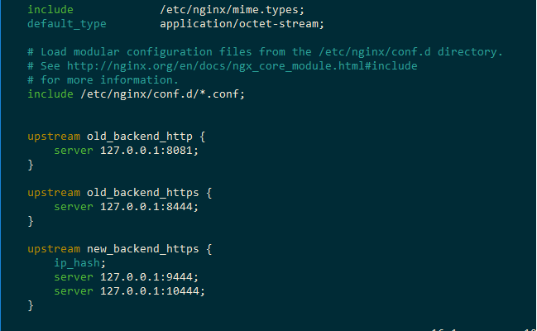
These define the backend server(s) used

Slide 35
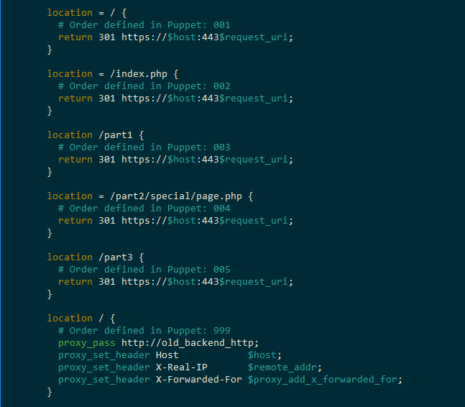
These define the matches for http traffic

Slide 36
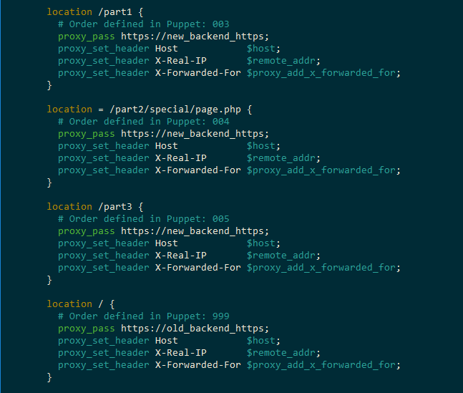
These define the matches for https traffic

Slide 37
Questions?

Slide 38
Dual-CMS Routing
How We Took Our New CMS Live
One URI at a Time
Gene Liverman
gliverma@westga.edu
@technicalissues
github.com/genebean
linkedin.com/in/geneliverman

