Slide 1

A guide for the UWG-Techs Slack Team

Slide 2
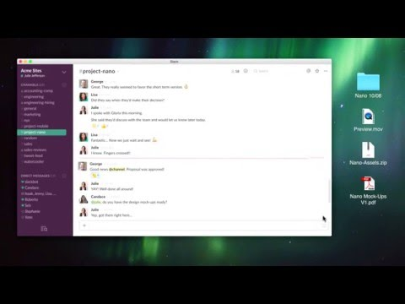
What is Slack? Watch this video to find out.
Hint: think the best of Google chat and old old school chat rooms combined with features neither of them has.

Slide 3
Why not just keep using Google’s chat?
Cons of instant messaging apps:
You have to be online and around the device you have chat open on
History is totally optional
Group conversations are challenging
Pros of Slack:
One-on-one conversations and group / team conversations happen in the same tool
Messages go to persistent places (channels) so you can read them now or later
Notifications from external sources and tools

Slide 4
Channels
Channels that start with # are open to all
Channels that start with a lock are invite-only
What we have so far:
#general: Generalized work-related chatting
#random: Chat that’s not work-related
#triage: Gather here when things hit the fan
🔒apps: Applications support chat
🔒ops: SysAdmin chat and related bot notifications
🔒web: Chat for web people and associate bots
🔒zabbix-notices: Every single Zabbix alert

Slide 5
Direct Messages
One-on-one conversations like would be done in Google
Persistent just like channels

Slide 6
Integrations
(today)
GitLab: Repositories on code.westga.edu can be configured to send their activity to a channel.
Puppet-related repos post to #ops
Web-related repos post to #web
Marvin: A hubot instance that interacts with our Puppet server
Zabbix: A notification script is setup on the Zabbix server so that all notices go to #zabbix-notices.
We could easily have more granular sets of notices go to other channels too.

Slide 7
More
Integrations
There are TONS of things that can be integrated. Two are already “approved” for use:
GitHub (https://goo.gl/OC8XLe)
Google Drive (https://goo.gl/7LywDo)
All the others can be seen at https://uwg-techs.slack.com/apps

Slide 8
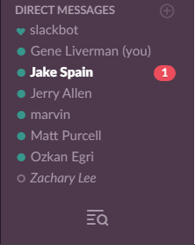
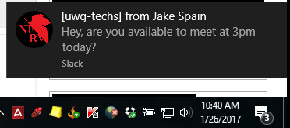
Notifications
Whenever you get a direct message there will be an icon next to the name of whoever sent it:
You will also get a desktop notification like this:

Slide 9
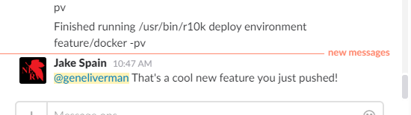
When are you notified?
When someone @mentions you like so:
When you get a direct message
When someone uses one of the special @mentions for a channel or group

Slide 10
Getting Started
Sign up: https://uwg-techs.slack.com/signup
Please make your user name something related to your real name
Get the desktop client: https://uwg-techs.slack.com/downloads
Log into the desktop client
Edit your profile and fill in the first name and last name fields
Join private channels: direct message Gene or Jake to get invites to #zabbix-notices and your team’s channel.
Configure desktop notifications for #zabbix-notices (details on next slide)

Slide 11
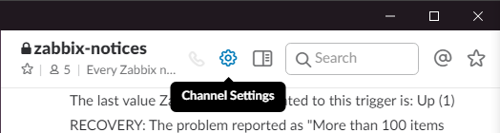
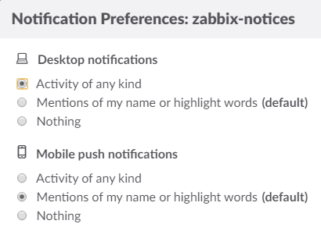
Notifications for #zabbix-notices
Select the #zabbix-notices channel on the left side and then click the “Channel Settings” gear and select “Notification preferences…”
Change the radio button under “Desktop notifications” to “Activity of any kind.”
Optionally, you can do the same for mobile alerts here too.

Slide 12
Responding to Zabbix alerts
Post a message in #zabbix-alerts if you are responding to an alert so that others will know someone is on it.

Slide 13
Do even more...
Threaded conversations: https://goo.gl/R5Xjkc
Make voice and video calls from Slack: https://goo.gl/Tt13o2
Check out the Slack blog for new features and updates: https://slackhq.com/tagged/the-product
Get more channels! We can have as many as we want.

Slide 14
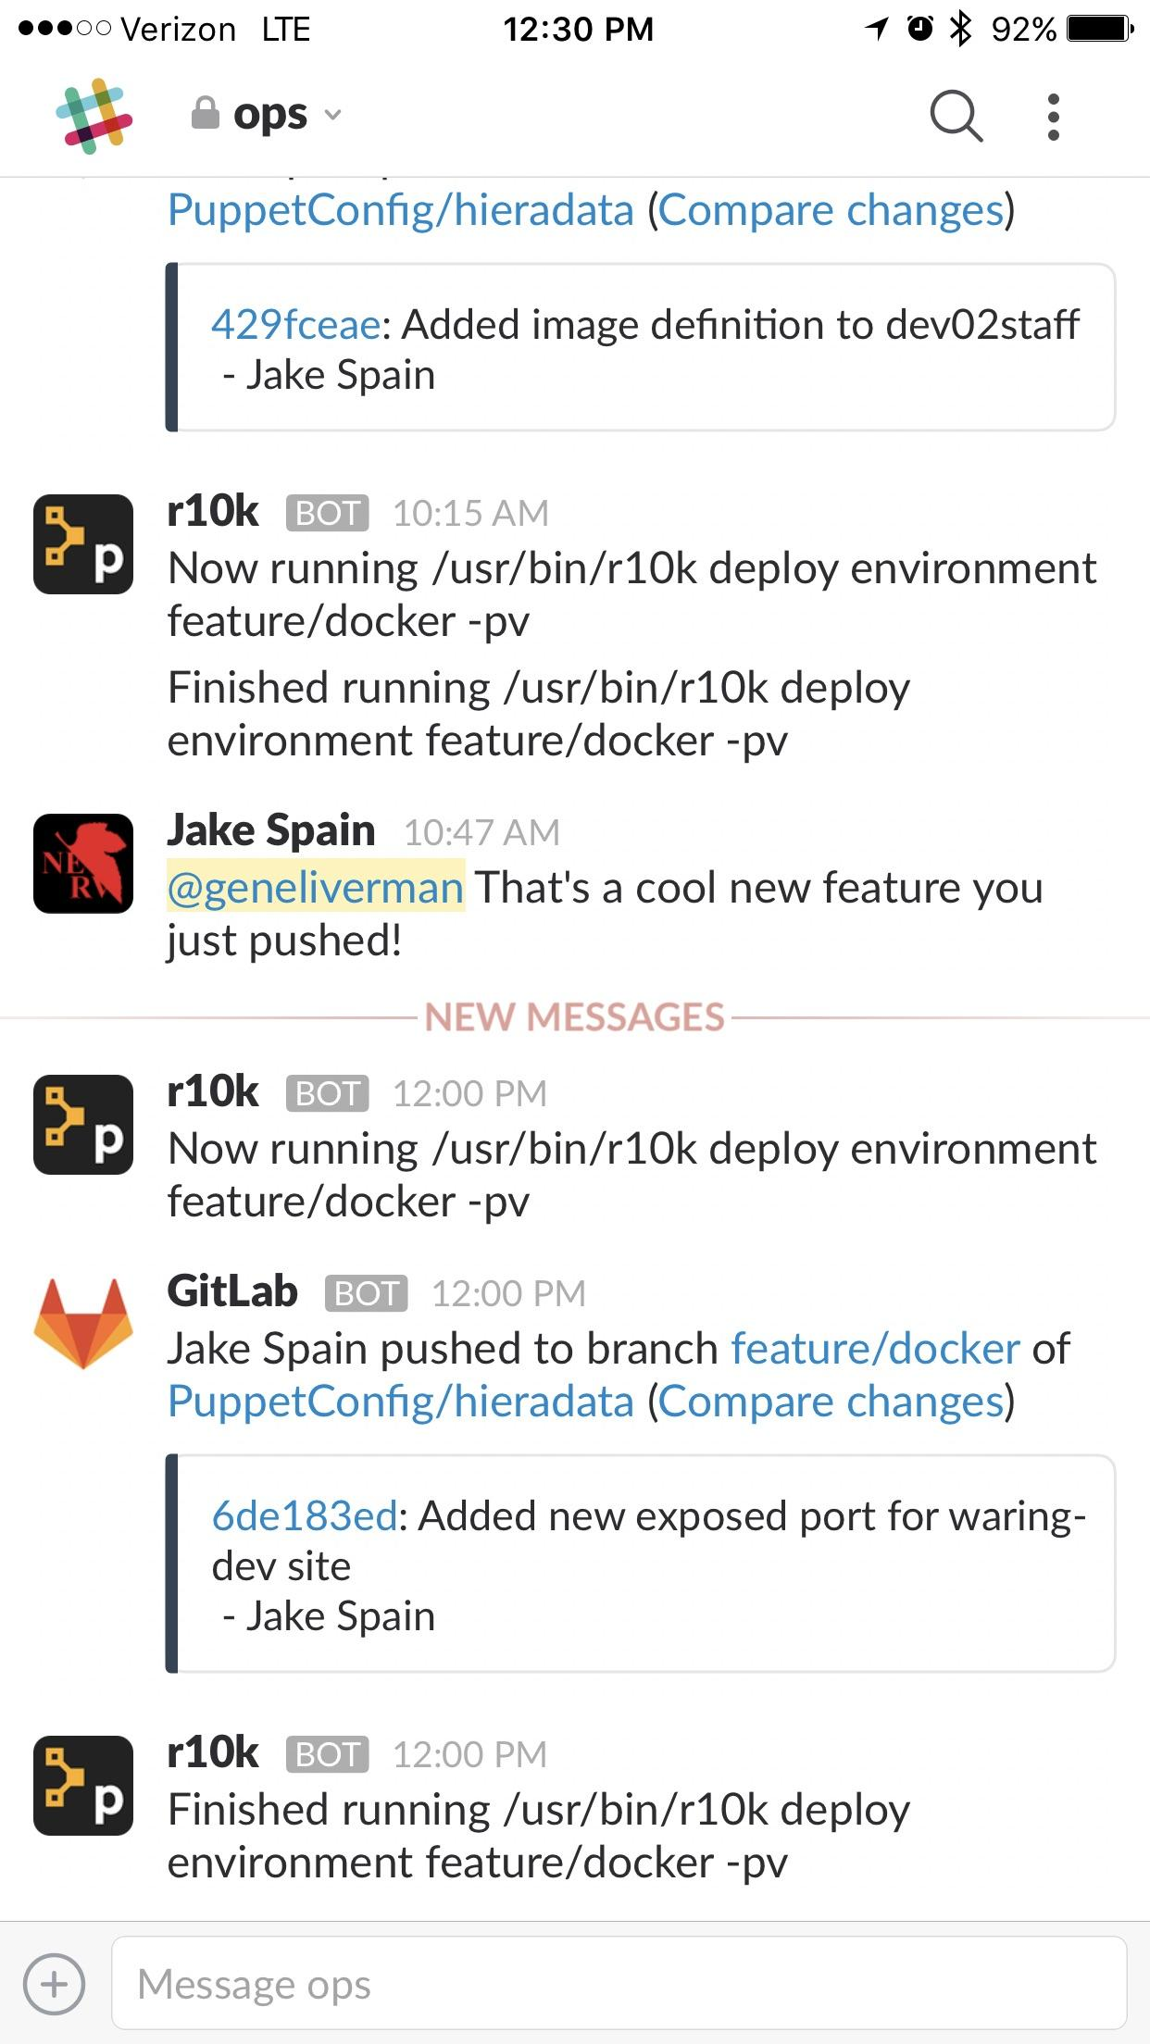
Other ways to participate
Slack also has clients besides the desktop one:
Mobile apps like the one pictured here
A web client is als available at https://uwg-techs.slack.com

