Slide 1
Infrastructure Overview
What we have and how it fits together

Slide 2
So far...
Wednesday:
Jerry and the Introduction
Justin on VM and Storage
Jake on Backups and Restore
Thursday:
Abigail on Windows Server Administration
Gabe on Diagnostics
Matt on File Mover Scripts and such

Slide 3
So, now what?
How the world gets to us
Firewall Zones
Data Centers
Data Center Networking
How VMware and the SAN are connected
F5 Load Balancers
Active Directory
DHCP and DNS
Where we have redundancy and what we don’t
Puppet & Foreman
Slack

Slide 4
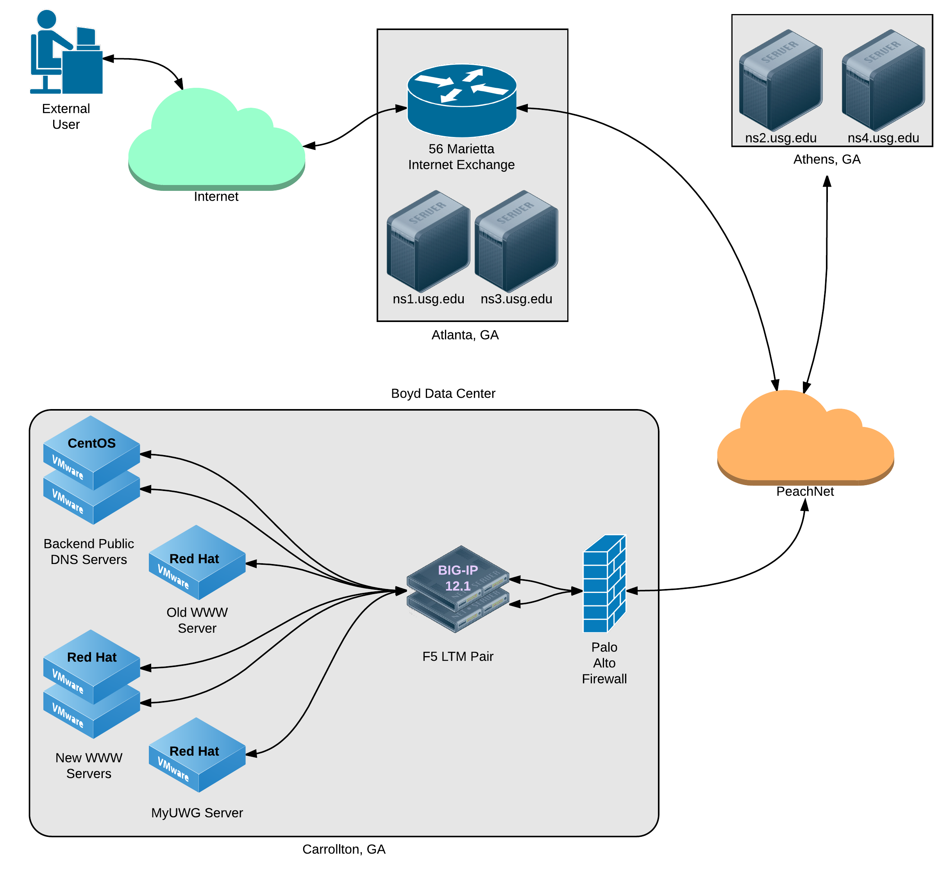
From the Internet to Us -- DNS & Web Sites
Notes:
DNS - 5 servers registered with Educause
PeachNet -- like an ISP but really just a big private WAN
GA Tech -- faster because on PeachNet
Web Sites - Some load balancing, some singles

Slide 5
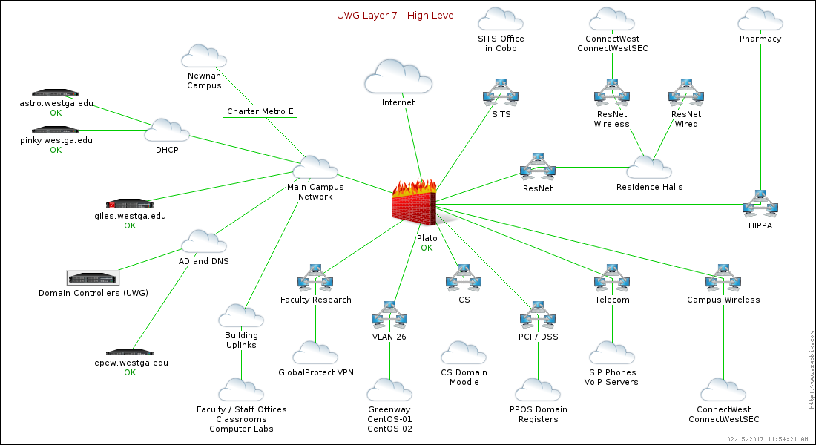
Firewall Zones
Notes:
Just give an overview of each zone and what a zone is

Slide 6
Data Centers
We have two… or is it three… or maybe its four

Slide 7
Boyd and Bremen
Boyd 101 and 103
Primary site
Has majority of our equipment
Houses
Core networking equipment
Building networking
Cable TV
Fiber distribution
10 server cabinets containing
~100 physical servers
Avaya SIP telephone equipment (primary)
PBX telephone system
Sync Global in Bremen
Disaster Recovery and Business Continuity (DRBC) site
Replica SAN
3 server cabinets
Pong - our NetWorker server
Tape library
Veeam server for Computer Science
Active Directory, DHCP, DNS, and NTP
More on this later
Telecom

Slide 8
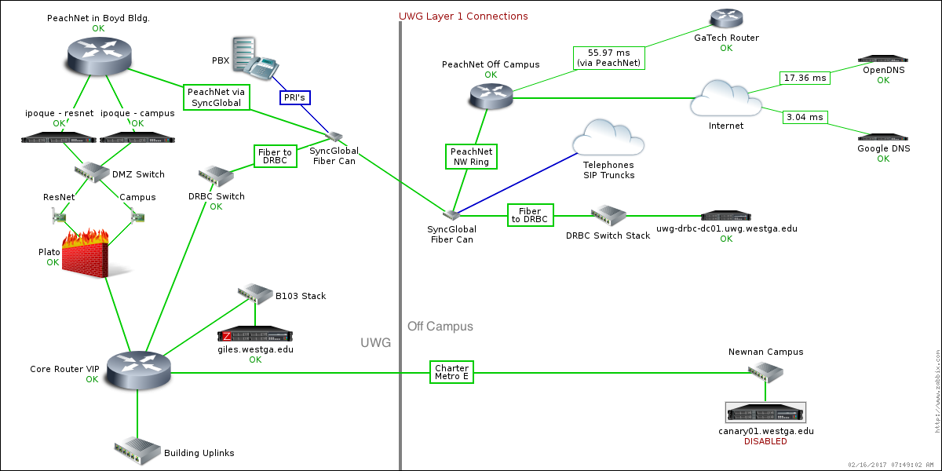
Boyd, Bremen, and beyond

Slide 9
Linode in Atlanta
DNS for westga.info domain
Off-site Zabbix

Slide 10
Amazon Web Services (AWS) in Oregon
Nothing yet but here's what's on the horizon:
Using US West availability zone for geographic redundancy
A “virtual private cloud” with a VPN tunnel to campus
Domain controllers for the UWG domain with DNS
Linux-based public DNS server
Domain controllers for the test domain
SSO server and any needed database (clustered with campus)
Load balancing service to route HA traffic
And just over the horizon…
Backup for www.westga.edu
Migrate services from Linode to here

Slide 11
Data Center Networking
Top-of-Rack & Redundancy
Notes:
Describe what top of rack switching is
Compare to patch panel alternative and home-runs
All routing done here

Slide 12
Blades, Storage, and Switching
Notes:
Go to diagram

Slide 13
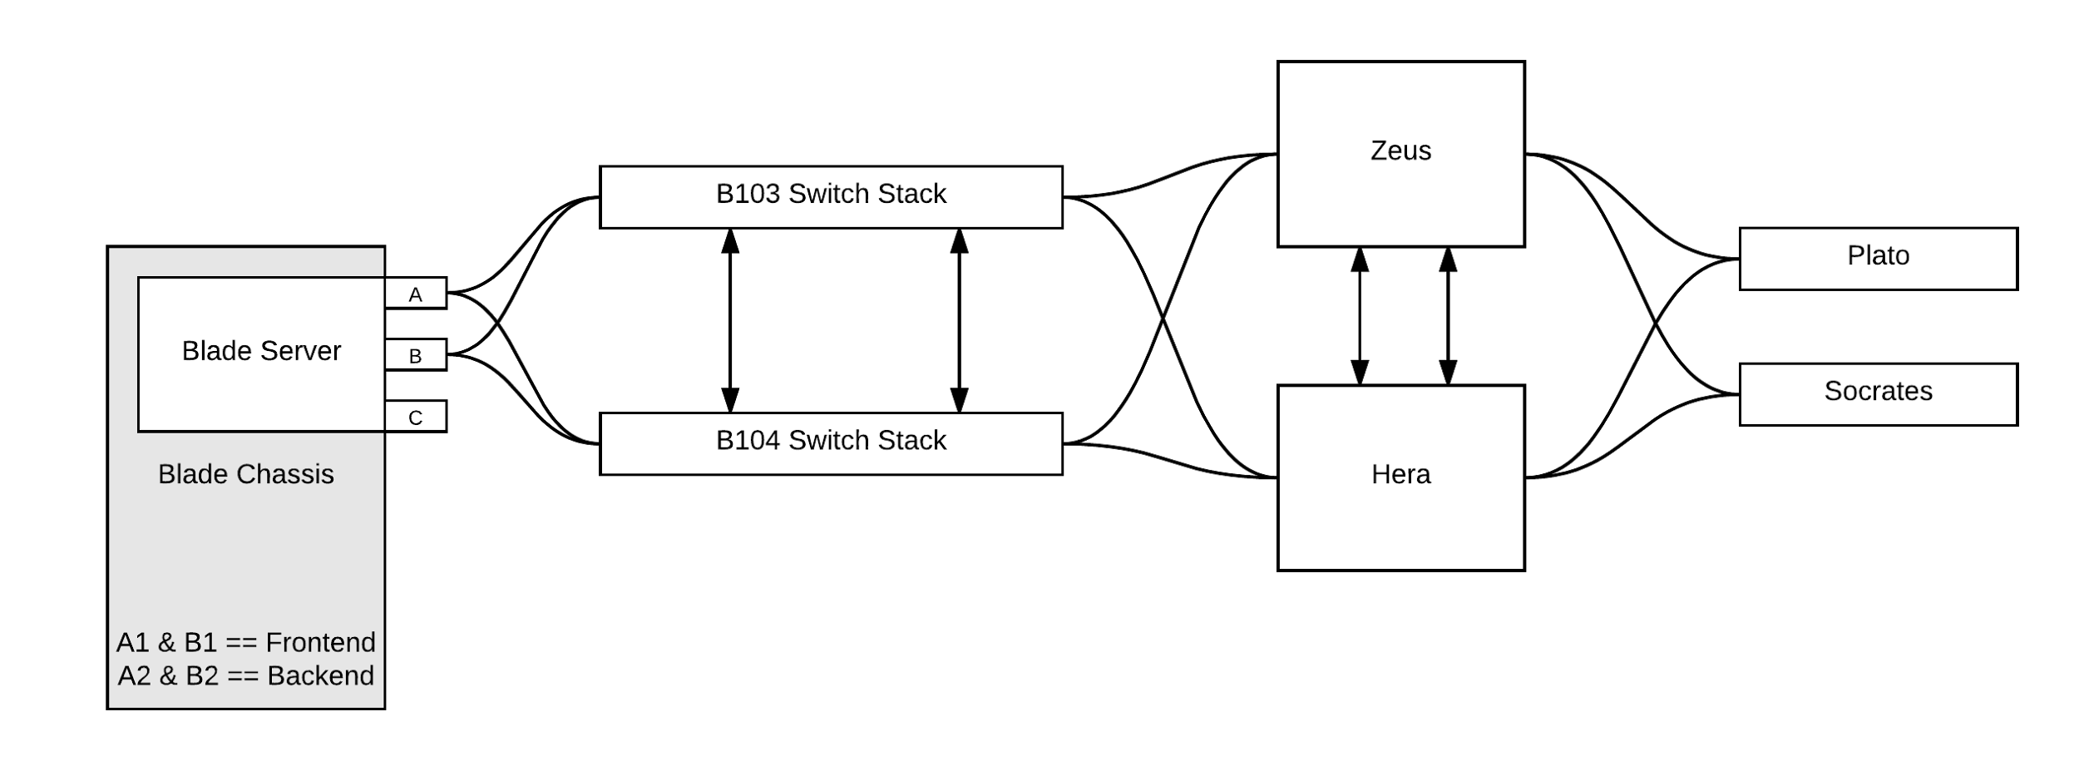
VMware and SAN Redundancy
Notes:
How blades connect
How chassis connects - both old and new
How SAN connects
MLAG on B103/B104
Lots of 10G

Slide 14
Regular Racks

Slide 15
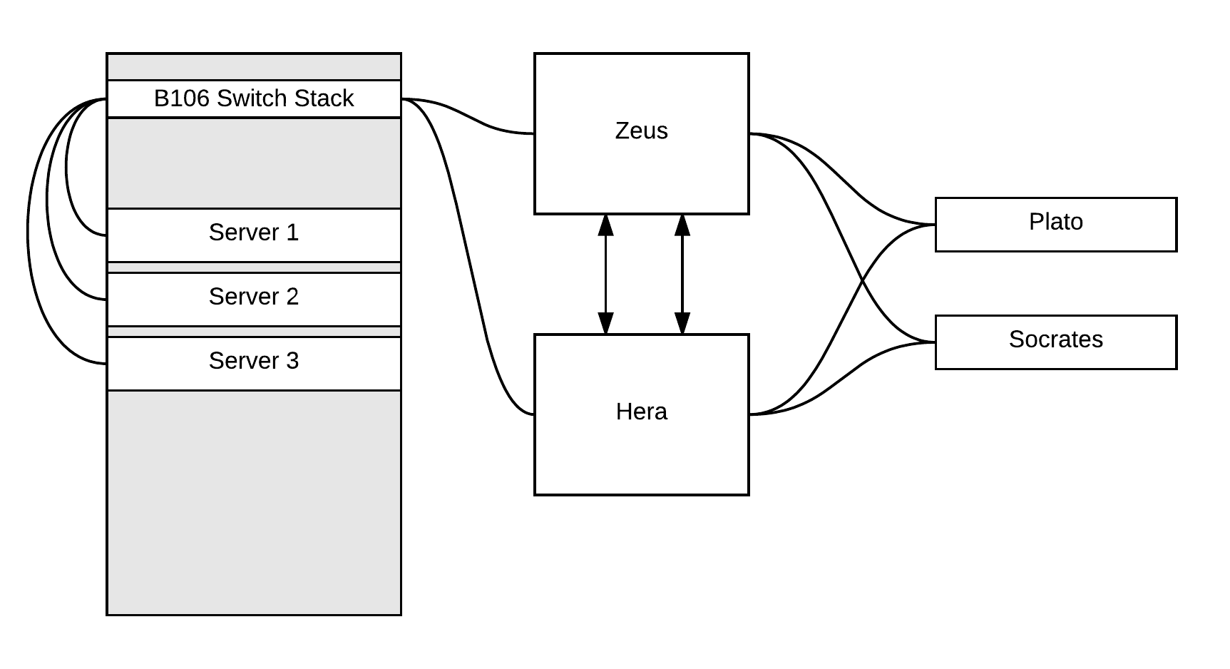
Typical Rack in Boyd
Notes:
Two switches, not redundant
Mostly 1G up links

Slide 16
Load Balancing
… or sometimes just a service proxy
Notes:
Pair of F5's, each connected to both cores
Services like www and LDAPS are redundant
Services like MyUWG and Parking are singles
Certs - most live here

Slide 17
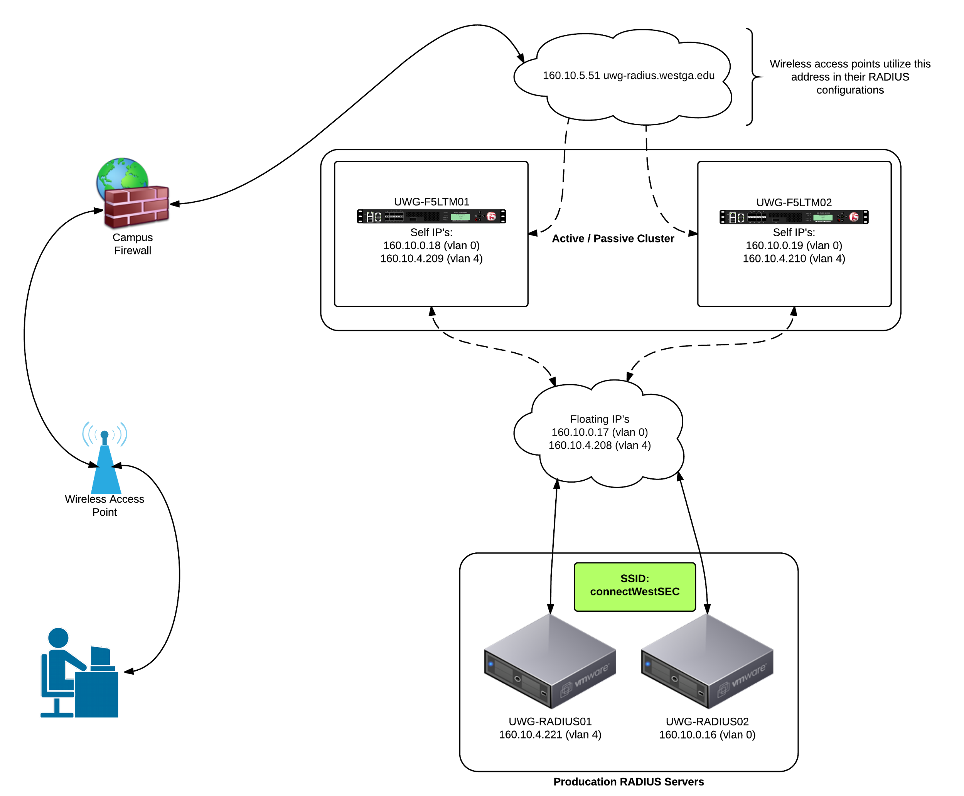
Load Balancing Example: RADIUS

Slide 18
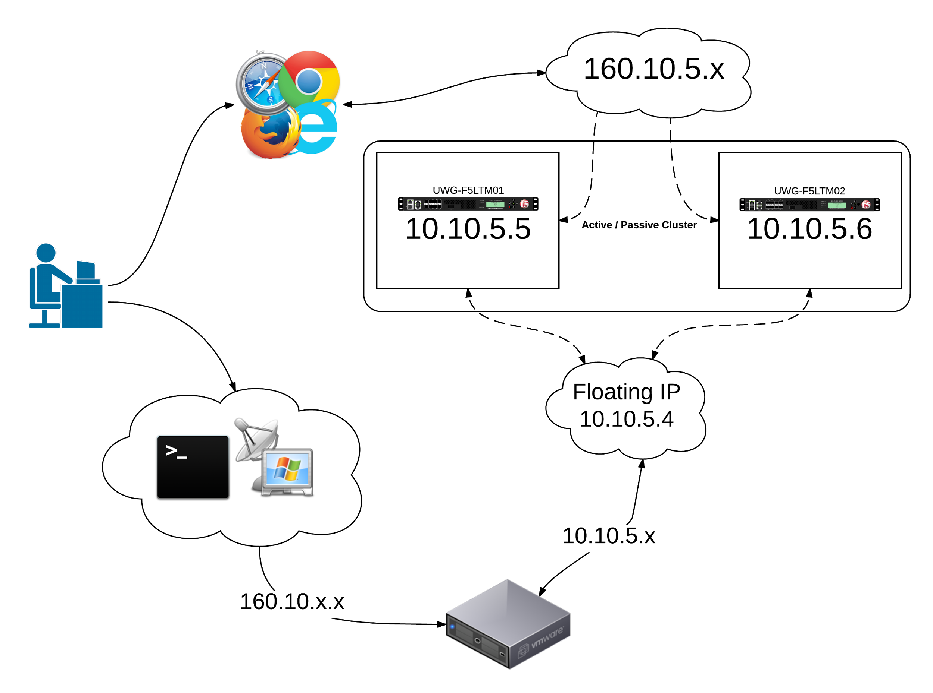
Frontend vs Backend access

Slide 19
Active Directory
Where it lives and why
Notes:
Physical and virtual in Carrollton
Virtual in Bremen

Slide 20
DHCP, DNS, & NTP
Getting an IP address, resolving names, &
finding out what time it is
Notes:
DHCP gives you an IP
DNS translates names to IP’s
NTP sets your clock

Slide 21
DHCP (and addressing in general)
Physical servers Astro and Pinky
Run in active / standby
Currently ISC, might change to Microsoft
Managed by IPControl aka the IPAM
Manual DHCP preferred over static IP

Slide 22
DNS - internal
Primary is 160.10.4.9
F5 address
Load balanced across two DC’s in Boyd
Secondary is 160.10.0.249
DC in Bremen
Runs on Hyper-V

Slide 23
DNS - external / public
Totally separate from internal servers
5 “servers”
6 real nodes
2 here
2 in Athens
2 in Atlanta

Slide 24
NTP
Always physical
Two CentOS boxes
Two OpenSUSE Leap boxes (in progress)
Stratum 2
Notes:
Stratum 0 = atomic or gps clock
Stratum 1 = computer connected to stratum 0 source

Slide 25
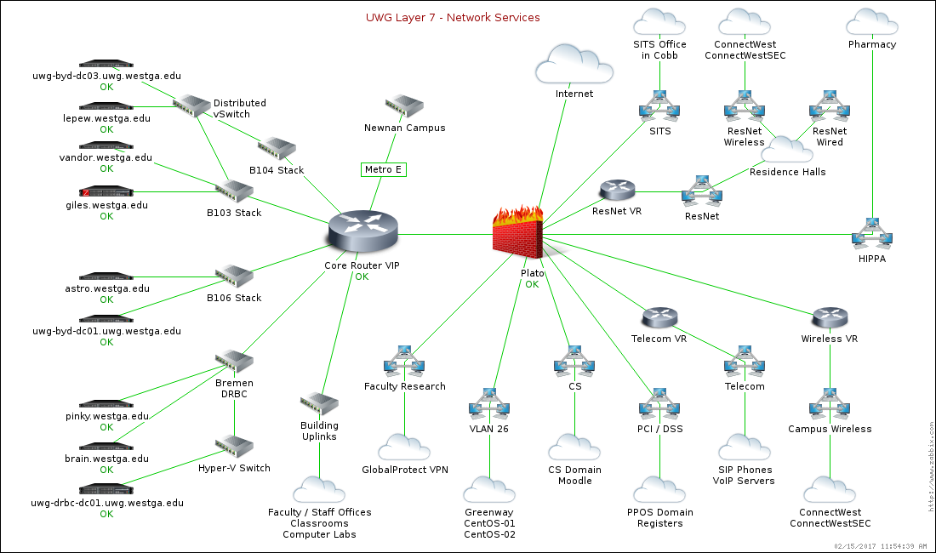
Network Services and the Firewall
Notes:
Show how components are spread out

Slide 26
Redundancy
Some systems have it, some don’t.
Notes:
Talk about the push for HA for critical systems

Slide 27
Puppet & Foreman
How we’re using it

Slide 28
Puppet & Foreman: Overview
Puppet:
Puppet DSL
Component Modules
Profiles
Roles
Hiera
Foreman:
Certificates
Environments
Reports
Host Groups
aka role assignment

Slide 29
Puppet DSL
“Puppet uses its own configuration language, which was designed to be accessible to sysadmins. The Puppet language does not require much formal programming experience and its syntax was inspired by the Nagios configuration file format.”
Puppet’s DSL looks a bit like Ruby and, under the hood, a lot of Ruby is used.
https://docs.puppet.com/puppet/4.8/lang_summary.html

Slide 30
Component Modules
Normal modules that manage one particular technology.
For example, puppetlabs/apache.
https://docs.puppet.com/pe/2016.5/r_n_p_intro.html

Slide 31
Profiles
Wrapper classes that use multiple component modules to configure a layered technology stack.
https://docs.puppet.com/pe/2016.5/r_n_p_intro.html

Slide 32
Roles
Wrapper classes that use multiple profiles to build a complete system configuration.
https://docs.puppet.com/pe/2016.5/r_n_p_intro.html

Slide 33
Hiera
“Hiera is a key/value lookup tool for configuration data. Hiera makes Puppet better by keeping site-specific data out of your manifests. Puppet classes can request whatever data they need, and your Hiera data will act like a site-wide config file. Hiera 3 is compatible with Puppet 4; for Puppet 3.8 or earlier, use Hiera 1.”
https://docs.puppet.com/hiera/

Slide 34
Foreman
ENC
instead of site.pp
Certificates
Environments
Reports
Host Groups
aka role assignment

Slide 35
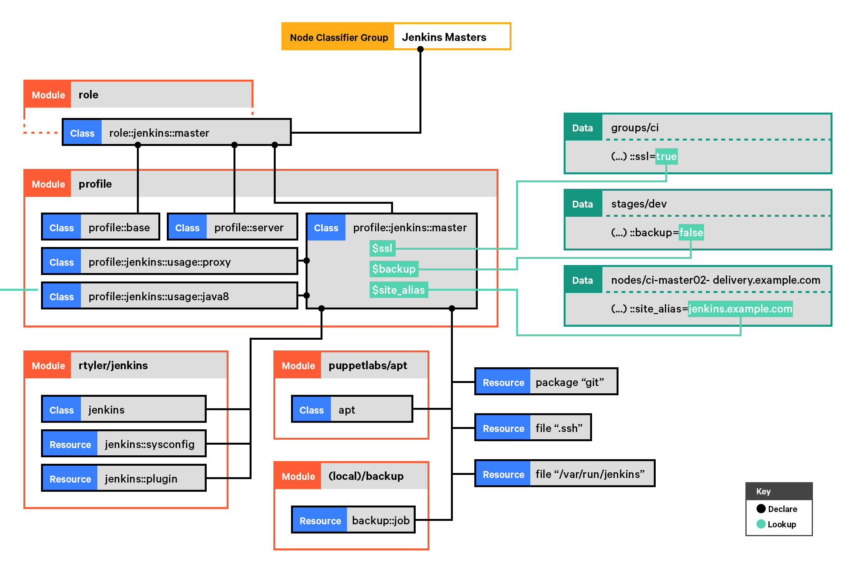
Putting it together

Slide 36
In short, from top to bottom:
“Your node classifier assigns one role class to a group of nodes. The role manages a whole system configuration, so no other classes are needed. The NC does not configure the role in any way. That role class declares some profile classes with include, and does nothing else.”
For example: class role::jenkins::master { include profile::base include profile::server include profile::jenkins::master }
https://docs.puppet.com/pe/2016.5/r_n_p_intro.html

Slide 37
In short, from top to bottom:
“Each profile configures a layered technology stack, using multiple component modules and the built-in resource types. (In the diagram, profile::jenkins::master uses rtyler/jenkins, puppetlabs/apt, a home-built backup module, and some package and file resources.)
Profiles can take configuration data from Hiera or Puppet lookup. (In the diagram, three different hierarchy levels contribute data.)
Classes from component modules are always declared via a profile, and never assigned directly to a node. If a component class has parameters, you specify them in the profile; never use Hiera or Puppet lookup to override component class params.”
https://docs.puppet.com/pe/2016.5/r_n_p_intro.html

Slide 38

People, programs, and robots
Notes:
General intro
Share full presentation

