Slide 1
Going All-in on
Gateway API
Replacing Ingresses and Enhancing a Service Mesh

Slide 2
Who am I?
20+ years working in IT
Largely focused on systems administration and devops
Administered & used GKE in production for ~4 years
Have also done most other things too
I’m all about using the right tool for the job at hand
Mastodon: @genebean@fosstodon.org
GitHub: https://github.com/genebean
LinkedIn: https://www.linkedin.com/in/geneliverman/

Slide 3
Origin of this talk
Heard about Gateway API at SCaLE 20x (or maybe 21x)
Started a greenfield project at work
Project results will hang around a long time…
  let’s be as up-to-date as possible
  let’s not carry known pain points forward into this project
Wow… documentation is hard to find on the new stuff

Slide 4
But things didn’t go as planned…
Notes:
Priorities shifted, less hands on work than expected

Slide 5
Before we talk about Gateway API…

Slide 6
Why not just use the Ingress resource?
“The main limitation of Ingress is that it only works at Layer 7, specifically optimizing for HTTP and HTTPS traffic. Other L7 protocols (like gRPC) and non-L7 protocols (like TCP and UDP) must be handled using custom controller extensions rather than native Ingress capabilities.”
konghq.com/blog/engineering/gateway-api-vs-ingress

Slide 7
Why not just use the Ingress resource?
gRPC support was needed
TCP & UDP traffic
Progressive rollouts a la Argo Rollouts
Service mesh integration for observability

Slide 8
Gateway API

Slide 9
Why Gateway API?
“Overall, Gateways define a whole new way of declaring and managing traffic targeting Kubernetes services that avoids the limitations teams experience using only Ingress resources. The Gateway API creates a standardized model for enabling features like L4 support, advanced HTTP routing, and built-in traffic management in a portable fashion across all compliant gateway controllers. This will prevent vendor lock-in and give developers expanded declarative management without having to touch low-level controller configurations.”
konghq.com/blog/engineering/gateway-api-vs-ingress

Slide 10
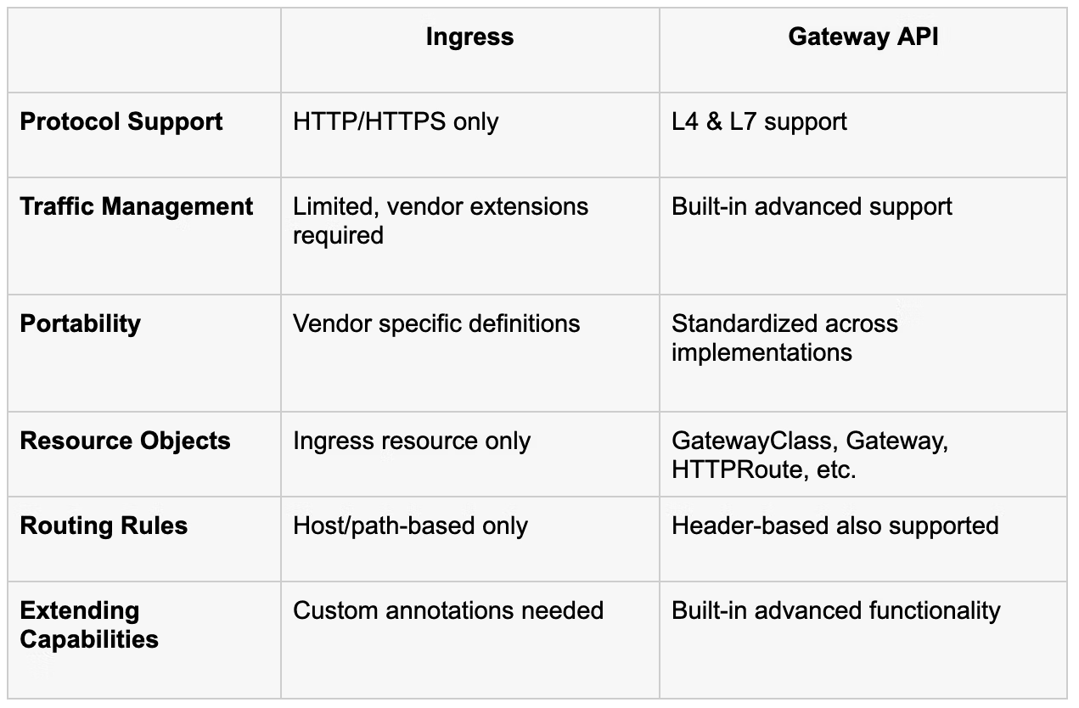
Why Gateway API?
“It’s important to note that Ingress is now frozen, and all new features are being added to the Gateway API going forward.”
konghq.com/blog/engineering/gateway-api-vs-ingress

Slide 11
The Plan

Slide 12
Components
Traefik for north/south traffic instead of Ingress resources
Linkerd for east/west traffic traversing the service mesh
Argo Rollouts for progressive delivery / safer deployments

Slide 13
North/South traffic
Traffic from outside a cluster to inside a cluster (and vice versa).
gateway-api.sigs.k8s.io/concepts/glossary#northsouth-traffic
Put another way, traffic from users of the things running inside the cluster and traffic from your cluster to external systems and services

Slide 14
East/West traffic
Traffic from workload to workload within a cluster.
gateway-api.sigs.k8s.io/concepts/glossary/#eastwest-traffic
Put another way, traffic between program A and program B or between pods within the same application stack

Slide 15
Safer deployment because of Argo Rollouts?
Deploy (roll out) applications to a subset of users, say 1% of traffic
Roll out new versions a little at a time
Halt, and even revert, rollout if metrics go sideways… automatically!
argoproj.github.io/rollouts

Slide 16
Why Traefik?
Simple: it seemed to be ubiquitous in all conversations, podcasts, presentations, and blog posts about Kubernetes and/or Docker
Also, fully supports Gateway API

Slide 17
Why Linkerd?
Super lightweight
Purpose built to just be a service mesh
Really fast
  livewyer.io/blog/service-meshes-decoded-istio-vs-linkerd-vs-cilium/

Slide 18
Introducing Gateway API

Slide 19
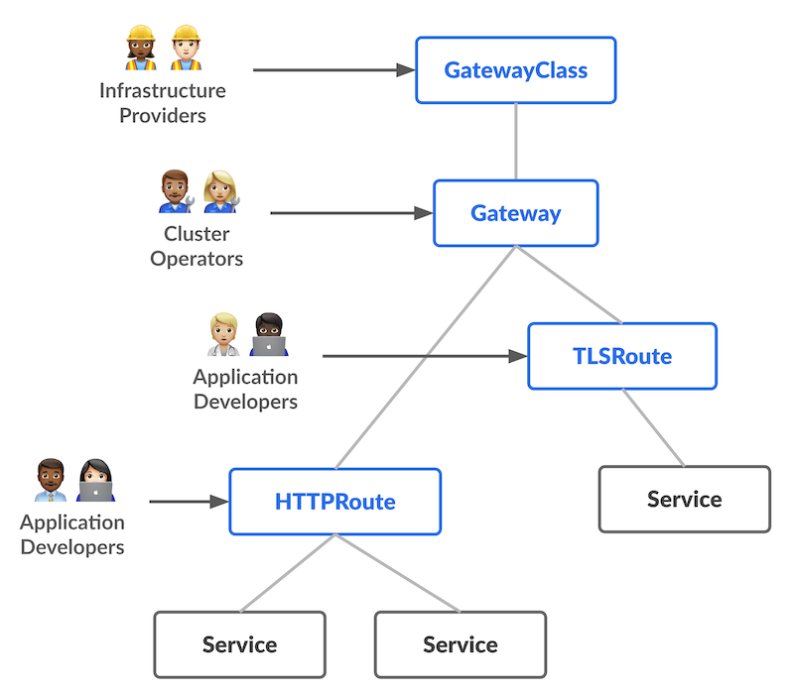
Resource Model
The overall resource model focuses on 3 separate personas and corresponding resources that they are expected to manage
https://gateway-api.sigs.k8s.io/concepts/roles-and-personas/

Slide 20
Sample GatewayClass
apiVersion: gateway.networking.k8s.io/v1
kind: GatewayClass
metadata:
name: traefik-v3
spec:
controllerName: traefik.io/gateway-controller
“GatewayClasses formalize types of load balancing implementations. These classes make it easy and explicit for users to understand what kind of capabilities are available via the Kubernetes resource model.”
gateway-api.sigs.k8s.io

Slide 21
Sample Gateway
apiVersion: gateway.networking.k8s.io/v1
kind: Gateway
metadata:
name: argocd-server-gateway
annotations:
cert-manager.io/cluster-issuer: "le[…]"
spec:
gatewayClassName: traefik-v3
listeners:
[ … see next slide … ]
“A Gateway describes how traffic can be translated to Services within the cluster. That is, it defines a request for a way to translate traffic from somewhere that does not know about Kubernetes to somewhere that does.”
“It defines a request for a specific load balancer config that implements the GatewayClass’ configuration and behaviour contract. The resource may be created by an operator directly, or may be created by a controller handling a GatewayClass.”
gateway-api.sigs.k8s.io/concepts/api-overview/#gateway

Slide 22
Sample Gateway listeners block
listeners:
- name: http
protocol: HTTP
port: 80
allowedRoutes:
namespaces:
from: Same
- name: https
protocol: HTTPS
port: 443
hostname: {{ .Values.hostname }}
allowedRoutes:
namespaces:
from: Same
tls:
mode: Terminate
certificateRefs:
- name: argocd-server-tls

Slide 23
Routes
“Gateway API supports typed Route resources and also different types of backends. This allows the API to be flexible in supporting various protocols (like HTTP and gRPC) and various backend targets (like Kubernetes Services, storage buckets, or functions).”
gateway-api.sigs.k8s.io/#gateway-api-concepts

Slide 24
Sample HTTPRoute: HTTP → HTTPS redirect
apiVersion: gateway.networking.k8s.io/v1
kind: HTTPRoute
metadata:
name: argocd-server-http
spec:
hostnames:
- {{ .Values.hostname }}
parentRefs:
- name: argocd-server-gateway
sectionName: http
kind: Gateway
rules:
- filters:
- type: RequestRedirect
requestRedirect:
scheme: https

Slide 25
Sample HTTPRoute: HTTPS
apiVersion: gateway.networking.k8s.io/v1
kind: HTTPRoute
metadata:
name: argocd-server-https
spec:
hostnames:
- {{ .Values.hostname }}
parentRefs:
- name: argocd-server-gateway
sectionName: https
kind: Gateway
rules:
- backendRefs:
- name: argocd-server
port: 80
matches:
- path:
type: PathPrefix
value: /

Slide 26
Service Mesh Variation
spec:
parentRefs:
- name: some-http-service
kind: Service
group: core
port: {{ .Values.collector.service.apiPort }}
rules:
- backendRefs:
- name: some-http-service
kind: Service
group: core
port: {{ .Values.collector.service.apiPort }}
weight: 100
spec:
parentRefs:
- name: some-grpc-service
kind: Service
group: core
port: {{ .Values.collector.service.grpcPort }}
rules:
- backendRefs:
- name: some-grpc-service
kind: Service
group: core
port: {{ .Values.collector.service.grpcPort }}
weight: 100
Notes:
Note that these target the service in both parentRefs and backendRefs

Slide 27
Challenges along the way

Slide 28
Not everything is rosy
Gateway API is not in tree with k8s so you have to manage CRDs
  Easy enough with Argo CD
Linkerd doesn’t support GRPCRoute v1 because of cloud providers
  #13032 [Gateway API] Support for GRPCRoute v1 (stable channel)
Getting Traefik to make CRDs optional was challenging:
  #1209 Don’t bundle Gateway API CRDs
  #1223 feat(Chart): 📦 add optional separated chart for CRDs
Gateway API v1.1.1 - fixed GRPCRoute with help from Flynn from Linkerd
  “It’s issue 3411. Its original PR was PR 3412, which has been merged. PR 3419 is next in line (the changelog for the 1.1.1 release); I think that’s the last PR before release.”
  https://github.com/kubernetes-sigs/gateway-api/releases/tag/v1.1.1

Slide 29
Even with challenges, still worth it.

Slide 30
Why is it worth it?
Easier to reason about
More flexible
Provides better visibility

Slide 31
Questions?

