Slide 1
Setup instructions
Install Igor Pro 7 64-bit version
Place NeuroMAVEN_0.6 and uu v1.0 folders into Igor Procedures folder
(~/Documents/WaveMetrics/Igor Pro 7 User Files/Igor Procedures; created by Igor installer)
Start Igor64
At the Igor command window, type init_neuromaven_environment()
Hit command-2 (ctrl-2 on Windows) to summon the paths panel. Enter file system paths to your raw data and desired database location.
Batch preprocessing stage 1
creates database folders
converts raw data to .ibw
computes all intermediate data structures for RAW data
computes references
makes SE data from 3SD waveforms (ALL and s01)
Batch preprocessing stage 2
refining SE data
writing .nse files – tabling for now – not urgent
make new reference and generate new sets
How to make aggregate ”image” plots from database
How to build long concatenated data “lists”
How to pull “snippets” from database
How to make reduced .nse files from snippets
current work point: stage 2 method
of doing this

Slide 2
High-level analysis schematic
RAW .ncs files
Batch preprocessing stage 1
full length RAW waves
(16-bit int)
SD-based CAR reference
other references
coherence based CAR
...
SDs_noblank
SDs_noblank
SDs_blank3SD
SDs_blank3SD
beige boxes:
only computed in
“extended stage 1”
SDs_blank4SD
SDs_blank4SD
Batch preprocessing stage 2
PSD_grand
PSD_grand
runningpower
runningpower
SEdata 3 SD s00
SEdata 3 SD s00
current work point: stage 2 method
of doing this
s00 is everything crossing 3SD
SEdata 3 SD s01
SEdata 3 SD s01
s01 is the basic “spike filter”
additional process
write nse files
etc

Slide 3
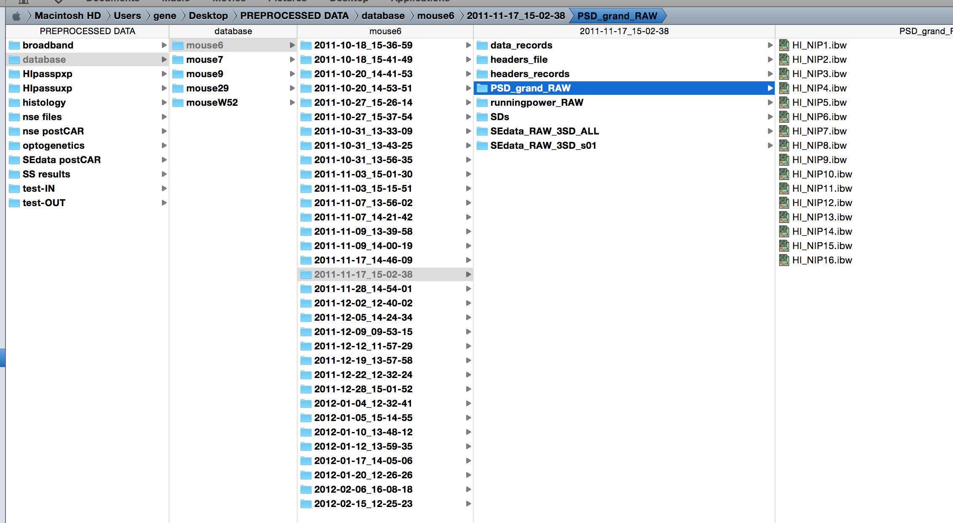
Basic database structure

Slide 4
Batch preprocessing stage 1
these functions are run from Neuralynx-preprocessor.pxp, which contains lists of recordings for each animal
right now the initial batch preprocessing, though it creates the CAR and AVG waves, does not use them.
data waves are left in RAW form and all parameters computed below are only for RAW waves.
do lots of directories
multiNCSloadpreprocesssave_new(7,111,"mouse29",experimentnames,channelmatchstring,filter,deletionswave,toptobottom_channellist,2, stage1extended)
do one directory (one recording session)
loadNCSdirandsaveoutwaves(nextinput_pathstring,nextoutput_pathstring,channelmatchstring[i],filter[i], stage1extended, deletionswave=deletions, toptobottomwave=toptobottomchannels)
loadNL_GC2(inputpathstring,channelmatchstring,maxpointstoload=30000000)
testandaveragematches(channelprefix)
refstatus = CARmaker_simple (channelprefix,0.5, 1.5)
WAVE SDs = $(SDs_batch(channelprefix, "RAW_noblank"))
WAVE SDs_RAW_3SD = $(blankedSDs_batch (channelprefix, "RAW_3SDblank_3ms", 3, 3))
WAVE SDs_RAW_4SD = $(blankedSDs_batch (channelprefix, "RAW_4SDblank_3ms", 4, 3))
makeallPSDs(channelprefix,16,"_psd",12000, 95,10*32000,"Welch", 0)
makeallrunningpower(channelprefix, 16, "_runningpower", 1, 0.2, 0.1, 10000, 12000, "Welch", 0)
MakeSEData_all_v3 (datalist, spikethreshold)
this function then creates data folders for all of the above,
moves those folders into a folder called “output”
do a save into the right file system folder, and voila, we have (next slide)...

Slide 5
Batch preprocessing stage 2
process_sessions("mouse9","","HI_NIP","CAR",1,"runningpower",runningpower_parameters,keepinRAM)
Single channel analysis, single channel output wave
runningpower
PSD_grand
SEdata
Single channel analysis, Multichannel output wave
SD
AER (actually a multisession output wave, uh-oh)
Multichannel analysis, Multichannel output wave
coherencematrix
weird legacy choice here: are we making one result wave per channel...
Process_Channels (subjectname, nextsessionname, channelmatchstring, 0, referencename, whichanalysis, analysisparameters)
Process_Channel2 ("mouse6", "2011-12-22_12-32-24", "HI_NIP8", "", "runningpower", runningpower_parameters)
options are “runningpower” ,“PSDgrand”, “SEdata”
these are the individual recording-level result waves
...or are we making one result wave for a whole session (i.e. the way I group SDs into arrays)?
computefromdatabasechannels("mouse9","2012-05-30_13-52-47","HI_NIP2","CAR",1,"SD",SD_params)
for preprocessing, only option here is “SD”
other options for stage 2: AER_postcar, coherencematrix

Slide 6
Processing diagram after initial load
Updating…
Process_Subjects (subjectstring, subjectstringISlist, referencename, channelliststring, whichanalysis, analysisparameters, keepinRAM)
A wrapper that calls Process_Subject as many times as necessary
Process_Subject (nextsubject, recordingstring, referencename, channelliststring, whichanalysis, analysisparameters,keepinRAM)
Make the output tracker, which may also be the output.
If analysistype is 0 or 1, make a grid. Grid gets filled with numbers or success/failure codes.
Process_session will return a strip that gets dumped into this grid
If analysistype is 2, make a 1D wave (one point per session). 1D wave gets filled with success/failure codes.
Process_session will return a success/failure code. May also create a wave that stays in RAM and needs to be renamed.
Process_Session (subjectname, recordingstring, channelliststring, referencename, whichanalysis, analysisparameters, keepinRAM)
Deals with a session. Always returns a wave reference. Dimensions of wave referenced will depend on analysistype
If analysistype is 0 or 1 (i.e. one wave needed for computation)
make a strip and populate it with numbers or success/failure codes by repeatedly running
returnwave[] = Process_Single_channel (subjectname, recordingstring, nextChannel, referencename, whichanalysis, analysisparameters, keepinRAM)
Process_single_channel returns a number – either the value or a success/error code
P_S_C and P_M_C always keep in RAM and never save to file system. Renaming and/or deleting or saving is handled by the calling function
Q: could we drop keeping in RAM? No, because sometimes they will be called from command line.
Q: what about P_M_C with coherence matrix? Why doesn’t it save to DB? Because calling function handles it, duh.
Elseif analysistype is 2 (i.e. more than one wave needed for computation)
returnwave = Process_Multi_Channels (channelliststring, whichanalysis, analysisparameters, keepinRAM)
Process_Multi_channels returns a textwave listing names of what was created and saved out
Are we saving out subject level result? If so then save out here
Are we keeping in RAM? Then duplicate and rename outputs received from Process_channel_ functions so not overwritten by next subject.
Return returnwave
Are we saving out subject level result? If so then save out here
Are we keeping in RAM? Then duplicate and rename outputs received from process_session so not overwritten by next subject.
For special case of SD waves, build the weird 2D wave and populate the newly created session wave and save it where it goes
Process_single_channel
IF Single channel analysis, single-session multichannel output wave: SD
create it here, and handle the naming and saving when the next loop closes. (i.e. name will be different if saving vs keeping). if SD build wave and populate it with return values from process_channels
...this thing does aggregation of AER and SDs...
computefromdatabasechannels("mouse9","2012-05-30_13-52-47","HI_NIP2","CAR",1,"SD",SD_params)
need to check if things already exist too...

Slide 7
Key functions for SE data and NSE files
MakeSEData_v3 (HI_NIPXX, ::headers_records:HI_NIPXX,::headers_file:HI_NIPXX,32, 8, 3.XXXX222e-05, "V", 0, "HI_NIPXX", "test")
newdatafolder root:SEdata
filter_SEdata_inplace("_sort1",30000,0,25,20)
write NSE: writeNSE(HI_NIPXX_SEheadfile,HI_NIPXX_SEheadrec,HI_NIPXX_SEdatarec, "Macintosh HD:Users:nipadmin:Desktop:00.nse")

Slide 8
How SE data is handled at stage 2
MakeAndSaveResultWave_Channel2 gets called with SEdata parameters
requesting, for example, _CAR_XSD_sYY_tMMMMMM_N
first logic choice: if we’re calling with SEdata, that means we either need to use or create the s00
so, is there a database folder for this recording called SEdata_CAR_XSD_s00?
(and does it have waves in it for the desired channel)
ref
spike templating (00 = all)
eventually do this check up top because this is the only condition
that creates need to load raw waves
windowing threshold
no
yes
this was not created at load for whatever reason
(trying new reference, code wasn’t done yet...)
do loads as normal for makeandsaveresultwave_channel2
load SEdata wave set from SEdata_CAR_3SD_s00
MakeSEData_v3 (...)
include what’s created in save out list
have 3SD_s00
new template filter requested?
no (YY = 00)
yes
filter_SEdata_inplace("_sort1",30000,0,25,20)
include what’s created in save out list
have 3SD_sYY
subinterval requested?
no
yes
pareSEdata with time restriction (did I write this??)
include what’s created in save out list
save outputs
DONE
save outputs is tricky. can’t just save out the whole folders because we don’t want to overwrite the
database folders since they contain channels other than the ones we’re working on. make a two-column text wave that contains
subdirectory and wavenames to save out. then when we get to the bottom just iterate through it.

Slide 9
what if we reversed the logic?
is function asking for time subinterval?
NO
YES
is function asking for s0N?
does the s0N the interval is to be based on exist in the db?
NO
YES
NO
YES
does s00 exist in the db?
NO
YES
make_SEdata
load it
load it
DONE
filter in place
limit in place
DONE
DONE
Notes:
call to Makeandsaveresultwave2 with SEdata parameter.
if (function doesn’t want s0N and doesn’t want time sub) OR (function wants s0N and s00 doesn’t exist)
makeSEdata

Slide 10
what if we reversed the logic?
already done: does SEdata exist in db?
if not then load it.
next: add this new logic:
does the SEparam include a new s_0N (i.e. anything other than 0)?
check if it exists
load it or create it
next: are we asking for time interval?
Notes:
call to Makeandsaveresultwave2 with SEdata parameter.
if (function doesn’t want s0N and doesn’t want time sub) OR (function wants s0N and s00 doesn’t exist)
makeSEdata

Slide 11
How to build long concatenated data “lists”
(subjectname, sessionname, channelstring, channelstringISlist, referencename, whichanalysis, makenewset)
catfromdatabase_channels ("mouse9","2012-05-04_09-50-11","HI_NIP",0, "CAR","runningpower",1)

Slide 12
8. How to pull “snoppets” from database
getsnoppet (18590)

Slide 13
Make SD and Avgevent rate maps
loadNCSdirandsave("","Macintosh HD:Users:gene:Desktop:PREPROCESSED DATA:HIpasspxp:mouse6:","CSC","",1,toptobottomwave=CM16_filters_AG1_CSCorder)
makeandsaveresultwave_sessions("mouse7","","HI_NIP","",0,"SD",SD_params)
computefromdatabasechannel("mouse9","2012-05-30_13-52-47","HI_NIP1","CAR",1,"SD",SD_params)

