Slide 1
Creating and Uploading
CPAN Modules
How to prepare a module for distribution and how to get it uploaded to CPAN

Slide 2
Presenter
Len Jaffe
Columbus, OH
Programmer @ 2Checkout.com
Just Another Hack Perler since 1990
ljaffe@2co.com
lenjaffe@jaffesystems.com
www.theycomewithcheese.com

Slide 3
PAUSE
The Perl programming Authors Upload Server
This is where you upload your distro for indexing and mirroring by the CPAN

Slide 4
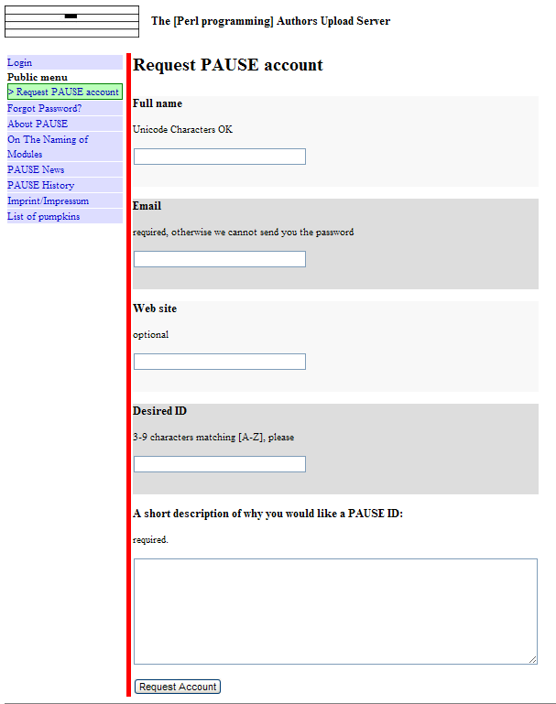
Request a PAUSE Account
https://pause.perl.org/pause/query

Slide 5
Request a PAUSE account
You'll get email
Also sent to modules@perl.org mailing list
Mailing list archive at http://www.xray.mpe.mpg.de/mailing-lists/modules
Read http://www.cpan.org/modules/04pause.html for gory details.

Slide 6
Register a namespace
Namespace for your module
  VendorAPI::2Checkout::Client
Log into PAUSE, submit the form.
  Receive email. Maybe haggle with moderators over the name.
Now name your module after the namespace and upload it.

Slide 7
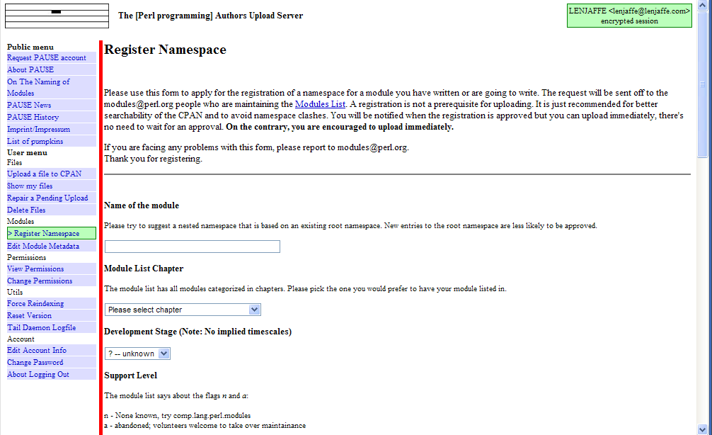
Register a Namespace

Slide 8
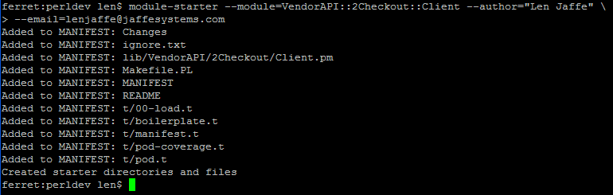
Module-starter
Use module-starter to bootstrap your distro

Slide 9
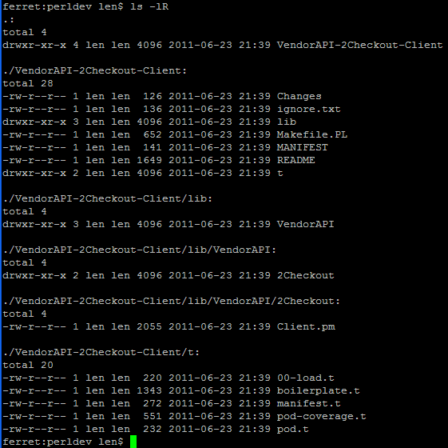
Generated Files

Slide 10
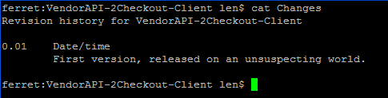
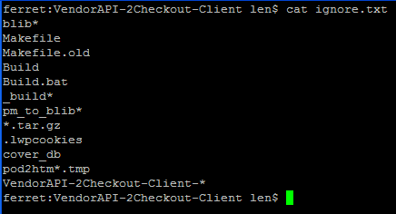
Changes and ignore.txt

Slide 11
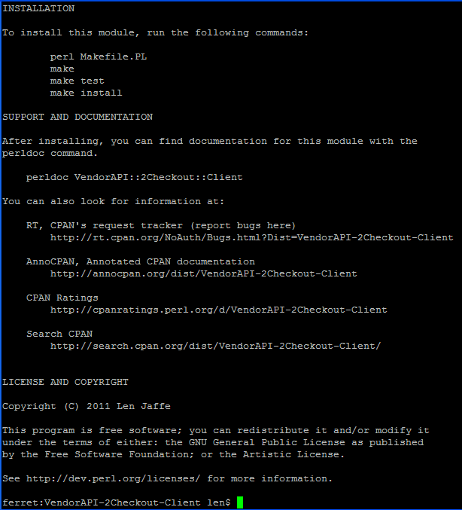
README

Slide 12
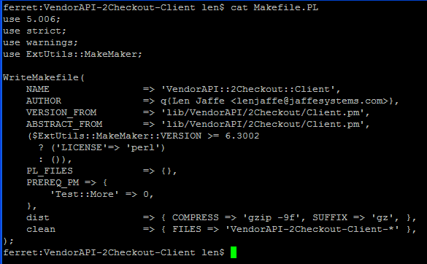
Makefile.PL

Slide 13

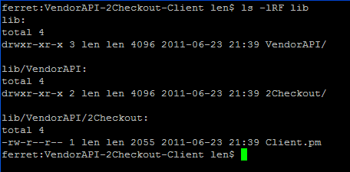
Tests and Module

Slide 14
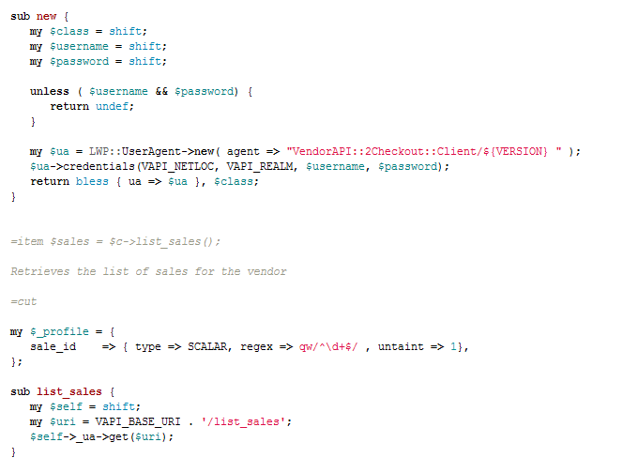
Write code and Tests

Slide 15
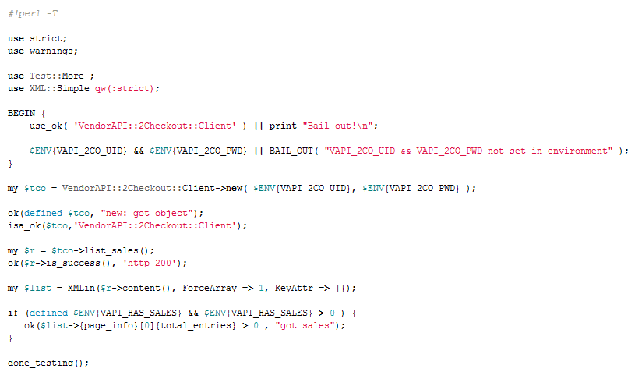
Write Tests and Code

Slide 16
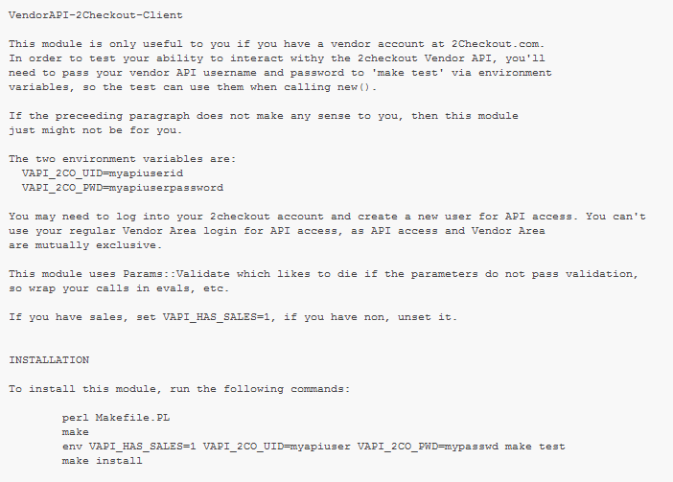
Change Boilerplate

Slide 17
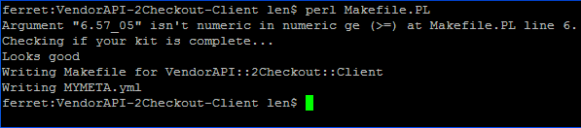
perl Makefile.Pl

Slide 18
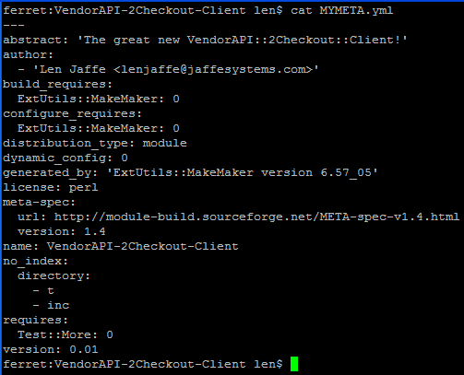
MYMETA.yml

Slide 19
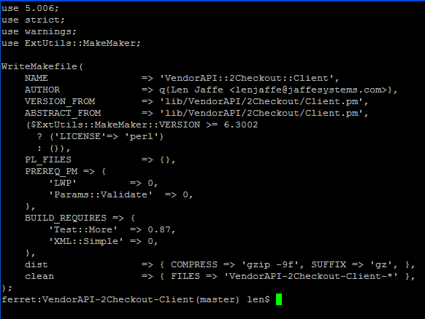
Modify Makefile.PL

Slide 20
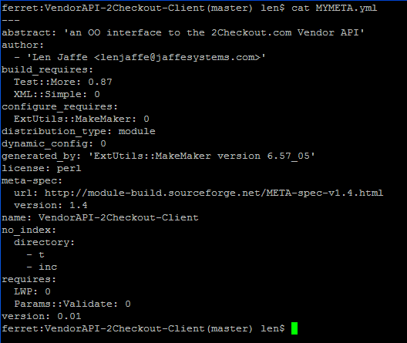
MYMETA.pl auto updated

Slide 21
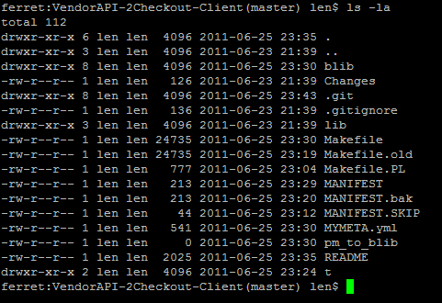
.bak files and .old files, etc.

Slide 22
Lather-rinse-repeat
It's an interative process.
  Write code and tests
  Make test
  Fix failures
  20 goto 10

Slide 23
Make manifest
Will include everything in the directory.
Don't want EVERYTHING, just some things
MANIFEST.SKIP
  Regexes. - skip files that match

Slide 24
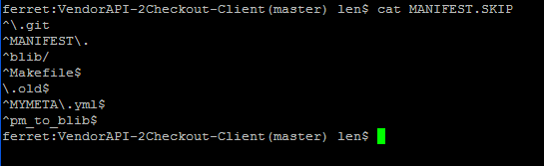
MANIFEST.SKIP

Slide 25
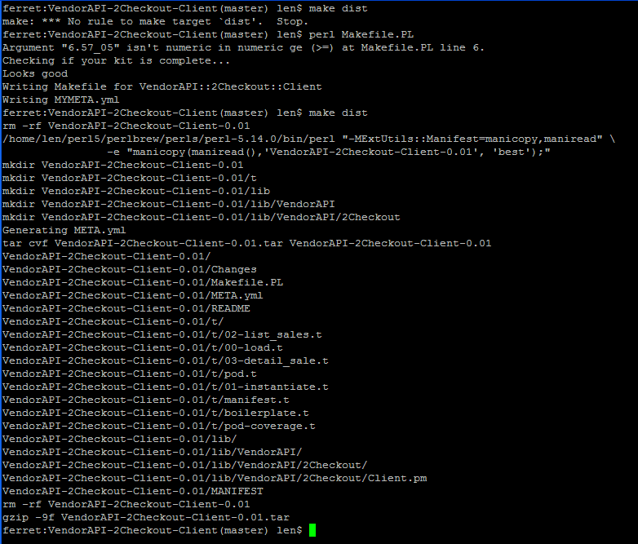
Make distribution

Slide 26
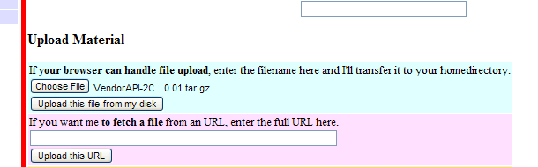
Upload to pause

Slide 27
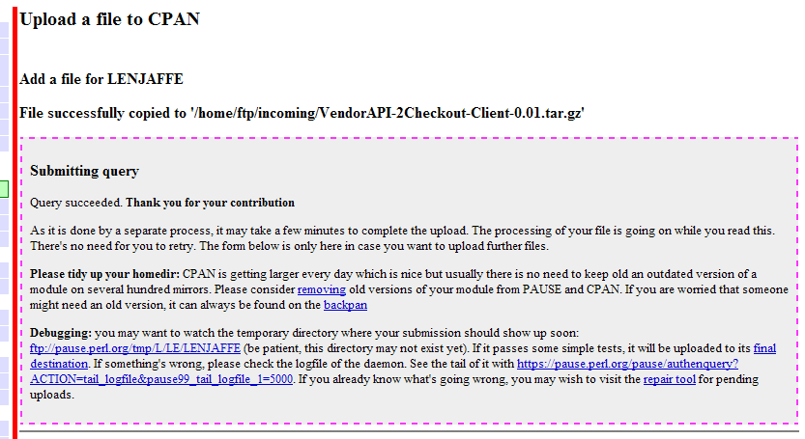
Upload to PAUSE

Slide 28
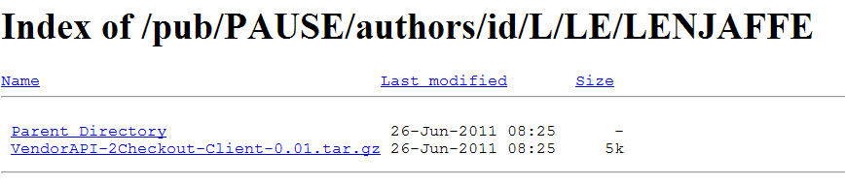
Upload to PAUSE

Slide 29
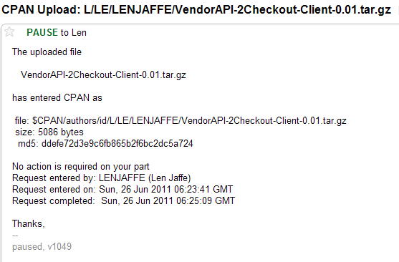
CPAN Entered Email

Slide 30
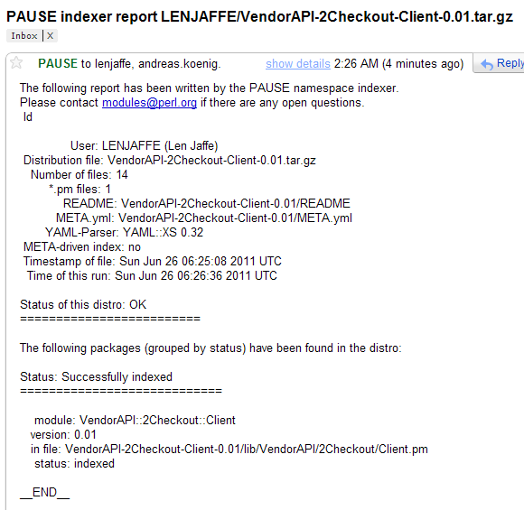
PAUSE Indexer Email

Slide 31
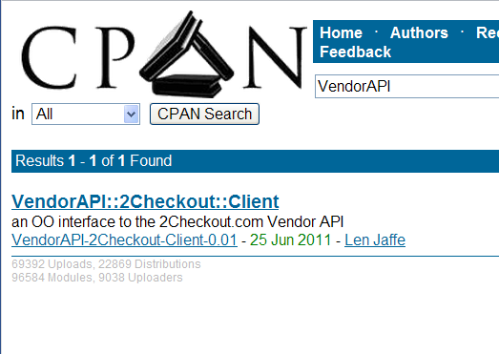
Suddenly CPAN

Slide 32
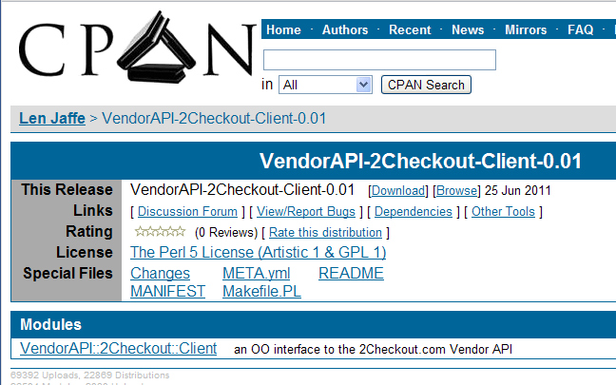
Eventually CPAN

Slide 33
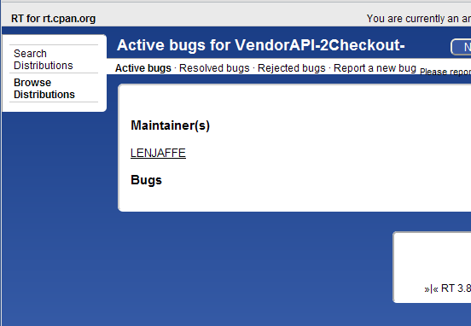
Support it

Slide 34
CPAN testers
Collective of Perlers running automated testing tools to test every module against every build.
cpantesters.org
They will test your distro and the results will be collated.
Dependencies link on the distro's cpan.org page.

Slide 35
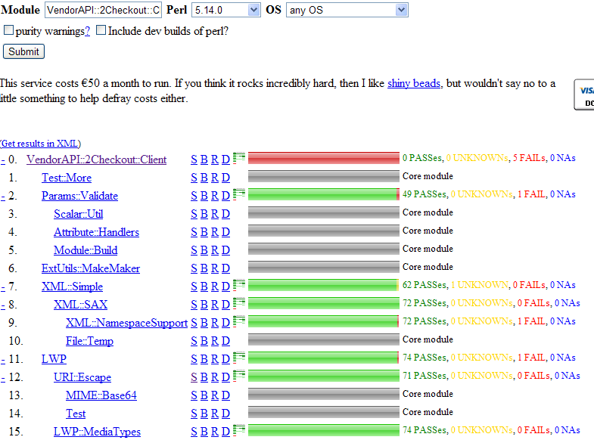
Dependencies

Slide 36
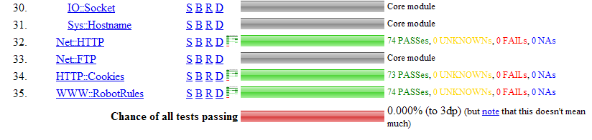
Dependencies

Slide 37
Big Finish
Process is well documented, and well indexed on the web.
Two web forms, some Perl hacking, and another web form.
Further reading:
  CPAN Testers Kwalitee score
  More toolchain goodies: Module::Build, Module::Install, Module::Starter plugins, Dist::Zilla

