Slide 1
Glowing Microbe
Can you give a microbe a brand-new glow?​

Slide 2

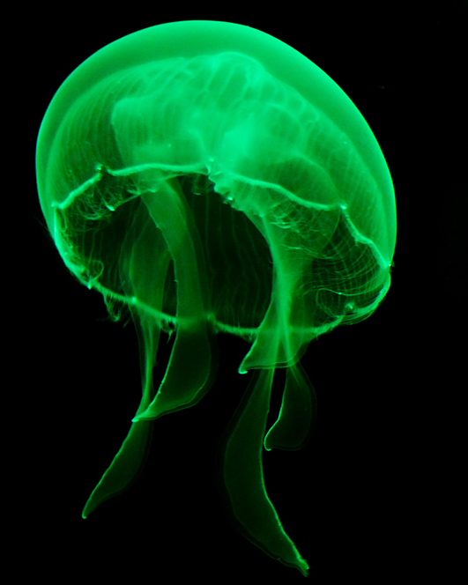
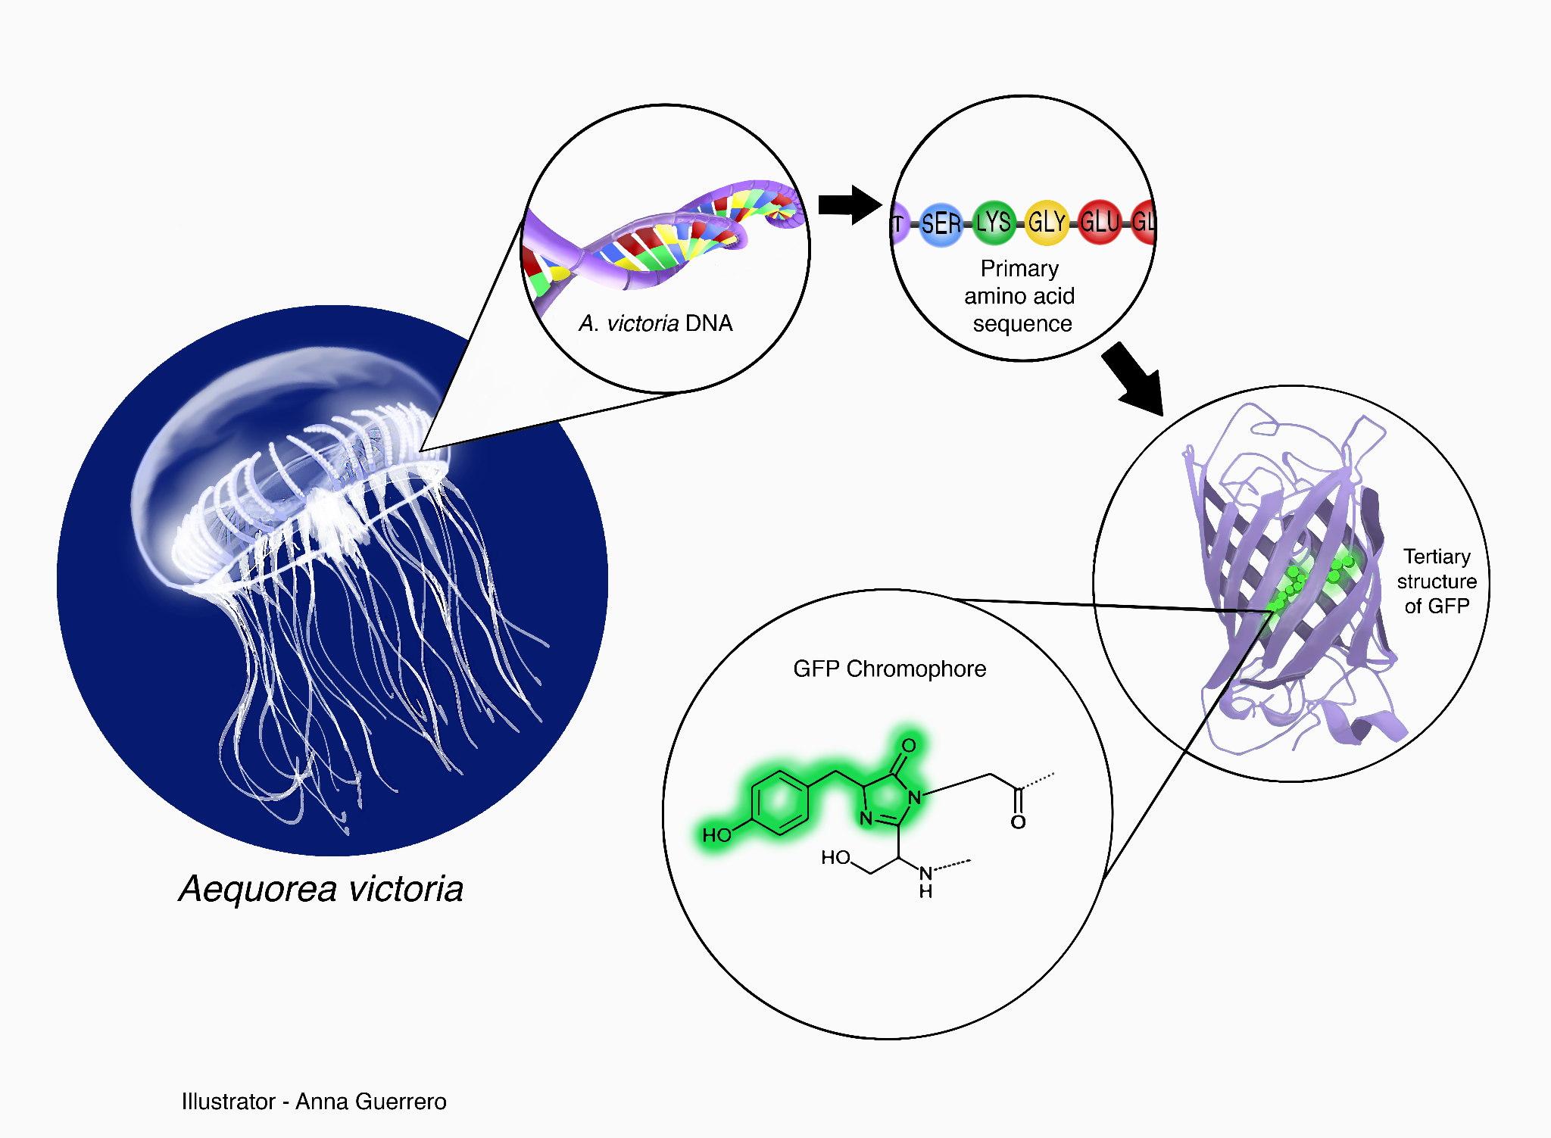
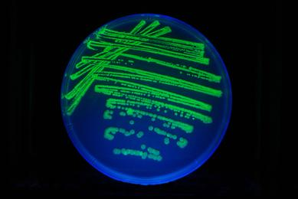

Where does the glow come from?​
Link to image
The green-glow gene (called GFP) comes from a jellyfish.​
Scientists move that gene into other living things — and they glow.​
Moving a gene from one organism to another gives it a new ability.​
Link to image
Link to image

Slide 3
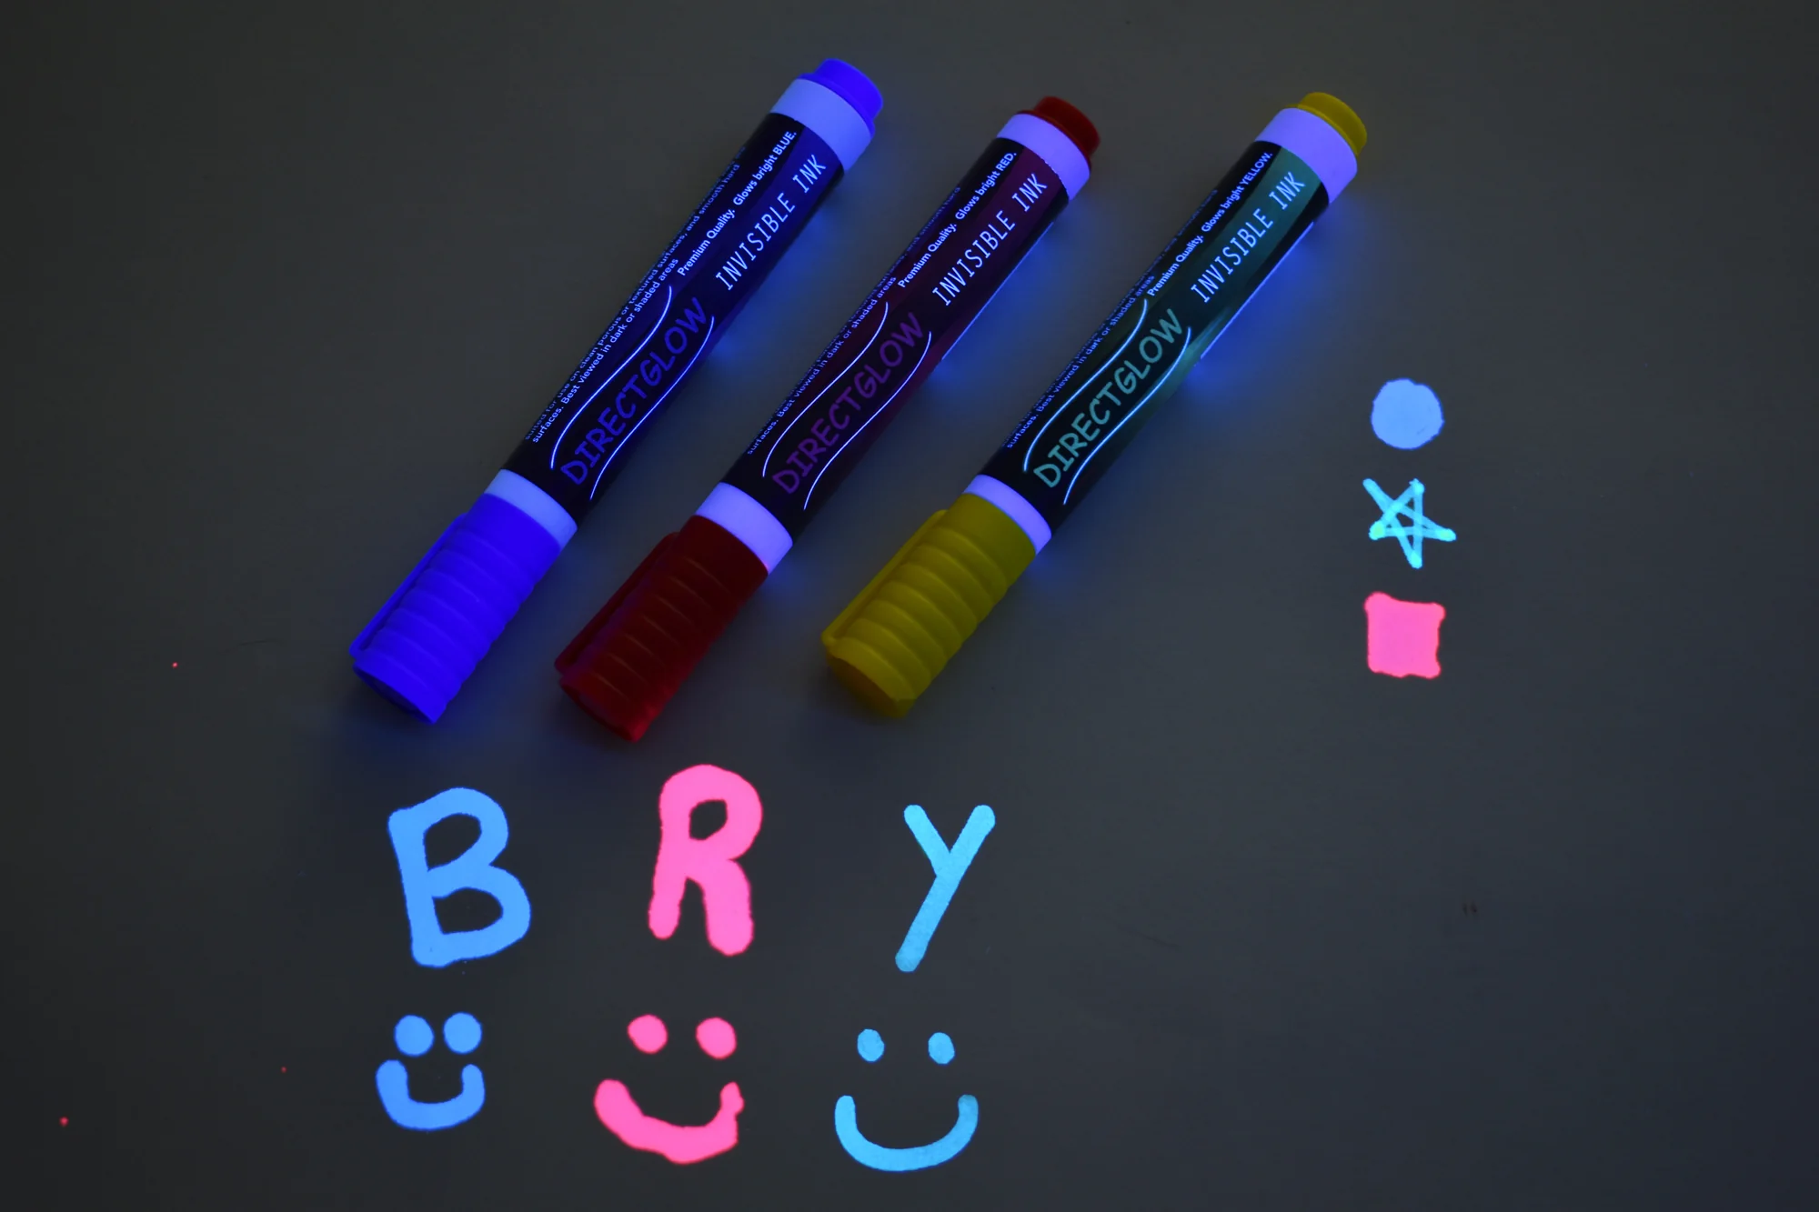


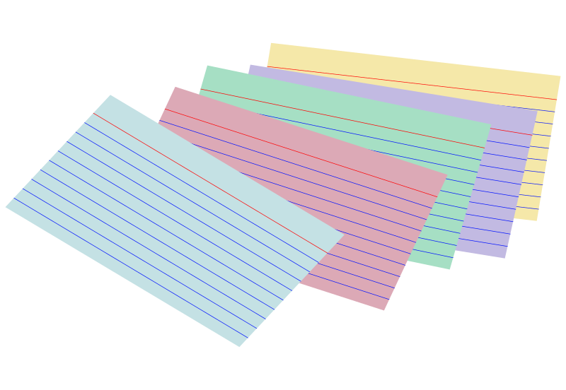
〰
Materials
〰
Paper microbe template​
GFP “glow gene” strip
Glow markers / stickers​
UV flashlight (optional)​

Slide 4
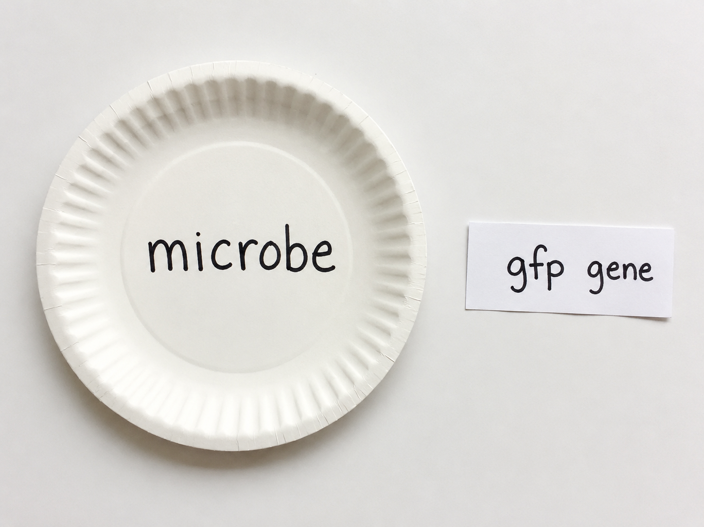
Step 1: Transform your microbe​
Each student gets a paper microbe.​
Glue the GFP “glow gene” strip inside it.​
Putting a new gene into a cell is called transforming it.​
UChicago Genehackers

Slide 5

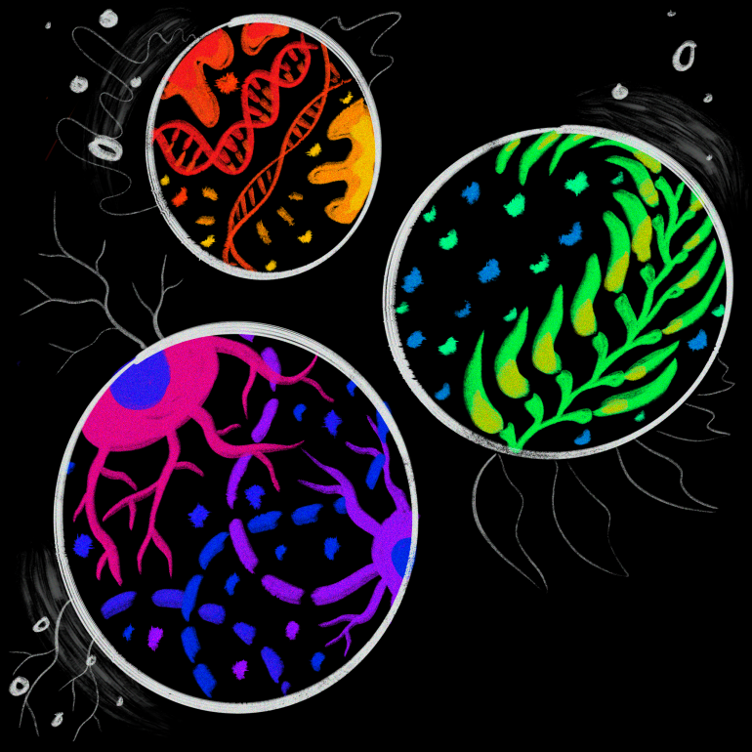
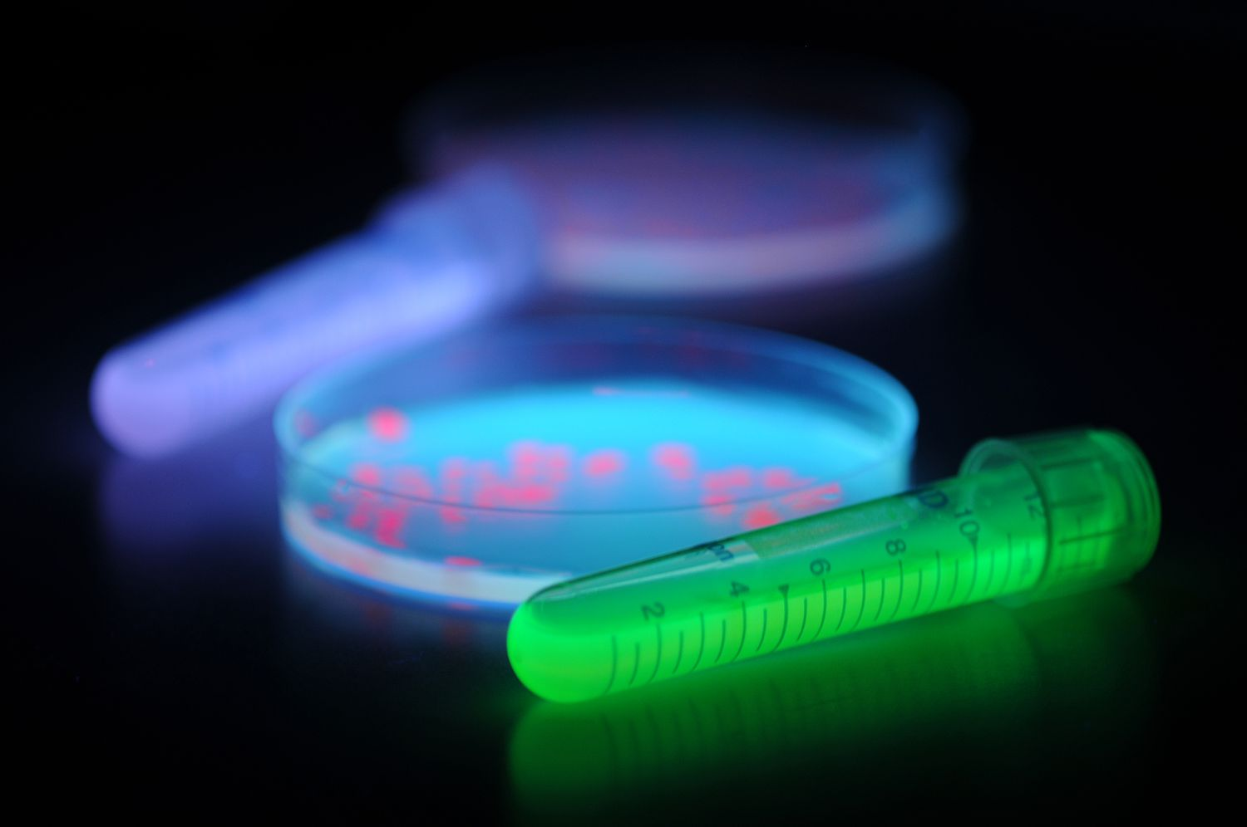
Step 2: Make it glow!
Decorate your microbe with glow markers or stickers.​
It now makes a new protein (GFP) that glows.​
If we have a UV light, we will see it shine!​
Link to image

Slide 6
Step 3: Give it a job​
Pick a second gene from the menu to give your microbe a job:​
“eats plastic,” “senses arsenic,” “makes medicine,” or “smells like banana.”​
Name your microbe and draw what it does.​
Pick a job!
Eats plastic
Senses arsenic
Makes medicine

Slide 7

Step 4: Show it off!
Share your engineered microbe and its job with the group.​
If we dim the lights with a UV flashlight, watch them glow.​
Every design is a little engineered organism.​

Slide 8
Glowing microbe: how did this work?​
Where did the glow gene come from?​
From a jellyfish — scientists moved its gene into another living thing.​
Adding a gene adds a new ability.​
What new thing does the microbe make now?​
A new protein (GFP) that glows.​
Real engineered microbes make insulin, sense pollution, and more.​

Slide 9
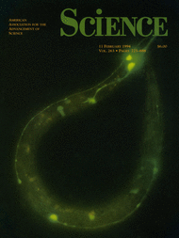
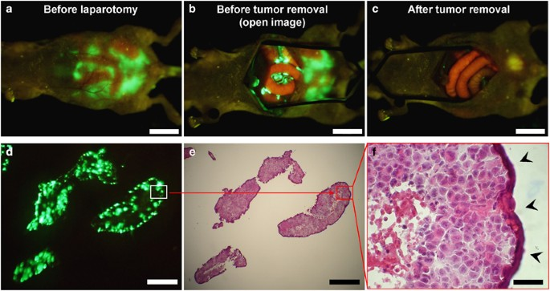
What does GFP look like in science papers?
Hoffman, Laboratory Investigation, 2015

Slide 10
Thank You!

