Slide 1
Synthetic Biology!
UChicago Genehackers

Slide 2


About us
We are UChicago Genehackers!
We are college students who compete in a synthetic biology research competition every fall with research projects that we do over the summer

Slide 3
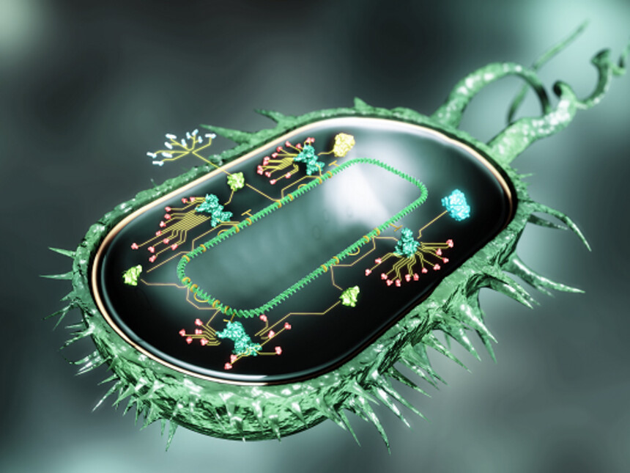
What is synthetic biology?
Synthetic Biology is essentially genetic engineering!
We take different parts of DNA and proteins from different organisms and make something new
What are some examples of synthetic biology?
Lab-grown meat, bacteria that eat plastic, medicine (like vaccines) made inside yeast, sustainable perfume (rare ingredients made inside yeast)

Slide 4
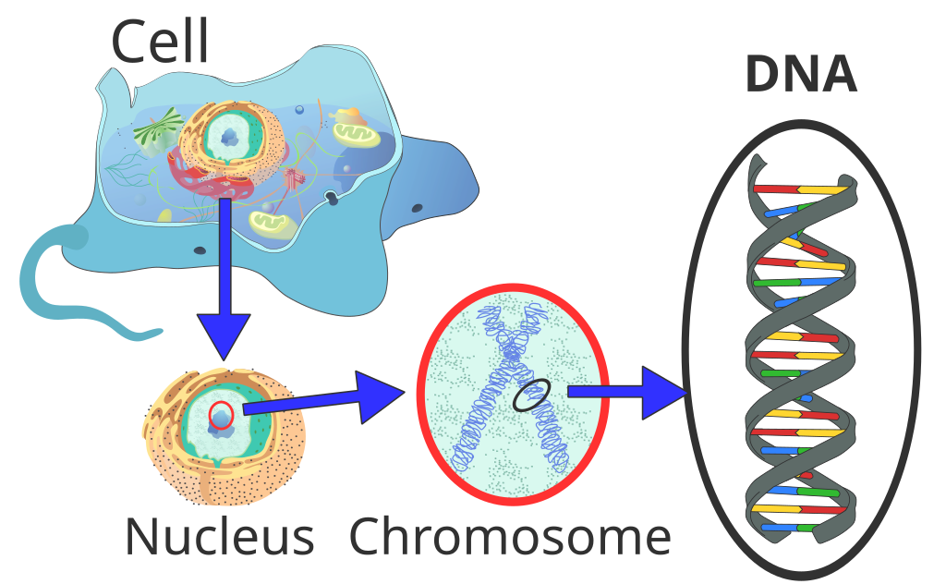
What is DNA?
DNA = “deoxyribonucleic acid”
A molecule that stores genetic information – the blueprint of life!
Genes - a segment of DNA that codes for a protein, which in turn codes for a trait (skin tone, eye color..etc)
It’s made of a code using four letters: A, T, C, and G.
How can we edit this code to change how organisms function?

