Slide 1
Name Bracelet
Can you make a sequence that codes for your name?

Slide 2
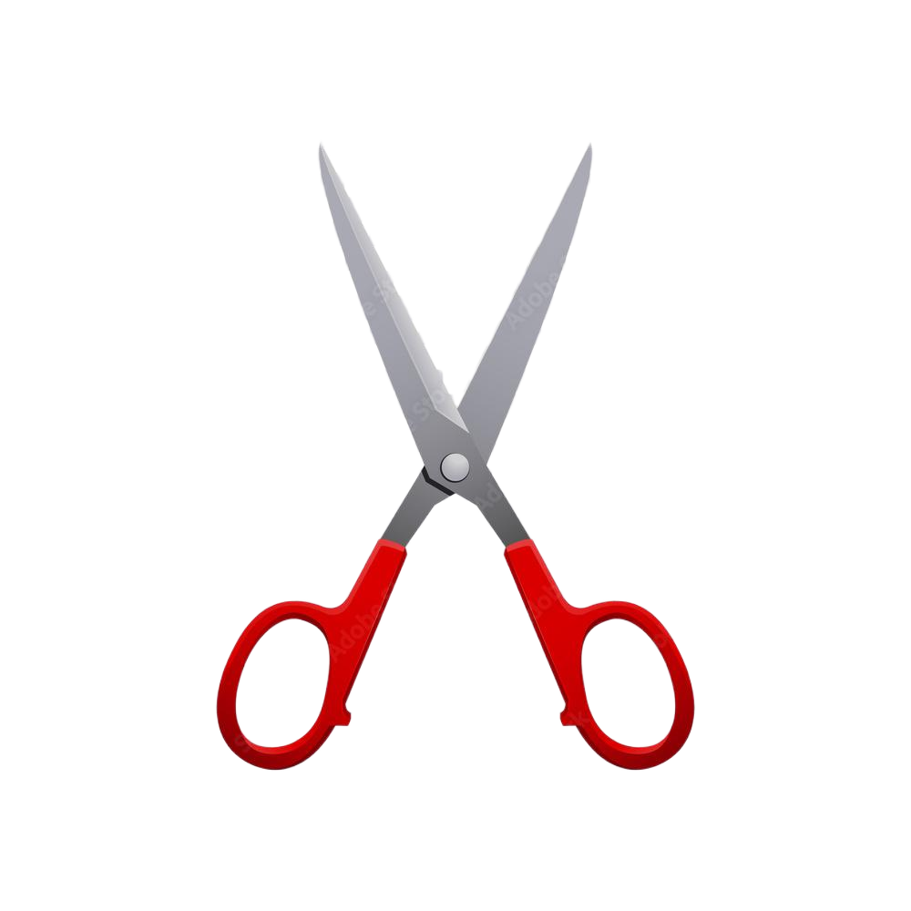
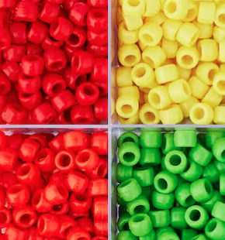
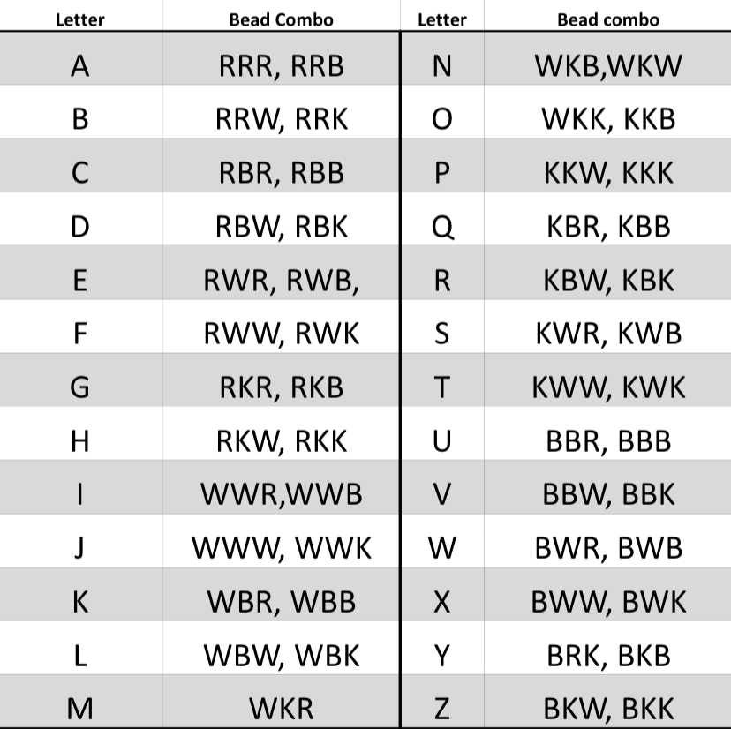
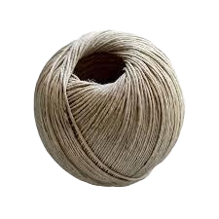
Materials

Slide 3
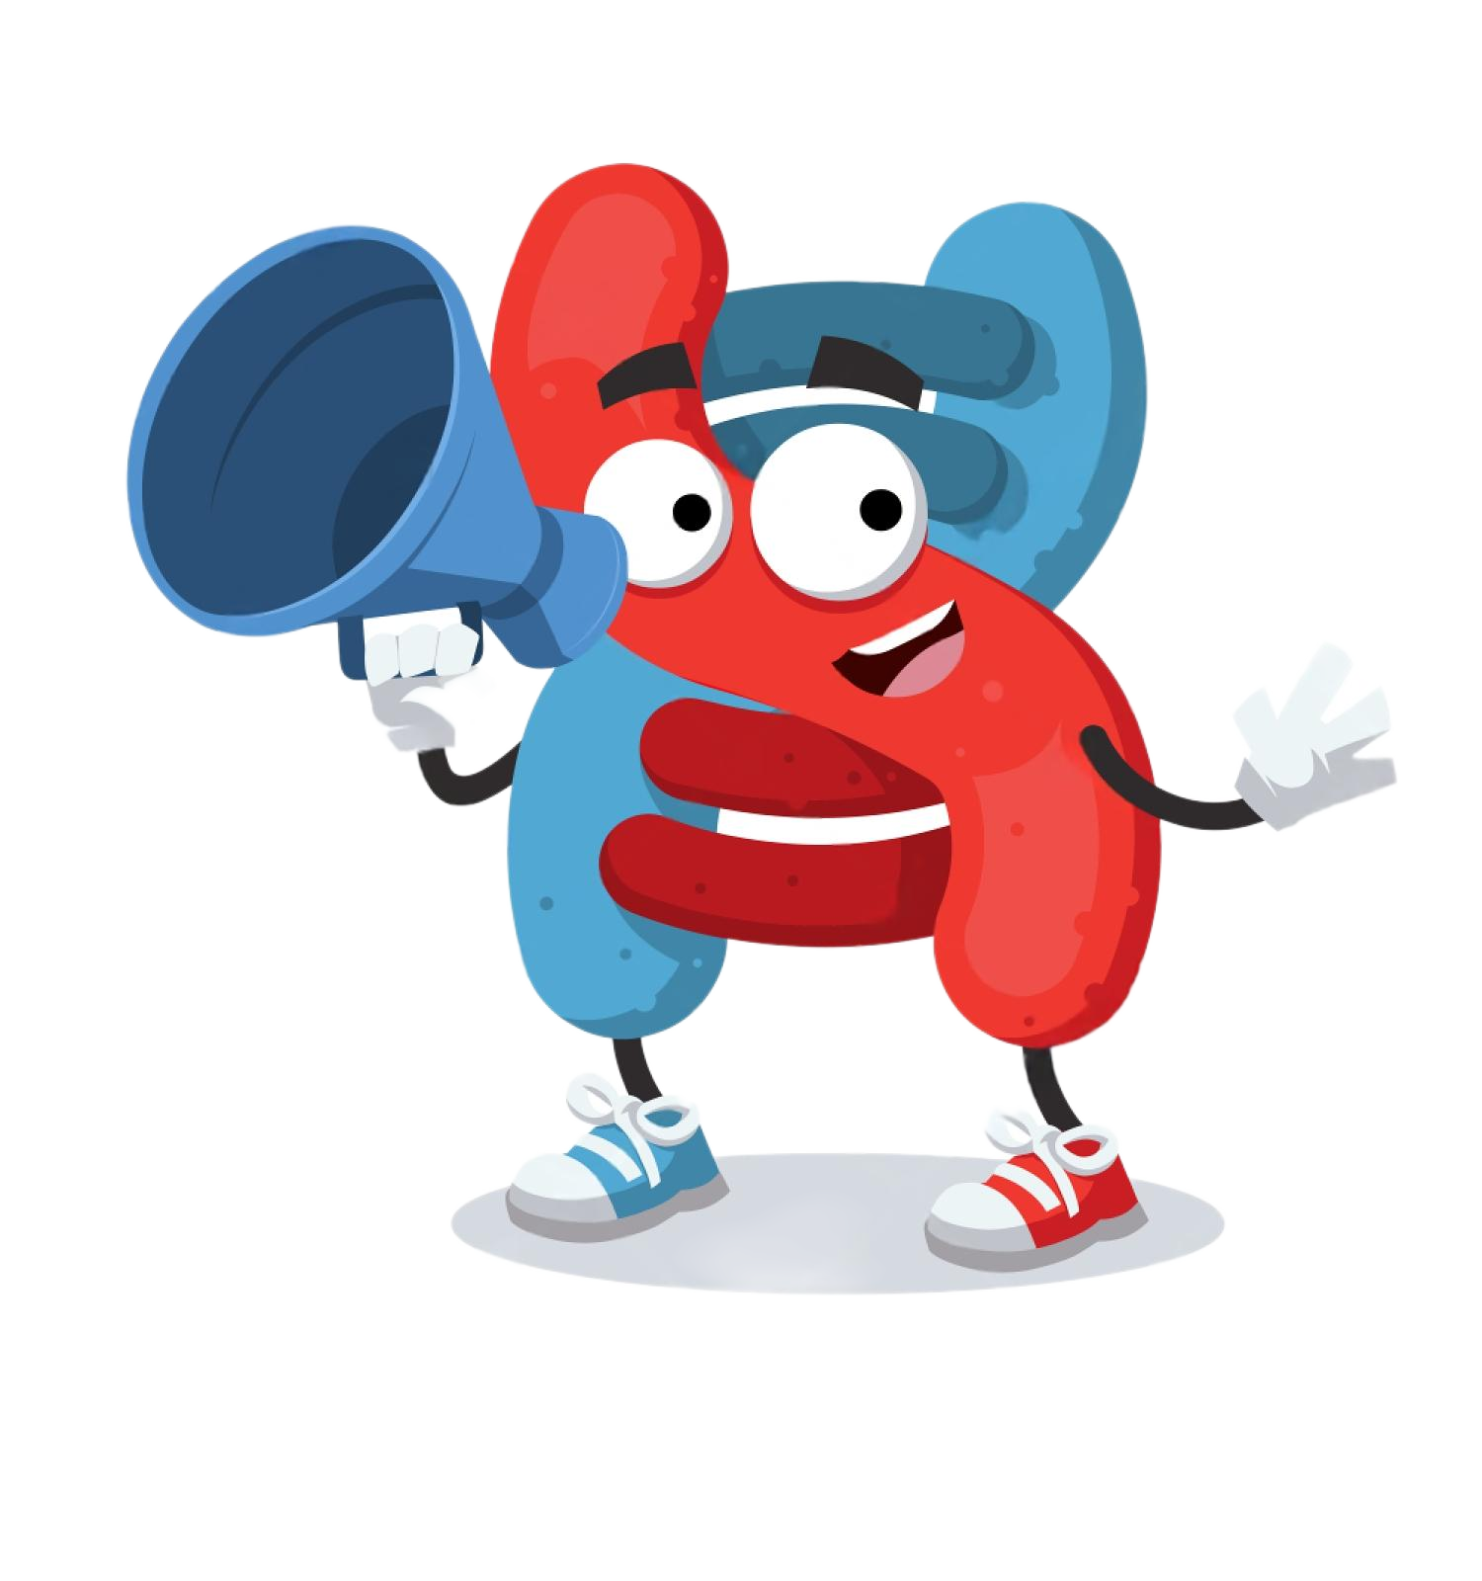
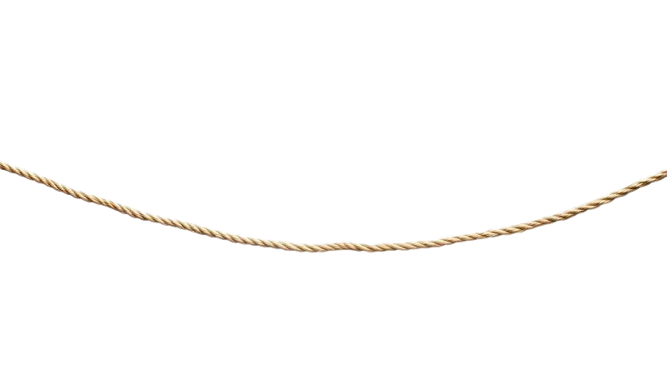
Step 1: Cut the String
- Using a pair of scissors, cut a piece of string that is roughly a foot long
Fun fact: The “string” part of DNA is called the “backbone”
+

Slide 4

Step 2: Choose a Name
- Some ideas:
Your name
Your favorite superhero’s name
Your sibling’s name
Your pet’s name
Your favorite animal

Slide 5
Step 3: Spell Your Name in Code
- Use this code dictionary to spell your chosen name in the code language
example: ‘Max’ → WKR, RRB, BWW
- Once you have your name spelled out, build your bracelet by following the code for your name
R → Color 1 B → Color 2
W → Color 3 K → Color 4

Slide 6
Step 4: Share with Others
- Exchange bracelets with your friends and use the code dictionary to decode the name on their bracelet
- Try to find someone that spelled out the same name as you
Keep in mind… They could have a different sequence of beads than you but still have the same coded name!

Slide 7
Name Bracelet: How did this work?
How many beads represent one letter? How many nitrogenous bases represent one codon?
Does a word make sense if a mistake is made?
Does it make sense to read your bracelet backwards? Can you read DNA backwards?
→ 3 beads represent one letter, and sometimes more than one set of 3 beads can represent the same letter. DNA works the same way. 3 bases represent one codon, which codes for one amino acid. A string of amino acids forms a protein.
→ Sometimes. Depending on which color you switch out, and what color you replace it with, your new word may or may not change. With DNA, a mistake is called a mutation. There are many types of mutations, and the ones that change the coded amino acid often lead to disorders or diseases.
→ Reading your coded sequence (bracelet) backwards will almost always change the message it encodes. Similarly, DNA must be read from one direction to the other (5’ end to 3’ end) to make sure that it encodes for the right amino acids and produces the right protein!

