Slide 1
Clean Drinking Water
What makes water unsafe to drink?

Slide 2
What could be some reasons for groundwater pollution?

Slide 3
Sorting Game
Sort the following examples into these 2 categories:
Natural Causes
Human Causes
Notes:
Distribute cards if you have them

Slide 4
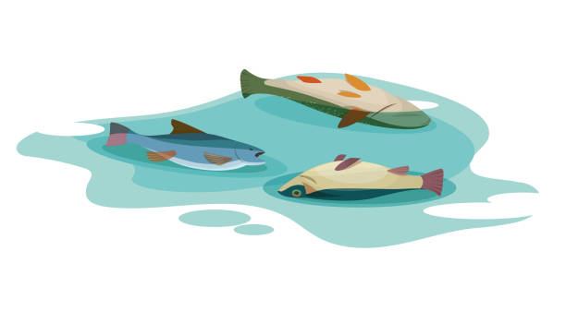
Animal Waste

Slide 5
Animal Waste - Natural Causes

Slide 6

Volcanoes

Slide 7
Volcanoes - Natural Causes

Slide 8

Algae

Slide 9
Algae - Natural Causes

Slide 10
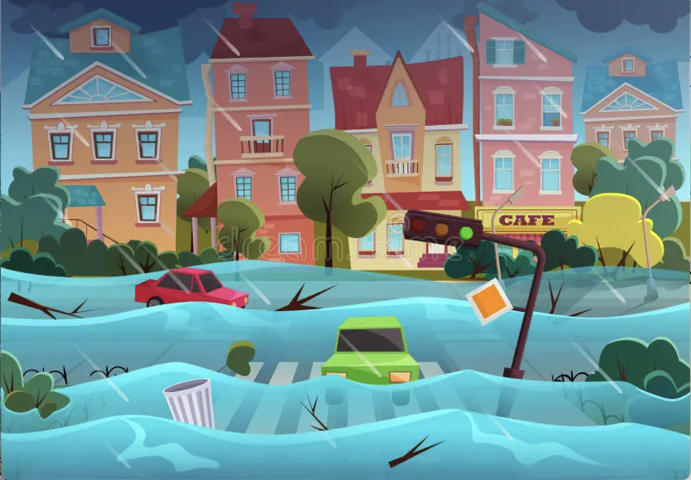
Silt from Floods

Slide 11
Silt from Floods - Natural Causes

Slide 12
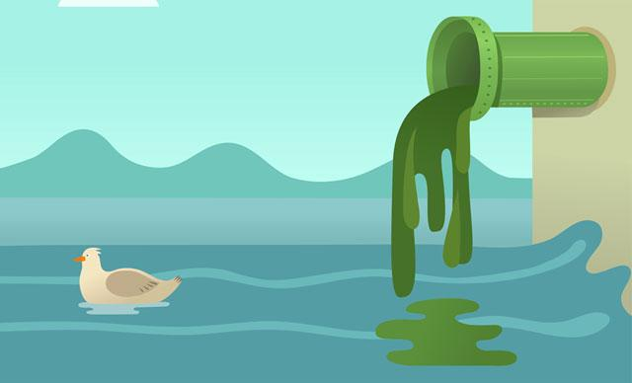
Sewage

Slide 13
Sewage - Human Causes

Slide 14
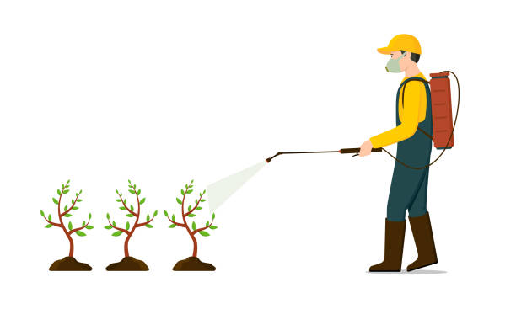
Fertilizers

Slide 15
Fertilizers - Human Causes

Slide 16
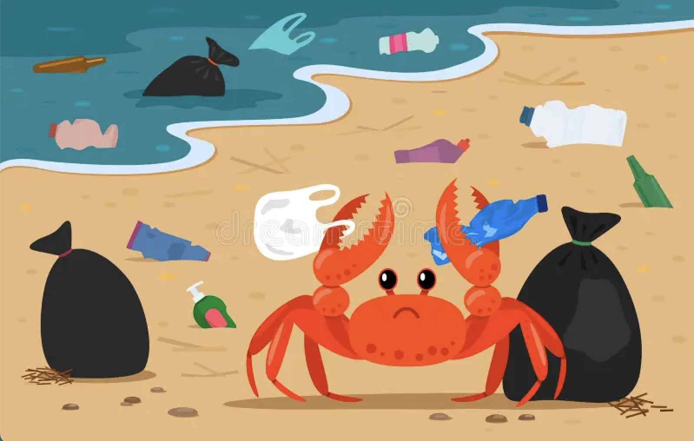
Waste

Slide 17
Waste - Human Causes

Slide 18
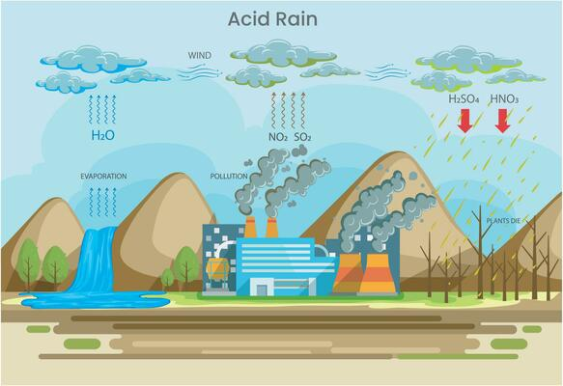
Acid Rain

Slide 19
Acid Rain - Human Causes

Slide 20

Oil Spills

Slide 21
Oil Spills - Human Causes

Slide 22
Designing an Arsenic Biosensor
How can we use genetic engineering to detect contamination in water?

Slide 23
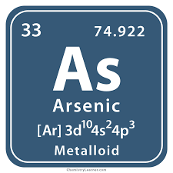
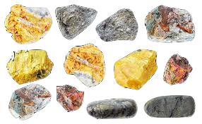
What is Arsenic?
Arsenic is a naturally occurring, highly toxic element
It is found in both organic and inorganic forms
It is often found in contaminated drinking water
It is poisonous and a carcinogen

Slide 24
Why does arsenic contamination in water matter?
Natural geological arsenic can be present in bedrock
The deeper the level of groundwater, the higher the concentration of arsenic
Arsenic from pesticides and fertilizers can get into groundwater
Arsenic is very bad for the human body. It can cause:
Liver and kidney damage
Skin disease and irritation
Cancer
- Current Arsenic detection methods are costly and/or time intensive

Slide 25
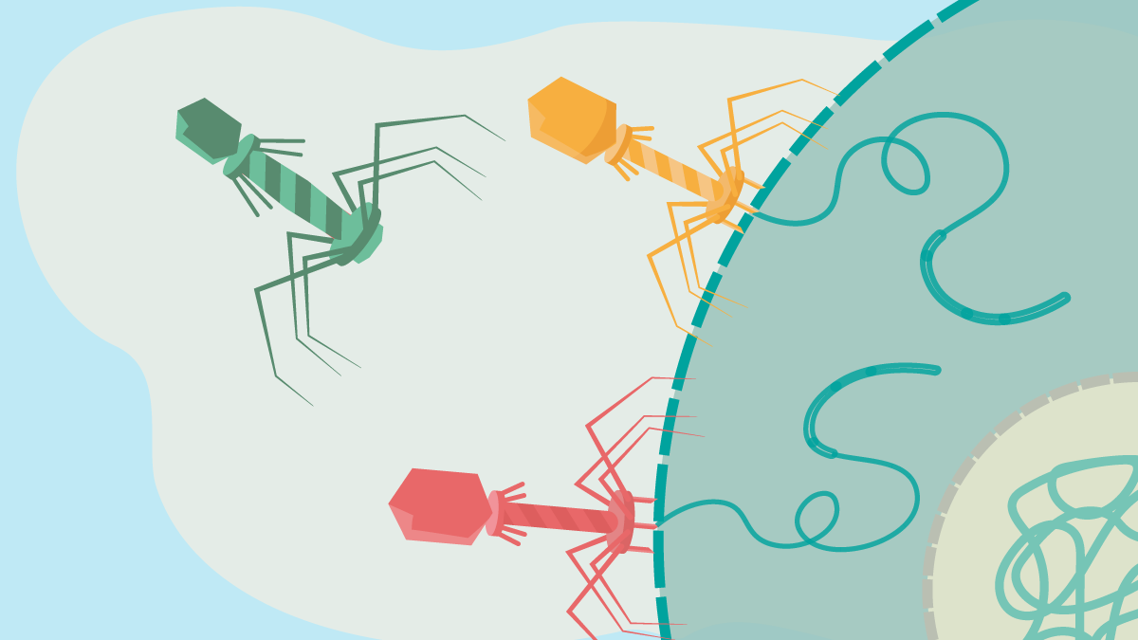
Designing a Bacteriophage Arsenic Detector!
M13 “Bacteriophage” = a virus that infects bacteria (but not humans!)
M13 bacteriophage insert their DNA into bacteria, which then start to produce more of the viruses themself
Using genetic engineering, we programmed bacteriophage to only grow in the presence of arsenic
→ By measuring how many bacteriophage we have, we can tell how much arsenic is present in the sample!
Notes:
If anyone asks, T means terminator and signals the end of the gene.

Slide 26
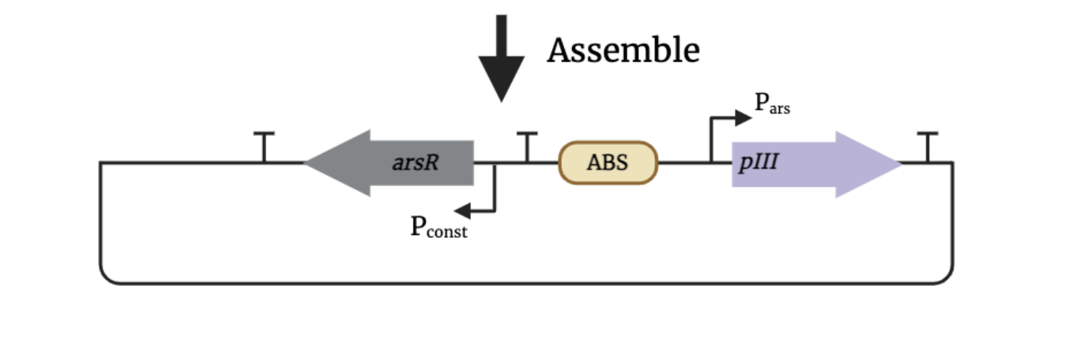
How does it sense arsenic?
This diagram shows how we set up DNA instructions inside bacteria so they make viruses only when arsenic is in the water.
Tips to understand a genetic circuit diagram!
What is a Plasmid?
–a small loop of DNA that we can design and put into bacteria.
What Do the Arrows Mean?
-Arrows show which direction a gene gets “read” or turned into a protein.
What’s a Promoter?
A promoter is a special DNA “on switch” that tells the cell when to start reading the next gene.

Slide 27
How does it sense arsenic?
arsR: A protein that acts like a switch: binds in the absence of arsenic and detaches when arsenic is present!
ArsR binding site (ABS): ArsR binds here and blocks gene activation. ArsR only lets go when arsenic is present!
Arsenic-sensitive promoter: turns ON when arsenic is present → pIII gene is activated!
Tips to understand a genetic circuit diagram!
What is a plasmid?
–a small loop of DNA that we can design and put into bacteria.
What do the arrows mean?
-Arrows show which direction a gene gets “read” or turned into a protein.
What is a promoter?
A promoter is a special DNA “on switch” that tells the cell when to start reading the next gene.
pIII: a phage replication protein that the virus needs in order to grow
A constitutive (always-on) switch, which makes sure ArsR is always present

Slide 28
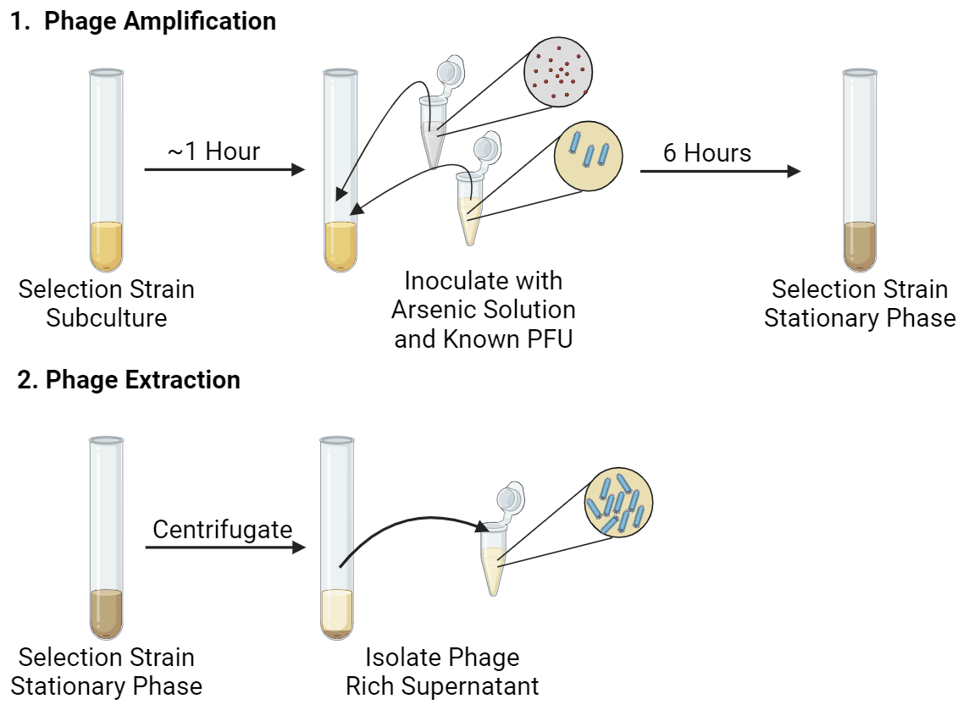
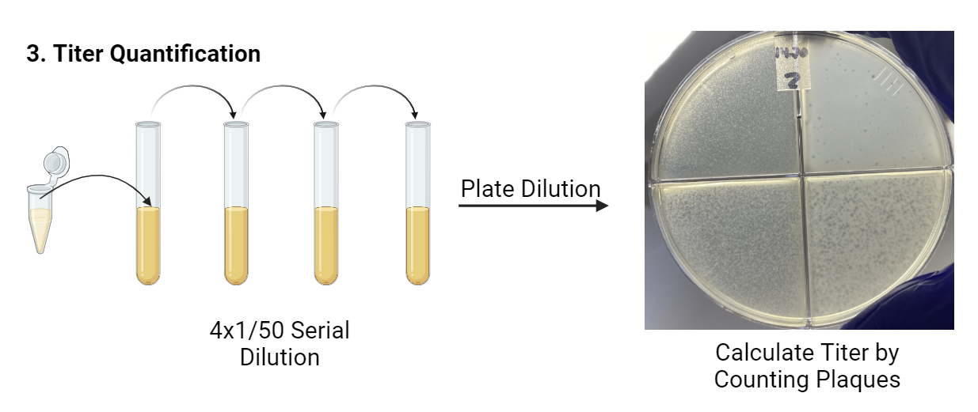
Deploying the Sensor!
Sensing Steps:
Combine Water + E. coli + phage
If arsenic is present → special gene (pIII) turns on
Phage grows more = more dots (plaques!)
We count the dots = amount of arsenic!
… Low cost & no special equipment!

Slide 29
Recap: In short…
Scientists engineer a tiny biological “switch” that reacts to arsenic.​
No arsenic → the switch stays OFF → no signal.​
Arsenic present → the switch turns ON → it makes a signal.​
The more arsenic, the stronger the signal we can measure.​
The arsenic switch
No arsenic
switch OFF
Arsenic!
switch ON → signal
more signal = more arsenic​

Slide 30
Make your own water filter!
How can we clean up water?
Notes:
Credit: inspired by https://www.teachengineering.org/activities/view/cub_environ_lesson06_activity2

Slide 31
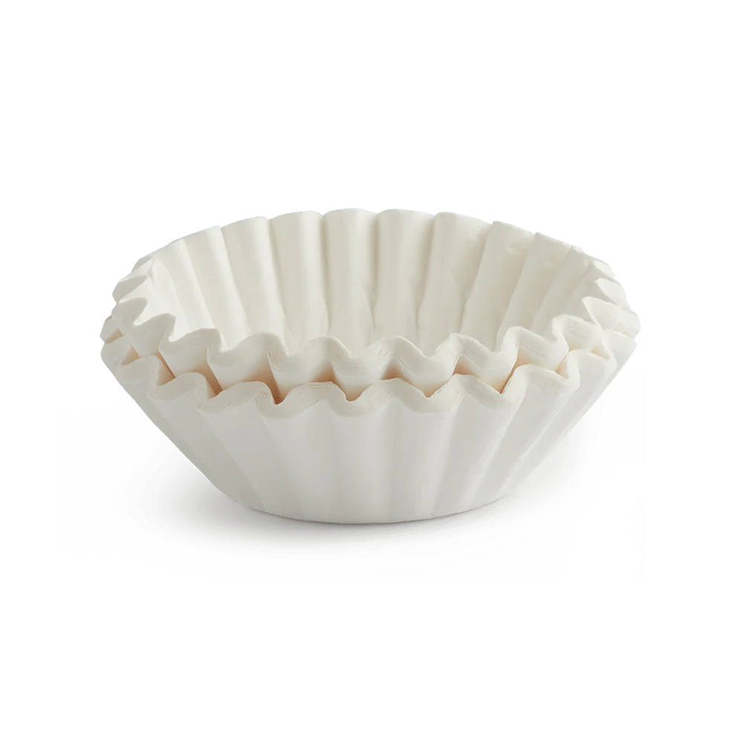


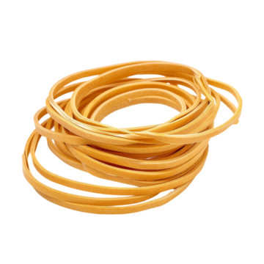
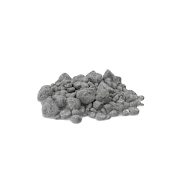
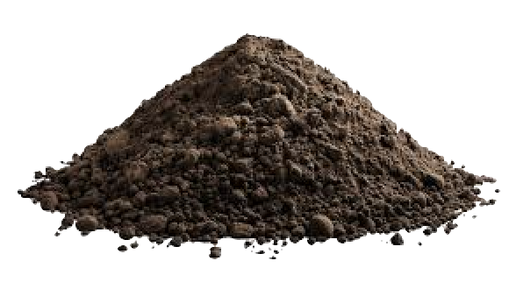
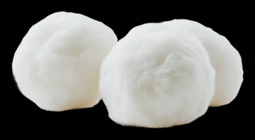
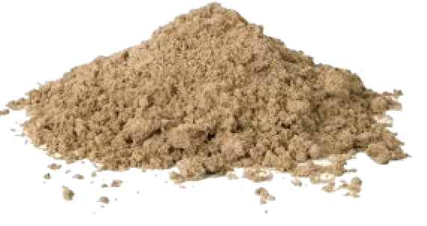
Materials

Slide 32

Your Task: design a new water filtration system for a small community with a polluted water supply

Slide 33
Step 1: Observation & Planning
Each group will get:
a pre-cut 2-liter bottle
a ½-¾ cup (100-200 ml) sample of the "polluted water" in a beaker or cup
one type of "filter" (one group will not get a filter in order to test the mesh only)
a spoon
Draw a picture of the "polluted water." Describe in words what it looks and smells like.

Slide 34

Step 1: Observation & Planning
Gently stir the solution and record your sight and smell observations on the worksheet. Never taste the solution
Write down any questions you think are important to answer throughout the activity (i.e., what makes a good filter?).
Write down on your worksheets your predictions for what you think your filter material will do

Slide 35
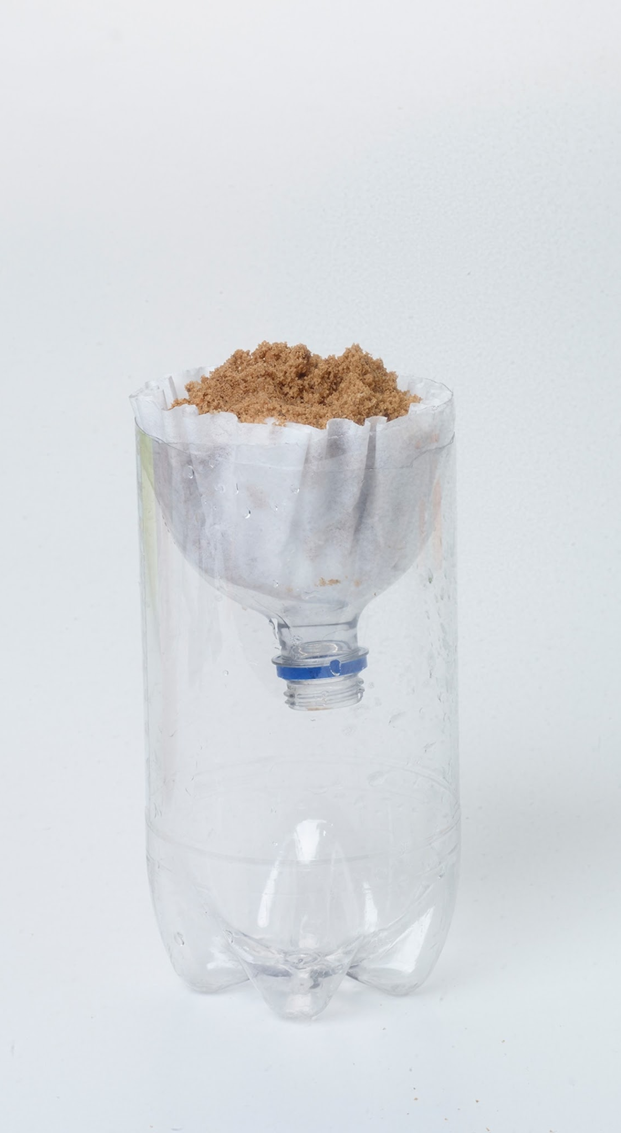
Step 2: Prepare Your Filter
Set up your filters by placing the filter material into the inverted 2-liter bottle top
Place the filter in the end of the bottle with the neck, so it functions like a funnel using the other half of the bottle as a stand
Draw a sketch of your setup on the worksheet

Slide 36
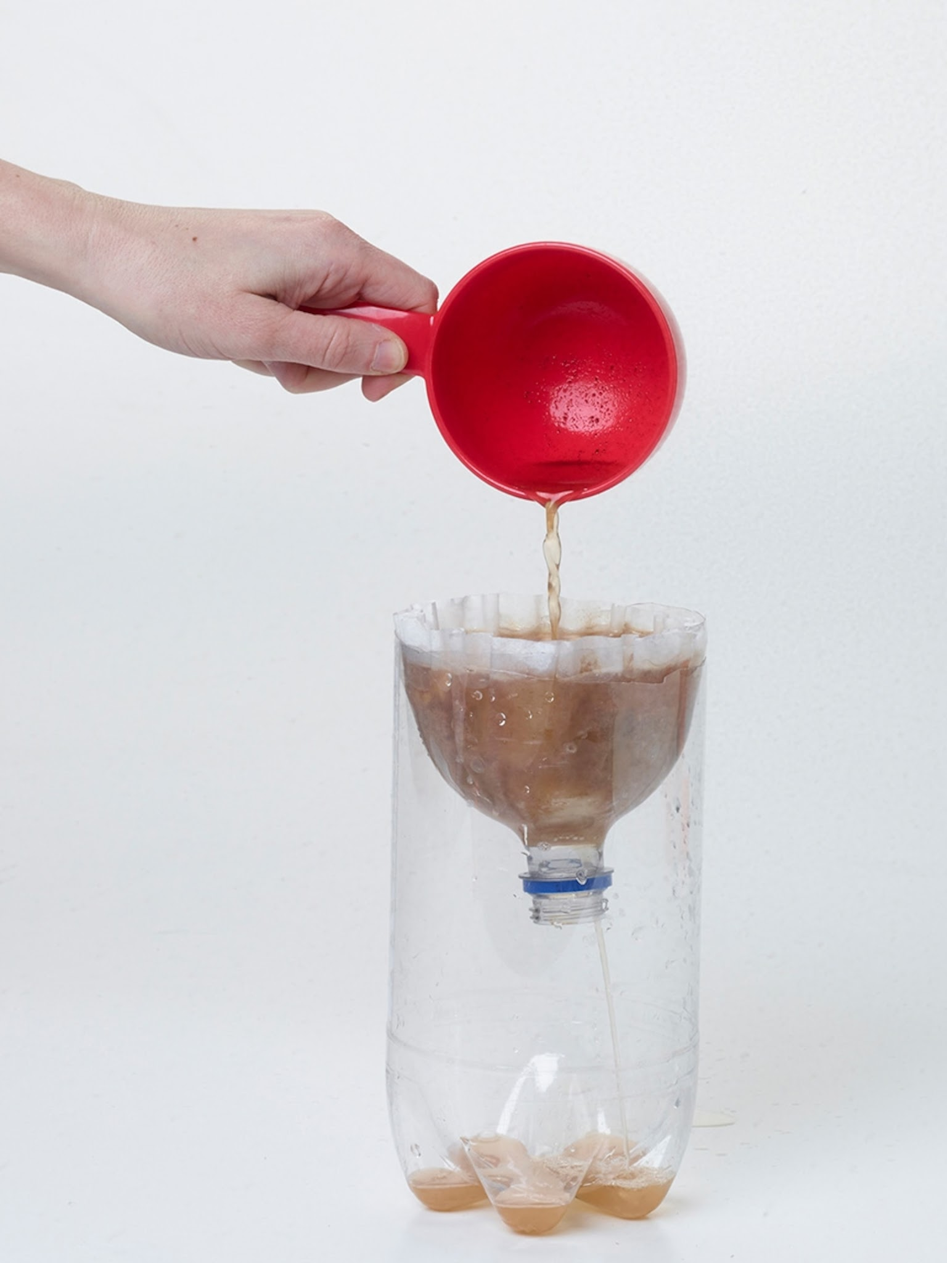
Step 3: Adding the Polluted Water
Gently stir the "polluted water" and slowly pour it into the filter
Observe what happens during the filtration
Record your observations and draw pictures of the filtered water
Question: Why do some filtration systems take longer than others?

Slide 37
Now, work with your group to design the best water filtration system given the filter material options

Slide 38
Step 1: Observation & Planning
Each group will get:
a pre-cut 2-liter bottle
a ½-¾ cup (100-200 ml) sample of the "polluted water" in a beaker or cup
a spoon
Send one group member to the front to collect your filter materials
Make your groups' water filter system and draw pictures of it on your worksheets

Slide 39
Step 2: Testing Your Filter
Gently stir the polluted water supply and then slowly pour an amount into the filter
For teams that used filter paper, be careful not to pour the liquid above the top of the filter
Carefully observe what happens and record it on your worksheets
Label your filtered water and bring it to the front

Slide 40
Step 3: Present Your Results
Explain your filter to the class
What materials did you use and why?
Did your filter take a long time?
What similarities and differences do we see between filters?
Which water is cleanest? Why?

Slide 41
Thank You!

