Slide 1
CRISPR Cut-and-Paste
Can you edit a gene like a real scientist?

Slide 2

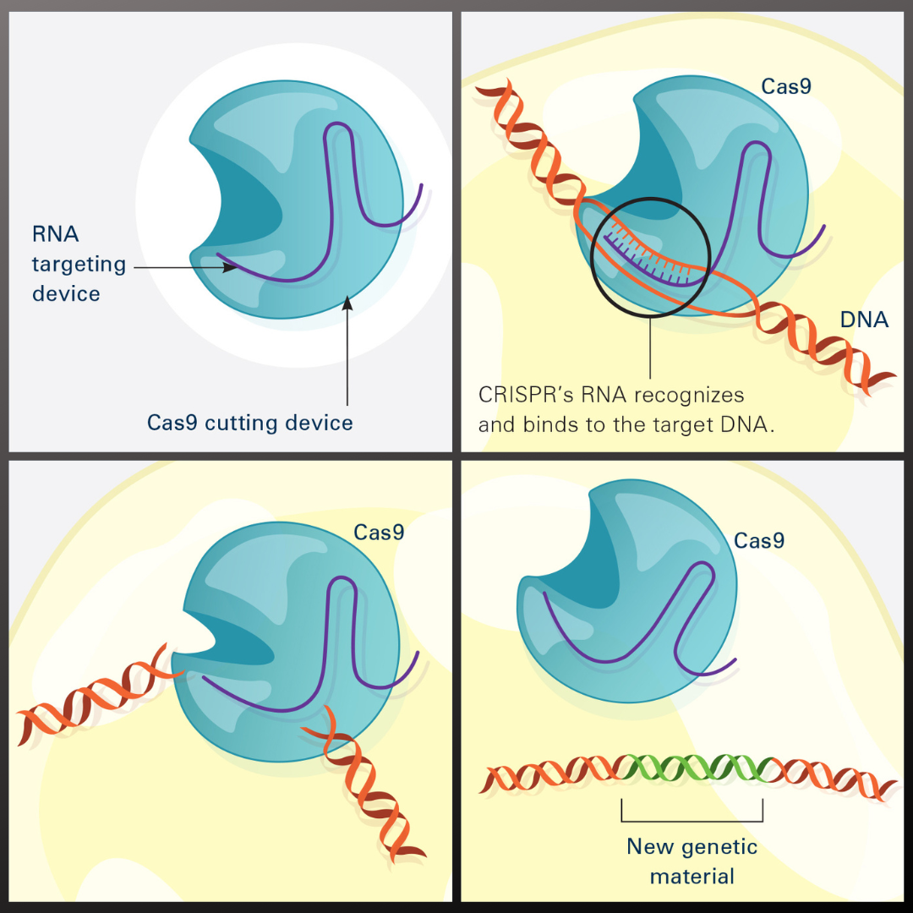

What is CRISPR?
CRISPR is a find-and-replace tool for DNA.​
A guide tells the Cas9 “scissors” exactly where to cut.​
Cut out the target, paste in a new sequence, and one trait changes.​
It is precise: only the matching spot is cut.​
Link to image

Slide 3
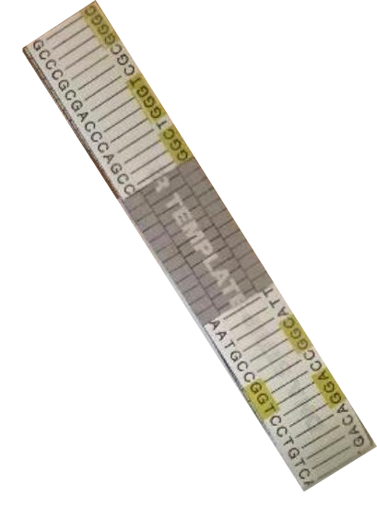
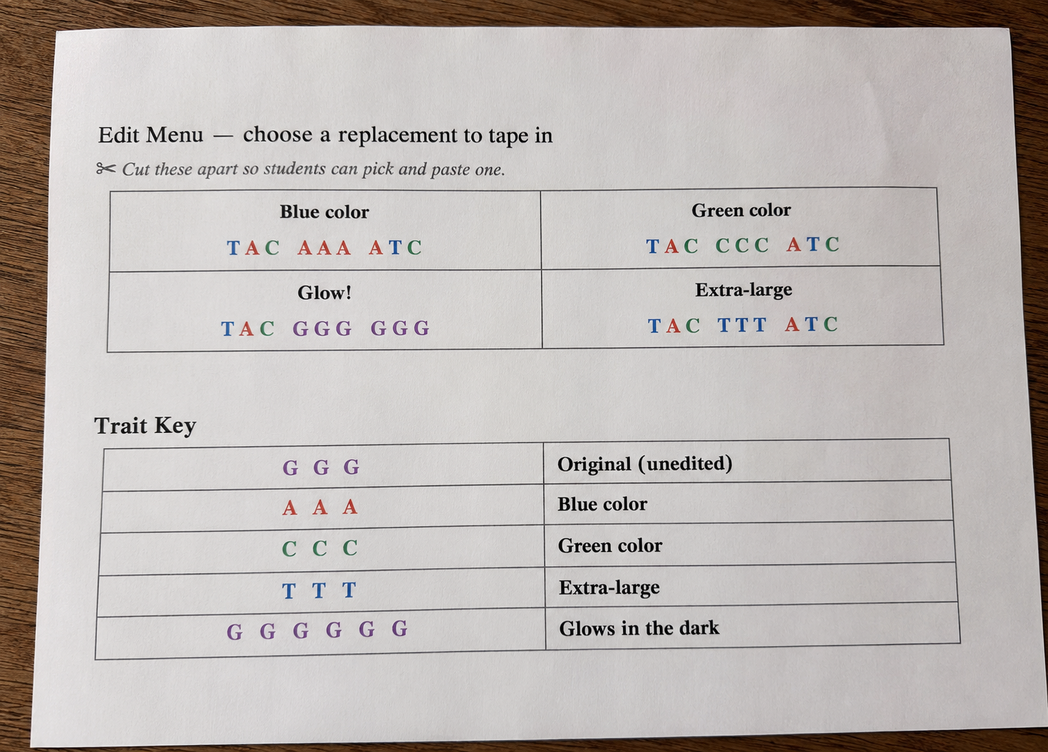

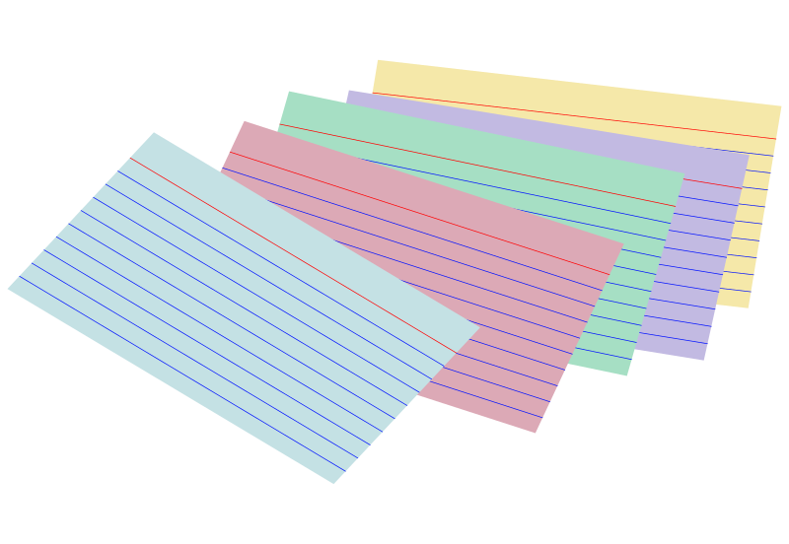
〰
Materials
〰
DNA Strips (printed)
Guide RNA Cards
Edit menu + trait key
Scissors and tape

Slide 4
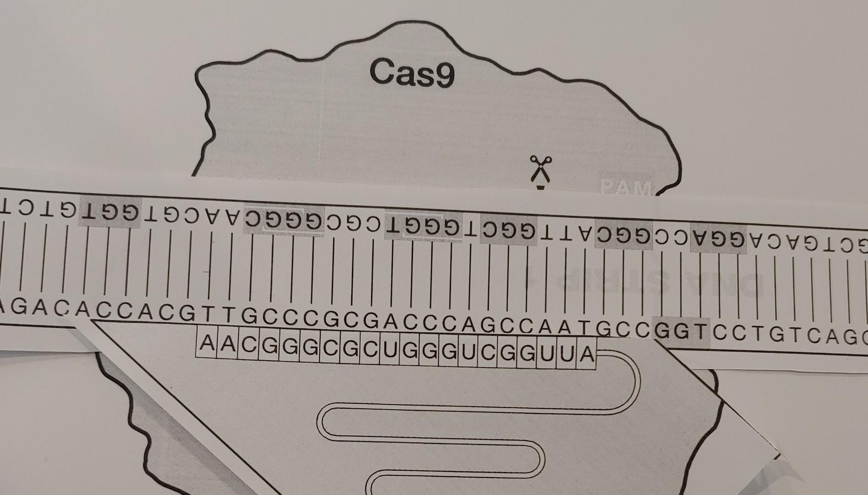
Step 1: Find your target
Your guide-RNA card shows a short target sequence (like GAT-TAC).​
Scan your DNA strip to find the one spot that matches.​
That match is where the edit will happen.​
Link to image
UChicago Genehackers

Slide 5

Step 2: Cut it out
Use scissors to cut out the matching target sequence.​
Only that spot, because the guide matched only there.​
This is the Cas9 “cut.”​
✂️

Slide 6
Step 3: Paste in a new gene
Pick a replacement sequence from the edit menu.​
Tape it into the gap you cut.​
Look it up on the trait key. Your edit changed the organism!​
Edit menu
Blue color
Green color
Glow!

Slide 7
CRISPR: how did this work?​
Why does Cas9 need a guide instead of cutting anywhere?​
The guide gives CRISPR its precision. It cuts only the matching spot.​
Cutting at random could damage the wrong gene.​
What could happen if TWO spots matched the guide?​
Both might get cut (an “off-target” edit).​
Avoiding off-target cuts is a real challenge scientists work on.​

Slide 8
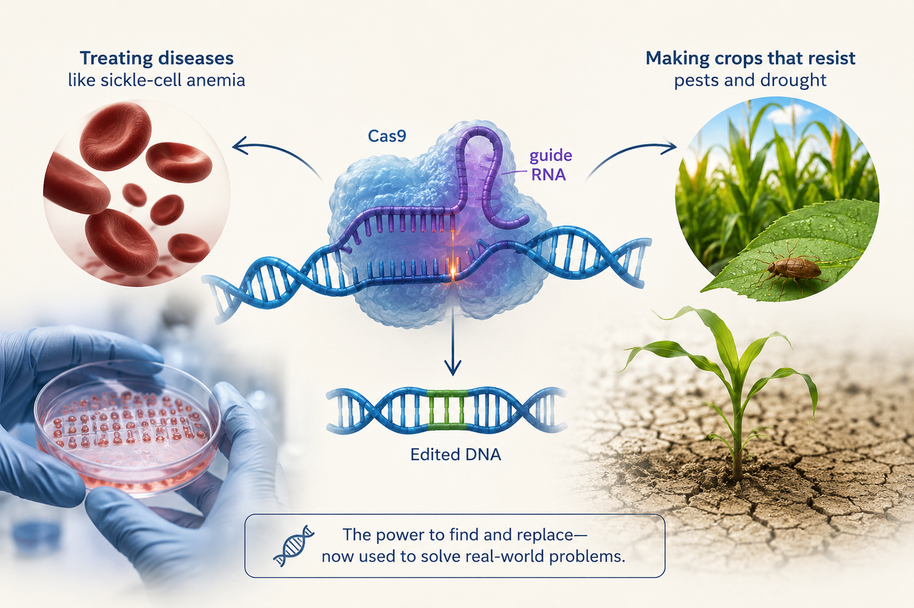
CRISPR in the real world
Some examples….
Treating diseases like sickle-cell anemia.​
Making crops that resist pests and drought.​
It is the same find-and-replace idea you just did, just inside real cells.​

Slide 9
Thank You!

