Slide 1
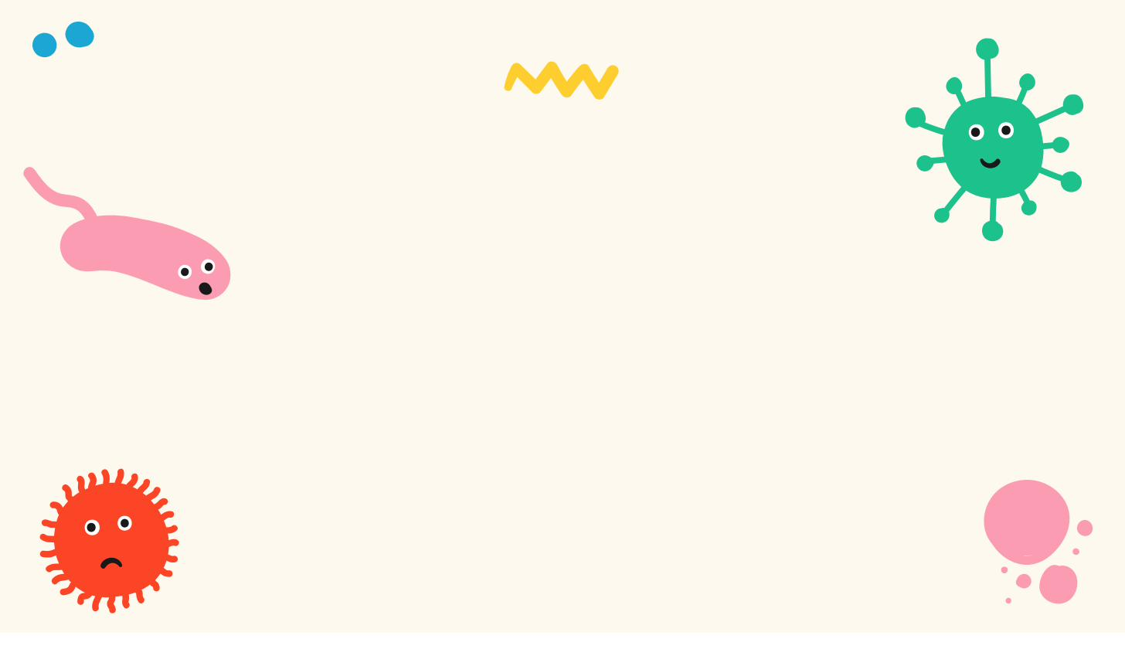
DNA Extraction
How can we get DNA out of cells?

Slide 2
〰
Materials
〰
🍓
🛍️
🧴
🧂
Strawberry
Resealable bag
Dish soap
Salt
🧪
☕
🥤
🥢
Rubbing alcohol (cold)
Coffee filter
Clear cup
Stirrer
UChicago Genehackers

Slide 3


Step 1: Smash the cells!
Pull off any green leaves.
Seal the strawberry in the bag and mash it for about two minutes.
Breaking cells open like this is called lysing.
🍓
UChicago Genehackers

Slide 4

Step 2: Prepare the extraction liquid
In a cup, mix: ½ cup water, 2 tsp dish soap, 1 tsp salt.
Stir gently — try not to make bubbles.
This is your DNA extraction liquid.
The recipe
½ cup water
2 tsp dish soap
1 tsp salt
UChicago Genehackers

Slide 5
Step 3: Chemically lyse the cells
Pour the extraction liquid into the bag with the mashed strawberry.
Gently mix for one more minute.
Soap breaks open the cell membranes; salt frees the DNA.
🧴
UChicago Genehackers

Slide 6
Step 4: Filter it
Place a coffee filter over a clear cup.
Pour the mixture through to catch the pulp.
Now only the liquid (with the DNA) is left.
☕
UChicago Genehackers

Slide 7
Step 5: Extract the DNA!
Slowly pour cold rubbing alcohol down the side of the cup — do not stir.
A white, cloudy layer appears: that is the DNA!
Spool it onto a stirrer to lift it out.
DNA appears!
UChicago Genehackers

Slide 8
DNA extraction: how did this work?
Why do we use dish soap and salt?
Cell membranes are made of fat, and soap breaks down fat — opening the cells.
Salt helps separate the DNA from the proteins around it.
Why does the alcohol make the DNA appear?
DNA can’t dissolve in alcohol, so it clumps together and becomes visible.
Getting DNA out like this is the first step of every real engineering project.
UChicago Genehackers

Slide 9
Thank You!

