Slide 1
Build-a-DNA
Double Helix
Can you build the twisted ladder of life?

Slide 2


What does DNA look like?
We know DNA is a four-letter code, but what shape is it?
DNA is a double helix: a twisted ladder.
The two sides are the backbone; the rungs are pairs of letters.
a twisted ladder

Slide 3

The pairing rule
Each rung of the ladder is a pair of bases.
The rule you will discover: A always pairs with T.
And C always pairs with G.
This matching is how DNA copies itself and also how scientists write new DNA.
Always pairs
A
—
T
C
—
G

Slide 4
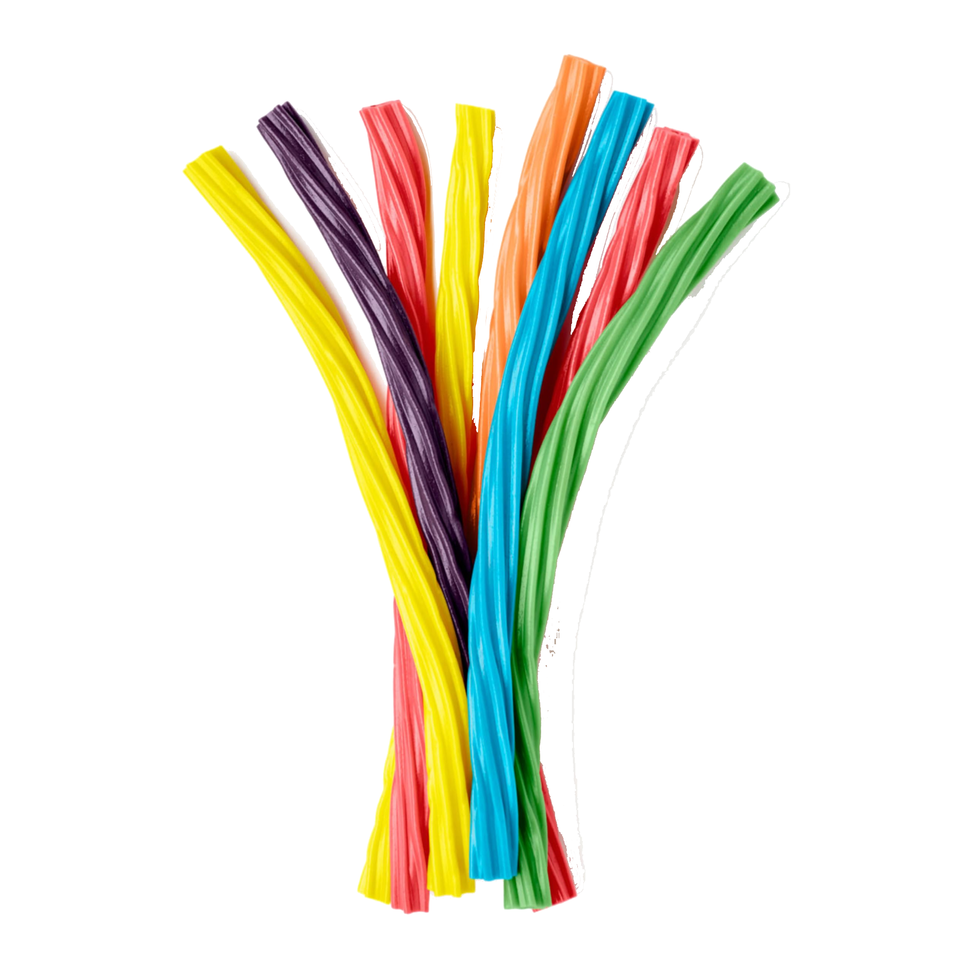
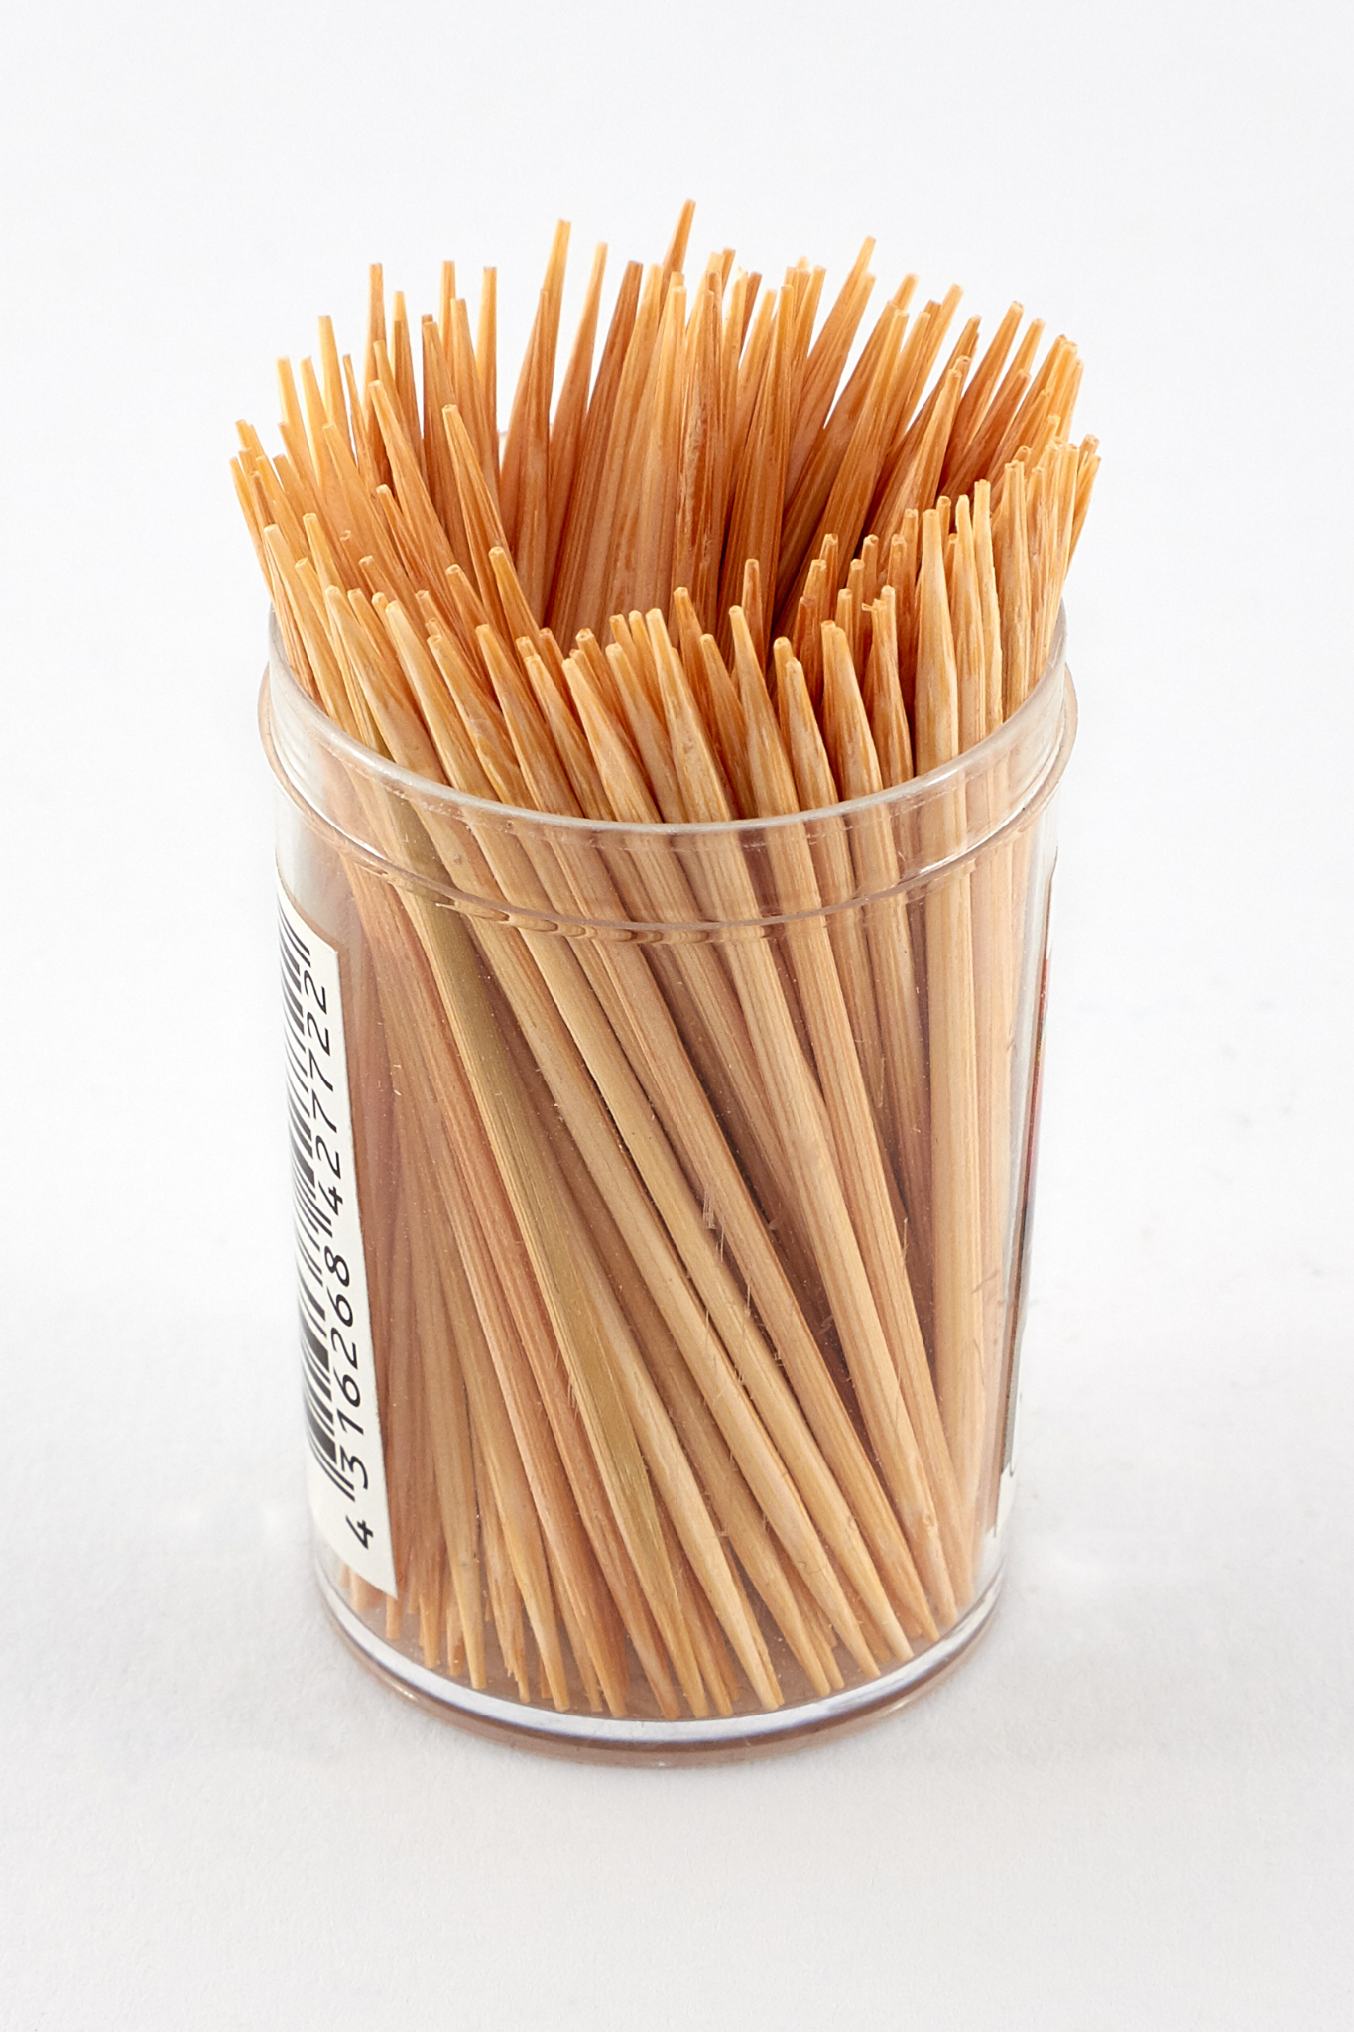
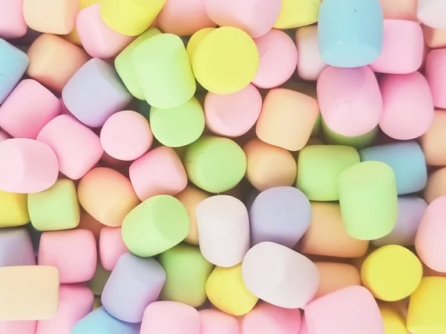

〰
Materials
〰
Gummies or marshmallows (4 colors) — bases
Licorice/Twizzlers (2 colors) - backbone
Toothpicks - rungs
Paper plate - work surface

Slide 5
Step 1: Lay out the two backbones
Place two pieces of licorice side by side on your plate.
These are the two rails of your DNA ladder.
UChicago Genehackers

Slide 6
Step 2: Add the base pairs
Pick a colored base for one rail.
Find the ONE base that pairs with it (A-T, C-G).
Push a toothpick through the pair to connect the rails.
Repeat for several rungs
Use the rule
A
+
T
C
+
G

Slide 7
Step 3: Twist it into a helix
Once you have several rungs, gently twist the ladder.
You just built a DNA double helix!
Compare with a friend. Did you both follow the pairing rule?

Slide 8
Double helix: how did this work?
What base pairs with A? What pairs with C?
A always pairs with T, and C always pairs with G.
There are only two kinds of rungs in all of DNA.
Why does this pairing let DNA copy itself?
If you unzip the ladder, each side is a template.
The pairing rule rebuilds the missing half perfectly. This is also how scientists synthesize new DNA.

Slide 9
Thank You!

