Slide 1
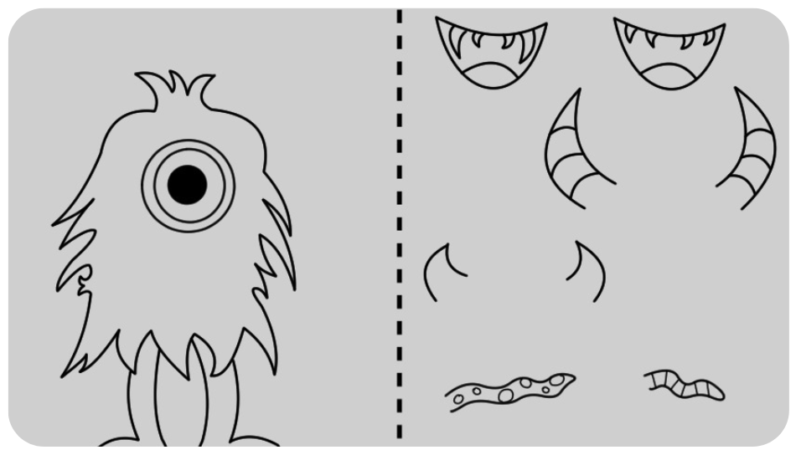
Monster
Making
Activity

Slide 2
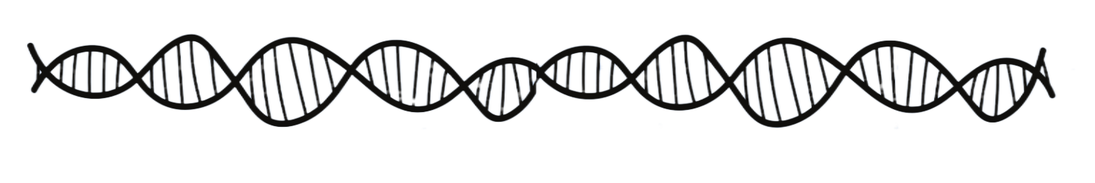
Background: DNA!
- Recap:
DNA is made of long strands, which we can break down into segments
A long segment of DNA codes for a protein, which in turn codes for a trait
So, genes are like recipes for how you look
HAIR
EYES
TEETH

Slide 3
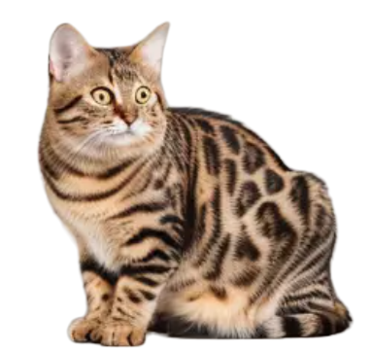

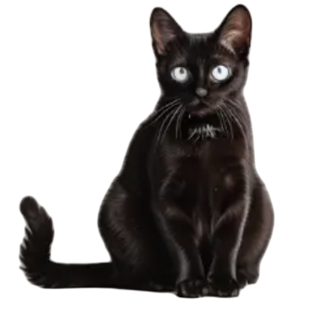
Spot the Difference!

Slide 4
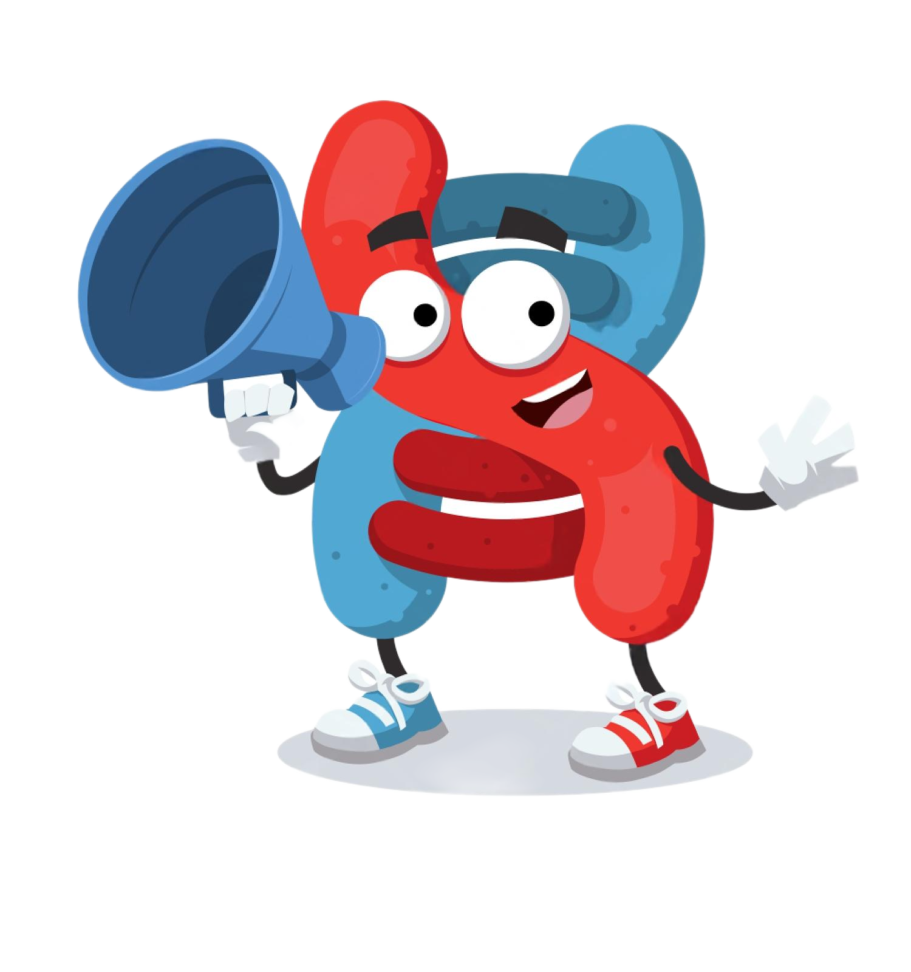
Remember this guy?
- As we mentioned, the dna is made up of 2 ribbons
- For those 2 ribbons to connect, their building blocks
need to fit together.
- Let’s see how! →

Slide 5
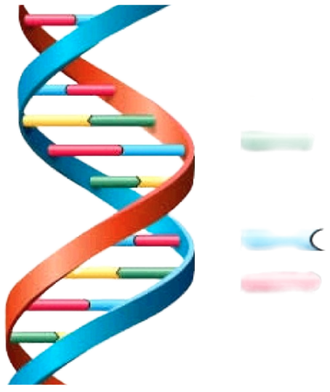
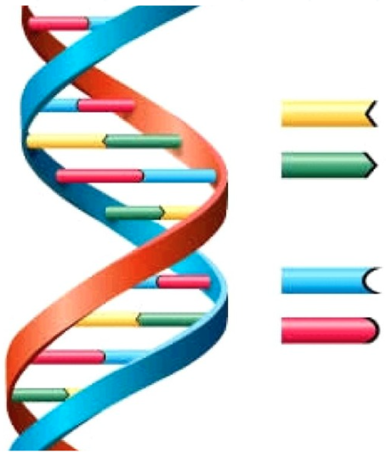
Pairing
The A base (yellow) pairs up with the T base (green)
and the C base (blue) pairs up with the G base (red)
A
T
C
G

Slide 6
Monster
Making
Can you make a monster from a recipe?

Slide 7
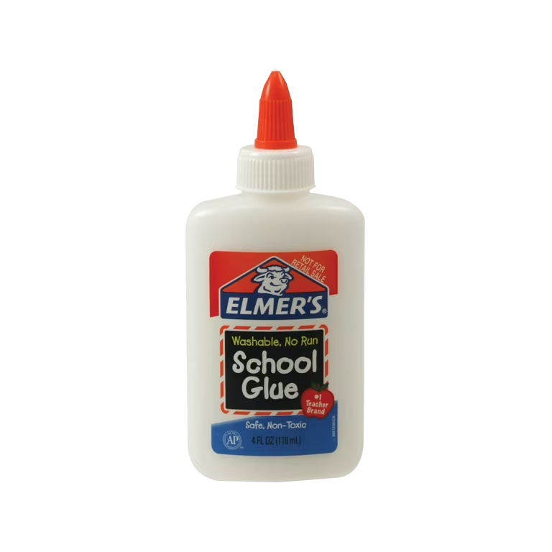
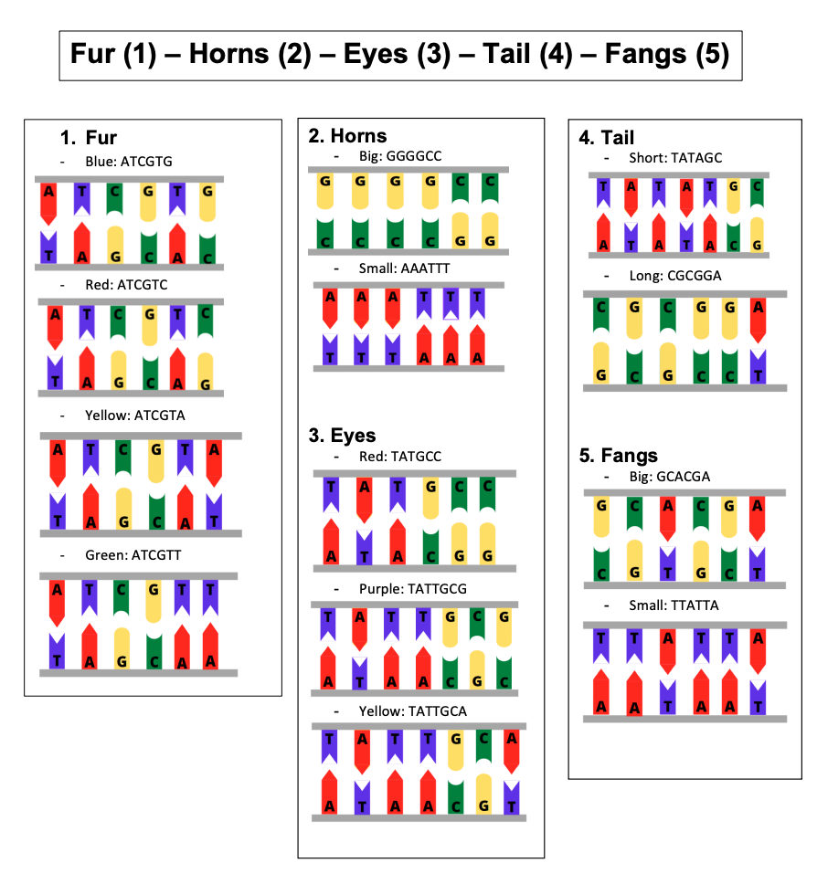
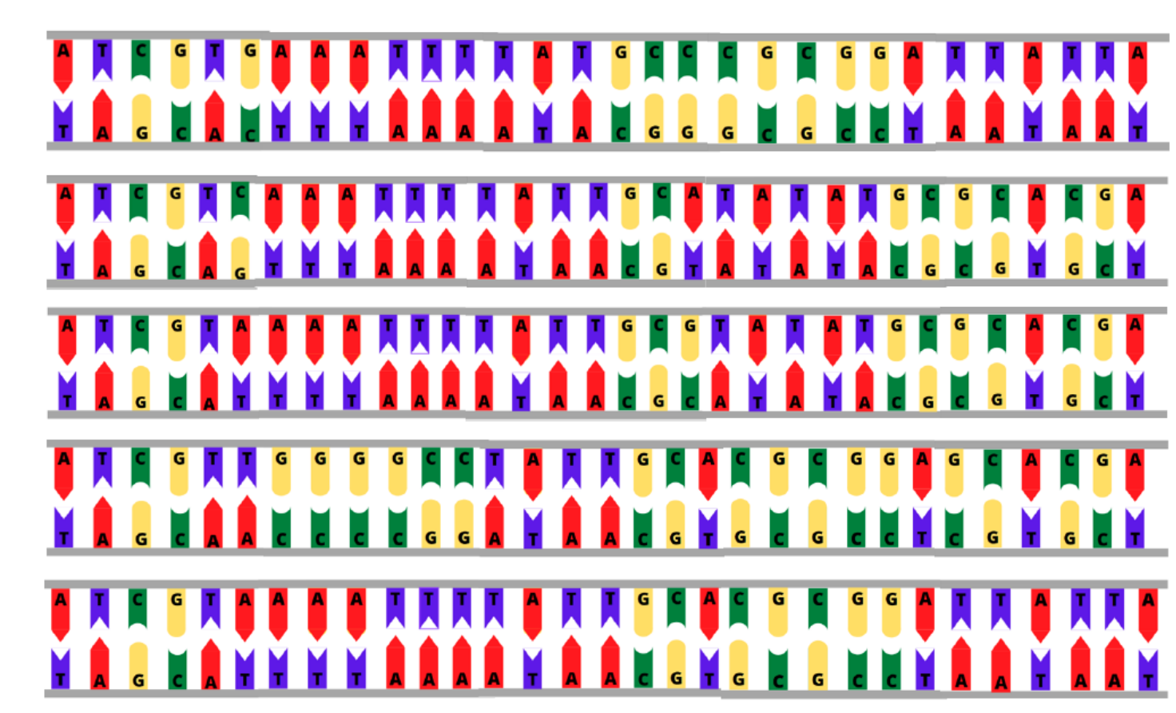
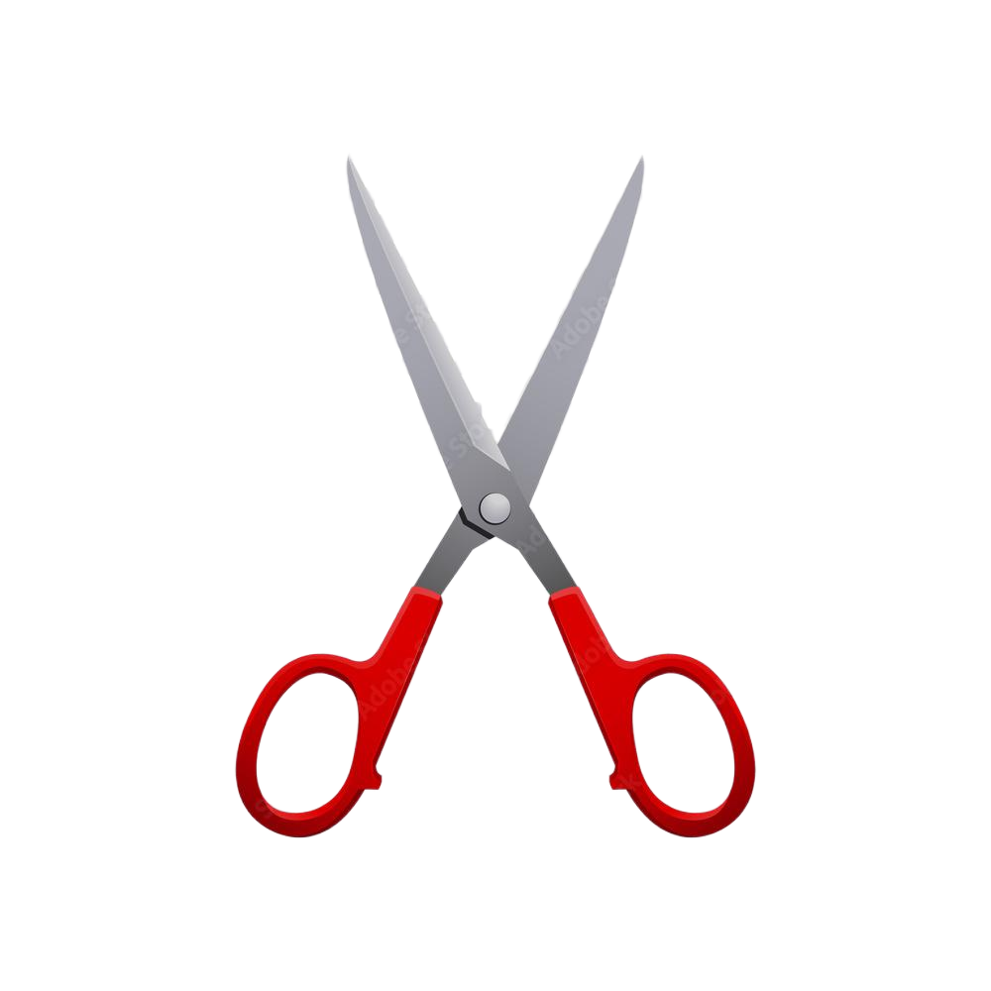
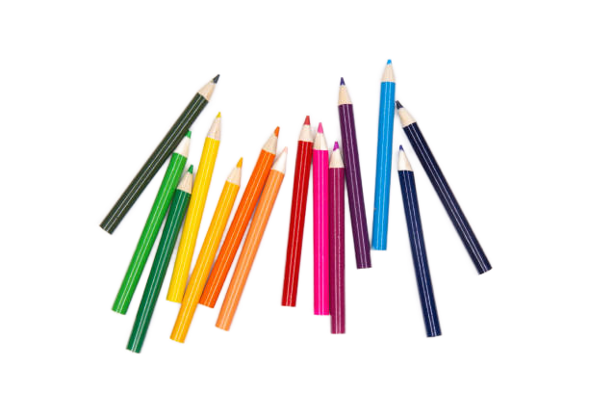
Materials
Gene sequences
Rubric

Slide 8
Game Plan
1
2
You will get a recipe and materials to make your own monster
This recipe will tell you the colour of the fur and eyes and the size of the teeth, horns and the tail.

Slide 9
Game Plan
Match up the patterns on your sequence to the cheat sheet to figure out which traits your monster should have!
Notes:
Pause and do activity

Slide 10
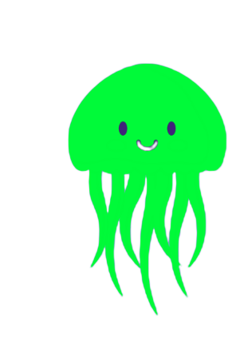
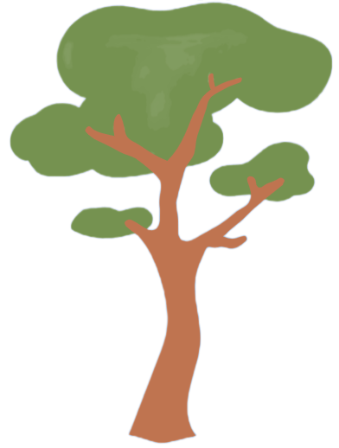
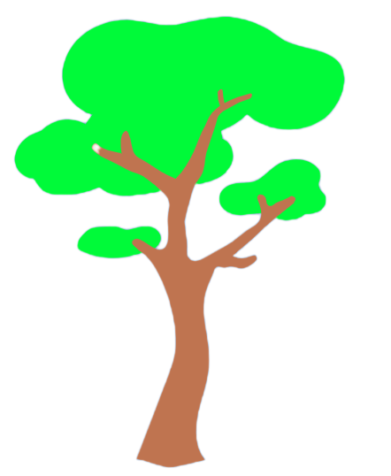


Synthetic Biology
We can add or remove certain genes from the DNA to change a living thing
Neon jellyfish
Boring tree
Cool neon tree

Slide 11
Game Plan
Now, find a partner and decide on a part of your monster to swap (for example, your monster’s eye color or horn size)
Find the specific gene that codes for this trait in your sequence and cut it out. Swap it with your partner and glue it onto your sequence
Now you have a whole new monster!
Notes:
Pause and do activity

Slide 12
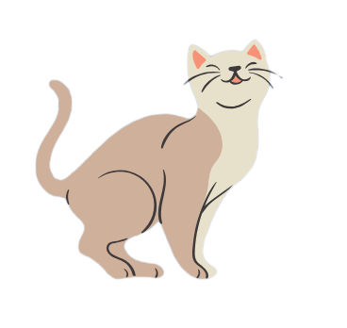
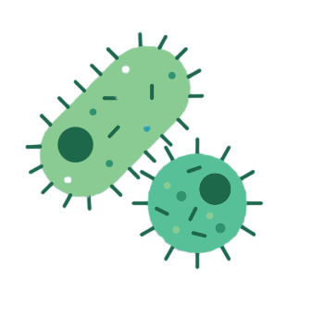
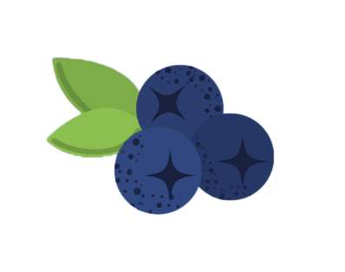
Now you can see …
By changing the DNA sequence, you made a custom monster based on what you wanted it to look like
That is exactly what synthetic biologists do. They change plant, animal, and bacterial DNA to give them a new function.

Slide 13
Thank You!

