Slide 1

Selenium Script Runner
Burcu ERGUN ,Gökçe Ekin NEHAS
CENG552 Final Project
08.01.2018
Computer Science Department

Slide 2
Outline
Motivation
Selenium Usage Area Our Test Environment
Selenium Script Runner
Sample Test Case
Conclusions

Slide 3
Motivations of The Project
Our QA Test Group doing embedded systems black-box testing.
We have large scale Product variations. So we need reusable test modules for covere all different product testing.

Slide 4
Selenium Usage Area
We use selenium for testing Wireless Access Point(WAP) WEB UI testing.
But we have also more Web UI except WAP Web UI.
For example cloud Web UI, power adapter Web UI etc.
And we need generic selenium runner system with our test automation system.

Slide 5
Selenium Usage Area
We also test for each WAP these web UI
Our each WAP connected to a virtual PC and we run the selenium these PC.
We have 4 test house and each test house has more than 20 WAP test setup.
So we need dynamic system for running test all PC same time with different inputs.

Slide 6
Selenium Script Runner
Selenium Script runner is provide user flexible usage for the all web sites testing and managing.
It is a simple jar file which has inputs WebUI map, test step list, web address.
We have script for copy the jar files all the PC.

Slide 7
Selenium Script Runner Input Files
Selenium Script runner has three input files
Web Link File
Mapping file
Test Step List file

Slide 8
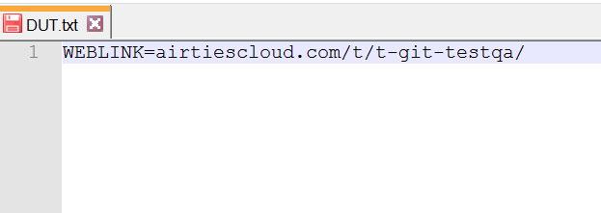
Web Link File
Web Link file is defining beginning of the URL
WebLink File
It is input variable for test case and it automatically writing to the text fle while test is running

Slide 9
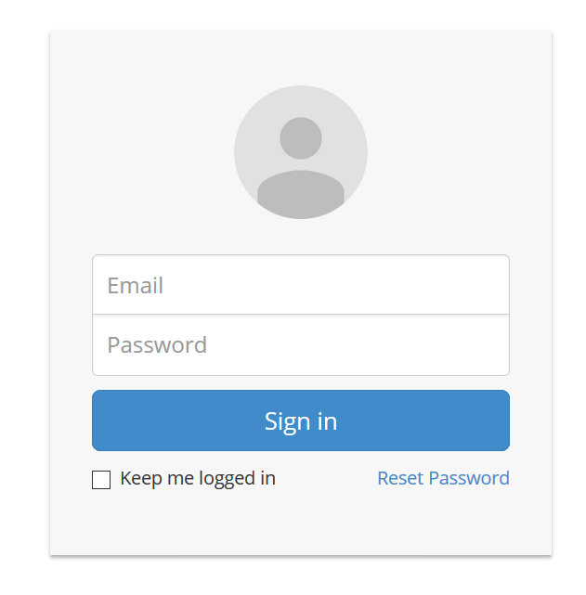
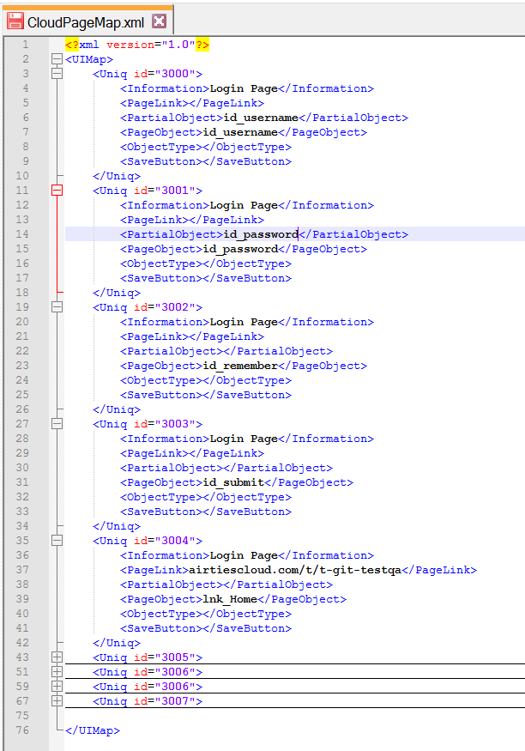
Mapping File
Mapping file is defining of the Web UI elements. It is xml file.
All page items has ID. <PageObject> tag define object ID or Xpath.
We use this <uniq id> for defining test steps.

Slide 10
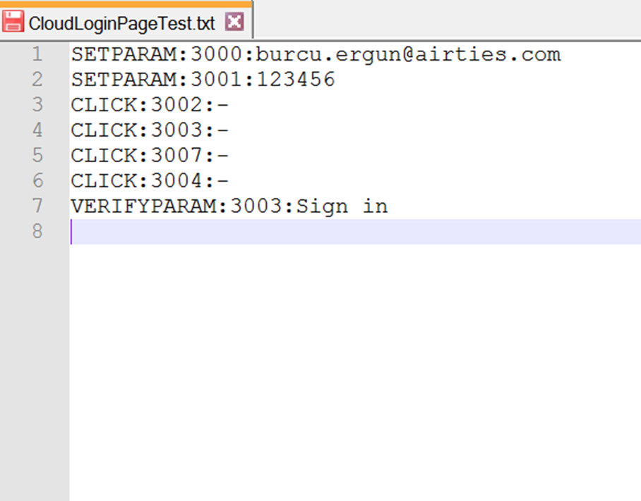
Test Step List File
Test Step List operations are given as input to tes case.
Operations are wiriting a text file and send related directory automatically.
Usage is like this
Operations list
CLICK
SETPARAM
VERIFYPARAM
VERIFYOBJECT

Slide 11
Test Step List File

Slide 12
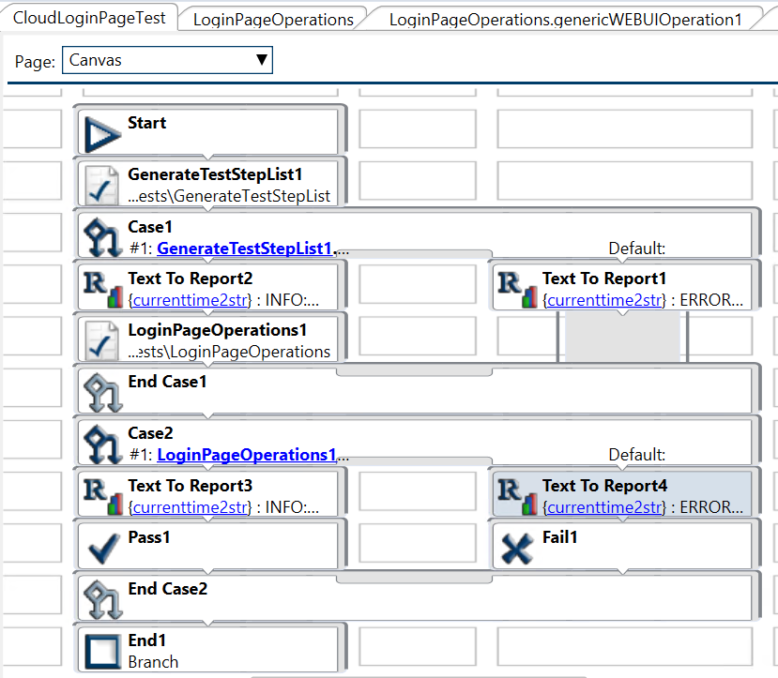
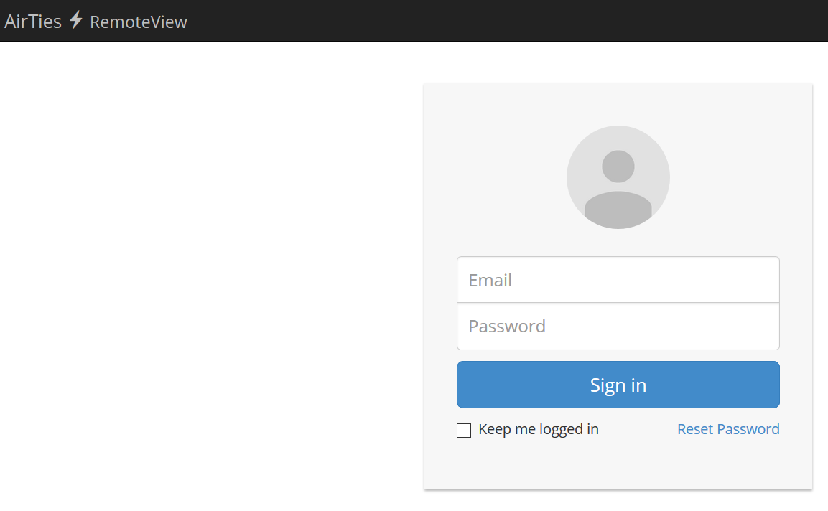
Sample Test Case For Cloud WEBUI
Sample Cloud Login Operations Test Case. Test operations sequence give GenerateTestStepList1 module as input string. And then writing a text file from this module sending related directory
Notes:
The test model can be considered
as a reference test model2 in the sense that it captures all
possible usage scenarios for a family of systems

Slide 13
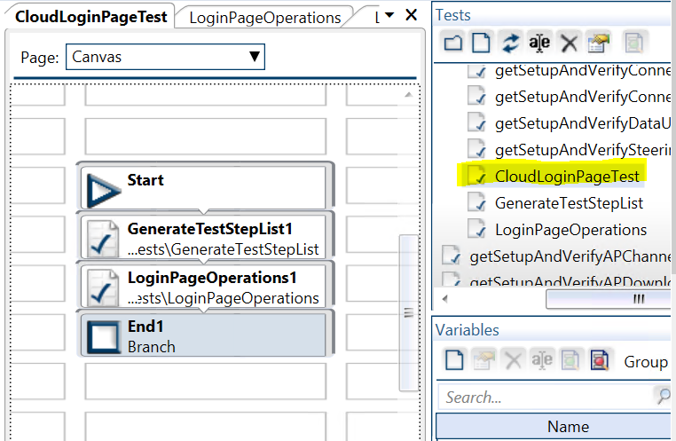
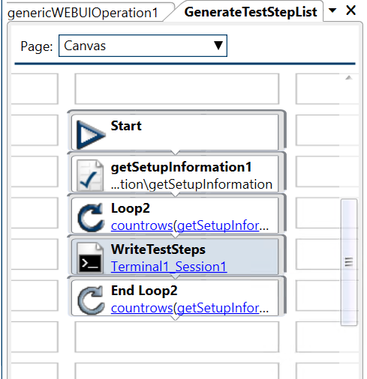
Test Case Preparation(1)
Generate Test Step List
Setup Information
Generate Test Step List : TestStep.txt is generated and send given directory in this module. Ssh connection is done to virtual PC, file created to given directory which we run our .jar file.
Setup Information : Return PC list as output from this module. And loop count is equal to PC count.
Notes:
The test model can be considered
as a reference test model2 in the sense that it captures all
possible usage scenarios for a family of systems

Slide 14
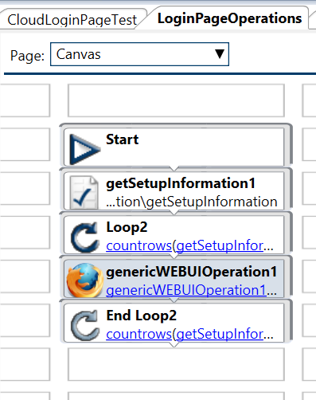
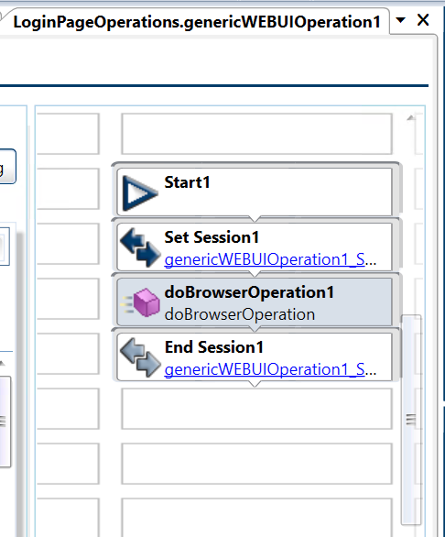
Test Case Preparation(2)
Library function
Test Automation System Library
We integrated our jar file doBrowserOperation. Running jar file operation is done by this function.
Notes:
The test model can be considered
as a reference test model2 in the sense that it captures all
possible usage scenarios for a family of systems

Slide 15
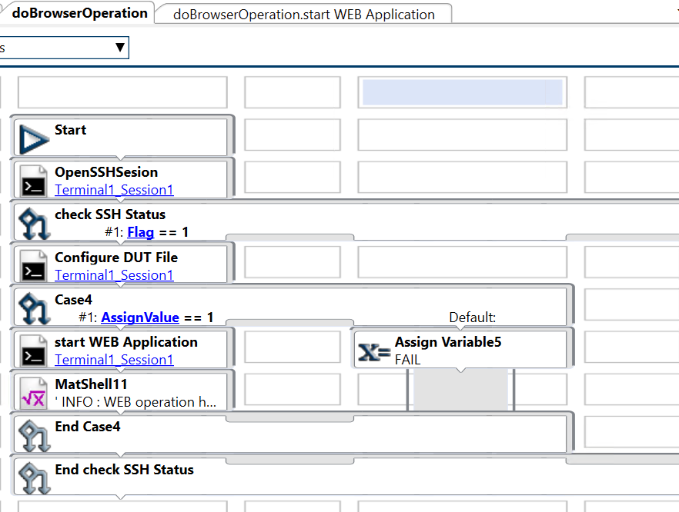
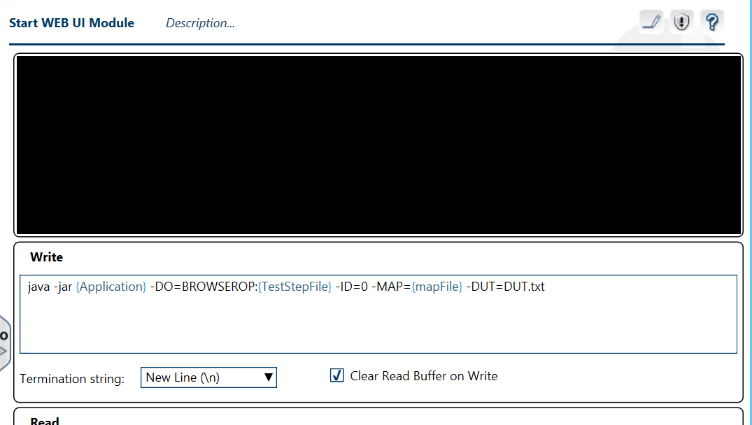
Test Case Preparation(2)
Jar file running here with given input.
SSH start here given PC IP
Notes:
The test model can be considered
as a reference test model2 in the sense that it captures all
possible usage scenarios for a family of systems

Slide 16
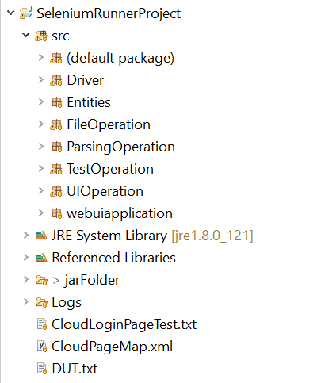
Selenium Scripts Runner Source Code
Junit Test Class Package
Log operation during testing
Map of the web ui xml file pars operation
Arguments take and operation select
UI operations classes
Program Main
Jar file folder with sample input files

Slide 17
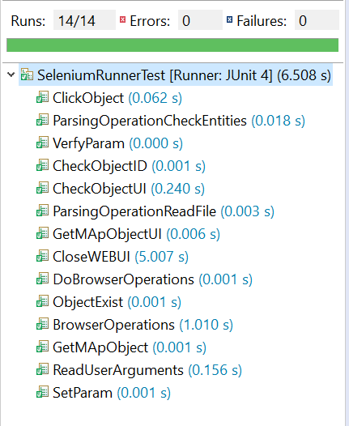
Selenium Scripts Runner Source Junit Tests

Slide 18
Conclusion
GenerateTestStepList and getSetupInformation modules can use for all test cases.
We just give these inputs for run test, operations list and web link adress and mapping.
Mapping is one time effort for the each different web address.
We can create lots of different scenario with mapping ID’s.
When test login scenario for different web link we need the change just map file.
Notes:
The test model can be considered
as a reference test model2 in the sense that it captures all
possible usage scenarios for a family of systems

