Slide 1

Selenium Script Runner
Burcu ERGUN ,Gökçe Ekin NEHAS
CENG552 Final Project
08.01.2018
Computer Science Department

Slide 2
Outline
Motivation
Selenium Usage Area; Our Test Environment
Selenium Script Runner
Sample Test Case
Conclusions

Slide 3
Motivations of The Project
Our QA Test Group doing embedded systems black-box testing.
We have a large scale of Product variations, so we need reusable test modules in order to cover all different product testing without giving any manual effort.

Slide 4
Selenium Usage Area
We use selenium to test Wireless Access Point(WAP) WEB UI.
But we also have different Web UIs except WAP Web UI.
For example; cloud Web UI, power adapter Web UI etc.
And we need generic selenium runner system supported by our test automation system.

Slide 5
Selenium Usage Area
We also have tests for each WAP on these web UIs
Our each WAP is connected to a virtual PC, and we run the selenium on these PCs.
We have 4 test houses, and each test house has more than 20 WAP test setup.
So we need a dynamic system to run the the test on all PCs at the same time, with different inputs.

Slide 6
Selenium Script Runner
Selenium Script runner provides flexible usage for all web sites to test and manage.
It is a simple jar file which has inputs as WebUI map, test step list, and web address.
We have below script to copy the jar files all to the PC.

Slide 7
Selenium Script Runner Input Files
Selenium Script runner has three input files
Web Link File
Mapping file
Test Step List file

Slide 8
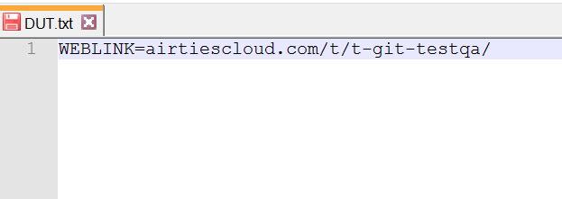
Web Link File
Web Link file defines the beginning of URL
WebLink File
It is a input variable for test case, and it automatically writes to the text file while the test is running.

Slide 9
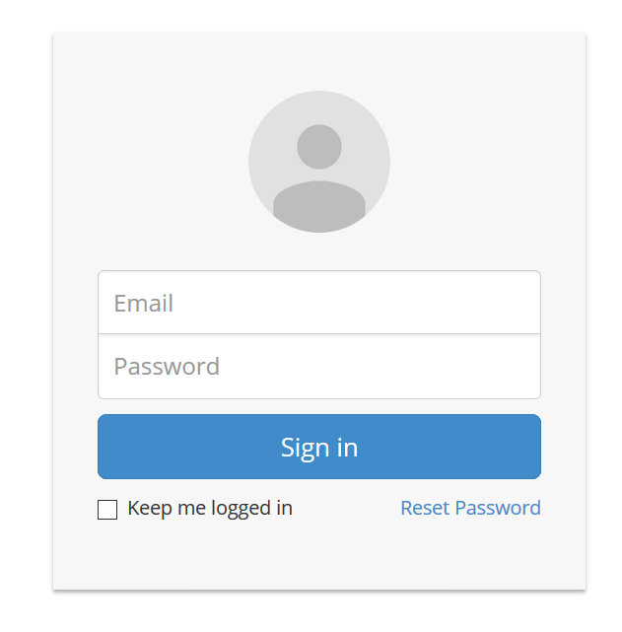
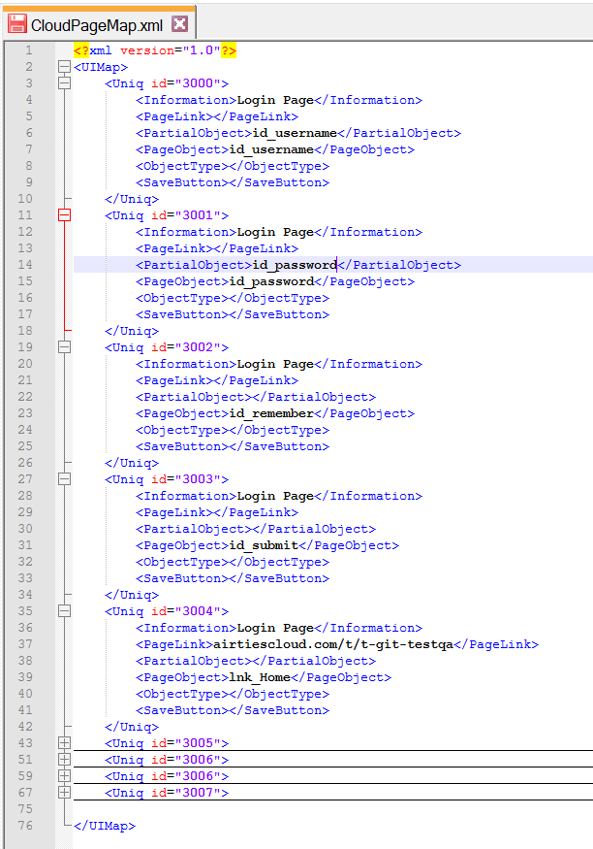
Mapping File
Mapping file is defines Web UI elements. It is xml file.
All page items have an ID. <PageObject> tag defines object ID or Xpath.
We use this <uniq id> for defining test steps.

Slide 10
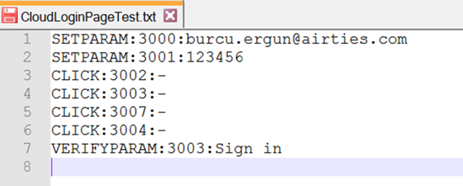
Test Step List File
Test Step List operations are given as input to test case.
Operations are written into a text file and send to the related directory automatically.
Usage is like this
Operations list
CLICK
SETPARAM
VERIFYPARAM
VERIFYOBJECT

Slide 11

Test Step List File

Slide 12
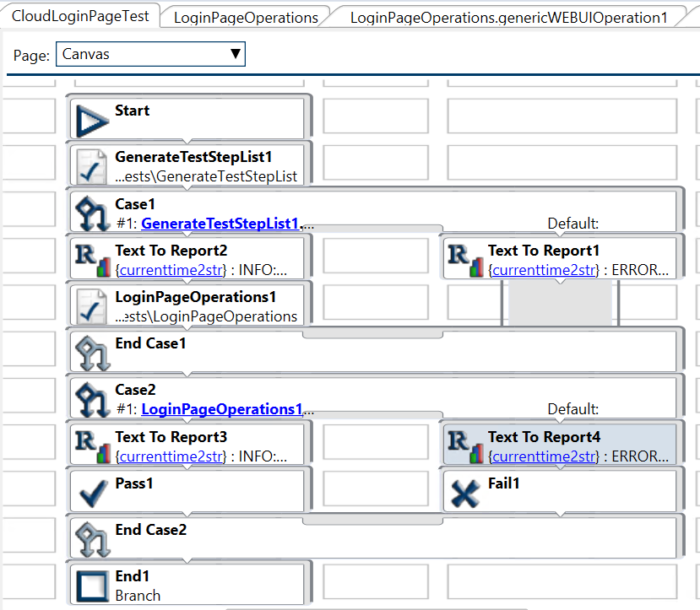
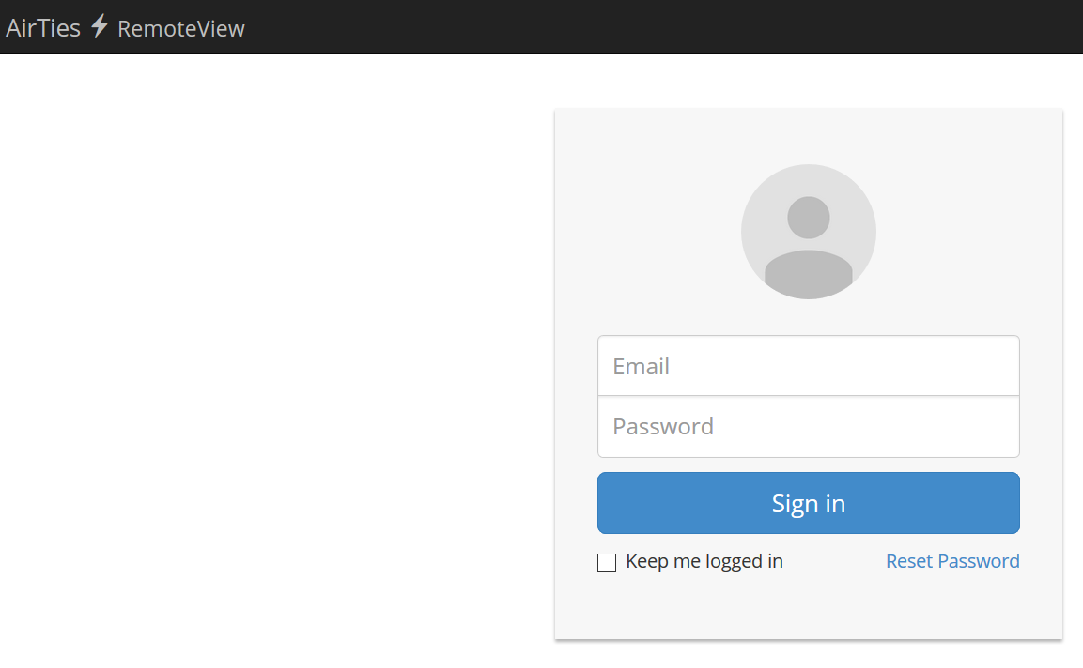
Sample Test Case For Cloud WEBUI
Sample Cloud Login Operations Test Case; Test operations sequence give GenerateTestStepList1 module as an input string, then writes to a text file from this modüle, and sends to the related directory
Notes:
The test model can be considered
as a reference test model2 in the sense that it captures all
possible usage scenarios for a family of systems

Slide 13
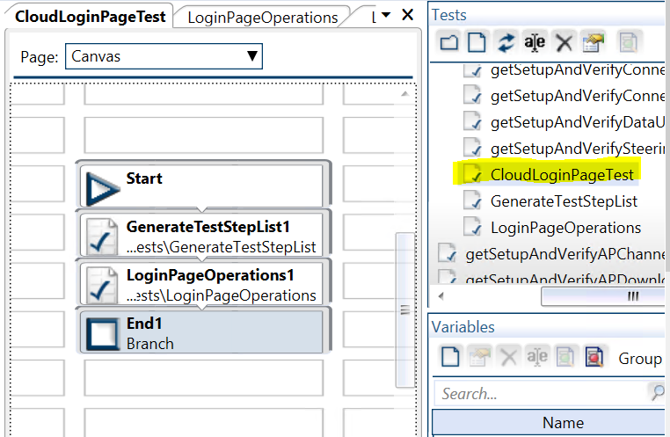
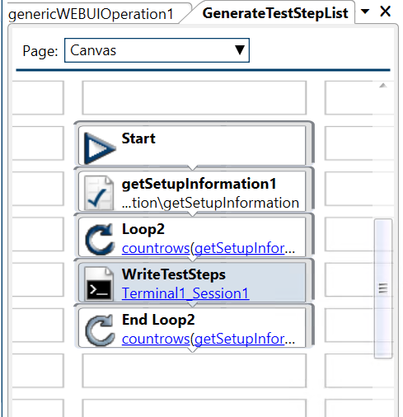
Test Case Preparation(1)
Generate Test Step List
Setup Information
Generate Test Step List : TestStep.txt is generated and sent to the given directory in the module. Ssh connection is done to virtual PC, a file is created to given directory, which we run our .jar file.
Setup Information : Return PC list as output from this module. And loop count is equal to PC count.
Notes:
The test model can be considered
as a reference test model2 in the sense that it captures all
possible usage scenarios for a family of systems

Slide 14
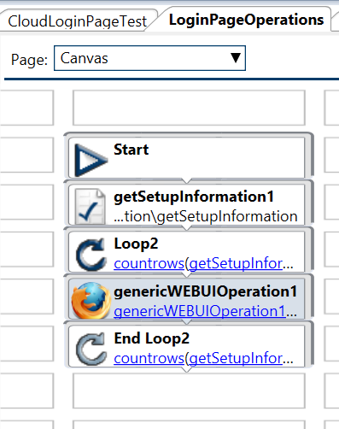
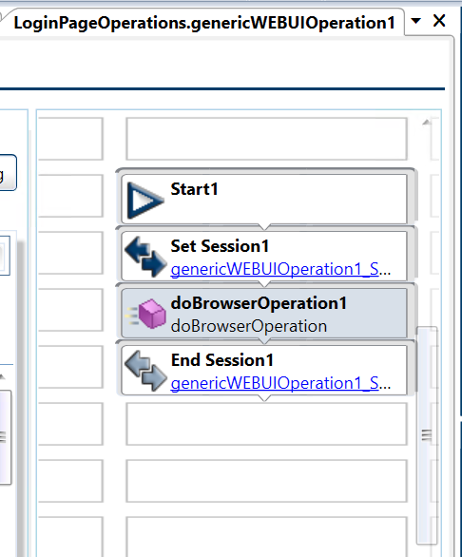
Test Case Preparation(2)
Library function
Test Automation System Library
We integrate our jar file as doBrowserOperation. Running jar file operation is done by this function.
Notes:
The test model can be considered
as a reference test model2 in the sense that it captures all
possible usage scenarios for a family of systems

Slide 15
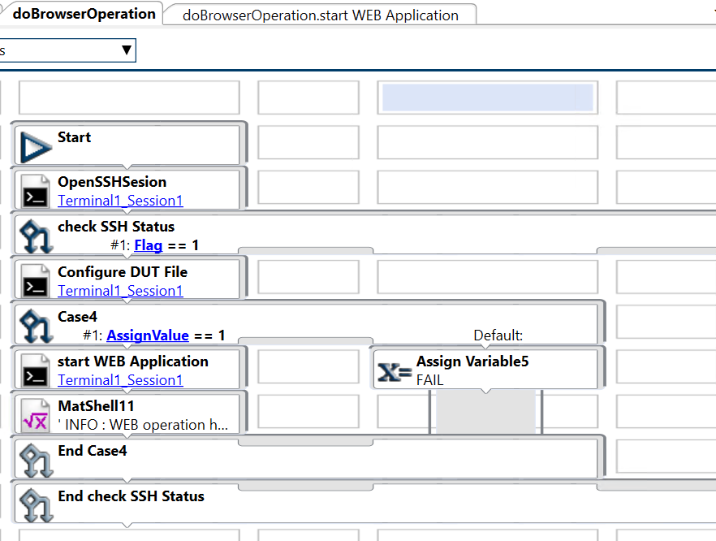
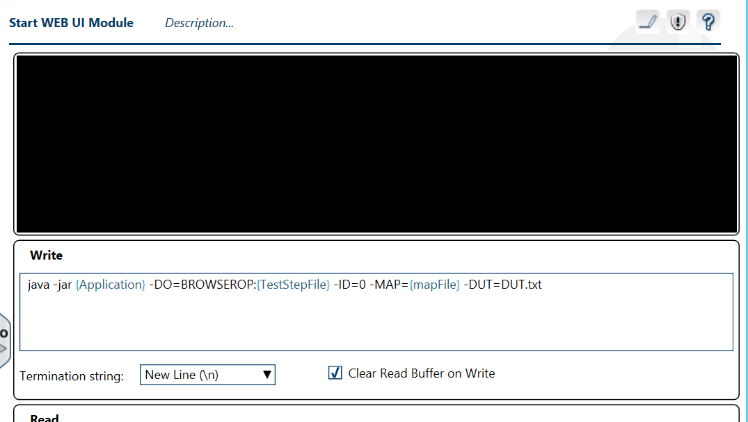
Test Case Preparation(2)
Jar file running here with given input.
SSH start here given PC IP
Notes:
The test model can be considered
as a reference test model2 in the sense that it captures all
possible usage scenarios for a family of systems

Slide 16
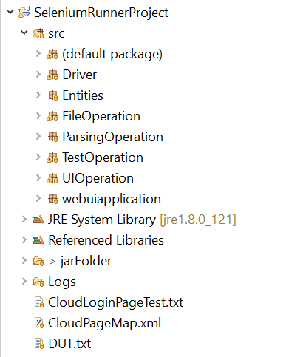
Selenium Scripts Runner Source Code
Junit Test Class Package
Log operation during testing
Map of the web ui xml file parse operation
Arguments taken and operation selected
UI operations classes
Program Main
Jar file folder with sample input files

Slide 17
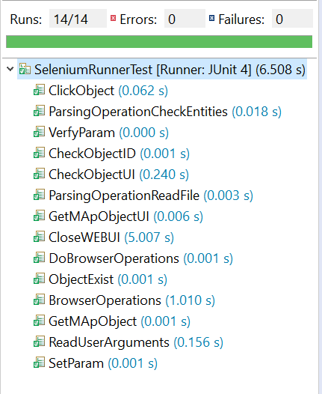
Selenium Scripts Runner Source Junit Tests

Slide 18
Conclusion
GenerateTestStepList and getSetupInformation modules can be used for all test cases.
We just give these inputs to run the test; operations list, web link address, and mapping.
The only time effort is mapping for each different web address.
We can create lots of different scenarios with mapping IDs.
When we need a test login scenario for a different web link, we only need to change the map file, and the web link address.
Notes:
The test model can be considered
as a reference test model2 in the sense that it captures all
possible usage scenarios for a family of systems

