Slide 1
Open API

Slide 2
springdoc-openapi
https://springdoc.org/#migrating-from-springfox

Slide 3
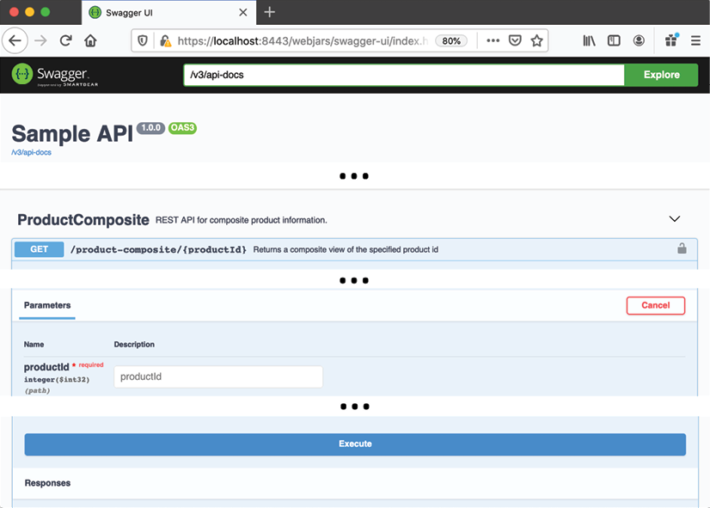
Swagger UI

Slide 4
Configuration
(api project)
implementation 'org.springdoc:springdoc-openapi-common:1.5.9’
(product-composite-service)
implementation 'org.springdoc:springdoc-openapi-webflux-ui:1.5.9'

Slide 5
OpenAPI bean in product-composite-service
The name, description, version, and contact information for the API
Terms of usage and license information
Links to external information regarding the API
@Bean
public OpenAPI getOpenApiDocumentation() {
return new OpenAPI()
.info(new Info().title(apiTitle)
.description(apiDescription)
.version(apiVersion)
.contact(new Contact()
.name(apiContactName)
.url(apiContactUrl)
.email(apiContactEmail))
.termsOfService(apiTermsOfService)
.license(new License()
.name(apiLicense)
.url(apiLicenseUrl)))
.externalDocs(new ExternalDocumentation()
.description(apiExternalDocDesc)
.url(apiExternalDocUrl));
}

Slide 6
application.yml
springdoc.swagger-ui.path and springdoc.api-docs.path
springdoc.packagesToScan and springdoc.pathsToMatch

Slide 7
API-specific documentation to the ProductCompositeService interface
@Operation and @ApiResponse annotations
@RestControllerAdvice and @ExceptionHandler
@Tag: The documentation of the API on the resource level

Slide 8
Building and running
cd $PROJ_HOME/4-openapi
./gradlew clean build && docker-compose build && docker-compose up -d
docker ps --format {{.Names}}
./test-em-all.bash

Slide 9
Testing
http://localhost:8080/openapi/swagger-ui.html
http://localhost:8080/openapi/v3/api-docs
curl -X GET "http://localhost:8080/product-composite/123" -H "accept: application/json"

