Slide 1
Persistence

Slide 2
Persistence setup
The standard ports used: 3306 for MySQL and 27017 for MongoDB
The product and recommendation microservices will use Spring Data for MongoDB
The review microservice will use Spring Data for the JPA to access a MySQL database

Slide 3
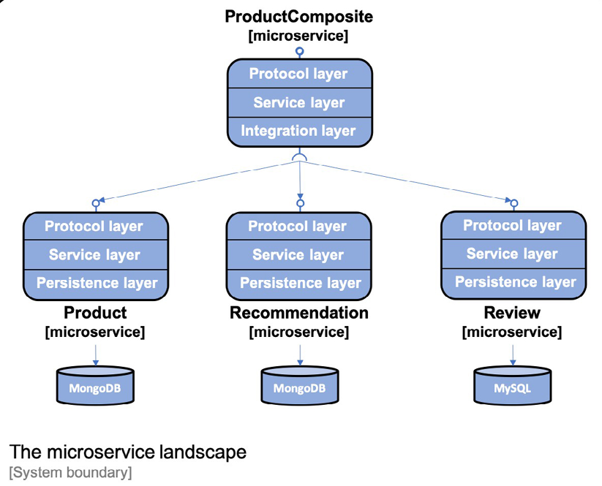
Layers

Slide 4
Access data stored in MongoDB and MySQL
docker-compose exec mongodb mongo product-db --quiet --eval "db.products.find()”
docker-compose exec mysql mysql -uuser -p review-db -e "select * from reviews"

Slide 5
MapStruct, Spring Data, and the JDBC drivers in core services
MapStruct generates the implementation of the bean mappings at compile time by processing MapStruct annotations
ext {
mapstructVersion = "1.3.1"
}
implementation "org.mapstruct:mapstruct:${mapstructVersion}"
annotationProcessor "org.mapstruct:mapstruct-processor:${mapstructVersion}"
testAnnotationProcessor "org.mapstruct:mapstruct-processor:${mapstructVersion}"
compileOnly "org.mapstruct:mapstruct-processor:${mapstructVersion}"
implementation 'org.springframework.boot:spring-boot-starter-data-mongodb'
implementation 'org.springframework.boot:spring-boot-starter-data-jpa'
implementation 'mysql:mysql-connector-java'

Slide 6
Testcontainers for automated integration tests
implementation platform('org.testcontainers:testcontainers-bom:1.15.2')
testImplementation 'org.testcontainers:testcontainers'
testImplementation 'org.testcontainers:junit-jupiter'
testImplementation 'org.testcontainers:mongodb'
implementation platform('org.testcontainers:testcontainers-bom:1.15.2')
testImplementation 'org.testcontainers:testcontainers'
testImplementation 'org.testcontainers:junit-jupiter'
testImplementation 'org.testcontainers:mysql'

Slide 7
ProductEntity, RecommendationEntity and ReviewEntity
MongoDB:
The @Document(collection = "products") annotation is mapped to a collection in MongoDB with the name products.
The @Id and @Version annotations are used to mark the id and version fields to be used by Spring Data
The @Indexed(unique = true) annotation is used to get a unique index created for the business key, productid
MySQL:
The @Entity and @Table annotations are mapped to a table in a SQL database with the name reviews.
The @Table annotation is also used to specify that a unique compound index will be created for the compound business key
The @Id and @Version annotations are used to mark the id and version fields
To direct Spring Data for JPA to automatically generate unique id values for the id field, we are using the @GeneratedValue annotation

Slide 8
Repositories
The CrudRepository base class provides standard methods for performing basic create, read, update, and delete operations on the data stored in the databases
The PagingAndSortingRepository base class adds support for paging and sorting to the CrudRepository base class

Slide 9
Transactional
public interface ReviewRepository extends CrudRepository<ReviewEntity, Integer> {
@Transactional(readOnly = true)
List<ReviewEntity> findByProductId(int productId);
}

Slide 10
Automated tests
@DataMongoTest: This annotation starts up a MongoDB database when the test starts.
@DataJpaTest: This annotation starts up a SQL database when the test starts.
Automatic rollback is disabled with the class level annotation @Transactional(propagation = NOT_SUPPORTED)

Slide 11
Testcontainers
https://www.testcontainers.org
Simplifies running automated integration tests by running resource managers like a database or a message broker as a Docker container
public abstract class MySqlTestBase {
private static MySQLContainer database =
new MySQLContainer("mysql:5.7.32");
static {
database.start();
}
@DynamicPropertySource
static void databaseProperties(DynamicPropertyRegistry registry) {
registry.add("spring.datasource.url", database::getJdbcUrl);
registry.add("spring.datasource.username", database::getUsername);
registry.add("spring.datasource.password", database::getPassword);
}
}
class PersistenceTests extends MySqlTestBase {
class ReviewServiceApplicationTests extends MySqlTestBase {

Slide 12
Optimistic locking mechanism
product-service PersistenceTests
@Test void optimisticLockError()

Slide 13
Sorting and paging
@Test
void paging() {
repository.deleteAll();
List<ProductEntity> newProducts = rangeClosed(1001, 1010)
.mapToObj(i -> new ProductEntity(i, "name " + i, i))
.collect(Collectors.toList());
repository.saveAll(newProducts);
Pageable nextPage = PageRequest.of(0, 4, ASC, "productId");
nextPage = testNextPage(nextPage, "[1001, 1002, 1003, 1004]",
true);
nextPage = testNextPage(nextPage, "[1005, 1006, 1007, 1008]",
true);
nextPage = testNextPage(nextPage, "[1009, 1010]", false);
}

Slide 14
Testing
cd $PROJ_HOME/5-persistence
./gradlew microservices:product-service:test --tests PersistenceTests

Slide 15
Logging the database connection URL
public class ProductServiceApplication {
private static final Logger LOG =
LoggerFactory.getLogger(ProductServiceApplication.class);
public static void main(String[] args) {
ConfigurableApplicationContext ctx =
SpringApplication.run(ProductServiceApplication.class, args);
String mongodDbHost =
ctx.getEnvironment().getProperty("spring.data.mongodb.host");
String mongodDbPort =
ctx.getEnvironment().getProperty("spring.data.mongodb.port");
LOG.info("Connected to MongoDb: " + mongodDbHost + ":" +
mongodDbPort);
}
}

Slide 16
Service layer
private final ServiceUtil serviceUtil;
private final ProductRepository repository;
private final ProductMapper mapper;
@Autowired
public ProductServiceImpl(ProductRepository repository, ProductMapper mapper, ServiceUtil serviceUtil) {
this.repository = repository;
this.mapper = mapper;
this.serviceUtil = serviceUtil;
}

Slide 17
Input validation
public Product getProduct(int productId) {
if (productId < 1) throw new InvalidInputException("Invalid
productId: " + productId);
ProductEntity entity = repository.findByProductId(productId)
.orElseThrow(() -> new NotFoundException("No product found for
productId: " + productId));
Product response = mapper.entityToApi(entity);
response.setServiceAddress(serviceUtil.getServiceAddress());
return response;
}

Slide 18
Idempotent delete method
public void deleteProduct(int productId) {
repository.findByProductId(productId).ifPresent(e ->
repository.delete(e));
}

Slide 19
Java bean mapper: MapStruct
The entityToApi() method maps entity objects to the API model object
The apiToEntity() method maps API model objects to entity objects
Ignore the id and version fields that are missing in the API model class
After a successful Gradle build, the generated mapping implementation can be found in the build/classes folder for each project

Slide 20
Service tests
private WebTestClient.BodyContentSpec postAndVerifyProduct(int productId, HttpStatus expectedStatus) {
Product product = new Product(productId, "Name " + productId,
productId, "SA");
return client.post()
.uri("/product")
.body(just(product), Product.class)
.accept(APPLICATION_JSON)
.exchange()
.expectStatus().isEqualTo(expectedStatus)
.expectHeader().contentType(APPLICATION_JSON)
.expectBody();
}

Slide 21
Composite service API
Adding new operations in the composite service API
Adding methods in the integration layer
Implementing the new composite API operations
Updating the composite service tests

Slide 22
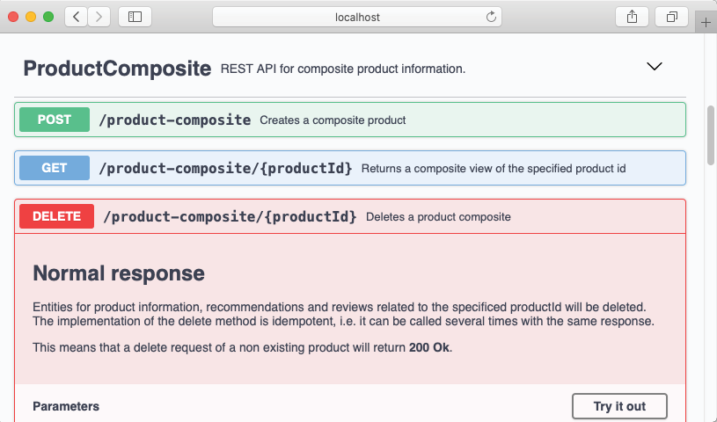
New operations

Slide 23
Methods in the integration layer
@Override
public Product createProduct(Product body) {
try {
return restTemplate.postForObject(
productServiceUrl, body, Product.class);
} catch (HttpClientErrorException ex) {
throw handleHttpClientException(ex);
}
}
@Override
public void deleteProduct(int productId) {
try {
restTemplate.delete(productServiceUrl + "/" + productId);
} catch (HttpClientErrorException ex) {
throw handleHttpClientException(ex);
}
}

Slide 24
Composite service tests
@Test
void createCompositeProduct2() {
ProductAggregate compositeProduct = new ProductAggregate(1, "name",
1, singletonList(new RecommendationSummary(1, "a", 1, "c")),
singletonList(new ReviewSummary(1, "a", "s", "c")), null);
postAndVerifyProduct(compositeProduct, OK);
}
@Test
void deleteCompositeProduct() {
ProductAggregate compositeProduct = new ProductAggregate(1, "name",
1,singletonList(new RecommendationSummary(1, "a", 1, "c")),
singletonList(new ReviewSummary(1, "a", "s", "c")), null);
postAndVerifyProduct(compositeProduct, OK);
deleteAndVerifyProduct(compositeProduct.getProductId(), OK);
deleteAndVerifyProduct(compositeProduct.getProductId(), OK);
}

Slide 25
Adding databases to the Docker Compose
mongodb:
image: mongo:4.4.2
mem_limit: 512m
ports:
- "27017:27017"
command: mongod
healthcheck:
test: "mongo --eval 'db.stats().ok'"
interval: 5s
timeout: 2s
retries: 60
…
depends_on:
mongodb:
condition: service_healthy
depends_on:
mysql:
condition: service_healthy

Slide 26
Database connection configuration: application.yml
spring.data.mongodb:
host: localhost
port: 27017
database: product-db
logging:
level:
org.springframework.data.mongodb.core.MongoTemplate: DEBUG
---
spring.config.activate.on-profile: docker
spring.data.mongodb.host: mongodb

Slide 27
MongoDB and MySQL CLI tools for troubleshoting
docker-compose exec mongodb mongo –quiet
docker-compose exec mysql mysql -uuser -p review-db

Slide 28
Manual testing
cd $PROJ_HOME/5-persistence
./gradlew build && docker-compose build && docker-compose up
http://localhost:8080/openapi/swagger-ui.html
(productid=12345)
docker-compose exec mongodb mongo product-db --quiet --eval "db.products.find()”
docker-compose exec mongodb mongo recommendation-db --quiet --eval "db.recommendations.find()”
docker-compose exec mysql mysql -uuser -p review-db -e "select * from reviews"

Slide 29
Automated tests
cd $PROJ_HOME/5-persistence
./test-em-all.bash start stop

