Slide 1
Reactive Microservices

Slide 2
Non-blocking synchronous APIs and event-driven asynchronous services
The create, read, and delete services exposed by the product composite microservice will be based on non-blocking synchronous APIs.
The read services provided by the core microservices will also be developed as non-blocking synchronous APIs.
The create and delete services provided by the core microservices will be developed as event-driven asynchronous services.
The synchronous APIs provided by the composite microservices to create and delete aggregated product information will publish create and delete events on these topics.

Slide 3
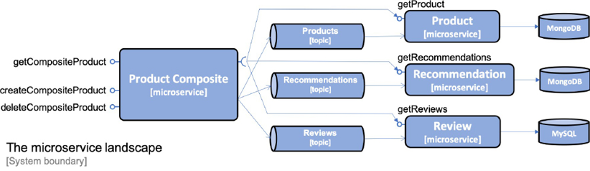
Reactive architecture

Slide 4
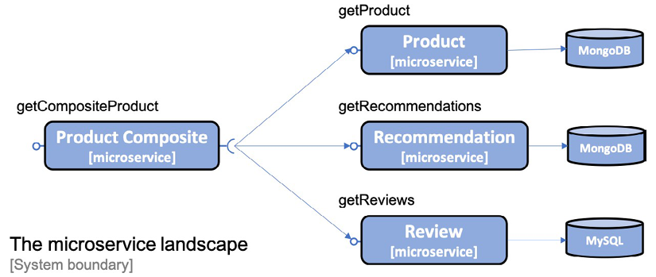
Non-blocking synchronous REST APIs

Slide 5
Non-blocking persistence using Spring Data for MongoDB
public interface ProductRepository extends ReactiveCrudRepository <ProductEntity, String> {
Mono<ProductEntity> findByProductId(int productId);
}
public interface RecommendationRepository extends ReactiveCrudRepository<RecommendationEntity, String> {
Flux<RecommendationEntity> findByProductId(int productId);
}
(In test: set up a sequence of processing steps that both executes the repository find operation
and also verifies the result)
StepVerifier.create(repository.findById(newEntity.getId()))
.expectNextMatches(foundEntity -> areProductEqual(newEntity, foundEntity))
.verifyComplete();

Slide 6
Non-blocking REST APIs in the core services
Mono<Product> getProduct(@PathVariable int productId);
(fluent API in Project Reactor)
public Mono<Product> getProduct(int productId) {
if (productId < 1) {
throw new InvalidInputException("Invalid productId: " + productId);
}
return repository.findByProductId(productId)
.switchIfEmpty(Mono.error(new NotFoundException("No product found
for productId: " + productId)))
.log(LOG.getName(), FINE)
.map(e -> mapper.entityToApi(e))
.map(e -> setServiceAddress(e));
}

Slide 7
Running the blocking code using a Scheduler for relational database
@Autowired
public ReviewServiceApplication(
@Value("${app.threadPoolSize:10}") Integer threadPoolSize,
@Value("${app.taskQueueSize:100}") Integer taskQueueSize
) {
this.threadPoolSize = threadPoolSize;
this.taskQueueSize = taskQueueSize;
}
@Bean
public Scheduler jdbcScheduler() {
return Schedulers.newBoundedElastic(threadPoolSize,
taskQueueSize, "jdbc-pool");
}

Slide 8
@Override
public Flux<Review> getReviews(int productId) {
if (productId < 1) {
throw new InvalidInputException("Invalid productId: " + productId);
}
LOG.info("Will get reviews for product with id={}", productId);
return Mono.fromCallable(() -> internalGetReviews(productId))
.flatMapMany(Flux::fromIterable)
.log(LOG.getName(), FINE)
.subscribeOn(jdbcScheduler);
}

Slide 9
Non-blocking REST APIs in the composite services
@Override
public Mono<ProductAggregate> getProduct(int productId) {
return Mono.zip(
values -> createProductAggregate(
(Product) values[0],
(List<Recommendation>) values[1],
(List<Review>) values[2],
serviceUtil.getServiceAddress()),
integration.getProduct(productId),
integration.getRecommendations(productId).collectList(),
integration.getReviews(productId).collectList())
.doOnError(ex ->
LOG.warn("getCompositeProduct failed: {}",
ex.toString()))
.log(LOG.getName(), FINE);
}

Slide 10
Integration layer: WebClient
public class ProductCompositeIntegration implements ProductService, RecommendationService, ReviewService {
private final WebClient webClient;
@Autowired
public ProductCompositeIntegration(
WebClient.Builder webClient, ...
) {
this.webClient = webClient.build();
}
@Override
public Mono<Product> getProduct(int productId) {
String url = productServiceUrl + "/product/" + productId;
return webClient.get().uri(url).retrieve()
.bodyToMono(Product.class)
.log(LOG.getName(), FINE)
.onErrorMap(WebClientResponseException.class,
ex -> handleException(ex)
);
}

Slide 11
Test code
class ProductCompositeServiceApplicationTests {
@BeforeEach
void setUp() {
when(compositeIntegration.getProduct(PRODUCT_ID_OK)).
thenReturn(Mono.just(new Product(PRODUCT_ID_OK, "name", 1,
"mock-address")));
when(compositeIntegration.getRecommendations(PRODUCT_ID_OK)).
thenReturn(Flux.fromIterable(singletonList(new
Recommendation(PRODUCT_ID_OK, 1, "author", 1, "content",
"mock address"))));
when(compositeIntegration.getReviews(PRODUCT_ID_OK)).
thenReturn(Flux.fromIterable(singletonList(new
Review(PRODUCT_ID_OK, 1, "author", "subject", "content",
"mock address"))));

Slide 12
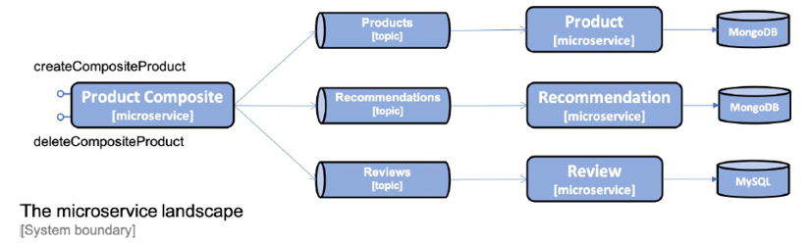
Event-driven asynchronous services

Slide 13
Spring Cloud Stream and messaging
Consumer groups
Retries and dead-letter queues
Guaranteed orders and partitions
@Autowired
private StreamBridge streamBridge;
@PostMapping
void sampleCreateAPI(@RequestBody String body) {
streamBridge.send("topic", body);
}
@Bean
public Consumer<String> mySubscriber() {
return s -> System.out.println("ML RECEIVED: " + s);
}

Slide 14
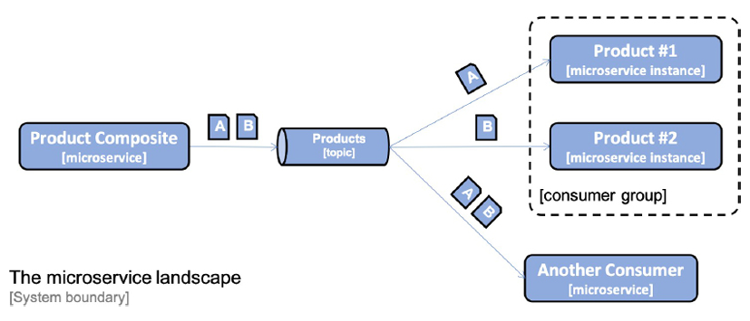
Consumer groups
spring.cloud.stream:
bindings.messageProcessor-in-0:
destination: products
group: productsGroup

Slide 15
Retries and dead-letter queues
spring.cloud.stream.bindings.messageProcessor-in-0.consumer:
maxAttempts: 3
backOffInitialInterval: 500
backOffMaxInterval: 1000
backOffMultiplier: 2.0
spring.cloud.stream.rabbit.bindings.messageProcessor-in-0.consumer:
autoBindDlq: true
republishToDlq: true
spring.cloud.stream.kafka.bindings.messageProcessor-in-0.consumer:
enableDlq: true

Slide 16
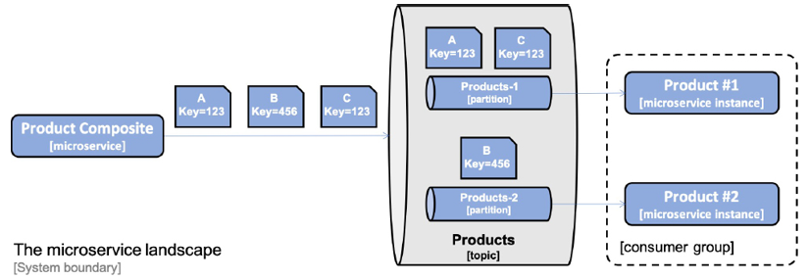
Guaranteed order and partitions
spring.cloud.stream.bindings.messageProcessor-in-0:
destination: products
group:productsGroup
consumer:
partitioned: true
instance-index: 0
(composite service)
spring.cloud.stream.bindings.products-out-0.producer:
partition-key-expression: headers['partitionKey']
partition-count: 2

Slide 17
Topics and events
The type of event, for example, a create or delete event
A key that identifies the data, for example, a product ID
A data element, that is, the actual data in the event
A timestamp, which describes when the event occurred
Event class in api project

Slide 18
Configuring Spring Cloud Stream and binders for RabbitMQ and Kafka
dependencies {
implementation 'org.springframework.cloud:spring-cloud-starter-stream-rabbit'
implementation 'org.springframework.cloud:spring-cloud-starter-stream-kafka'
testImplementation 'org.springframework.cloud:spring-cloud-stream::test-binder'
}
ext {
springCloudVersion = "2020.0.3"
}
dependencyManagement {
imports {
mavenBom "org.springframework.cloud:spring-cloud-
dependencies:${springCloudVersion}"
}
}

Slide 19
Message processors in product service
@Configuration
public class MessageProcessorConfig {
private final ProductService productService;
@Autowired
public MessageProcessorConfig(ProductService productService)
{
this.productService = productService;
}
@Bean
public Consumer<Event<Integer,Product>> messageProcessor() {
...

Slide 20
block()
Ensures that the message processor waits for the productService bean to complete its creation or deletion in the underlying database.
Only handle a few incoming messages in parallel, one per partition as described. This means that we will only have a few threads blocked concurrently, which will not negatively impact the performance or the scalability.

Slide 21
Service implementations
@Override
public Mono<Product> createProduct(Product body) {
if (body.getProductId() < 1) {
throw new InvalidInputException("Invalid productId: " +
body.getProductId());
}
ProductEntity entity = mapper.apiToEntity(body);
Mono<Product> newEntity = repository.save(entity)
.log(LOG.getName(), FINE)
.onErrorMap(
DuplicateKeyException.class,
ex -> new InvalidInputException
("Duplicate key, Product Id: " + body.getProductId()))
.map(e -> mapper.entityToApi(e));
return newEntity;
}

Slide 22
Configuration for consuming events: application.yml
spring.cloud.stream:
defaultBinder: rabbit
default.contentType: application/json
spring.cloud.stream.kafka.binder:
brokers: 127.0.0.1
defaultBrokerPort: 9092
spring.rabbitmq:
host: 127.0.0.1
port: 5672
username: guest
password: guest
---
spring.config.activate.on-profile: docker
spring.rabbitmq.host: rabbitmq
spring.cloud.stream.kafka.binder.brokers: kafka
spring.cloud.stream:
bindings.messageProcessor-in-0:
destination: products

Slide 23
Test code
@SpringBootTest
class ProductServiceApplicationTests {
@Autowired
@Qualifier("messageProcessor")
private Consumer<Event<Integer, Product>> messageProcessor;
private void sendCreateProductEvent(int productId) {
Product product = new Product(productId, "Name " + productId, productId, "SA");
Event<Integer, Product> event = new Event(CREATE, productId, product);
messageProcessor.accept(event);
}
private void sendDeleteProductEvent(int productId) {
Event<Integer, Product> event = new Event(DELETE, productId, null);
messageProcessor.accept(event);
}

Slide 24
Publishing events in the integration layer
@Override
public Mono<Product> createProduct(Product body) {
return Mono.fromCallable(() -> {
sendMessage("products-out-0",
new Event(CREATE, body.getProductId(), body));
return body;
}).subscribeOn(publishEventScheduler);
}
private void sendMessage(String bindingName, Event event) {
Message message = MessageBuilder.withPayload(event)
.setHeader("partitionKey", event.getKey())
.build();
streamBridge.send(bindingName, message);
}

Slide 25
Configuration for publishing events
spring.cloud.stream:
bindings:
products-out-0:
destination: products
recommendations-out-0:
destination: recommendations
reviews-out-0:
destination: reviews
spring.cloud.stream.bindings.products-out-0.producer:
partition-key-expression: headers['partitionKey']
partition-count: 2

Slide 26
Test code
@Test
void createCompositeProduct1() {
ProductAggregate composite = new ProductAggregate(1, "name", 1, null, null, null);
postAndVerifyProduct(composite, ACCEPTED);
final List<String> productMessages = getMessages("products");
final List<String> recommendationMessages = getMessages("recommendations");
final List<String> reviewMessages = getMessages("reviews");
// Assert one expected new product event queued up
assertEquals(1, productMessages.size());
Event<Integer, Product> expectedEvent =
new Event(CREATE, composite.getProductId(), new Product(composite.getProductId(), composite.getName(), composite.getWeight(), null));
assertThat(productMessages.get(0), is(sameEventExceptCreatedAt(expectedEvent)));
// Assert no recommendation and review events
assertEquals(0, recommendationMessages.size());
assertEquals(0, reviewMessages.size());
}
@SpringBootTest
@Import({TestChannelBinderConfiguration.class})
class MessagingTests {
@Autowired
private OutputDestination target;
@BeforeEach
void setUp() {
purgeMessages("products");
purgeMessages("recommendations");
purgeMessages("reviews");
}

Slide 27
Saving events
spring.cloud.stream:
bindings:
products-out-0:
destination: products
producer:
required-groups: auditGroup

Slide 28
Health API
Spring Boot module Actuator: https://docs.spring.io/spring-boot/docs/current/reference/html/production-ready-endpoints.html
ProductCompositeIntegration and CompositeReactiveHealthContributor
The health endpoint is, by default, set to /actuator/health
@Autowired
ProductCompositeIntegration integration;
@Bean
ReactiveHealthContributor coreServices() {
final Map<String, ReactiveHealthIndicator> registry = new LinkedHashMap<>();
registry.put("product", () -> integration.getProductHealth());
registry.put("recommendation", () -> integration.getRecommendationHealth());
registry.put("review", () -> integration.getReviewHealth());
return CompositeReactiveHealthContributor.fromMap(registry);
}
management.endpoint.health.show-details: "ALWAYS"
management.endpoints.web.exposure.include: "*"
curl localhost:8080/actuator/health -s | jq .

Slide 29
Using RabbitMQ without using partitions
rabbitmq:
image: rabbitmq:3.8.11-management
mem_limit: 512m
ports:
- 5672:5672
- 15672:15672
healthcheck:
test: ["CMD", "rabbitmqctl", "status"]
interval: 5s
timeout: 2s
retries: 60

Slide 30
Manual tests
cd $PROJ_HOME/6-reactive
./gradlew build && docker-compose build && docker-compose up -d
(several times) curl -s localhost:8080/actuator/health | jq -r .status
body='{"productId":1,"name":"product name C","weight":300, "recommendations":[
{"recommendationId":1,"author":"author 1","rate":1,"content":"content 1"},
{"recommendationId":2,"author":"author 2","rate":2,"content":"content 2"},
{"recommendationId":3,"author":"author
3","rate":3,"content":"content 3"}
], "reviews":[
{"reviewId":1,"author":"author 1","subject":"subject 1","content":"content 1"},
{"reviewId":2,"author":"author 2","subject":"subject 2","content":"content 2"},
{"reviewId":3,"author":"author 3","subject":"subject 3","content":"content 3"}
]}’
curl -X POST localhost:8080/product-composite -H ‘Content-Type: application/json’ -d ‘$body’

Slide 31
curl -X 'POST' \
'http://localhost:8080/product-composite' \
-H 'accept: */*' \
-H 'Content-Type: application/json' \
-d '{
"productId":1,"name":"product name C","weight":300,
"recommendations": [
{"recommendationId":1,"author":"author 1","rate":1,"content":"content 1"},
{"recommendationId":2,"author":"author 2","rate":2,"content":"content 2"},
{"recommendationId":3,"author":"author 3","rate":3,"content":"content 3"}
],
"reviews": [
{"reviewId":1,"author":"author 1","subject":"subject 1","content":"content 1"},
{"reviewId":2,"author":"author 2","subject":"subject 2","content":"content 2"},
{"reviewId":3,"author":"author 3","subject":"subject 3","content":"content 3"}
],
"serviceAddresses": {
"cmp": "string",
"pro": "string",
"rev": "string",
"rec": "string"
}
}'

Slide 32
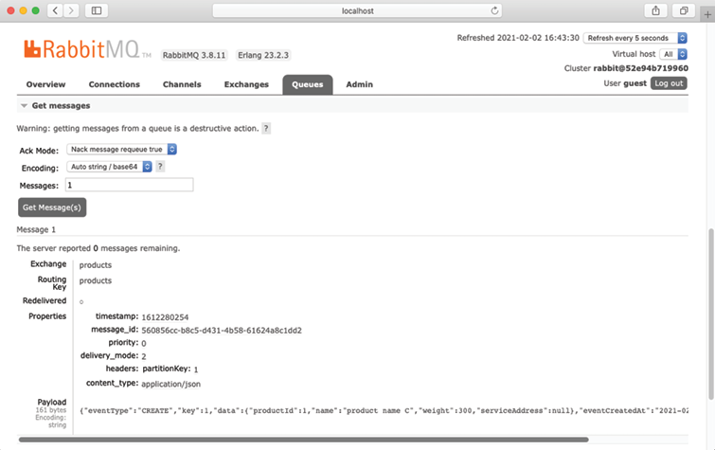
RabbitMQ
http://localhost:15672/#/queues
username/password: guest/guest
products.auditGroup -> Get messages
curl -s localhost:8080/product-composite/1 | jq
curl -X DELETE localhost:8080/product-composite/1
curl -s localhost:8080/product-composite/1 | jq
docker-compose down

Slide 33
Using RabbitMQ with partitions
product-p1:
build: microservices/product-service
mem_limit: 512m
environment:
- SPRING_PROFILES_ACTIVE=docker,streaming_partitioned,streaming_instance_1
depends_on:
mongodb:
condition: service_healthy
rabbitmq:
condition: service_healthy
export COMPOSE_FILE=docker-compose-partitions.yml
docker-compose build && docker-compose up –d
http://localhost:15672/#/queues
docker-compose down
unset COMPOSE_FILE

Slide 34
Using Kafka with two partitions per topic
kafka:
image: wurstmeister/kafka:2.12-2.5.0
mem_limit: 512m
ports:
- "9092:9092"
environment:
- KAFKA_ADVERTISED_HOST_NAME=kafka
- KAFKA_ADVERTISED_PORT=9092
- KAFKA_ZOOKEEPER_CONNECT=zookeeper:2181
depends_on:
- zookeeper
zookeeper:
image: wurstmeister/zookeeper:3.4.6
mem_limit: 512m
ports:
- "2181:2181"
environment:
- KAFKA_ADVERTISED_HOST_NAME=zookeeper
export COMPOSE_FILE=docker-compose-kafka.yml
docker-compose build && docker-compose up -d

Slide 35
docker-compose exec kafka /opt/kafka/bin/kafka-topics.sh --zookeeper zookeeper --list
docker-compose exec kafka /opt/kafka/bin/kafka-topics.sh --describe --zookeeper zookeeper --topic products
docker-compose exec kafka /opt/kafka/bin/kafka-console-consumer.sh --bootstrap-server localhost:9092 --topic products --from-beginning --timeout-ms 1000
docker-compose exec kafka /opt/kafka/bin/kafka-console-consumer.sh --bootstrap-server localhost:9092 --topic products --from-beginning --timeout-ms 1000 --partition 1
docker-compose down
unset COMPOSE_FILE

Slide 36
Running automated tests
unset COMPOSE_FILE
./test-em-all.bash start stop
export COMPOSE_FILE=docker-compose-partitions.yml
./test-em-all.bash start stop
unset COMPOSE_FILE
export COMPOSE_FILE=docker-compose-kafka.yml
./test-em-all.bash start stop
unset COMPOSE_FILE

