Slide 1
Kubernetes

Slide 2
Basic concepts
The desired state vs. the current state
Deploy and run containers
Zero-downtime rolling upgrades such as green/blue and canary deployments
liveness probe and readiness probe
horizontal autoscaler
Quotas
Namespace
service discovery
load balance
Ingress
Container Network Interface (CNI) specification: https://github.com/containernetworking/cni
Role-Based Access Control (RBAC)

Slide 3
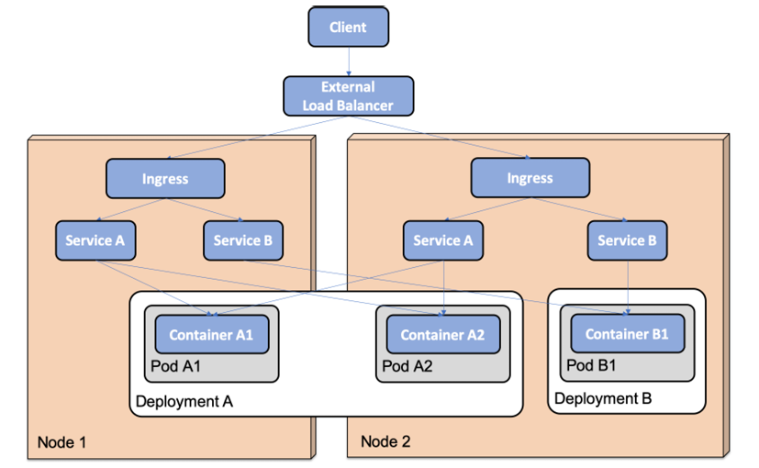
API objects
Node
Pod
Deployment
ReplicaSet
Service
Ingress
Namespace
ConfigMap
Secret
DaemonSet

Slide 4
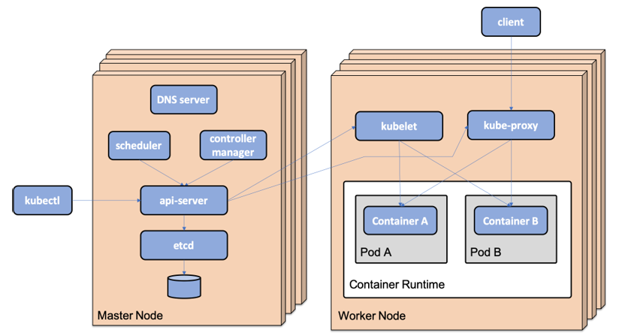
Kubernetes components
master nodes and worker nodes
api-server
etcd
Controller manager
Scheduler
kubelet
kube-proxy
Container runtime
Kubernetes DNS

Slide 5
Minikube
curl -LO https://storage.googleapis.com/minikube/releases/latest/minikube-darwin-amd64
sudo install minikube-darwin-amd64 /usr/local/bin/minikube
minikube profile my-profile
minikube config get profile
minikube profile list

Slide 6
kubectl
kubectl get: shows information about the specified API object
kubectl describe: gives more detail about the specified API object
kubectl logs: displays log output from containers
kubectl explain: show what fields are available when declaring a Kubernetes object
kubectl explain deployment.spec.template.spec.containers
By default, contexts are saved in the ~/.kube/config file
unset KUBECONFIG
kubectl config get-contexts
kubectl config use-context my-cluster
kubectl config set-context $(kubectl config current-context) --namespace my-namespace

Slide 7
Creating a Kubernetes cluster
unset KUBECONFIG
minikube start \
--profile=hands-on \
--memory=10240 \
--cpus=4 \
--disk-size=30g \
--kubernetes-version=v1.23.1 \
--driver=hyperkit
minikube profile hands-on
minikube status
minikube addons enable ingress
minikube addons enable metrics-server
kubectl get nodes
kubectl get pods --namespace=kube-system
kubectl get jobs --namespace=kube-system
Unset the KUBECONFIG environment variable
minikube start
allocate 10 GB of memory, to the cluster
4 CPU cores and 30 GB of disk space
Specify the Minikube profile: hands-on
Use the add-on

Slide 8
Deployment
kubectl create namespace first-attempts
kubectl config set-context $(kubectl config current-context) --namespace=first-attempts
cd $PROJ_HOME/7-k8s
kubectl apply -f kubernetes/first-attempts/nginx-deployment.yaml
kubectl get all
kubectl get pod --watch
kubectl delete pod --selector app=nginx-app
(Change to 3 replicas)
kubectl apply -f kubernetes/first-attempts/nginx-deployment.yaml
kubectl apply -f kubernetes/first-attempts/nginx-service.yaml
kubectl get svc
minikube ip
http://192.168.99.116:30080

Slide 9
Internal cluster IP address and port
kubectl run -i --rm --restart=Never curl-client --image=curlimages/curl --command -- curl -s 'http://nginx-service:80'
kubectl delete namespace first-attempts

Slide 10
Managing local Kubernetes cluster
minikube stop
minikube start
kubectl config set-context $(kubectl config current-context) --namespace=hands-on
minikube delete --profile hands-on

