Slide 1
Kubernetes - Container

Slide 2
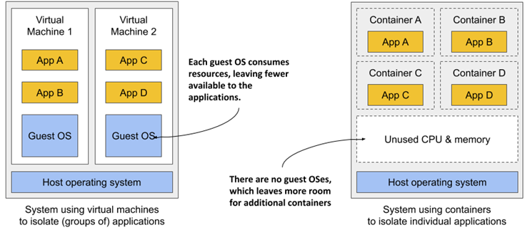
VM vs. Container

Slide 3
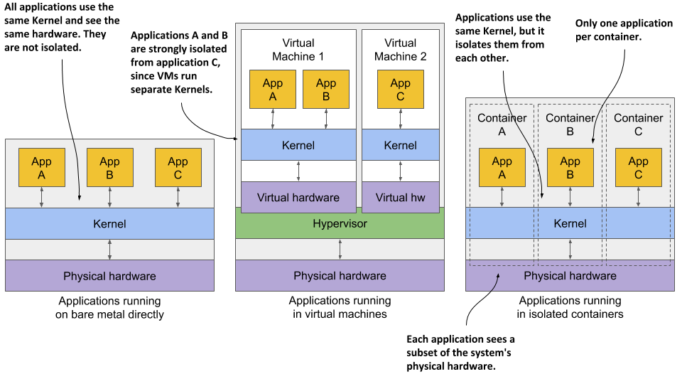
Bare metal, VM and container

Slide 4
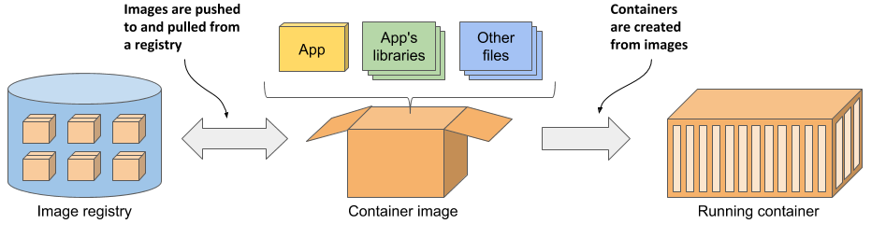
Containers, images and Registries

Slide 5
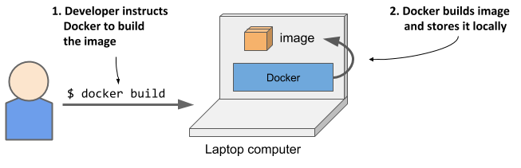
Building a container image

Slide 6
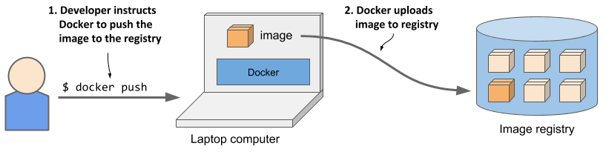
Push a container image to a registry

Slide 7
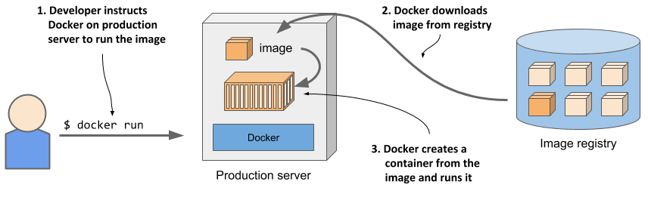
Running a container

Slide 8
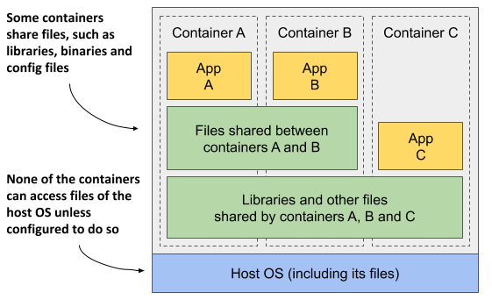
Sharing image layers

Slide 9
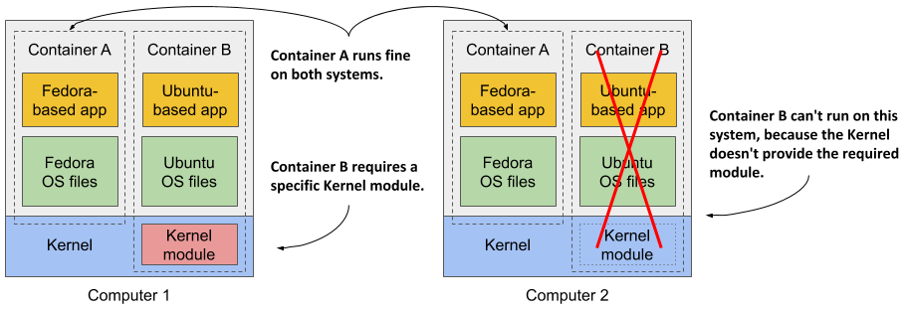
Limitations of container images

Slide 10
Installing Docker
http://docs.docker.com/install

Slide 11
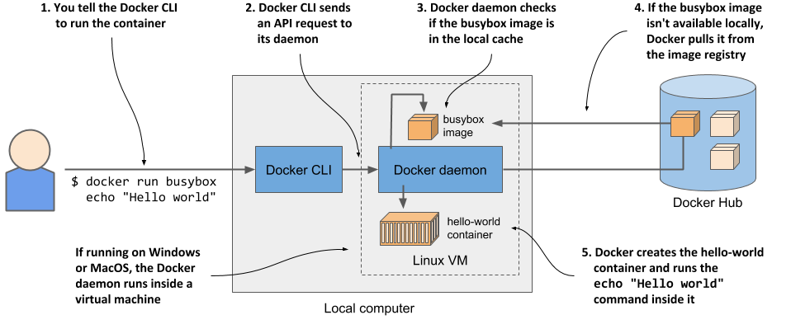
Running a container
$ docker run busybox echo “Hello, World”
$ docker run redis:alpine
$ docker run redis:5.0.7-alpine

Slide 12
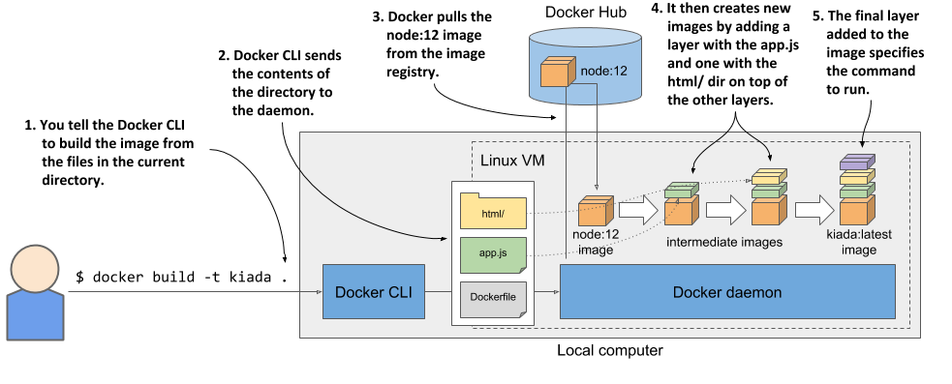
Building a container image
FROM node:12
COPY app.js /app.js
COPY html/ /html
ENTRYPOINT ["node", "app.js"]
$ docker build -t kiada:latest .
$ docker images
$ docker history kiada:latest
$ docker run --name kiada-container -p 1234:8080 -d kiada

Slide 13
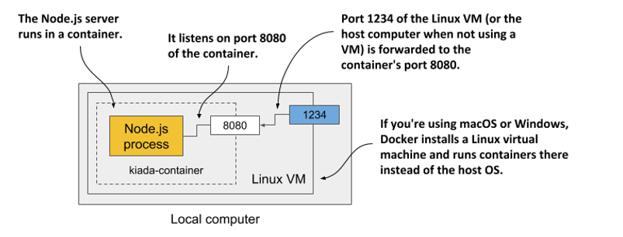
Accessing the container
$ curl localhost:1234
$ docker ps
$ docker inspect kiada-container
$ docker logs kiada-container

Slide 14
Distributing the container image
$ docker tag kiada genedocker/kiada:0.1
$ docker images
$ docker login -u yourid -p yourpassword docker.io
$ docker push yourid/kiada:0.1
$ docker run -p 1234:8080 -d genedocker/kiada:0.1
$ docker stop kiada-container
$ docker rm kiada-container
$ docker rmi kiada:latest
$ docker image prune

Slide 15
Container isolation: Namespaces
The Mount namespace (mnt) isolates mount points (file systems).
The Process ID namespace (pid) isolates process IDs.
The Network namespace (net) isolates network devices, stacks, ports, etc.
The Inter-process communication namespace (ipc) isolates the communication between processes (this includes isolating message queues, shared memory, and others).
The UNIX Time-sharing System (UTS) namespace isolates the system hostname and the Network Information Service (NIS) domain name.
The User ID namespace (user) isolates user and group IDs.
The Cgroup namespace isolates the Control Groups root directory.

Slide 16
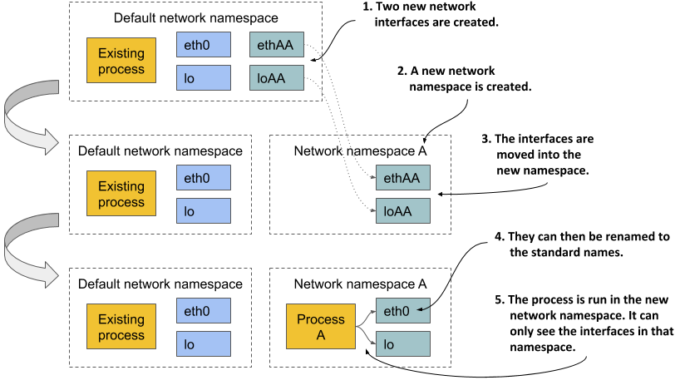
Network namespace

Slide 17
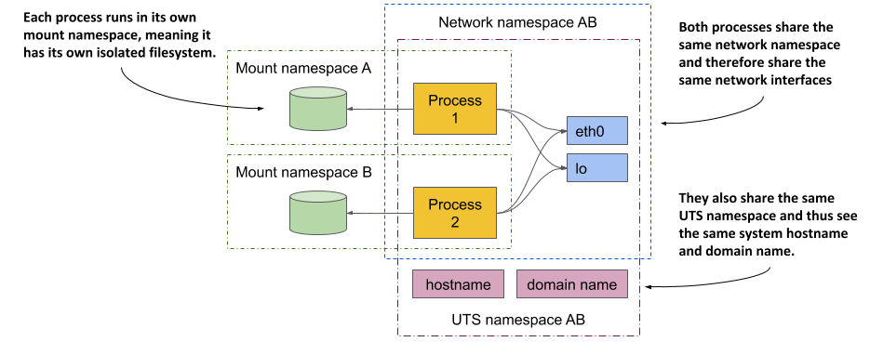
Sharing namespaces

Slide 18
Running a shell inside an existing container
$ docker exec -it kiada-container bash
# ps aux

Slide 19
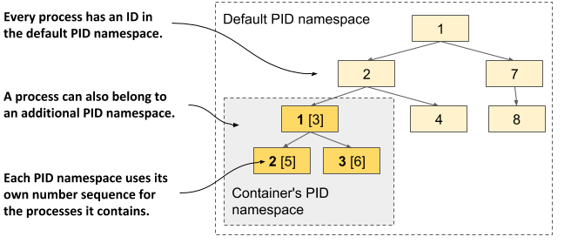
PID namespace
(another terminal)
$ ps aux | grep app.js
# ls /
In Docker Desktop
$ docker run --net=host --ipc=host --uts=host --pid=host \
-it --security-opt=seccomp=unconfined --privileged --rm \
-v /:/host alpine chroot /host

Slide 20
Control Groups
$ docker run --cpuset-cpus="1,2" ...
$ docker run --cpus="0.5" ...
$ docker run --memory="100m" ...

