Slide 1
Kubernetes – Deploying Applications

Slide 2
Managed Kubernetes services
Google - Google Kubernetes Engine,
Amazon - Amazon Elastic Kubernetes Service,
Microsoft - Azure Kubernetes Service,
IBM - IBM Cloud Kubernetes Service

Slide 3
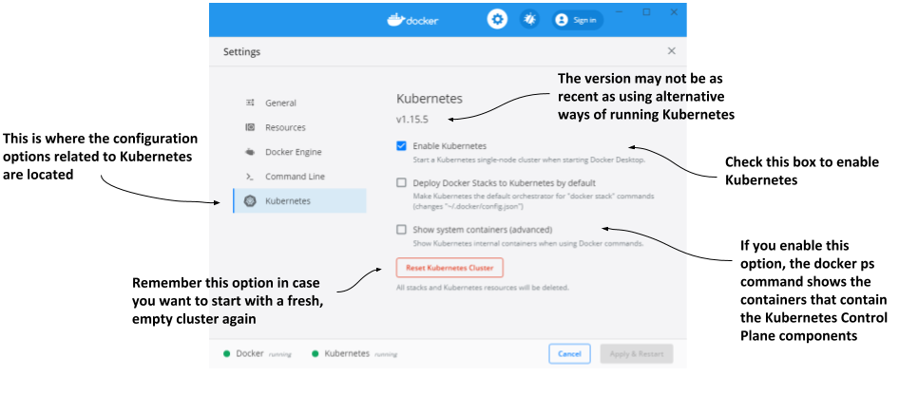
Docker Desktop

Slide 4
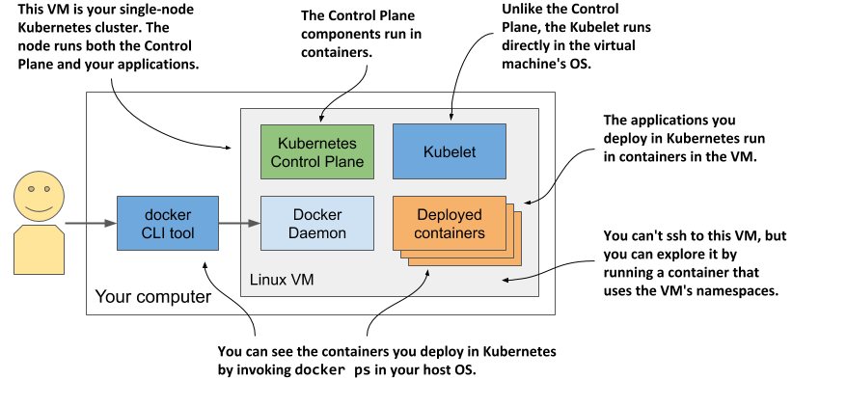
$ docker run --net=host --ipc=host --uts=host --pid=host --privileged \
--security-opt=seccomp=unconfined -it --rm -v /:/host alpine chroot /host

Slide 5
Minikube
http://github.com/kubernetes/minikube
$ curl -LO https://storage.googleapis.com/minikube/releases/latest/minikube-linux-amd64 && \
sudo install minikube-linux-amd64 /usr/local/bin/minikube
$ minikube start
(Linux)
$ minikube start --vm-driver none
$ minikube status

Slide 6
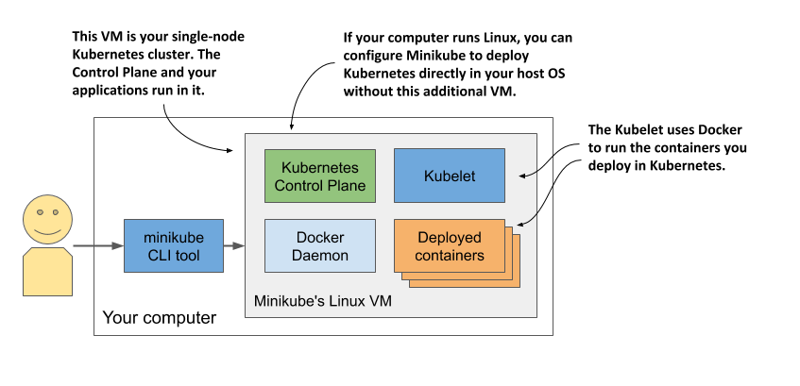
$ minikube ssh
# ps aux
# docker ps
(list containers using your local docker CLI instance)
$ eval $(minikube docker-env)

Slide 7
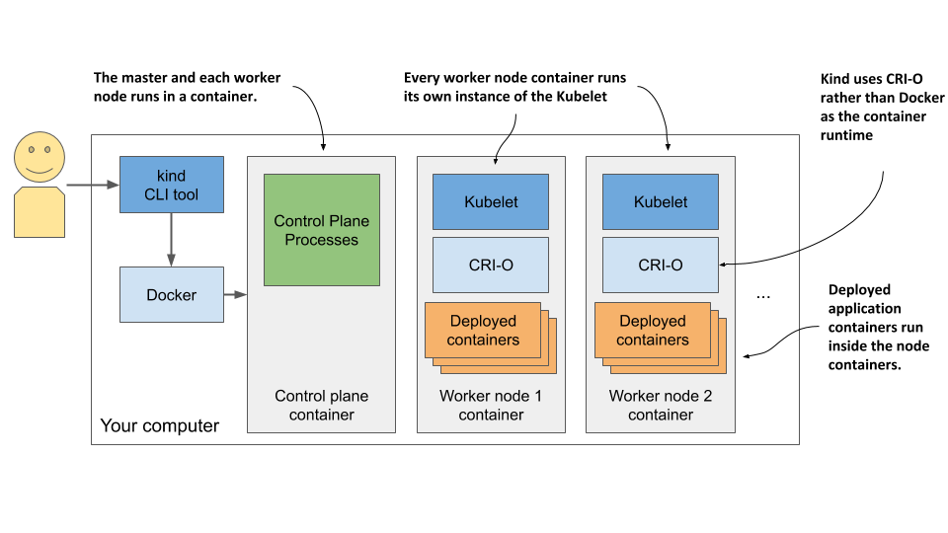
Kubernetes in Docker (KinD)
https://kind.sigs.k8s.io/docs/user/quick-start/
$ curl -Lo ./kind https://kind.sigs.k8s.io/dl/v0.11.1/kind-$(uname)-amd64
$ chmod +x ./kind
$ mv ./kind /some-dir-in-your-PATH/kind
$ kind create cluster

Slide 8
Multi-node cluster with KinD
kind: Cluster
apiVersion: kind.sigs.k8s.io/v1alpha3
nodes:
- role: control-plane
- role: worker
- role: worker
$ kind create cluster --config kind-multi-node.yaml
$ kind get nodes
$ docker ps
$ docker exec -it kind-control-plane bash
# crictl ps

Slide 9
Google Kubernetes Engine
https://cloud.google.com/container-engine/docs/before-you-begin
Signing up for a Google account if you don’t have one already.
Creating a project in the Google Cloud Platform Console.
Enabling billing. This does require your credit card info, but Google provides a 12-month free trial with a free $300 credit. And they don’t start charging automatically after the free trial is over.
Downloading and installing the Google Cloud SDK, which includes the gcloud tool.
Creating the cluster using the gcloud command-line tool

Slide 10
Creating a GKE Kubernetes cluster
https://cloud.google.com/compute/docs/regions-zones
$ gcloud config set compute/zone asia-east1-a
$ gcloud container clusters create kiada --num-nodes 3
$ gcloud compute instances list
$ gcloud container clusters resize kiada --size 0

Slide 11
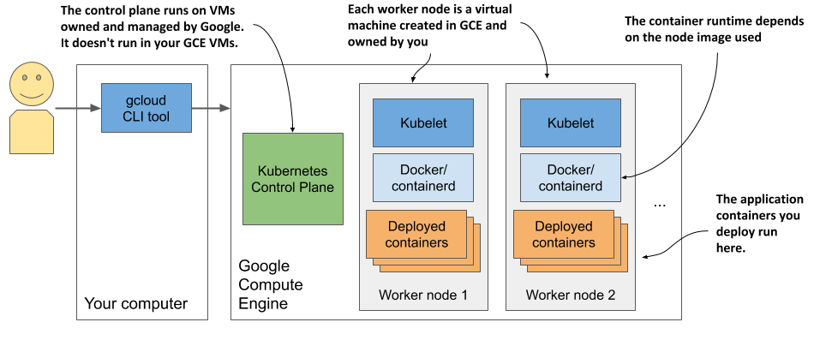
$ gcloud compute ssh gke-kiada-default-pool-9bba9b18-4glf
# docker ps

Slide 12
Amazon Elastic Kubernetes Service
https://docs.aws.amazon.com/eks/latest/userguide/getting-started-eksctl.html
https://aws.amazon.com/about-aws/global-infrastructure/regional-product-services/
$ eksctl create cluster --name kiada --region eu-central-1 --nodes 3 --ssh-access

Slide 13
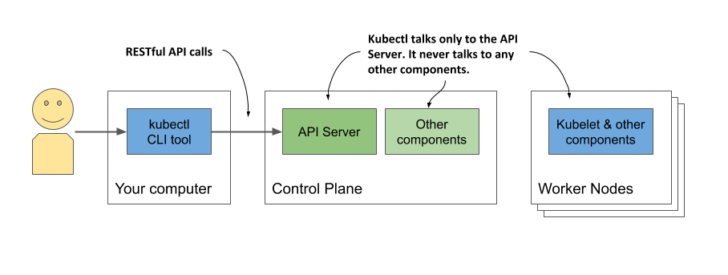
kubectl
(Linux)
$ curl -LO "https://dl.k8s.io/release/$(curl -L -s https://dl.k8s.io/release/stable.txt)/bin/linux/amd64/kubectl"
$ chmod +x kubectl
$ sudo mv kubectl /usr/local/bin/
(Mac)
$ brew install kubectl
(Windows)
download from https://storage.googleapis.com/Kubernetes-release/release/v1.18.2/bin/windows/amd64/kubectl.exe

Slide 14
Alias
(open ~/.bashrc)
alias k=kubectl
(Windows)
doskey k=kubectl $*
(PowerShell)
set-alias -name k -value kubectl
Install bash-completion
(open ~/.bashrc)
$ source <(kubectl completion bash)
$ complete -o default -F __start_kubectl k

Slide 15
kubeconfig configuration
~/.kube/config
$ export KUBECONFIG=/path/to/custom/kubeconfig
$ kubectl cluster-info

Slide 16
Using kubectl
$ kubectl get nodes
$ kubectl describe node gke-kiada-85f6-node-0rrx

Slide 17
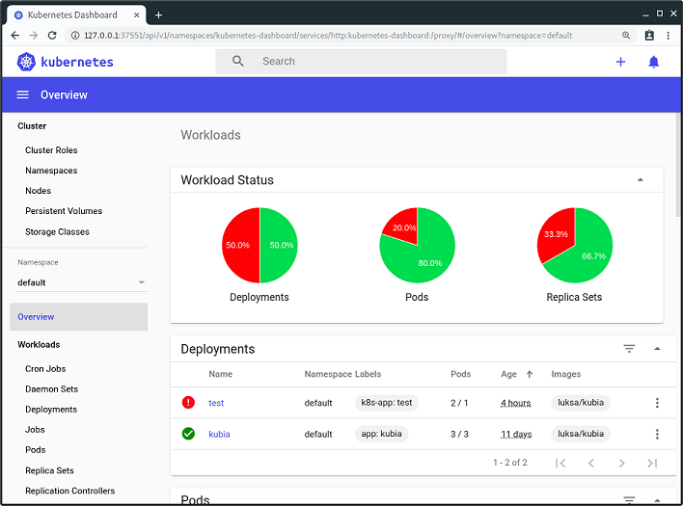
Kubernetes web dashboard
http://localhost:8001/api/v1/namespaces/kubernetes-dashboard/services/https:kubernetes-dashboard:/proxy/
(Docker Desktop)
$ kubectl apply -f https://raw.githubusercontent.com/kubernetes/dashboard/v2.0.0-rc5/aio/deploy/recommended.yaml
$ kubectl proxy
$ kubectl -n kubernetes-dashboard describe \
secret $(kubectl -n kubernetes-dashboard get secret | sls admin-user | ForEach-Object { $_ -Split '\s+' } | Select -First 1)

Slide 18
(Minikube)
$ minikube dashboard
(On-premise)
kubernetes.io/docs/tasks/access-application-cluster/web-ui-dashboard

Slide 19
Deploying an application
$ kubectl create deployment kiada --image=genedocker/kiada:0.1
$ kubectl get deployments

Slide 20
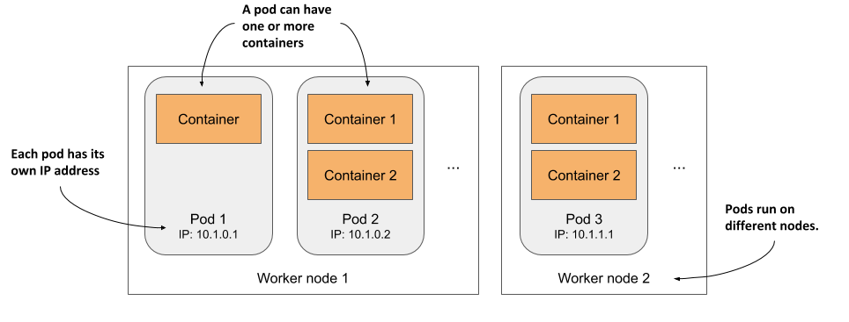
Containers, pods and worker nodes
$ kubectl get pods
$ kubectl describe pod xyz

Slide 21
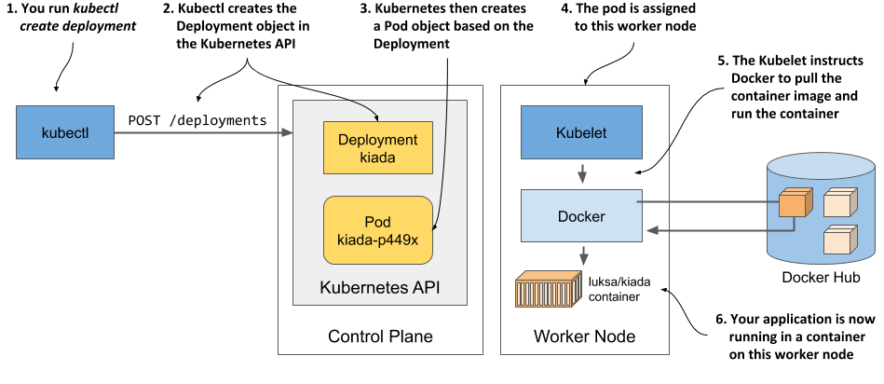
Deployment

Slide 22
Exposing services
$ kubectl expose deployment kiada --type=LoadBalancer --port 8080
$ kubectl get svc
$ kubectl api-resources

Slide 23
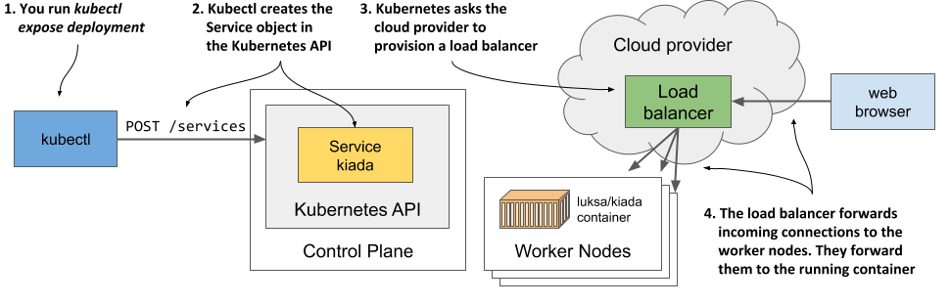
Load balancer services
$ kubectl get svc kiada
$ curl 35.246.179.22:8080
(Docker Desktop)
$ curl localhost:8080
(Minikube)
$ minikube service kiada –url
$ curl http://192.168.99.102:30838
$ kubectl get svc kiada

Slide 24
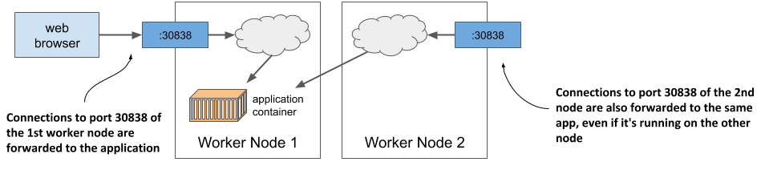
Node ports

Slide 25
Horizontally scaling
$ kubectl scale deployment kiada --replicas=3
$ kubectl get deploy
$ kubectl get pods
$ kubectl get pods -o wide
(observe multiple times)
$ curl 35.246.179.22:8080

Slide 26
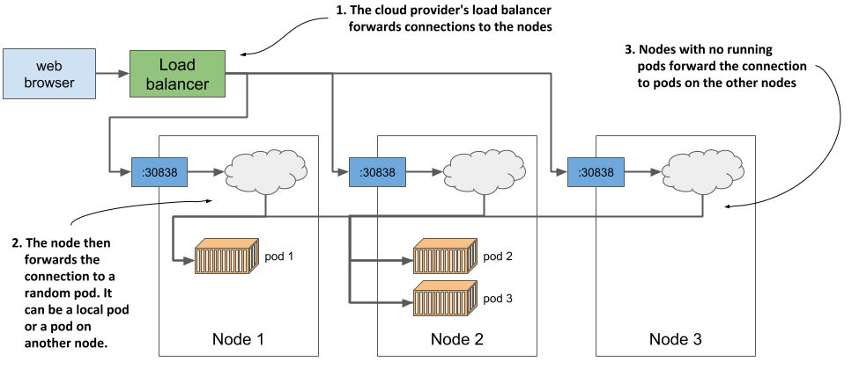
Load balancing services

Slide 27
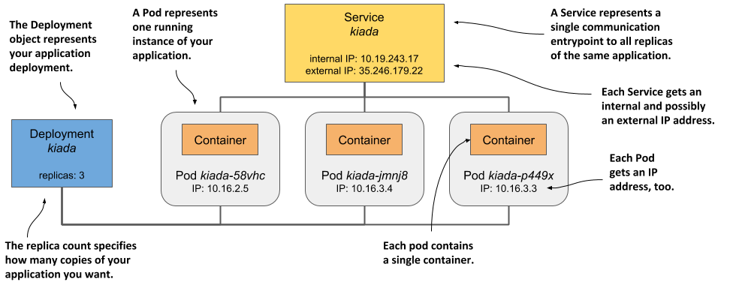
API objects – the logical view

