Slide 1
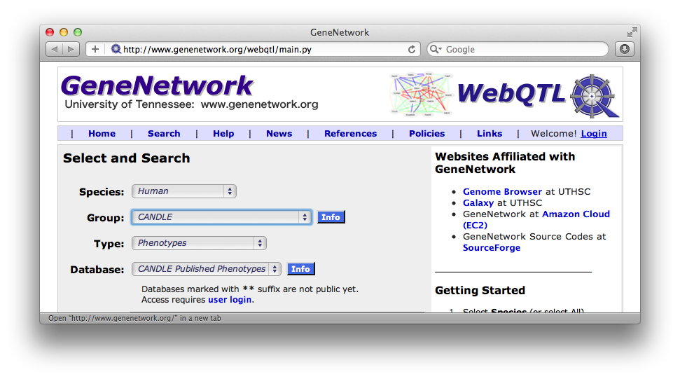
How to edit data in GeneNetwork
Robert W. Williams (March 2012 version 10
Step 1: Link to www.genenetwork.org
Comments: Do not use a mirror site of GN. Only data on the main site is permanent.

Slide 2
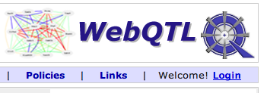
Step 2: Click on the Login header
Comments: Far right side of screen

Slide 3
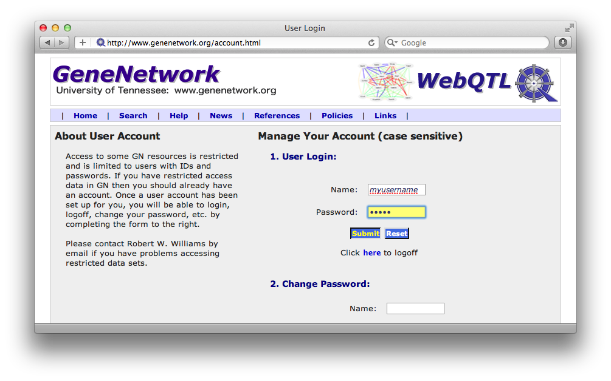
Step 3: Enter user name & password
Comments: You can change your password too

Slide 4
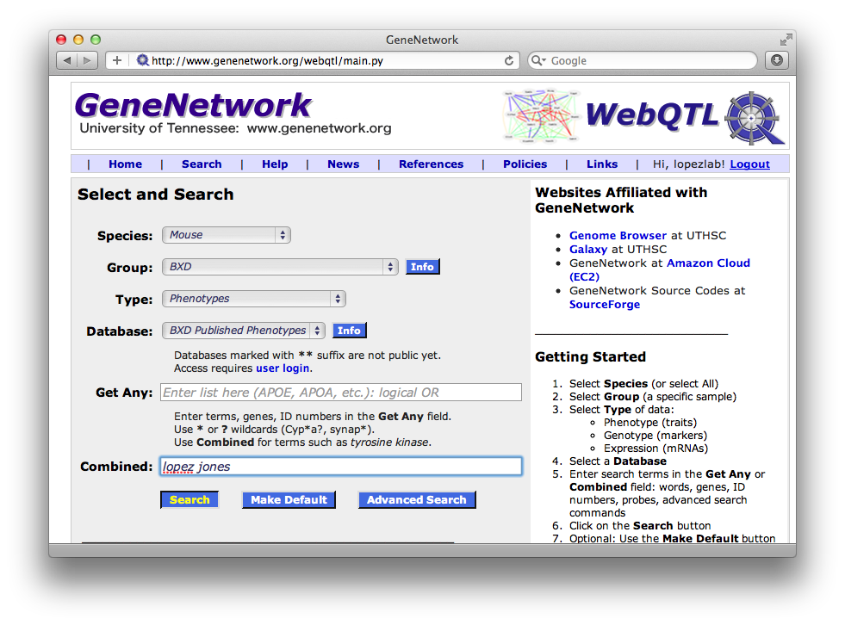
Step 4: Select species etc.
and then enter search terms for data
Notes:
In this case, the search is for any trait in the MOUSE BXD Phenotype database that includes both the word/names “Jones” and “Lopez”

Slide 5
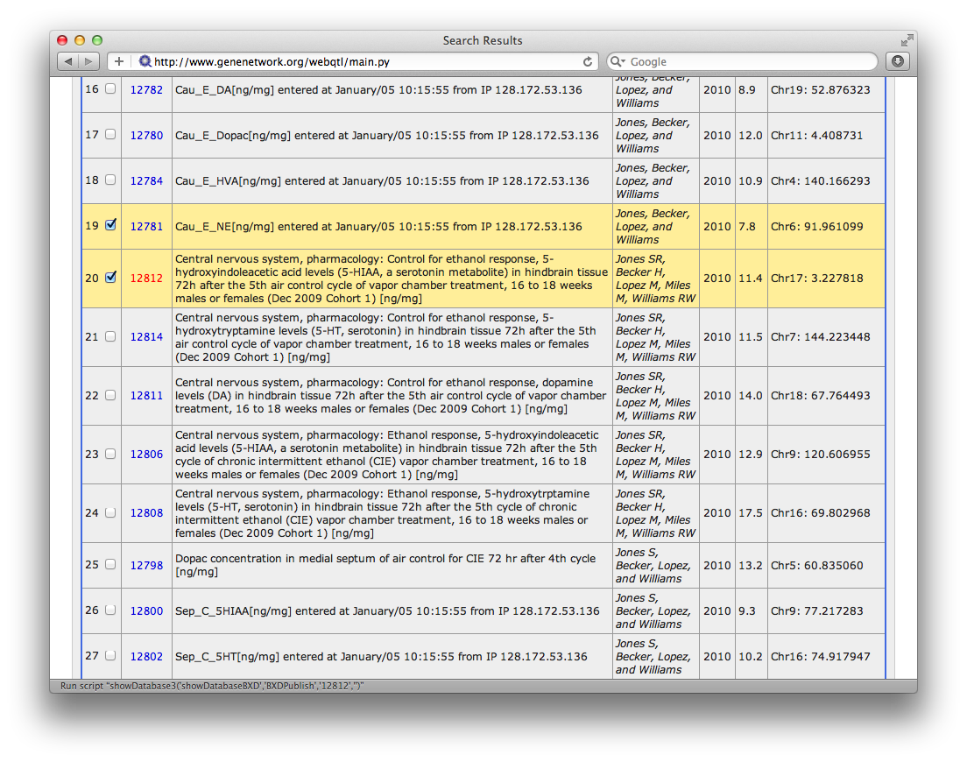
Step 5: Select the trait you want to
edit and open it up
Notes:
Click on the Trait Number

Slide 6
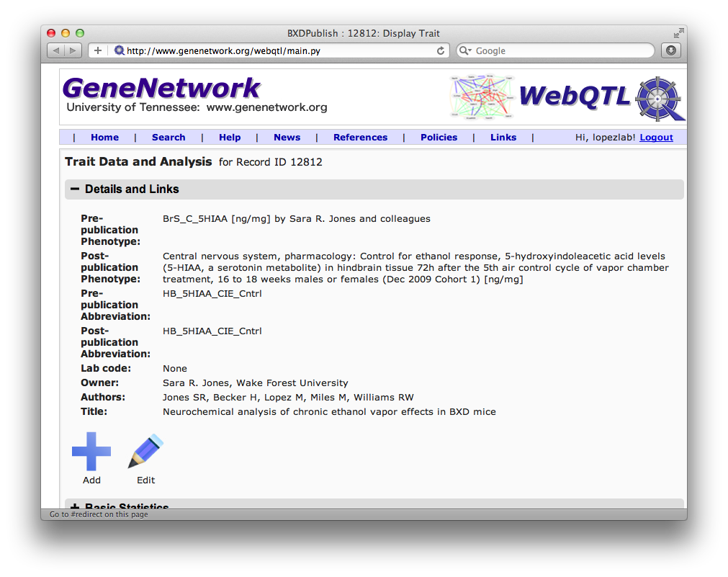
Step 6: The Trait Data and Analysis
Click the EDIT button (pencil icon)
Notes:
Click on the Trait Number

Slide 7
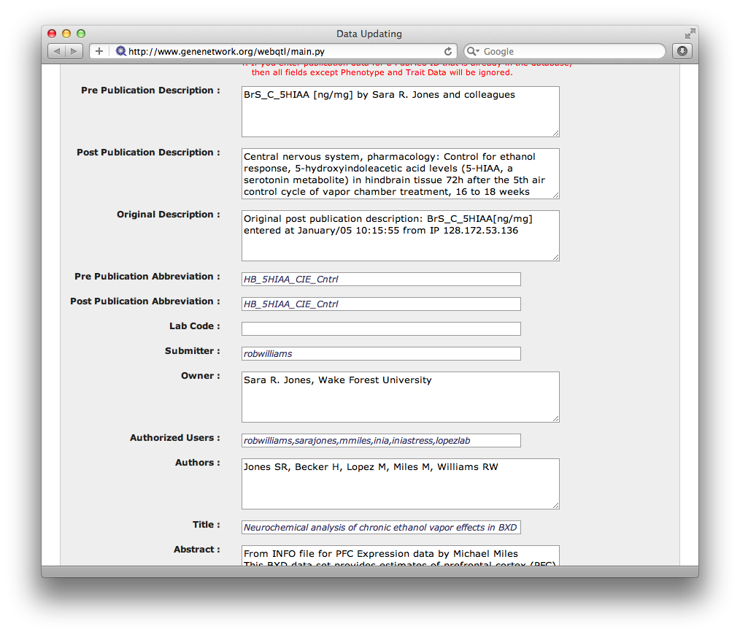
Step 7: Edit mode
Make changes (carefully as usual)
Notes:
Edit the contents of the fields.

Slide 8
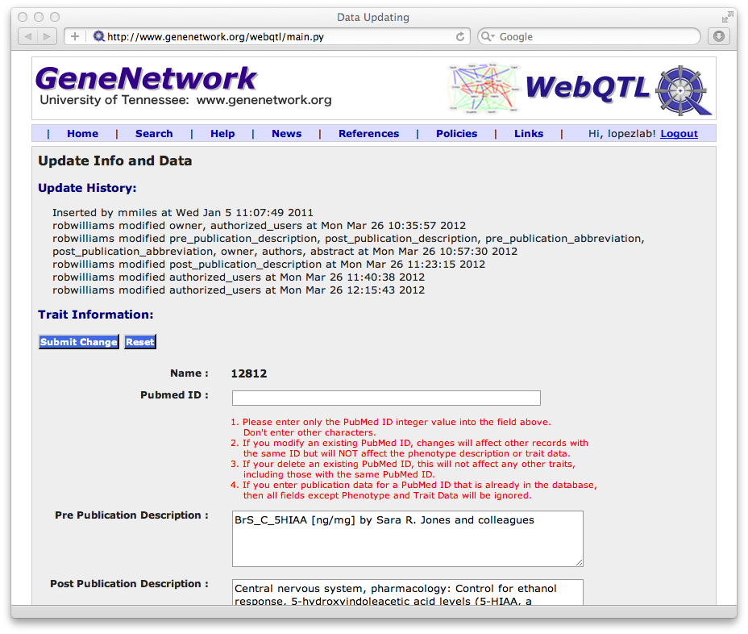
Step 8: Save your changes
Make changes (carefully as usual)
Notes:
Save the changes

Slide 9
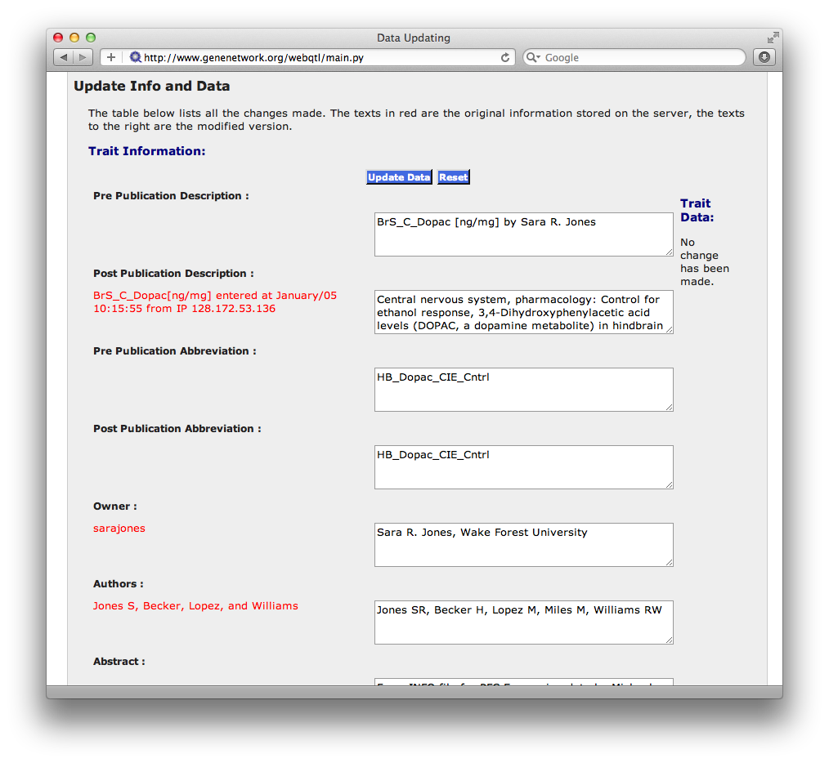
Step 9: Final review of changes
Notes:
Update the data. You can always make more changes

Slide 10
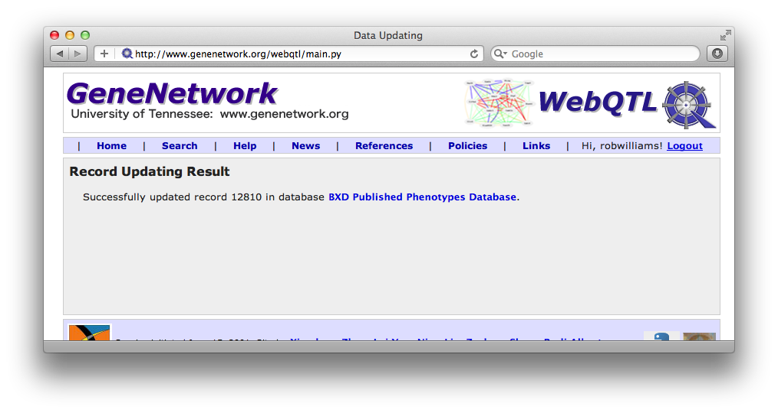
Step 10: You are done
Notes:
Now you can review.

